Slide 1
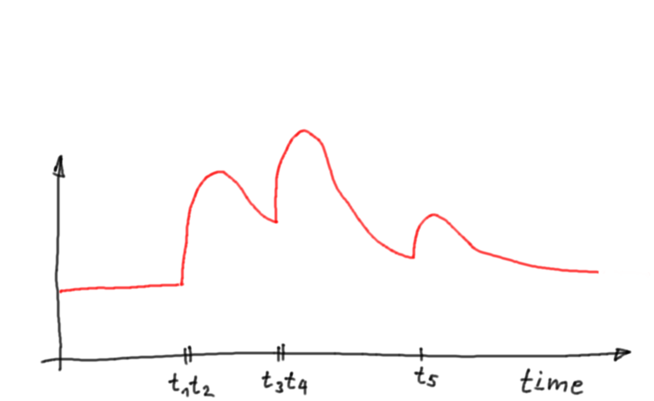
Single Pulse Extractor
[76ns, 45ns, 77ns, 46ns, 110ns]
and novel photon stream
Sebastian Achim Mueller
FACT General Meeting
Wuerzburg 2016

Slide 2
Motivation

Slide 3
Motivation
FACT is recording full, uncompressed video sequences of
300 frames per event (300 float values / pixel)
Many other IACTs (VERITAS, HESS, WHIPPLE, CAT, HEGRA) only have time and charge to digital converters (2 float values / pixel)

Slide 4
Motivation
FACT is even storing the video sequences which makes its records more than 2 orders of magnitude larger. But so far the FACT analysis software only implements a time and charge converter.
A single pulse extractor, finding the arrival times of each pulse on a time line, might increase the analysis performance
It is time to get something in return for all the money and time we spent on storage and bandwidth!

Slide 5
Motivation
So far, FACT has a software time and charge converter which extracts the arrival time of the 'main pulse' and the photon equivalent of the 'main pulse'
(300 float values are reduced to 2 float values)
Challenge of the time and charge converter:
What is the main pulse?
For large pulses the main pulse is easy to find but for an IACT it is all about the small pulses
Lower primary particle energy reconstruction threshold
→reconstruct the smallest pulses

Slide 6
Motivation
Lower the primary particle energy reconstruction threshold by recognizing smaller pulses
Increase gamma hadron separation power by new features based on the photon arrival time distribution (e.g. hadronic rain, Eckart Lorenz)
Calibrate the SIPM gain by extract the single p.e. pulses during usual observation in dark nights.

Slide 7
Method

Slide 8
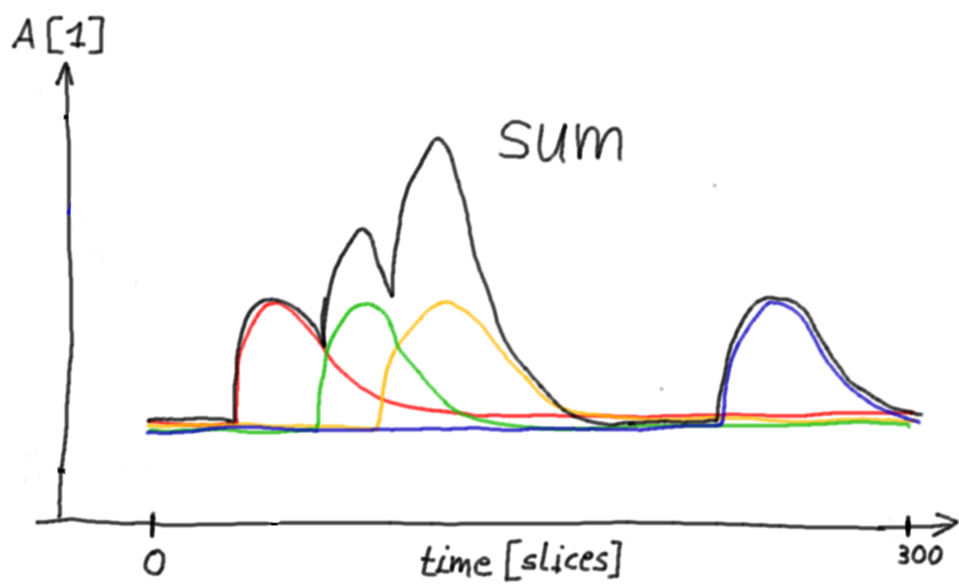
Method
Assumption
The amplitude distribution of a time line is only the sum of single pulses. No other effects contribute to the amplitudes.
We neglect electronic noise and assume that all read out artifacts (spikes, jumps,...) are already removed.

Slide 9
Method
->Initiate
->Template Pulse time lines
->Template Pulse integral
->Input time line
->do {
->convolve input time line and template pulse
->find max response in convolution time line
->store arrival time of max response
->subtract template pulse from input time line
->apply AC coupling to input time line
} while( has max response in convolution time line
)
->return arrival times
A robust pattern recognition to find the pulses on a time line using template convolution.
(by Sebastian)
An extractor to count the pulses iteratively by subtracting template pulses.
(by Adrian)

Slide 10
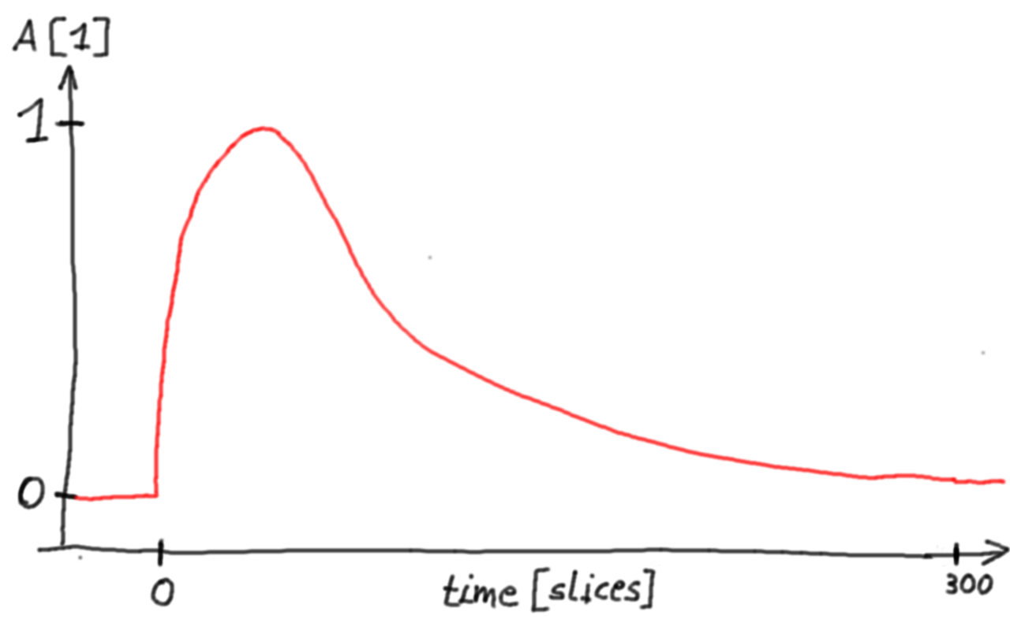
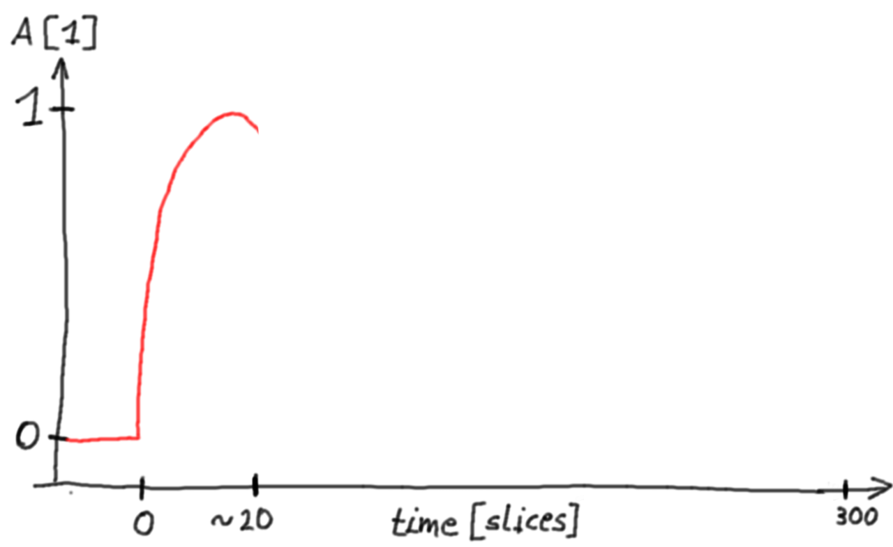
Algorithm
->Initiate
->Template Pulse time lines
->Template Pulse integral
->Input time line
->do {
->convolve input time line and template pulse
->find max response in convolution time line
->store arrival time of max response
->subtract template pulse from input time line
->apply AC coupling to input time line
} while( has max response in convolution time line
)
->return arrival times
Template Pulse time line (full)
Template Pulse time line (rising edge)

Slide 11
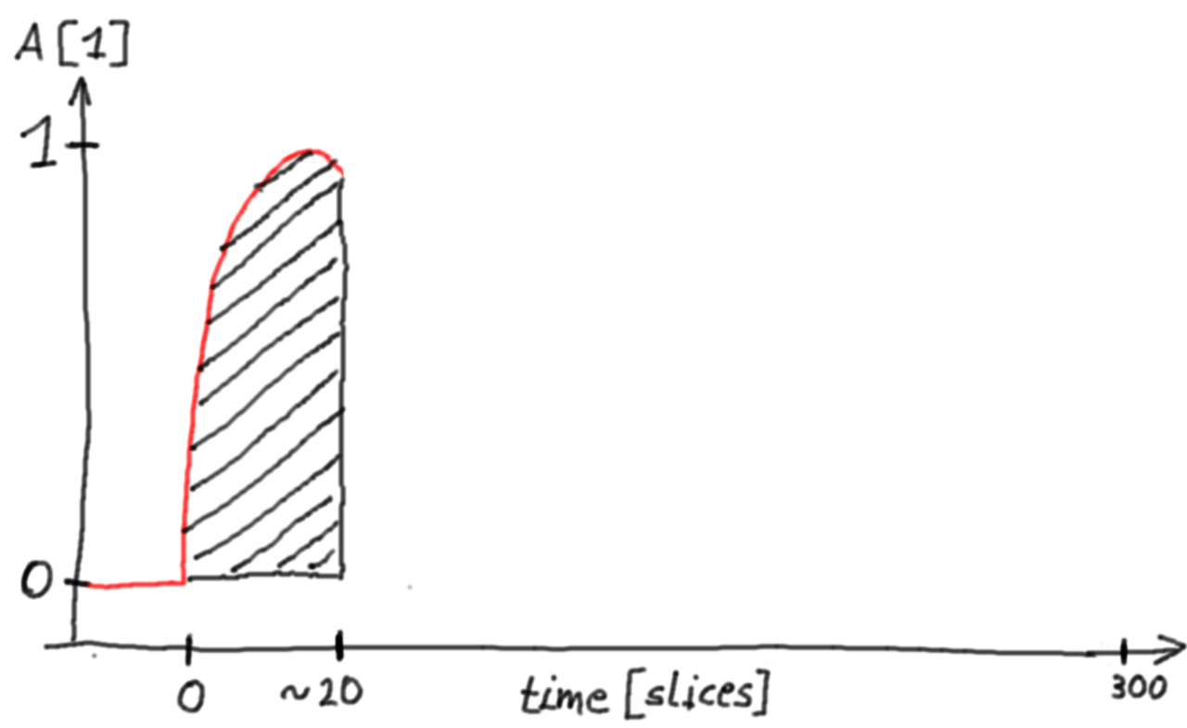
Algorithm
->Initiate
->Template Pulse time lines
->Template Pulse integral
->Input time line
->do {
->convolve input time line and template pulse
->find max response in convolution time line
->store arrival time of max response
->subtract template pulse from input time line
->apply AC coupling to input time line
} while( has max response in convolution time line
)
->return arrival times
Needed to normalize
upcoming convolution

Slide 12
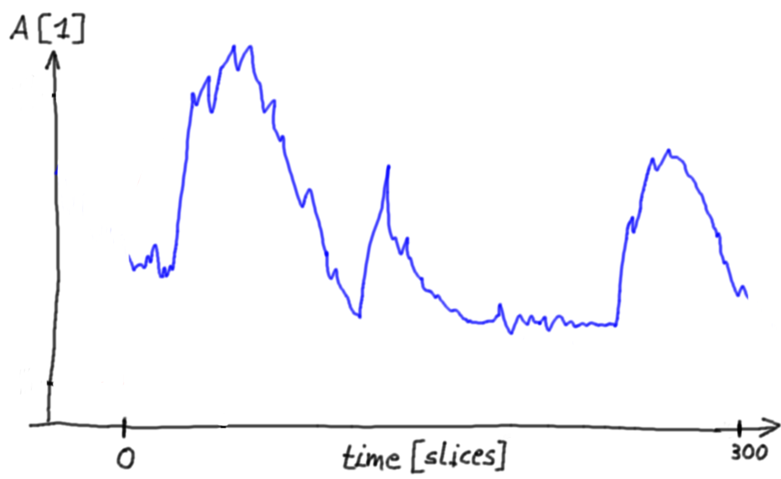
Algorithm
->Initiate
->Template Pulse time lines
->Template Pulse integral
->Input time line
->do {
->convolve input time line and template pulse
->find max response in convolution time line
->store arrival time of max response
->subtract template pulse from input time line
->apply AC coupling to input time line
} while( has max response in convolution time line
)
->return arrival times
Amplitude is normalized to 1 photo equivalent pulse

Slide 13
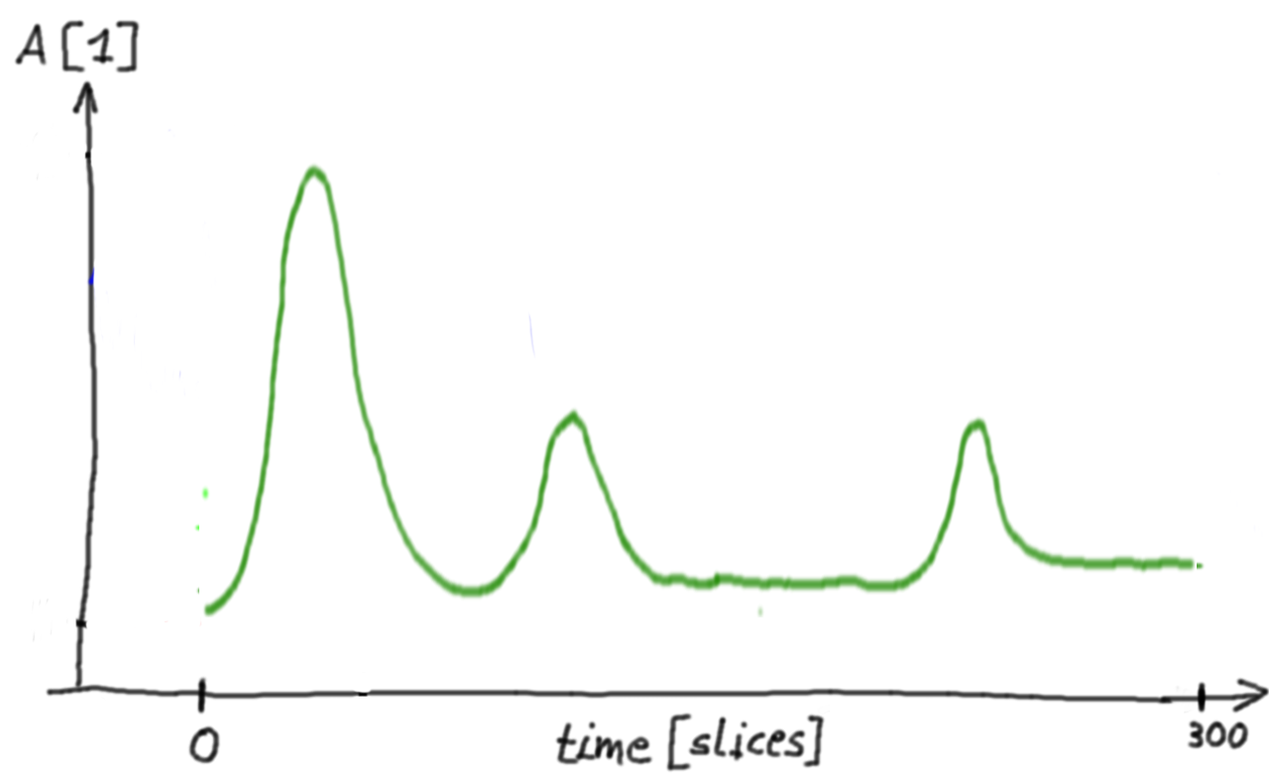
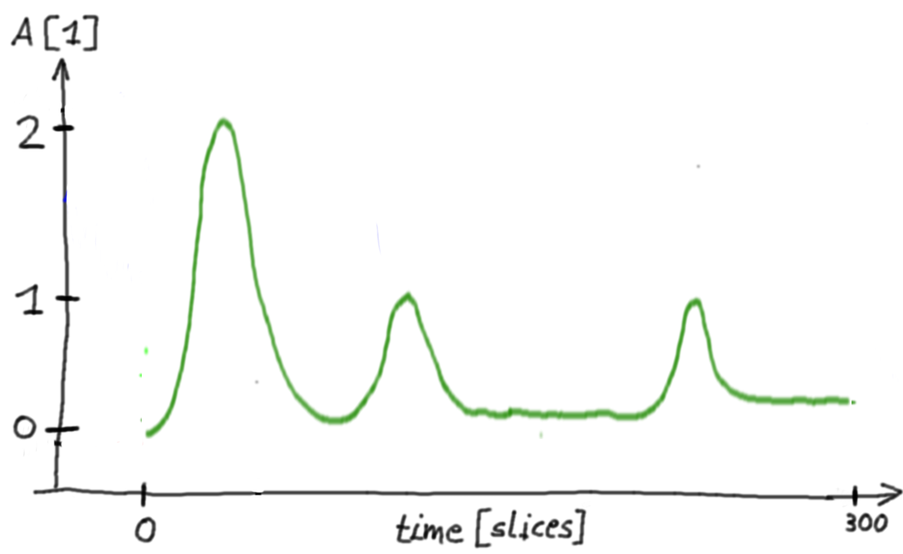
Algorithm
->Initiate
->Template Pulse time lines
->Template Pulse integral
->Input time line
->do {
->convolve input time line and template pulse
->find max response in convolution time line
->store arrival time of max response
->subtract template pulse from input time line
->apply AC coupling to input time line
} while( has max response in convolution time line
)
->return arrival times
*
Normalized using template pulse integral
Very smooth, acts like a frequency filter optimized for the pulse template (Transmission spectrum of filter is the pulse spectrum)

Slide 14
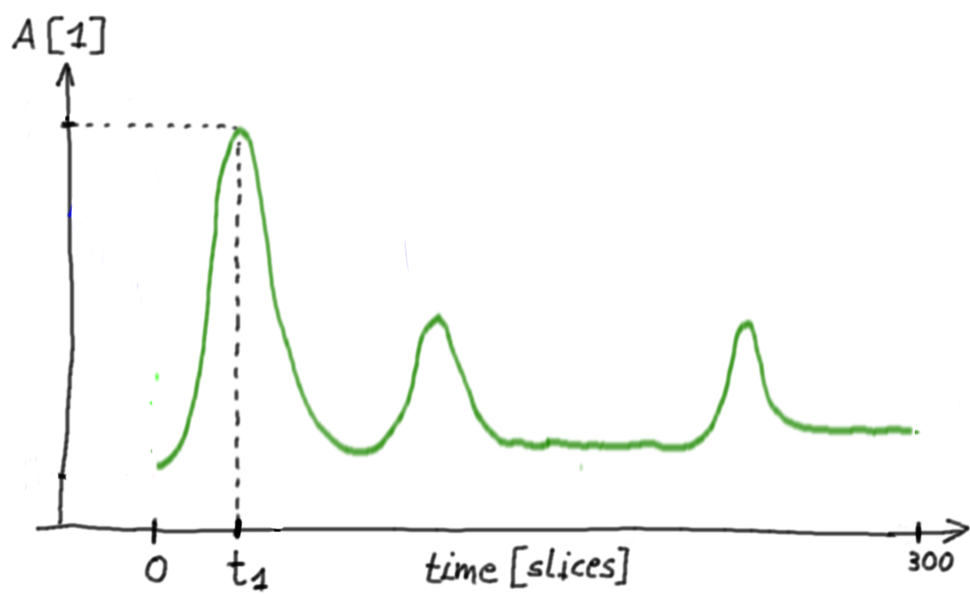
Algorithm
->Initiate
->Template Pulse time lines
->Template Pulse integral
->Input time line
->do {
->convolve input time line and template pulse
->find max response in convolution time line
->store arrival time of max response
->subtract template pulse from input time line
->apply AC coupling to input time line
} while( has max response in convolution time line
)
->return arrival times
Easy to find the peaks, noise is suppressed

Slide 15
Algorithm
->Initiate
->Template Pulse time lines
->Template Pulse integral
->Input time line
->do {
->convolve input time line and template pulse
->find max response in convolution time line
->store arrival time of max response
->subtract template pulse from input time line
->apply AC coupling to input time line
} while( has max response in convolution time line
)
->return arrival times
Append arrival time t of largest pulse to arrival time list
1

Slide 16
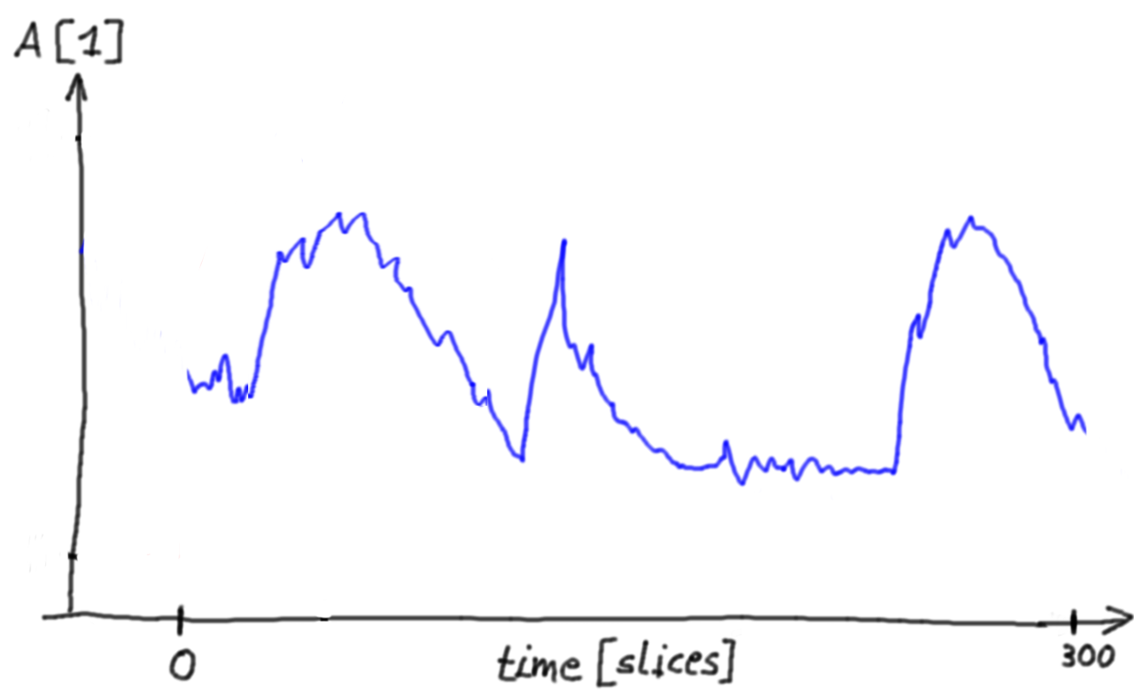
Algorithm
->Initiate
->Template Pulse time lines
->Template Pulse integral
->Input time line
->do {
->convolve input time line and template pulse
->find max response in convolution time line
->store arrival time of max response
->subtract template pulse from input time line
->apply AC coupling to input time line
} while( has max response in convolution time line
)
->return arrival times
-
Subtract at time t
1

Slide 17
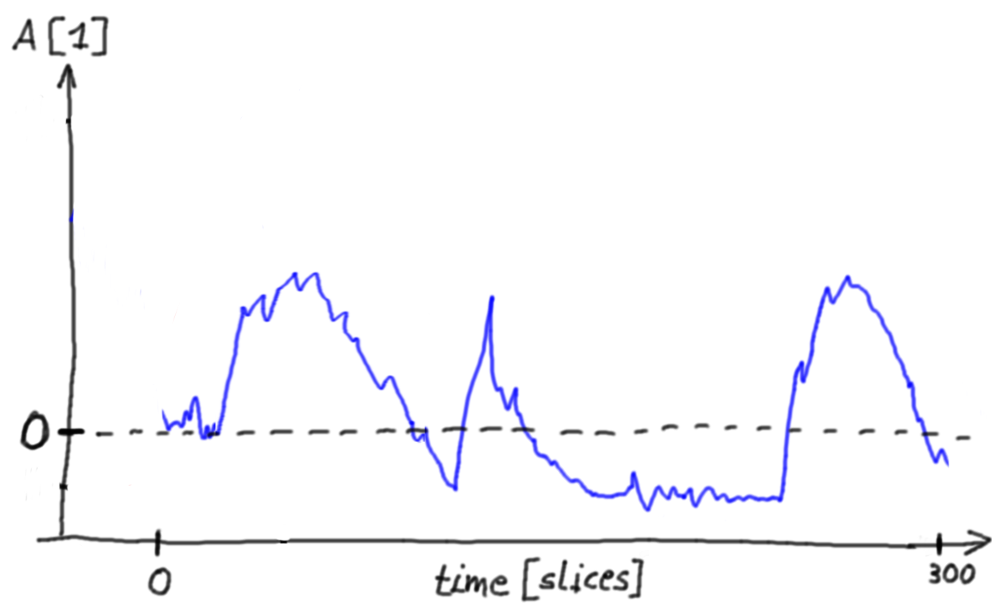
Algorithm
->Initiate
->Template Pulse time lines
->Template Pulse integral
->Input time line
->do {
->convolve input time line and template pulse
->find max response in convolution time line
->store arrival time of max response
->subtract template pulse from input time line
->apply AC coupling to input time line
} while( has max response in convolution time line
)
->return arrival times
Applying the AC coupling of FACT's readout

Slide 18
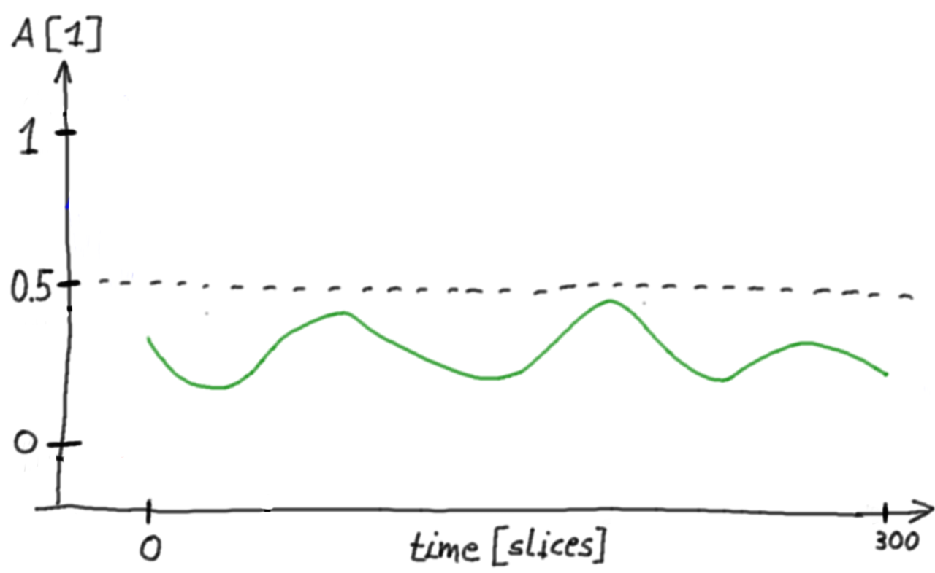
Algorithm
->Initiate
->Template Pulse time lines
->Template Pulse integral
->Input time line
->do {
->convolve input time line and template pulse
->find max response in convolution time line
->store arrival time of max response
->subtract template pulse from input time line
->apply AC coupling to input time line
} while( has max response in convolution time line
)
->return arrival times
When the maximum in the convolution response is below a certain threshold (0.5 photon equivalents), the extraction is stopped

Slide 19
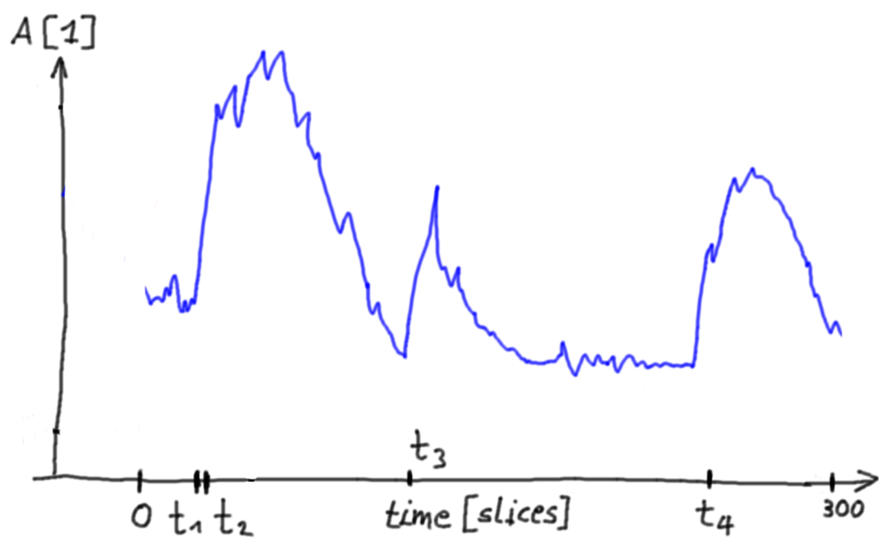
Algorithm
->Initiate
->Template Pulse time lines
->Template Pulse integral
->Input time line
->do {
->convolve input time line and template pulse
->find max response in convolution time line
->store arrival time of max response
->subtract template pulse from input time line
->apply AC coupling to input time line
} while( has max response in convolution time line
)
->return arrival times
Returns arrival time list
1
2
3
4
[ t , t , t , t ]

Slide 20
Implementation
Development Sandbox https://github.com/fact-project/single_pulse_extractor pure toy simulation with full simulation truth
(python)
Production Code in FACT-Tools https://github.com/fact-project/fact-tools no toy simulation, only FACT observations or FACT Monte Carlos in Master branch, ready to use
(java)

Slide 21
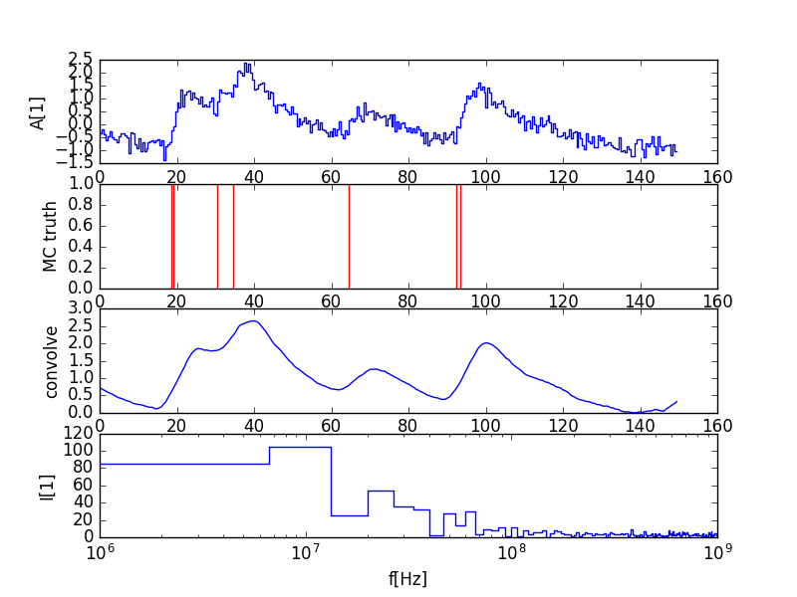
Example
Found at:
photons found: 0
photons injected: 7

Slide 22
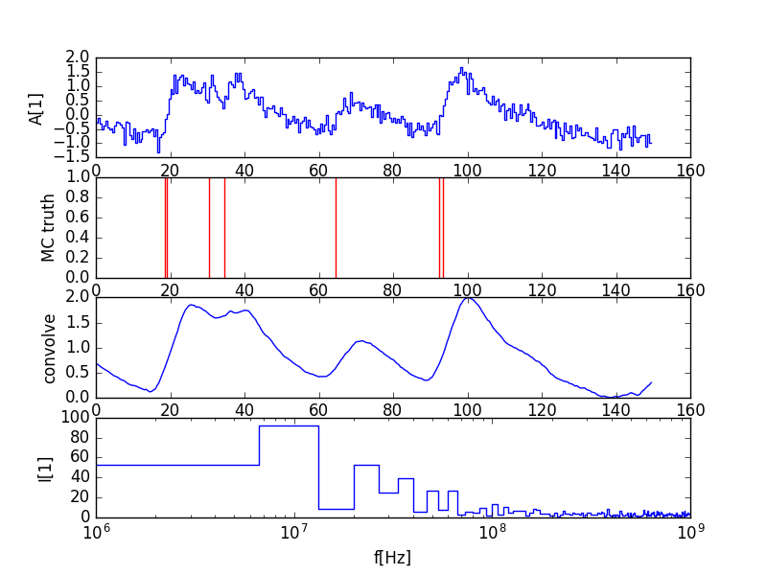
Example
Found at:
31.5ns
photons found: 1
photons injected: 7

Slide 23
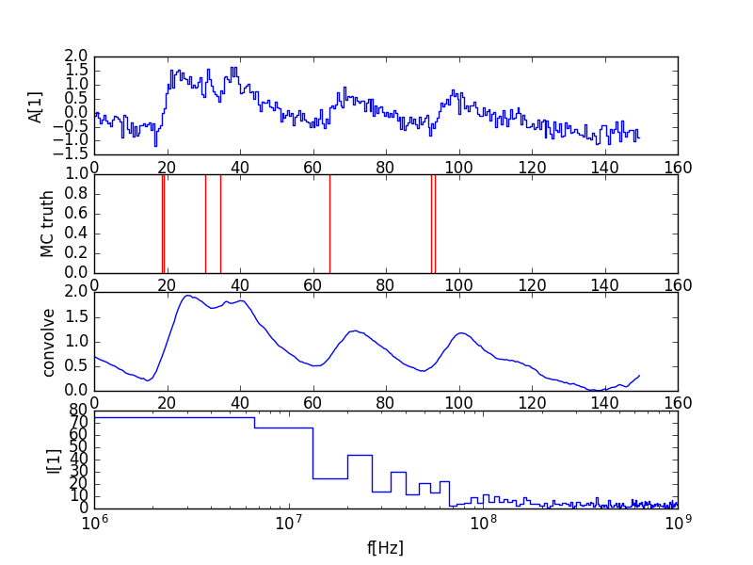
Example
Found at:
31.5ns
92.0ns
photons found: 2
photons injected: 7

Slide 24
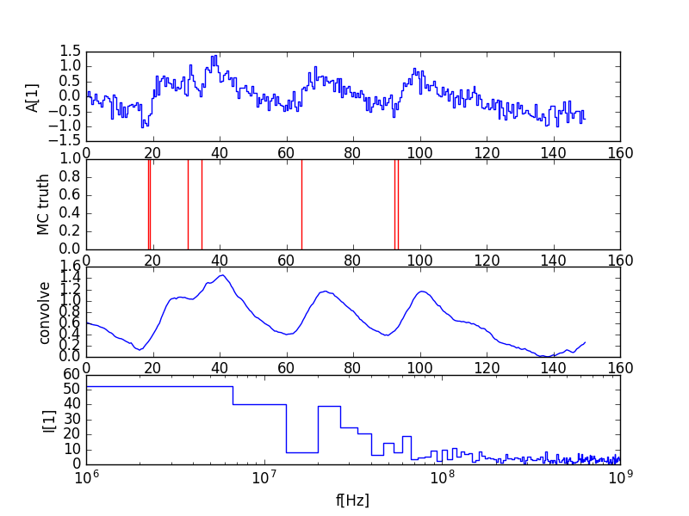
Example
Found at:
31.5ns
92.0ns
17.0ns
photons found: 3
photons injected: 7

Slide 25
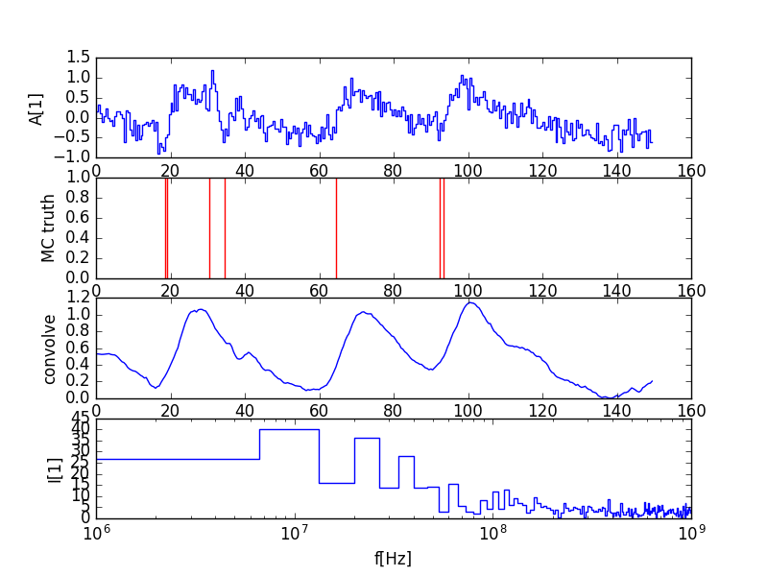
Example
Found at:
31.5ns
92.0ns
17.0ns
32.5ns
photons found: 4
photons injected: 7

Slide 26
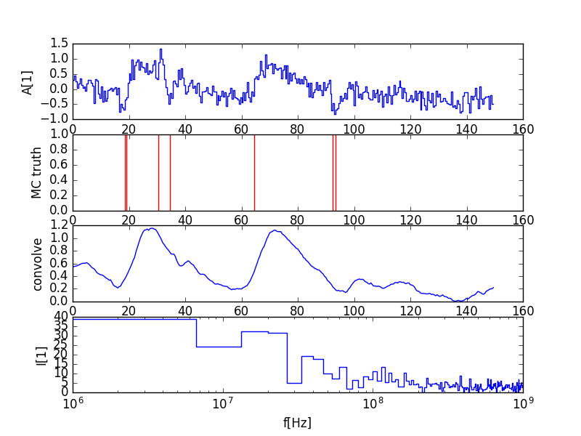
Example
Found at:
31.5ns
92.0ns
17.0ns
32.5ns
92.0ns
photons found: 5
photons injected: 7

Slide 27
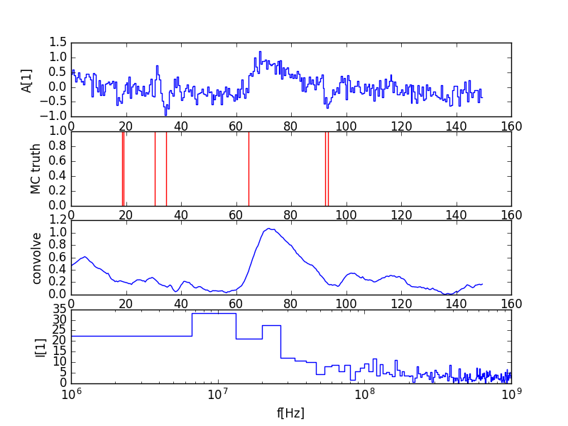
Example
Found at:
31.5ns
92.0ns
17.0ns
32.5ns
92.0ns
19.5ns
photons found: 6
photons injected: 7

Slide 28
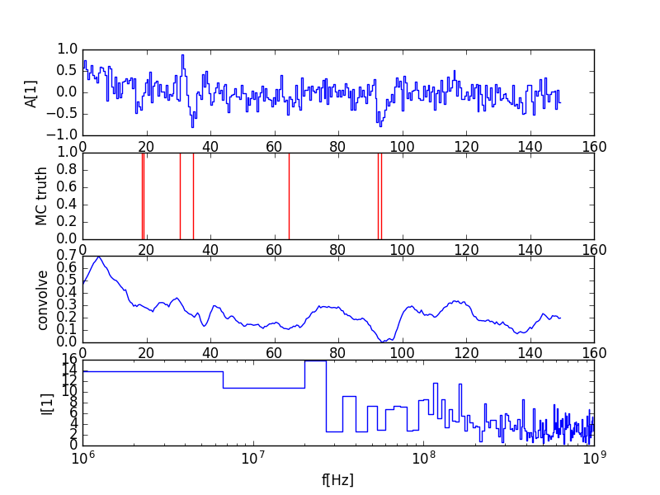
Example
Found at:
31.5ns
92.0ns
17.0ns
32.5ns
92.0ns
19.5ns
63.5ns
photons found: 7
photons injected: 7

Slide 29
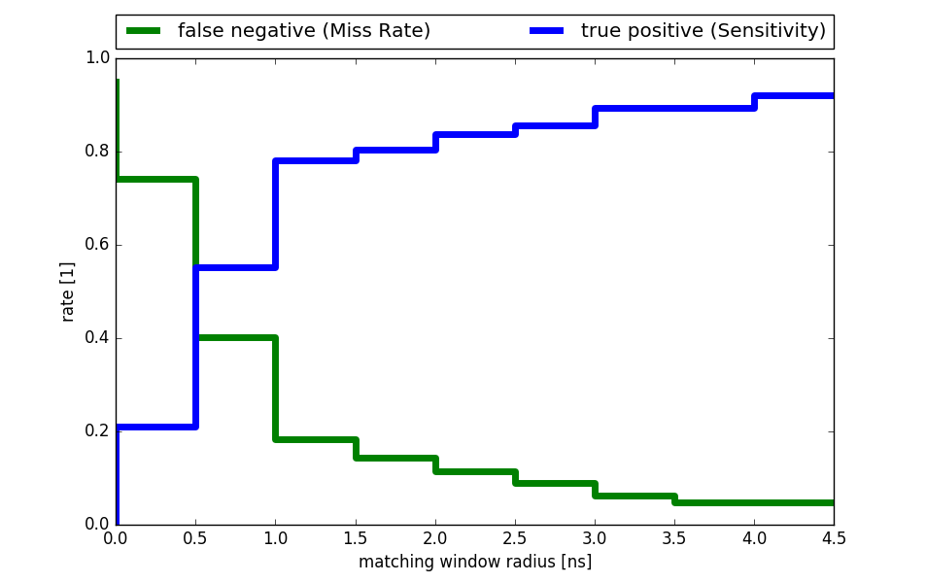
Performance
Sandbox toy MC based on MC truth
(python)
Dark night
50MHz NSB no Cherenkov single photons
(1000 time lines/bin)

Slide 30
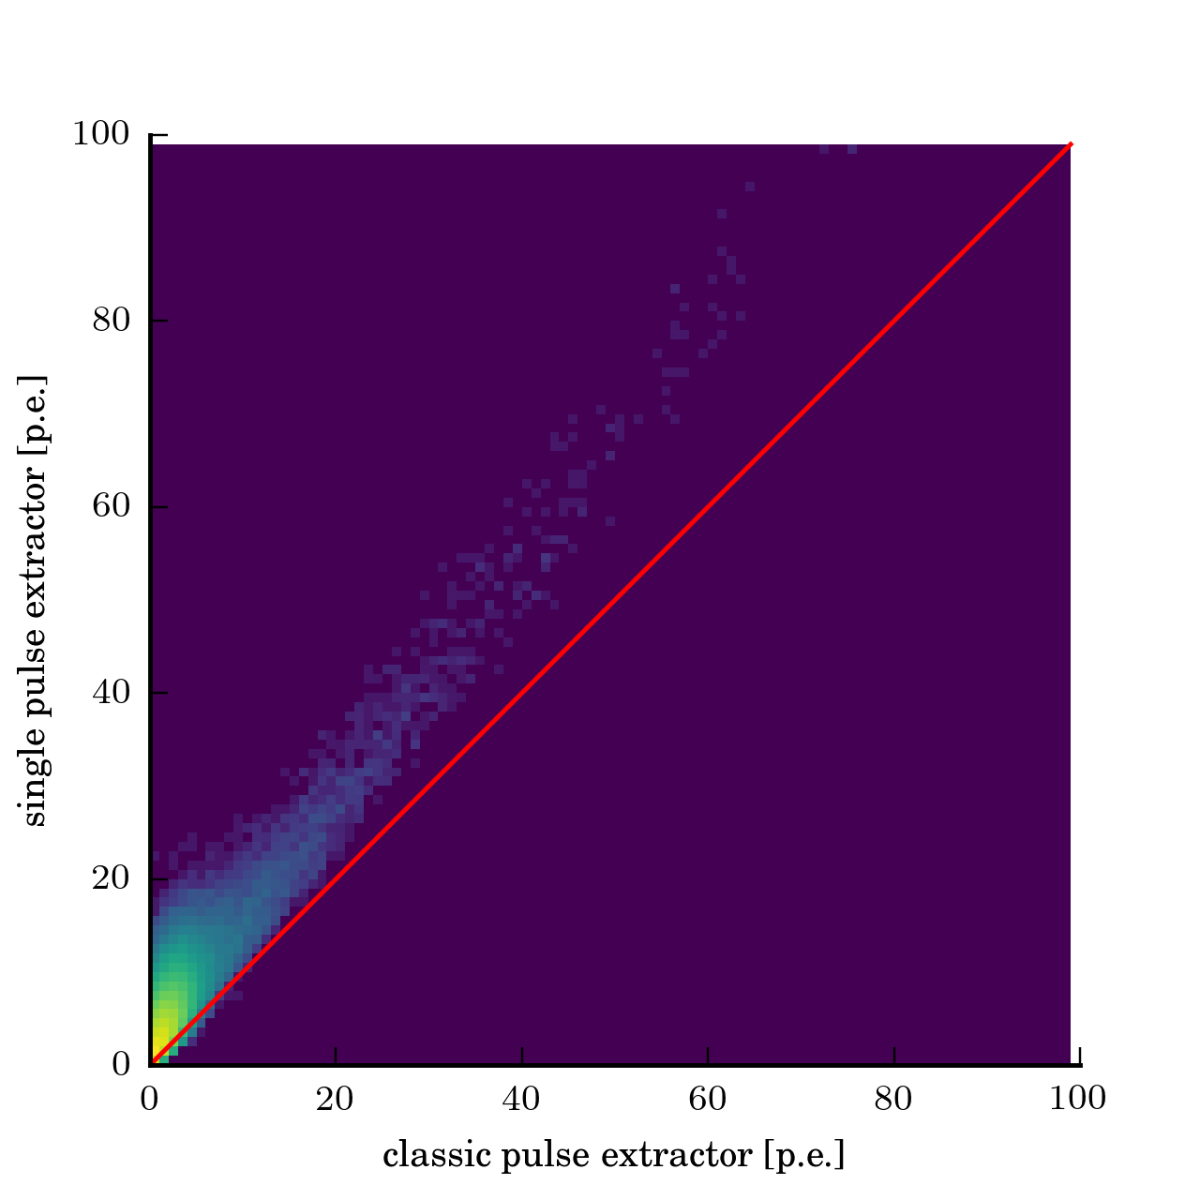
Compare
Single Pulse Extractor fact-tools production code
(java)
VS
Classic Photon Charge fact-tools production code
(java)
(316 MC events x 1440 time lines)

Slide 31
Integration into analysis
At the moment, all our image/video analysis is based on 2 float values / pixel (arrival time and photon equivalent)
arrival_time, photon_equvalent = timeAndCharge(pixel_time_line)
But the novel single pulse extractor returns a variable length float array of photon arrival times
arrival_times[] = singlePulseExtractor(pixel_time_line)
The concept is very different. Integration is not straight forward.

Slide 32
Photon Stream
We call the photon arrival time lists of all pixels the photon stream
Dir Y
3 Dimensions
Dir X
Field of View
time

Slide 33

Photon Stream
for each pixel:
Variable length array of the arrival slices for each photon
Only ~ 3.5kByte/event (typical)
Only photons. No noise.
Pixel 0: [],
Pixel 1: [111, 88, 114, 88],
Pixel 2: [],
Pixel 3: [95, 223, 98],
Pixel 4: [217],
Pixel 5: [40, 40, 41, 41, 42, 43],
Pixel 6: [...

Slide 34
Example

