Slide 1
BCGDV Machine learning assignment
Abhishek Das

Slide 2
section 1

Slide 3
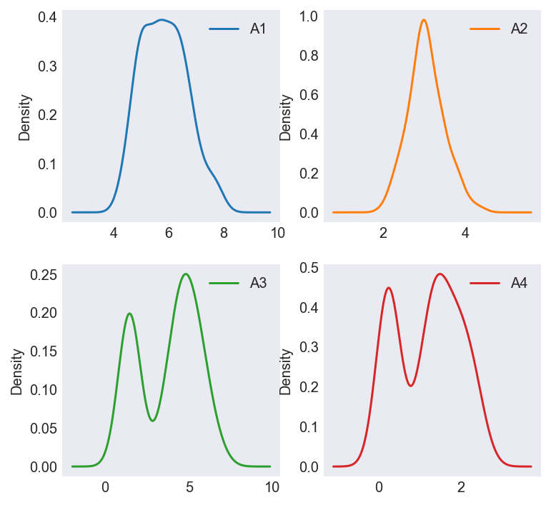
Standardization via min-max scaler
scales are of similar order but distributions different

Slide 4
K-Means Clustering
Intuitive: Randomly pick centroids and move them until they are ‘center’ of data clusters
Distance: Minimize within cluster variance = Euclidean²
Cohesion: How far are points from their centroid?
Separation: How far are clusters from each other?

Slide 5
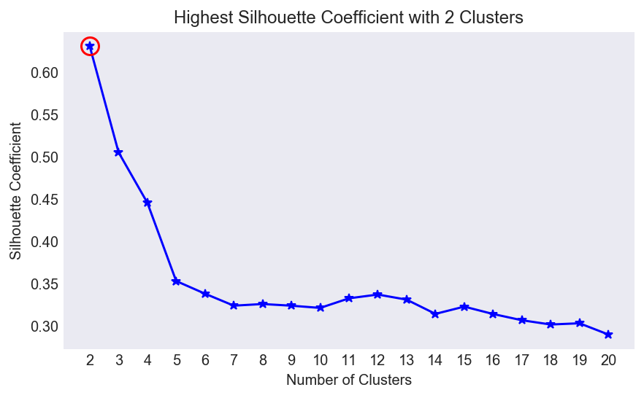
choosing the k in k-means
Standardized data

Slide 6
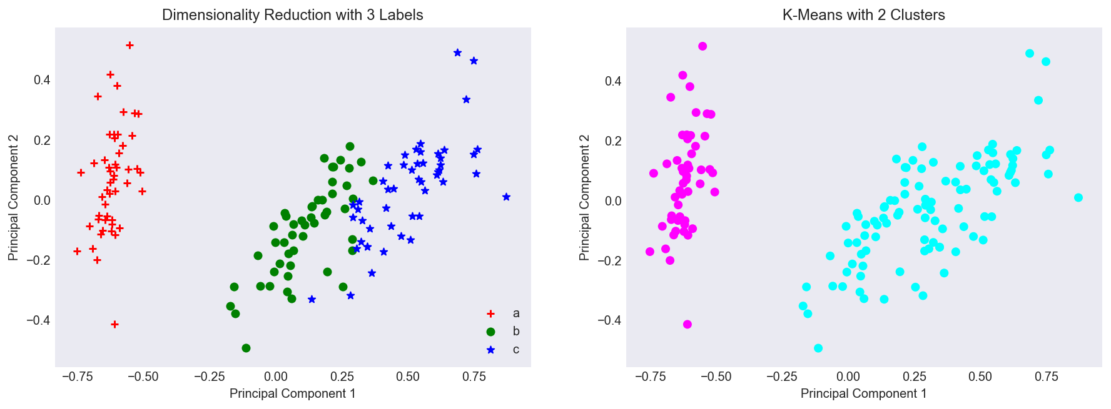
b and C are grouped together

Slide 7
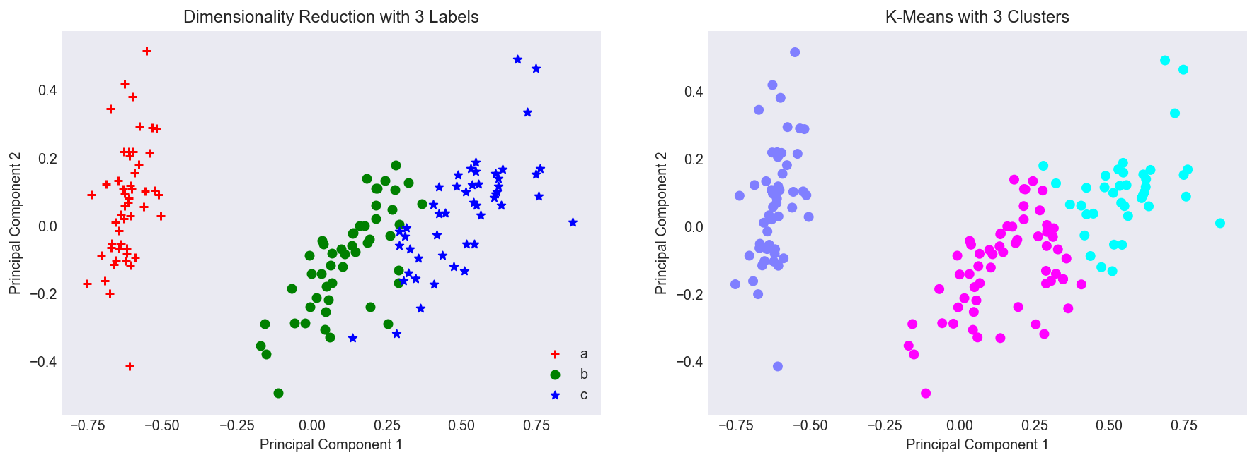
3 centroids is not a lot better…

Slide 8
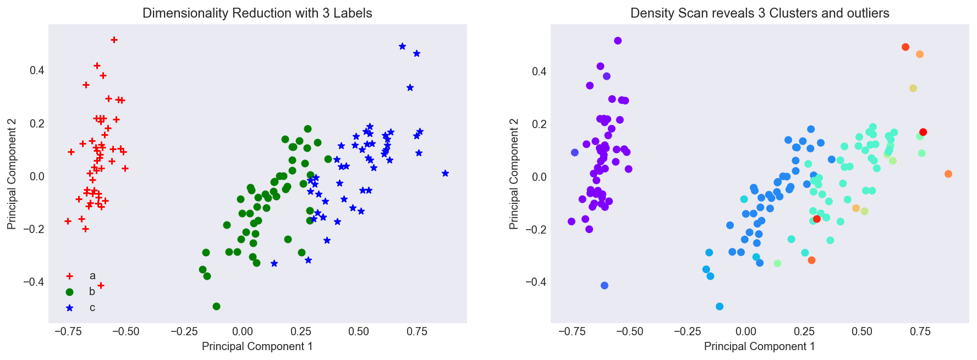
dbscan better but has outliers

Slide 9
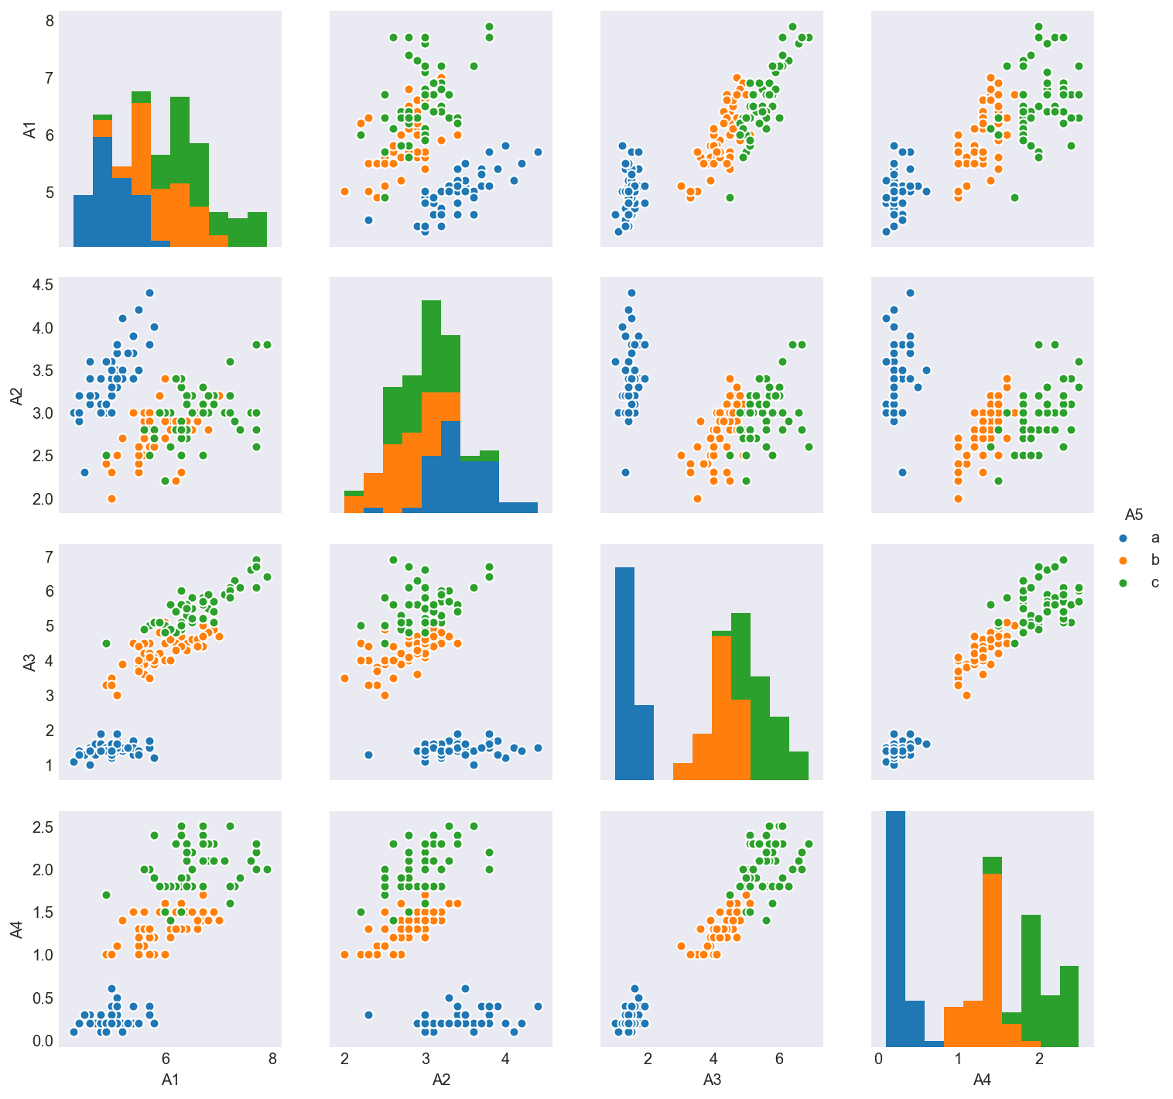
why K-means did poorly

Slide 10
section 2

Slide 11
Logistic Classifier
The more young children you are looking after and the more hungry you are, but the less alternative eating options in your area means a higher probability of you eating dinner at McDonalds tonight.
More comprehensible model

Slide 12
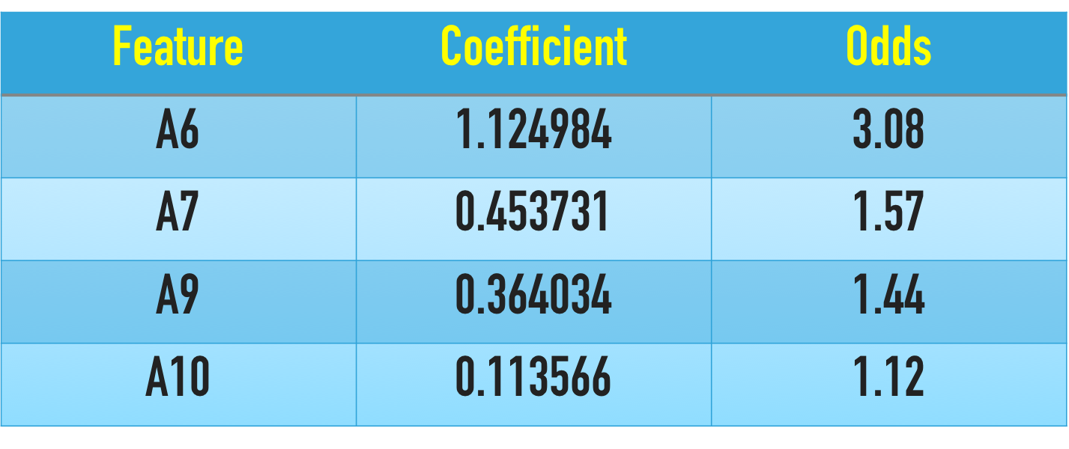
Best features
Odds of getting into Class 1 over Class 0
Holding other features constant

Slide 13
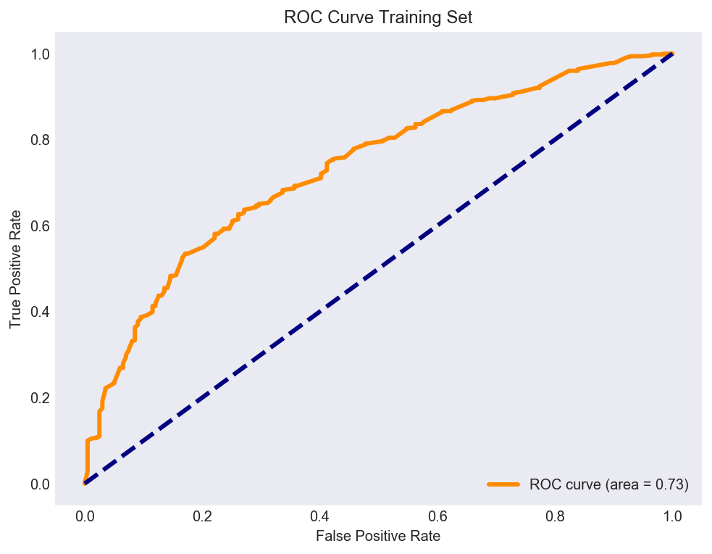
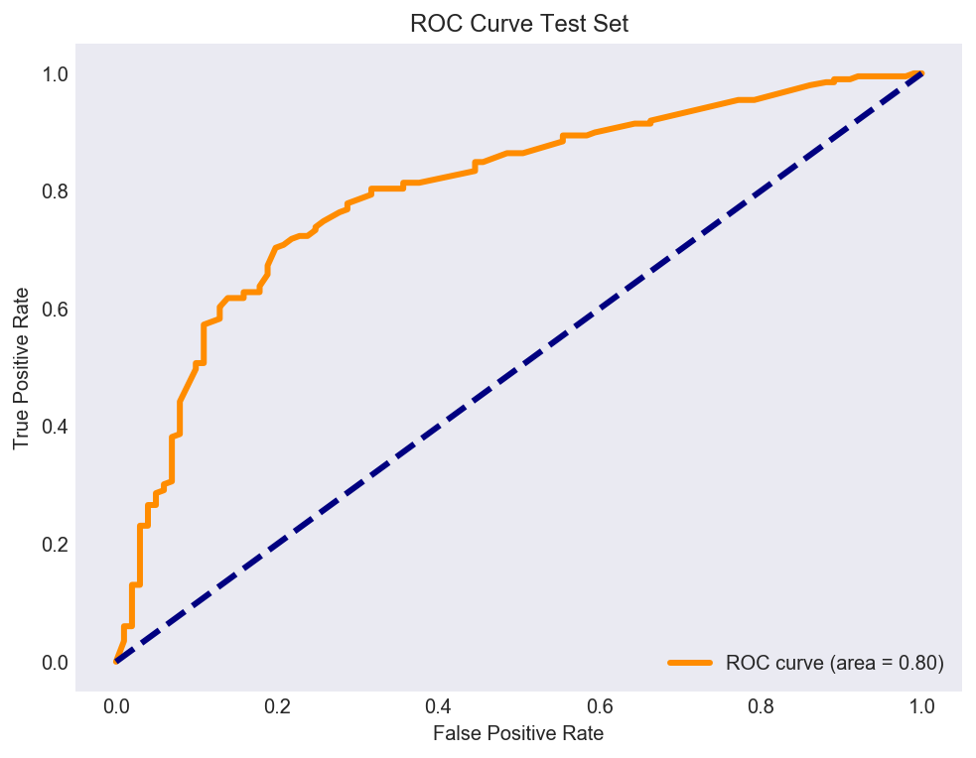
70-30 Train-test split
Four Factor Model

Slide 14
KNN Classifier
Residents of Glebe like residents of Newtown, Marrickville, Erskineville and Surry Hills are more likely to take public transport to the Central Business District
Group into a class based on neighbors
Also intuitive

Slide 15
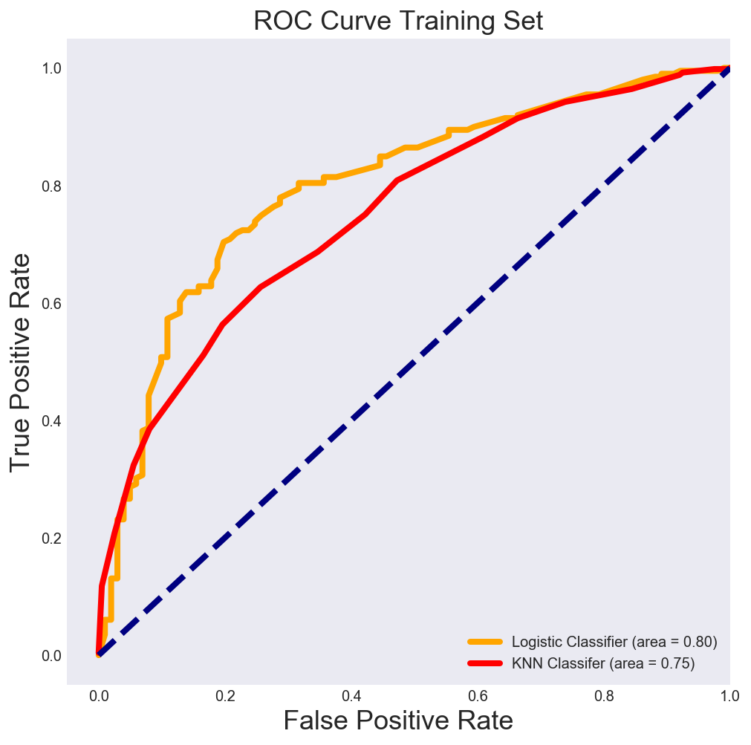
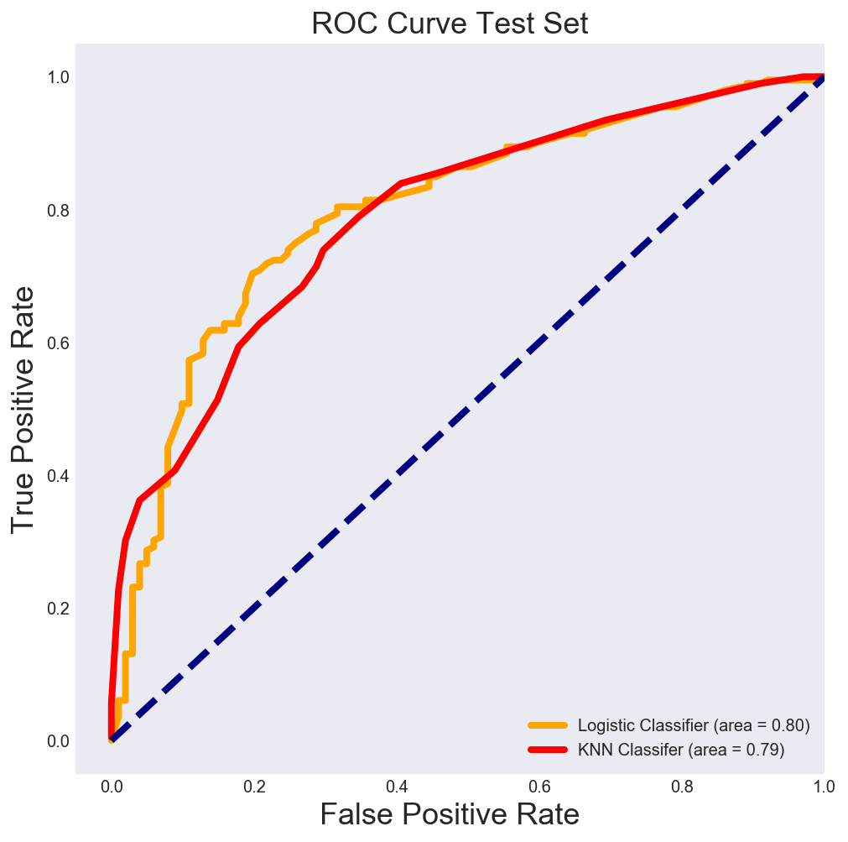
70-30 Train-test split
Four Factor Model

