Slide 1
BCGDV Machine learning assignment
Abhishek Das

Slide 2
section 1

Slide 3
K-Means Clustering
Text
Intuitive: Let’s randomly pick some centroids and move them around till they’re the ‘center’ of our data clusters
Distance: Minimizes within cluster variance = Euclidean²
Cohesion: How far are points from their centroid?
Separation: How far are clusters from each other?

Slide 4
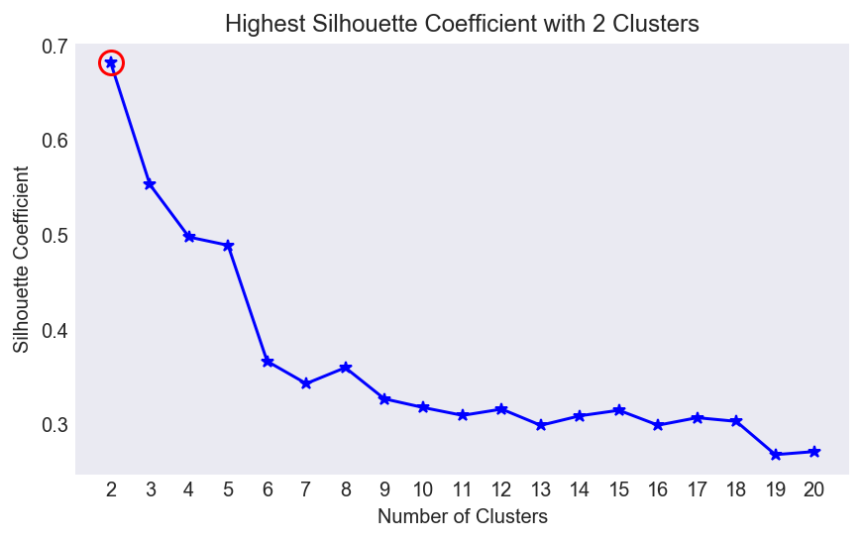
choosing the k in k-means
Text

Slide 5
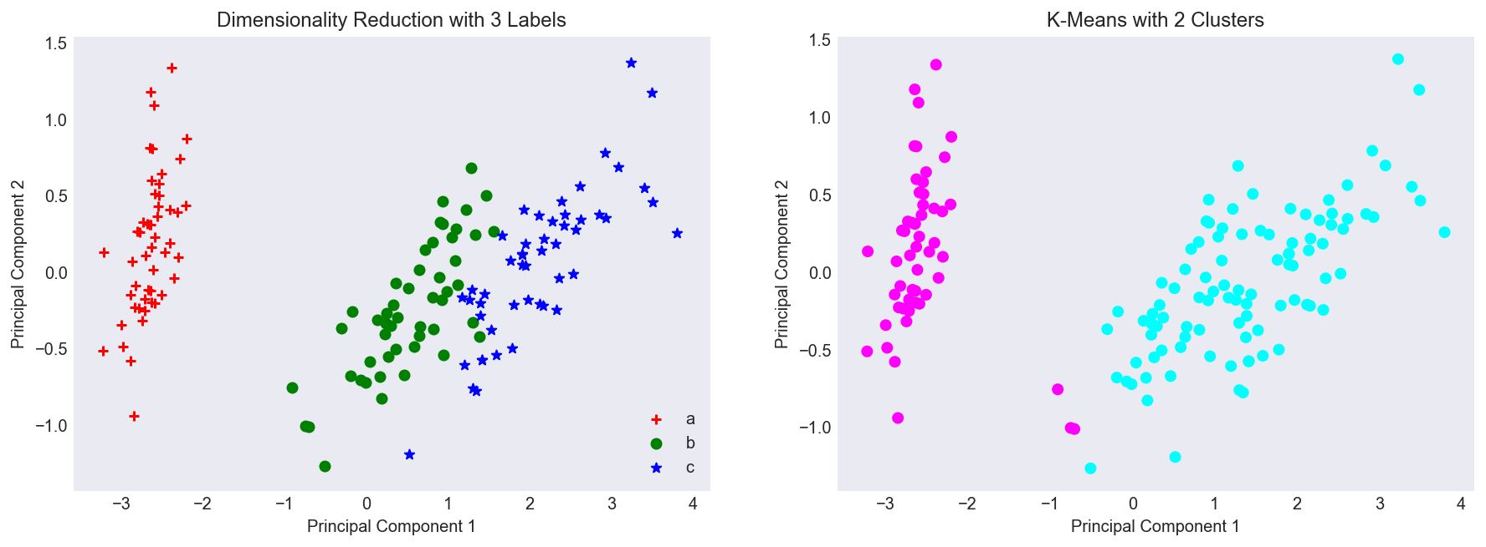
b and C are grouped together
Text

Slide 6
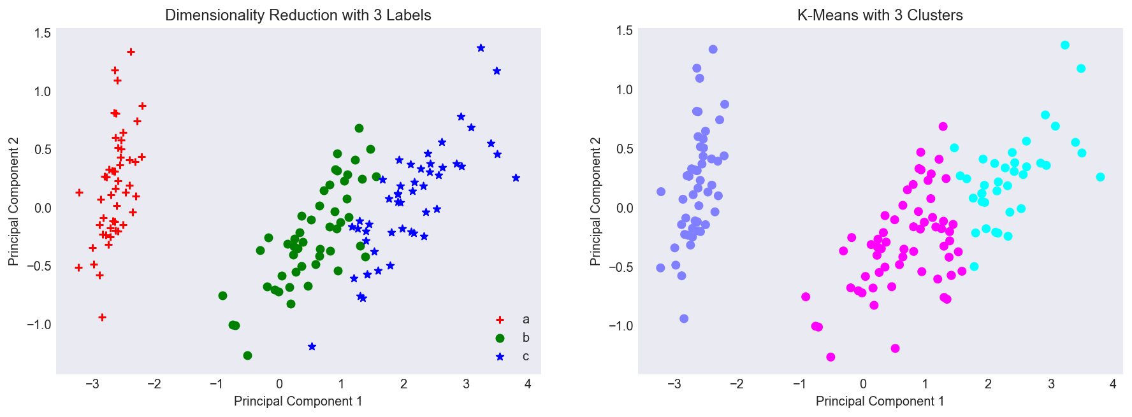
3 centroids is not a lot better…
Text

Slide 7
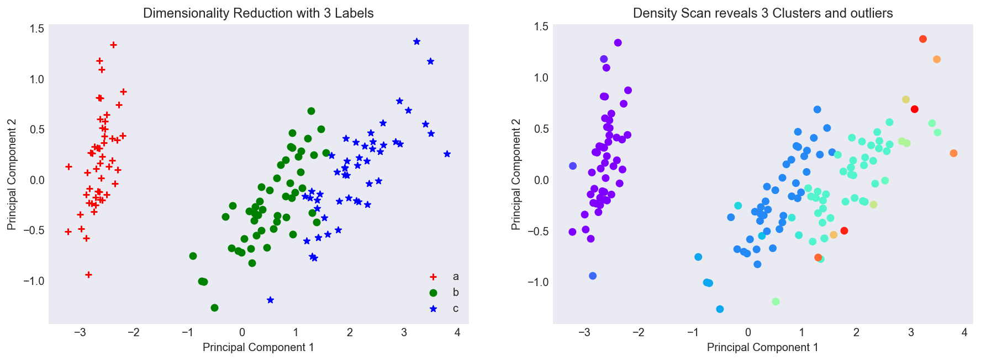
dbscan better but has outliers
Text

Slide 8
section 2

Slide 9
Logistic Classifier
Text
The more young children you are looking after and the more hungry you are, but the less alternative eating options in your area means a higher probability of you eating dinner at McDonalds tonight.
More comprehensible model

Slide 10
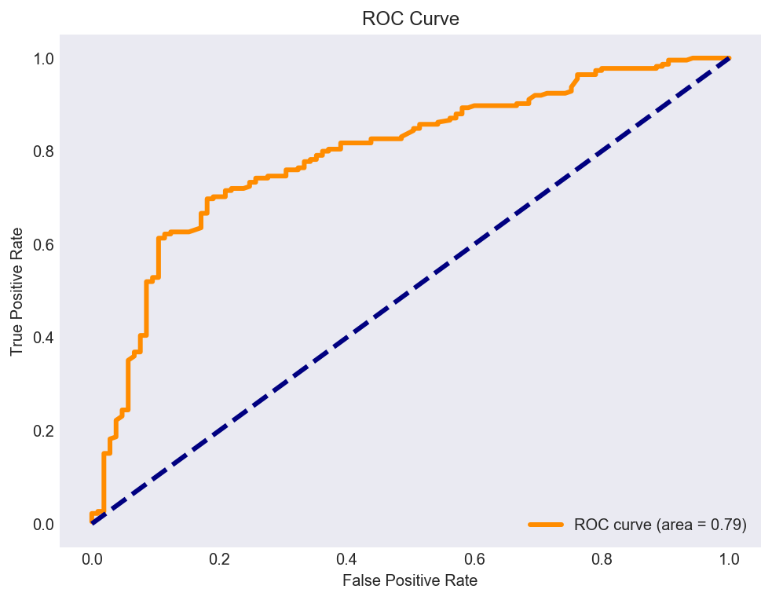
79% assigned to correct class
Text

Slide 11
KNN Classifier
Text
Residents of Glebe like residents of Newtown, Marrickville, Erskineville and Surry Hills are more likely to take public transport to work
Group into a class based on neighbors
Also intuitive

Slide 12
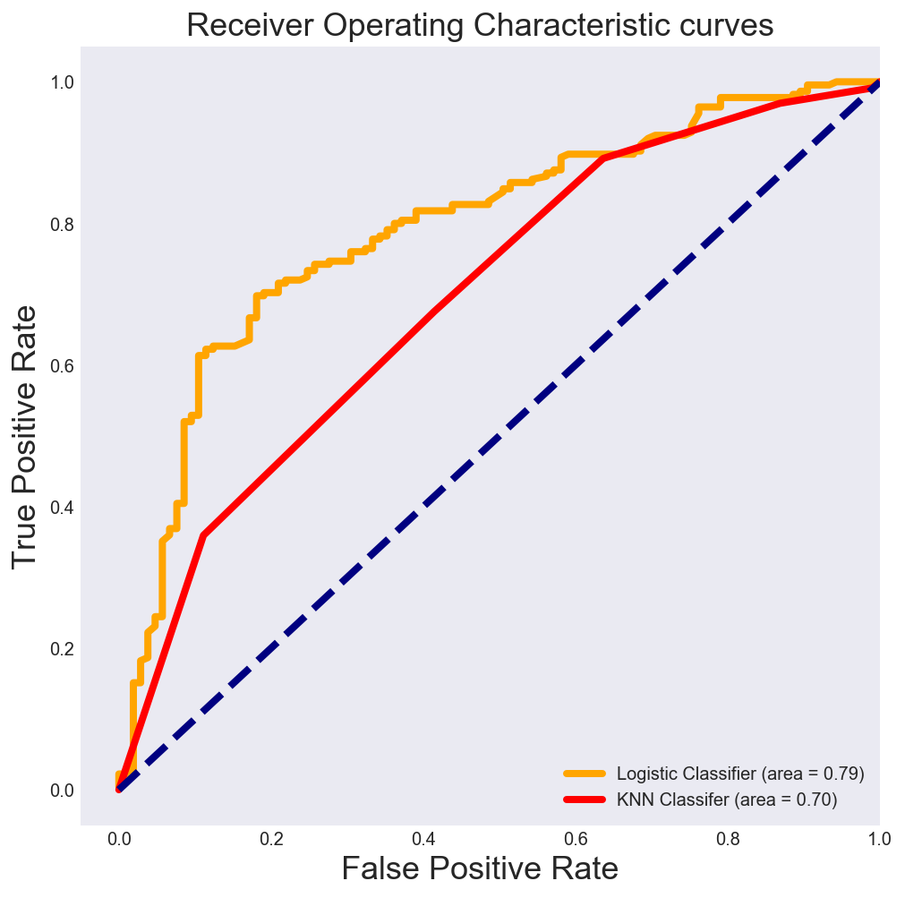
AUC Logistic > AUC KNN
Text

