Slide 1
Heat Kernel and Riemannian Manifolds
Sunhyuk Lim

Slide 2
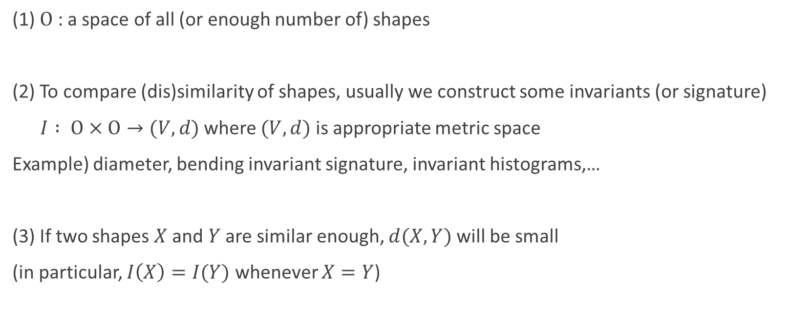
Basic philosophy of shape matching
(1) $Ο$ : a space of all (or enough number of) shapes
(2) To compare (dis)similarity of shapes, usually we construct some invariants (or signature)
$I : Ο×Ο→(V,d)$ where $(V,d)$ is appropriate metric space
Example) diameter, bending invariant signature, invariant histograms,…
(3) If two shapes $X$ and $Y$ are similar enough, $d(X,Y)$ will be small
(in particular, $I\left(X\right)=I(Y)$ whenever $X=Y$)

Slide 3
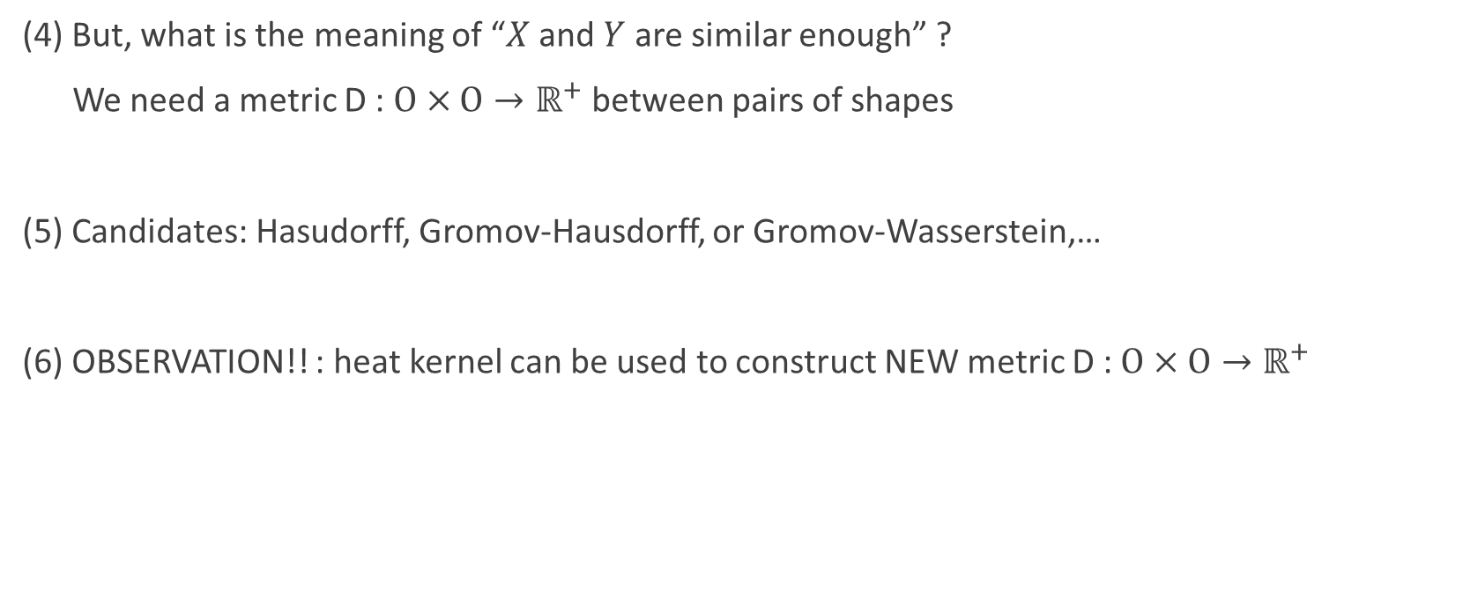
Basic philosophy of shape matching
(4) But, what is the meaning of “$X$ and $Y$ are similar enough” ?
We need a metric D : $Ο×Ο→ℝ^{+}$ between pairs of shapes
(5) Candidates: Hasudorff, Gromov-Hausdorff, or Gromov-Wasserstein,…
(6) OBSERVATION!! : heat kernel can be used to construct NEW metric D : $Ο×Ο→ℝ^{+}$

Slide 4
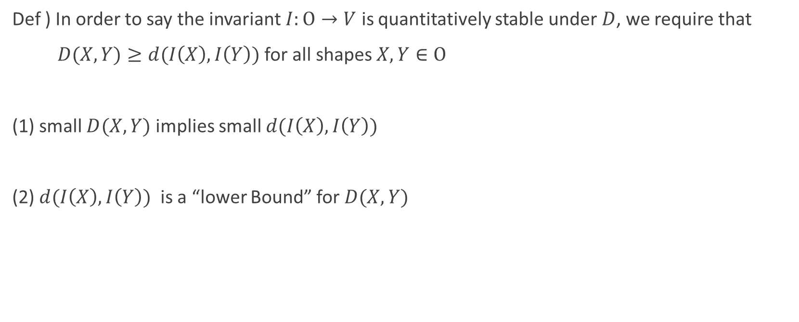

What is “good” metric $D$?
Def ) In order to say the invariant $I:Ο→V$ is quantitatively stable under $D$, we require that
$D(X,Y)≥d(I\left(X\right),I\left(Y\right))$ for all shapes $X,Y∈Ο$
(1) small $D(X,Y)$ implies small $d(I\left(X\right),I\left(Y\right))$
(2) $d(I\left(X\right),I\left(Y\right))$ is a “lower Bound” for $D(X,Y)$

Slide 5
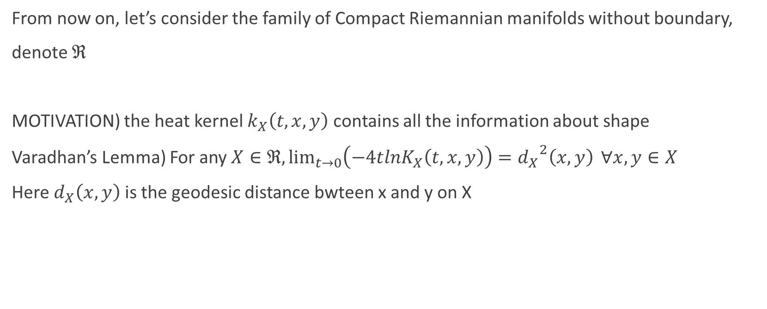
Heat Kernel
From now on, let’s consider the family of Compact Riemannian manifolds without boundary,
denote $ℜ$
MOTIVATION) the heat kernel $k_{X}\left(t,x,y\right)$ contains all the information about shape
Varadhan’s Lemma) For any$X∈ℜ, \lim_{t→0}\left(−4tlnK_{X}\left(t,x,y\right)\right)={d_{X}}^{2}\left(x,y\right) ∀x,y∈X$
Here $d_{X}\left(x,y\right)$ is the geodesic distance bwteen x and y on X

Slide 6
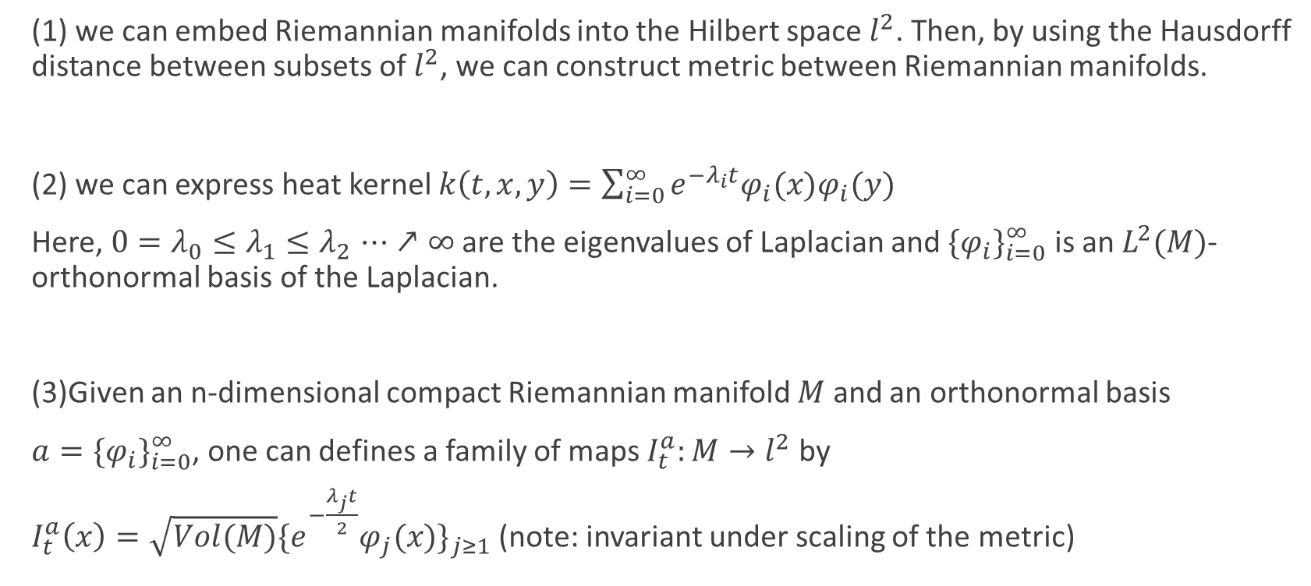
G.Berard, G.Besson, and S.Gallot’s way
(1) we can embed Riemannian manifolds into the Hilbert space $l^{2}$. Then, by using the Hausdorff distance between subsets of $l^{2}$, we can construct metric between Riemannian manifolds.
(2) we can express heat kernel $k\left(t,x,y\right)=\sum_{i=0}^{∞}{e^{−λ_{i}t}φ_{i}(x)φ_{i}(y)}$
Here, $0=λ_{0}≤λ_{1}{≤λ}_{2}⋯↗∞$ are the eigenvalues of Laplacian and ${\{φ_{i}\}}_{i=0}^{∞}$ is an $L^{2}(M)$-orthonormal basis of the Laplacian.
(3)Given an n-dimensional compact Riemannian manifold $M$ and an orthonormal basis
$a={\{φ_{i}\}}_{i=0}^{∞}$, one can defines a family of maps $I_{t}^{a}:M→l^{2}$ by
$I_{t}^{a}\left(x\right)=\sqrt{Vol(M)}{\{e_{}^{−\frac{λ_{j}t}{2}}φ_{j}(x)\}}_{j≥1}$ (note: invariant under scaling of the metric)

Slide 7

G.Berard, G.Besson, and S.Gallot’s way
(4) Let $HD$ denote the Hausdorff distance between subsets of $l^{2}$
Def) Given two Riemannian manifolds $M$ and $M′$, we define a family of distances
$d_{t}\left(M,M^{′}\right)=max⁡\{\sup_{a}\inf_{a^{′}}HD\left(I_{t}^{a}\left(M\right), I_{t}^{a^{′}}\left(M^{′}\right)\right),\sup_{a^{′}}\inf_{a}HD\left(I_{t}^{a^{′}}\left(M^{′}\right),I_{t}^{a}\left(M\right)\right)\}$

Slide 8
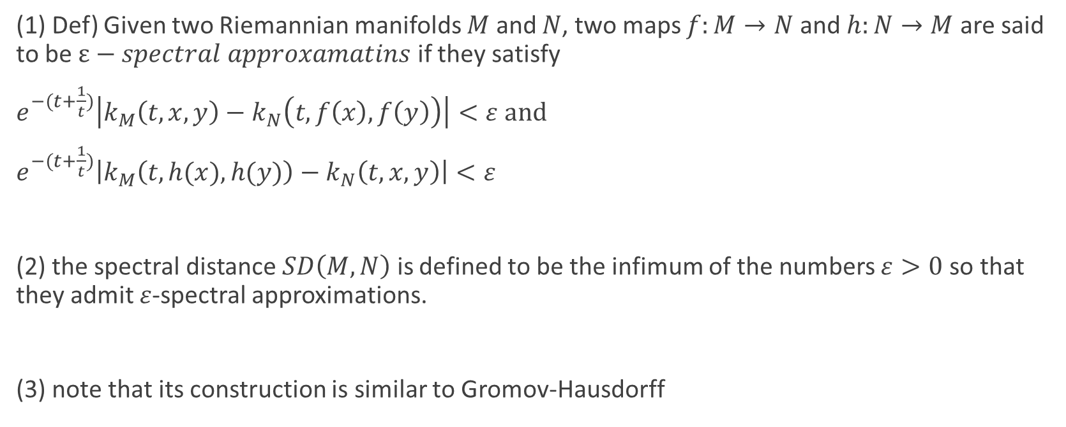
A.Kasue and H.Komura’s way
(1) Def) Given two Riemannian manifolds $M$ and $N$, two maps $f:M→N$ and $h:N→M$ are said to be $ε−spectral approxamatins$ if they satisfy
$e^{−(t+\frac{1}{t})}\left|k_{M}\left(t,x,y\right)−k_{N}\left(t,f\left(x\right),f\left(y\right)\right)\right|<ε and$
$e^{−(t+\frac{1}{t})}\left|k_{M}\left(t,h(x),h(y)\right)−k_{N}\left(t,x,y\right)\right|<ε$
(2) the spectral distance $SD\left(M,N\right)$ is defined to be the infimum of the numbers $ε>0$ so that they admit $ε$-spectral approximations.
(3) note that its construction is similar to Gromov-Hausdorff

Slide 9
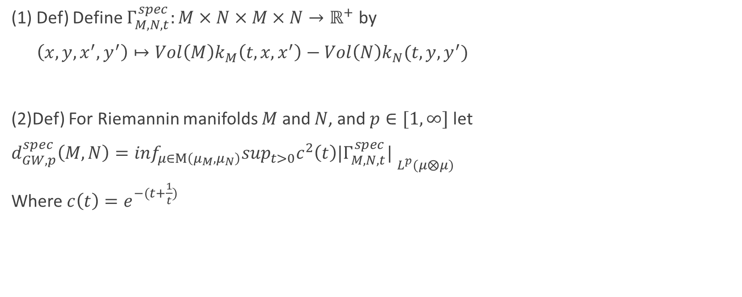
Spectral Gromov-Wasserstein distance
(1) Def) Define $Γ_{M,N,t}^{spec}:M×N×M×N→ℝ^{+}$ by
$\left(x,y,x^{′},y^{′}\right)↦Vol\left(M\right)k_{M}\left(t,x,x^{′}\right)−Vol\left(N\right)k_{N}(t,y,y^{′})$
(2)Def) For Riemannin manifolds $M$ and $N$, and $p∈[1,∞]$ let
$d_{GW,p}^{spec}\left(M,N\right)=\inf_{μ∈Μ\left(μ_{M},μ_{N}\right)}\sup_{t>0}c^{2}\left(t\right){|Γ_{M,N,t}^{spec}| }_{L^{p}(μ⨂μ)}$
Where $c\left(t\right)=e^{−(t+\frac{1}{t})}$

Slide 10
Goal of this project
(1)ambitious one- compare those three distances. Which one is better? Which one is more practically useful?
(2) humble one-computing distances between some classic Riemannian manifolds

