Slide 1
Scope
Key Activities
Outcomes & Assumptions
Build the Content Resolution API and deploy it as a Contentful App in EG’s organisation.
Implement fallback logic across locales and variants.
Implement the variant system by locale, tone and channel.
Connect the API to the traceability system, with one record per resolution.
Integrate with SFMC: a Marketing Object kept current on every content change and read at send time.
Outcomes:
Content Resolution API live as a Contentful App.
Variants resolved by locale, tone and channel, with fallback to the default content.
SFMC sends emails with content resolved at send time.
Every resolution traceable in EG’s log system.
Assumptions:
EG provides access to its Contentful organisation, an SFMC sandbox and a sample NBA payload from week 1.
NBA sends the decision payload: the values, and the key that names the content.
EG’s log system is available to receive the trace records.
Globant proprietary | Confidential information | Do not share without EXPLICIT Globant consent
1
Notes:
Scope of the deliverable: the Content Resolution API, deployed as a Contentful app in EG’s organisation (D-09). Assumptions are proposed for discussion and need EG’s confirmation.

Slide 2
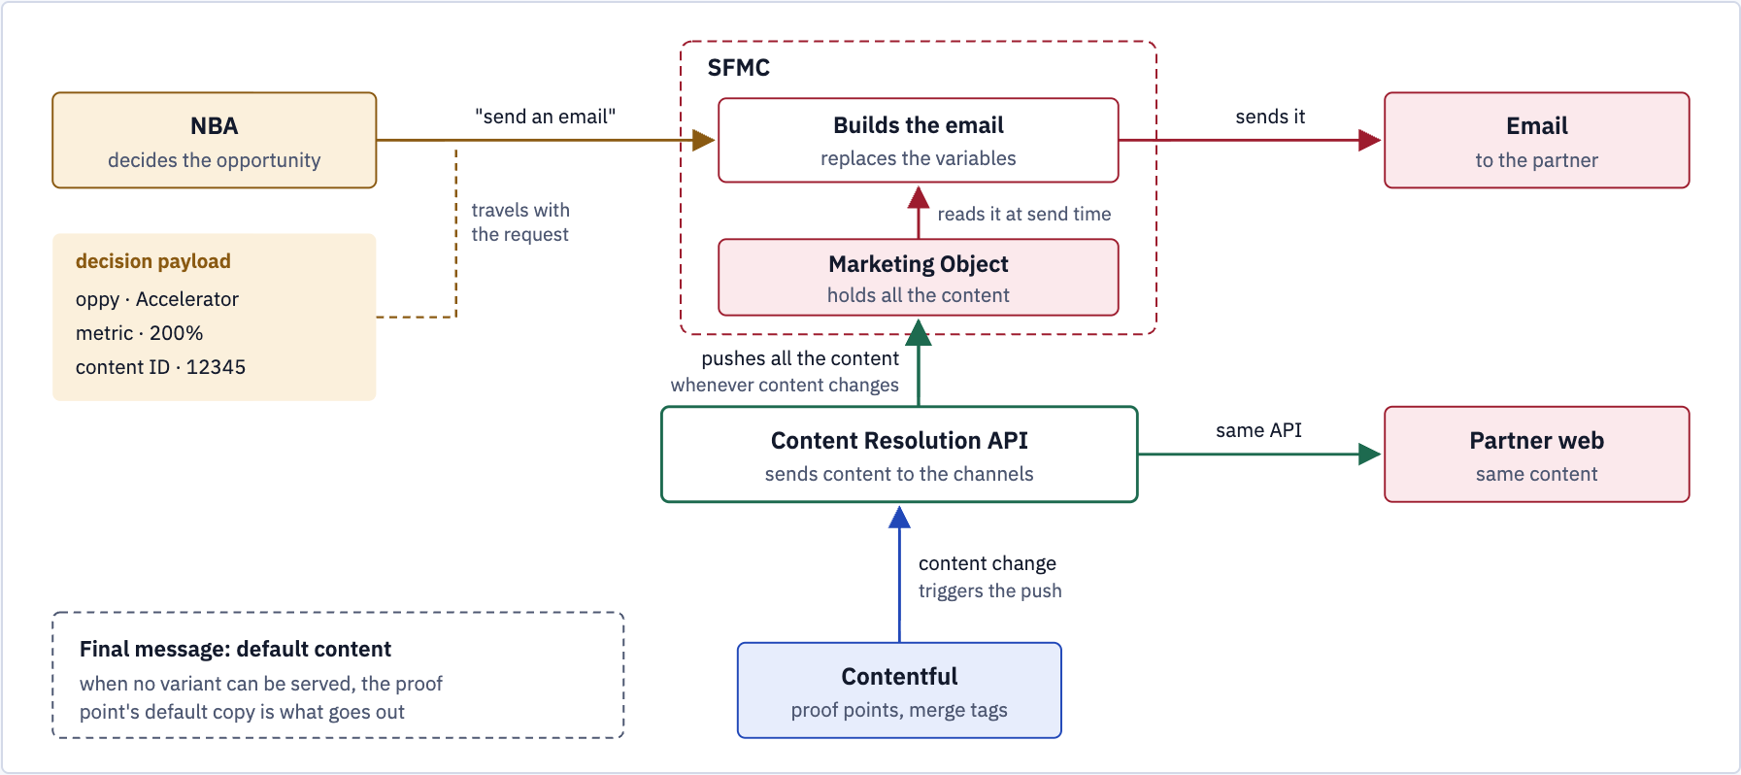
The send, end to end
Figure 13 — Contentful pushes content changes to SFMC; at send time SFMC fills in NBA’s values and sends.
Globant proprietary | Confidential information | Do not share without EXPLICIT Globant consent
2
Notes:
Figure 13. Whenever content changes in Contentful, the Content Resolution API pushes all of it to a Marketing Object in SFMC. At send time SFMC reads the Marketing Object, replaces the variables with the values NBA sent and sends the email. Partner web reads the same content through the same API. When no variant can be served, the default content goes out.

Slide 3
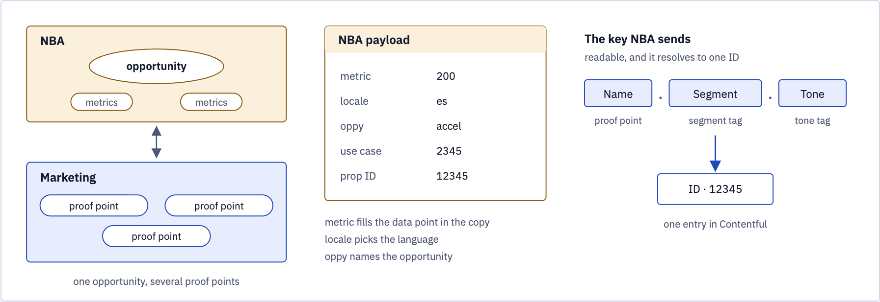
What NBA hands over
Figure 14 — The payload carries the values; the key names the content.
Globant proprietary | Confidential information | Do not share without EXPLICIT Globant consent
3
Notes:
Figure 14. The payload carries the values; the key names the content. Proof point name, segment and tone resolve to one entry ID.

Slide 4
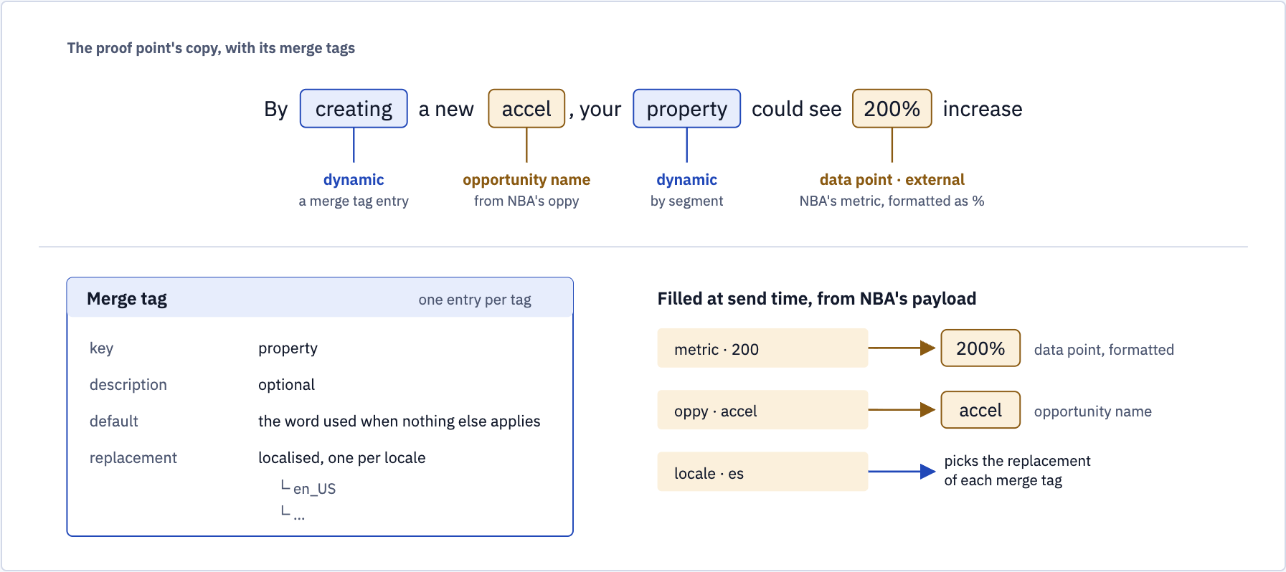
Merge tags in the copy
Figure 15 — Dynamic tags are entries of their own; NBA’s values fill the rest when SFMC builds the email.
Globant proprietary | Confidential information | Do not share without EXPLICIT Globant consent
4
Notes:
Figure 15. Dynamic tags are entries of their own, with a default and a replacement per locale; the opportunity name and the data point take NBA’s values when SFMC builds the email.

Slide 5
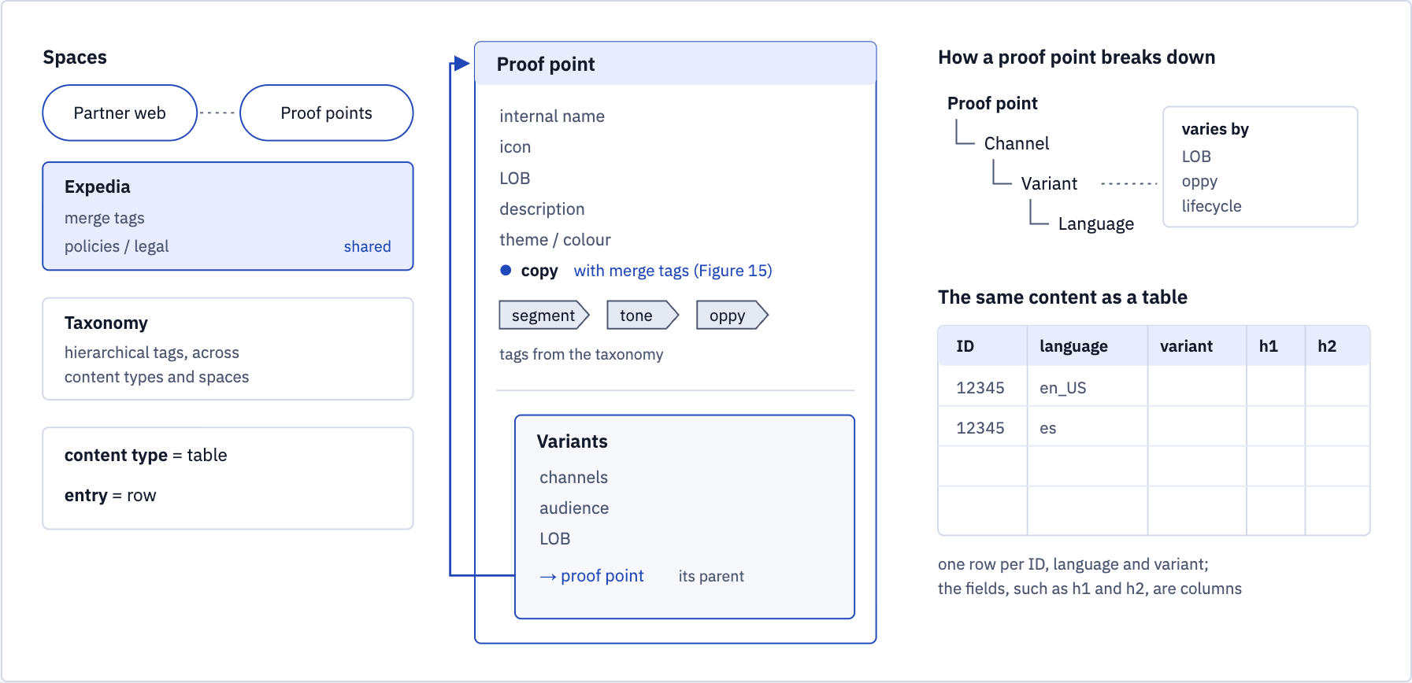
The content model behind it
Figure 16 — Shared Expedia space for merge tags and legal copy; a proof point breaks down by channel, variant and language.
Globant proprietary | Confidential information | Do not share without EXPLICIT Globant consent
5
Notes:
Figure 16. Merge tags and policies / legal copy sit in a shared Expedia space, and the taxonomy’s tags work across spaces. A proof point breaks down by channel, variant and language.

Slide 6
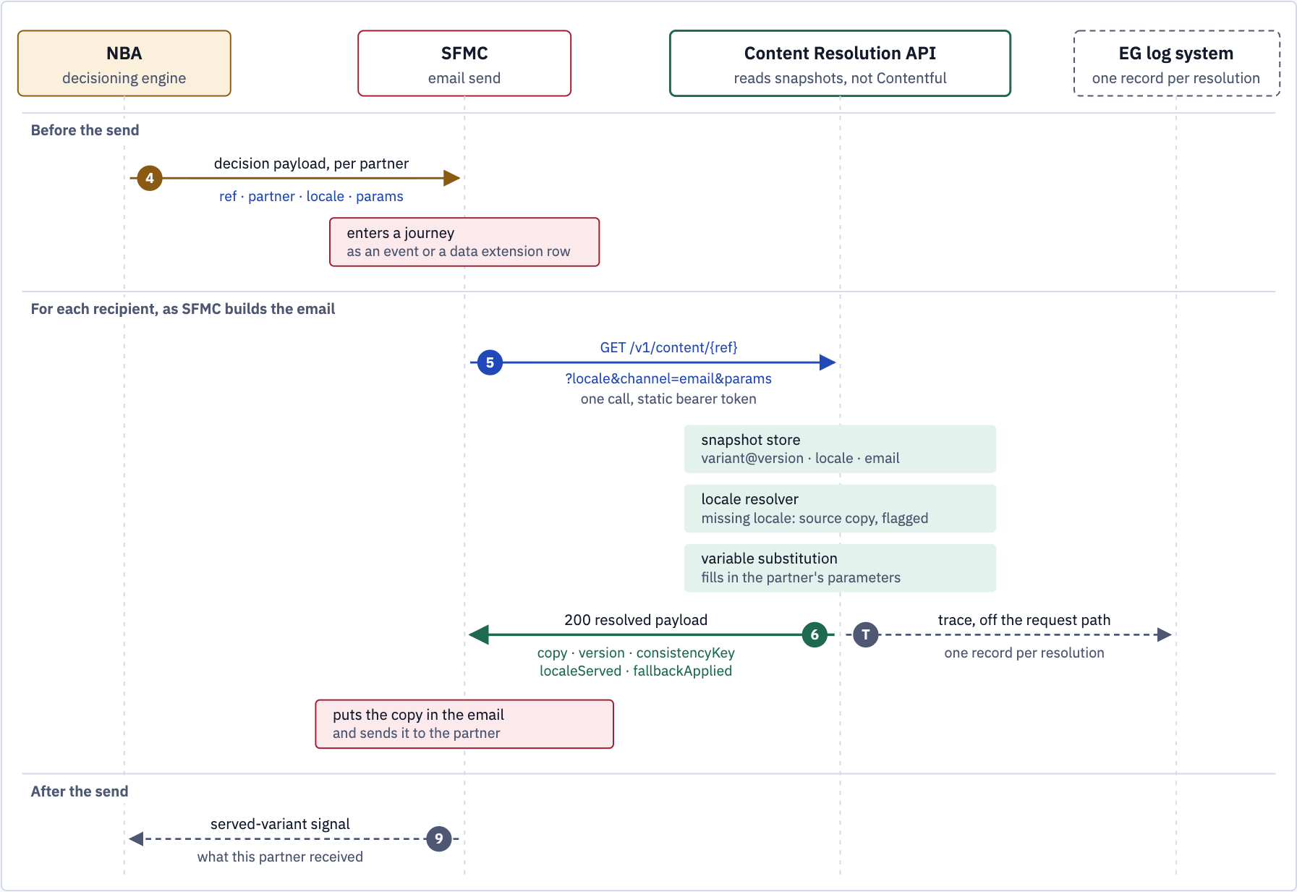
SFMC at send time, zoomed in
Three steps inside one call to the Content Resolution API; none of them reads Contentful.
Globant proprietary | Confidential information | Do not share without EXPLICIT Globant consent
6
Notes:
SFMC at send time, zoomed in. The three steps on the Content Resolution API happen inside the one call, and none of them reads Contentful. Solid arrows are synchronous requests; dashed are asynchronous. Step numbers follow the consumption flow.

Slide 7
Two months to build and deploy
Indicative plan, eight weeks from kick-off to the Content Resolution API live as a Contentful app.
W1
W2
W3
W4
W5
W6
W7
W8
Design and API contract
Endpoint, payload, snapshot model, auth
Contentful app foundation
App set up and hosted in EG’s organisation
Snapshots and Marketing Object
Publish on content change, push to SFMC
Resolution endpoint
Locale resolver, variable substitution, fallback
NBA and SFMC integration
NBA payload in, resolved copy into the send
Testing, performance, security
Burst after a large send, failure paths
Go-live and hand-over
Release in EG’s accounts, documentation
Design agreed
First email in sandbox
Live in production
Depends on EG providing access to its Contentful organisation, an SFMC sandbox and a sample NBA payload from week 1.
Globant proprietary | Confidential information | Do not share without EXPLICIT Globant consent
7
Notes:
Indicative plan. Phase durations and the three milestones are a proposal for discussion, not a commitment; they depend on access to EG’s Contentful organisation, an SFMC sandbox and a sample NBA payload from week 1.

