Slide 1

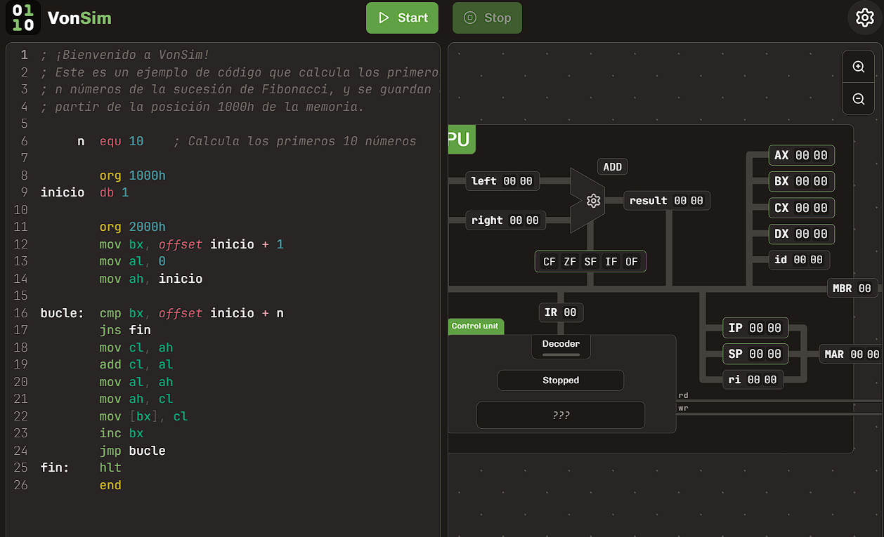

VonSim
Educational Simulator for Assembly
https://vonsim.github.io/
Notes:
Hello!
I want to tell you about VonSim, an educational simulator for Assembly.

Slide 2

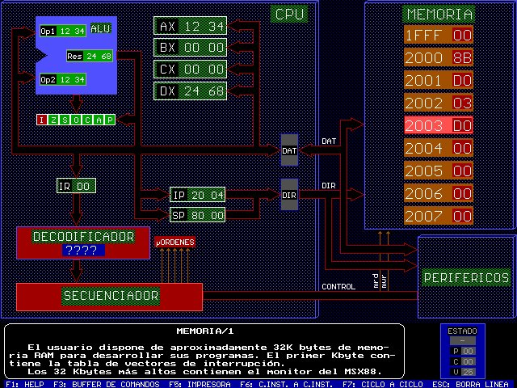


Context
Informatics School
  Universidad Nacional de La Plata
Courses that teach Assembly
  Computer Organization
  Computer Architecture
~1500 students per year
Previously: MSX88 simulator
  VonSim 1: 2017
  VonSim 2: 2023
MSX88
Notes:
We created VonSim to teach Assembly at the Universidad Nacional de La Plata, where we have more than a thousand students per year.
Previously, we used a very old simulator called MSX88.
VonSim was born as a replacement of MSX88, providing a backwards compatible version of the simulator with modern IDE features.
VonSim is now 8 years old, and has had a very positive impact in the learning experience of students.

