Slide 1

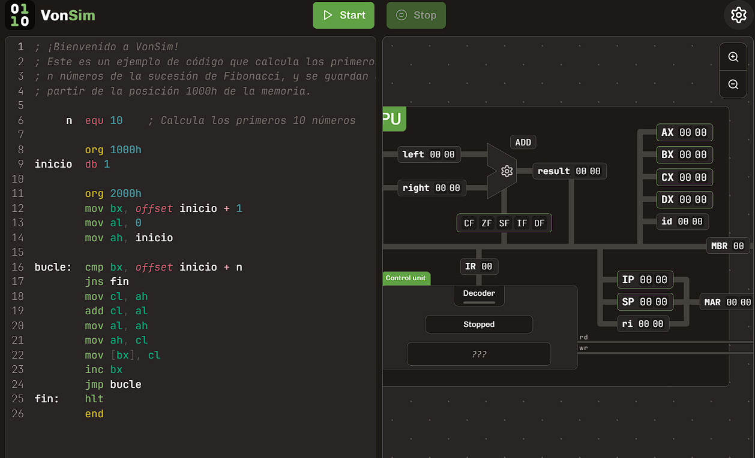

VonSim
Educational Simulator for Assembly
https://vonsim.github.io/
Notes:
Hi! I want to tell you about VonSim, an educational simulator for learning Assembly.

Slide 2

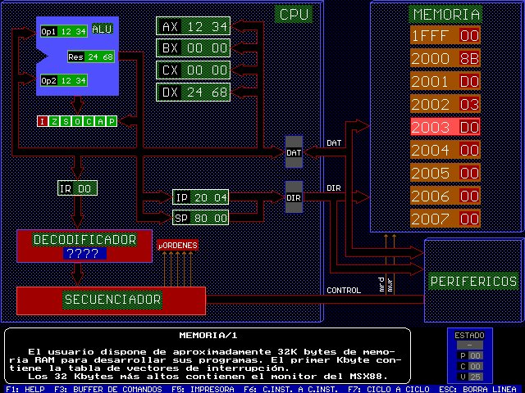


Context
Informatics School
Universidad Nacional de La Plata
Courses that teach Assembly
Computer Organization
Computer Architecture
~1500 students per year
Previously: MSX88 simulator
VonSim 1: 2017
VonSim 2: 2023
MSX88
Notes:
We created VonSim for our courses that teach Assembly at the Universidad Nacional de La Plata, where we have more than a thousand students per year. Previously, we used a very old simulator called MSX88, and VonSim was born as a web application that provided a backwards compatible version of the instruction set. VonSim is now 8 years old, and has had a very positive impact in the learning experience.

