Slide 1

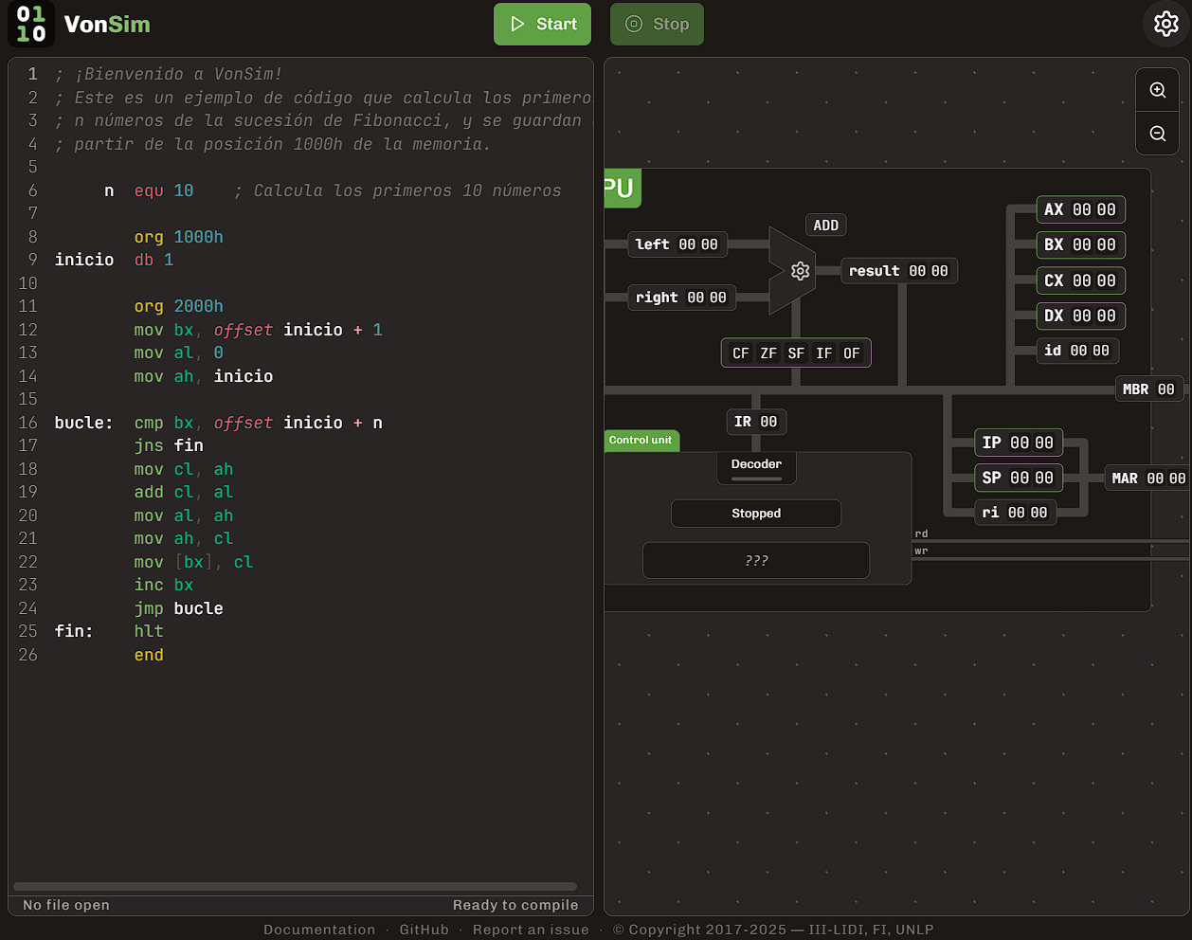

VonSim
Educational Simulator for Assembly
https://vonsim.github.io/
Notes:
Hello!
I want to tell you about VonSim, an educational simulator for Assembly.

Slide 2

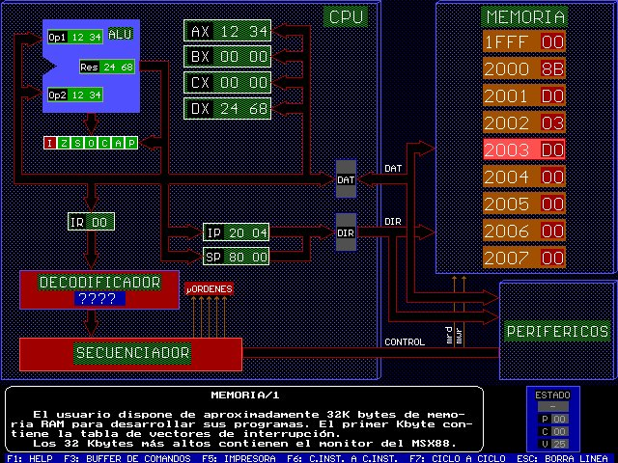


Context
Informatics School
Universidad Nacional de La Plata
Courses that teach Assembly
Computer Organization
Computer Architecture
~1500 students per year
Previously: MSX88 simulator
VonSim 1: 2017
VonSim 2: 2023
MSX88
Notes:
We created VonSim to teach Assembly at the Universidad Nacional de La Plata, where we have more than a thousand students per year.
Previously, we used a very old simulator called MSX88.
VonSim was born as a web application that provided a backwards compatible version of the instruction set.

Slide 3


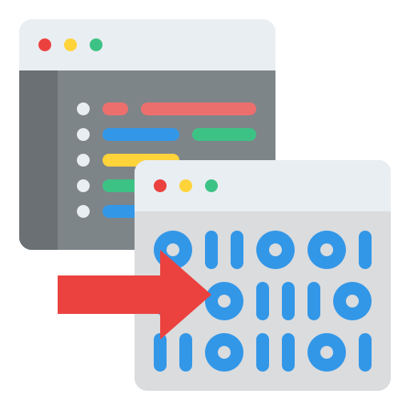



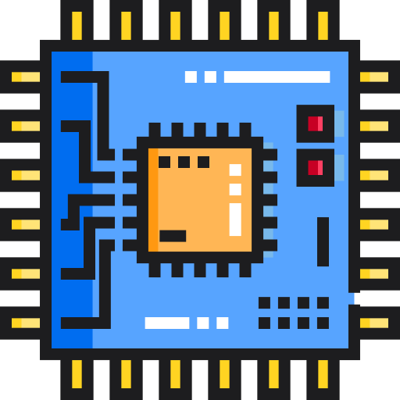




https://vonsim.github.io/
Web App
IDE
Compile & Ex
Debug
Simplified Architecture
Component Visualization
I/O Devices
Integrated Examples
Mobile/Tablet mode
Notes:
VonSim is a web application that features an integrated editor and simulator for a simplified x86 architecture.
Students can both write and run programs, visualizing the CPU, Buses, Memory and I/O devices as instructions are executed.
It also has other cool features, such as an integrated example gallery, mobile layout, and easy sharing of programs with a QR code.

Slide 4
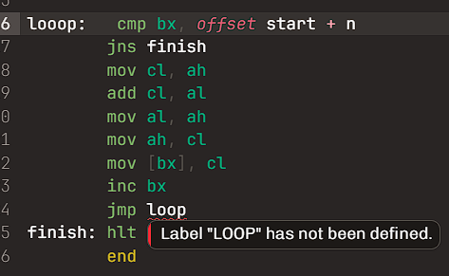
IDE
Syntax Coloring
Continuous compilation
Detailed error messages with visual feedback
Notes:
The IDE features continuous compilation and detailed error messages that allow quick feedback cycles and promote student independence.

Slide 5
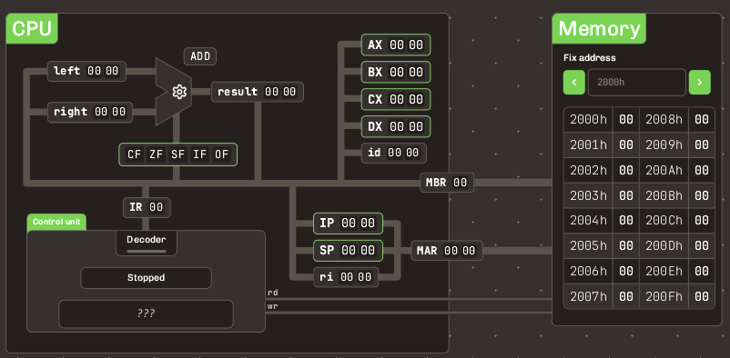
CPU/Memory
8 half registers - 8 bits each: AL, AH, BL, BH, Cl, CH, DL, DH
Can be addressed as 4 16-bit registers: AX, BX, CX, DX
Low/high parts
Especial state registers
ALU
Memory: 16838 bytes
16 bit addresses
Notes:
The 16-bit architecture features only 4 registers: AX, BX, CX and DX.
These can be addressed as half-registers with alternative names: AH, AL, and so own, where H stands for High and L for Low.
VonSim also includes typical state registers such as the Instruction and Stack Pointers, and a fixed-point Arithmetic Logic Unit

Slide 6
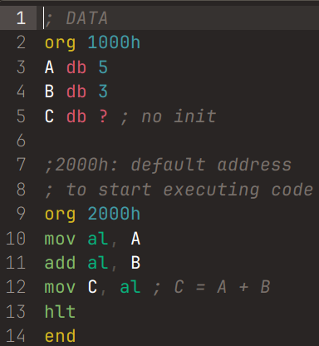
Simplified 8088 Assembly
Compute C = A + B
ORG <ADDRESS>
Explicit starting address for code/data
END
MOV dest, source
Data transfers
OP dest[, source]
OP = ADD | SUB | OR | AND | XOR | NEG | NOR
hlt
Stop execution
Notes:
The simplified assembly instruction set is minimalistic and yet it represents key aspects of the x86 architecture.
For example, VonSim requires specifying the memory layout manually with the ORG instruction.
The MOV instruction allows moving data between registers, or registers and memory, but indirect addressing can only be performed using the BX register.
The Arithmetic Logic Unit can only perform only basic operations. Students must therefore implement their own advanced operations such as multiplication.

Slide 7
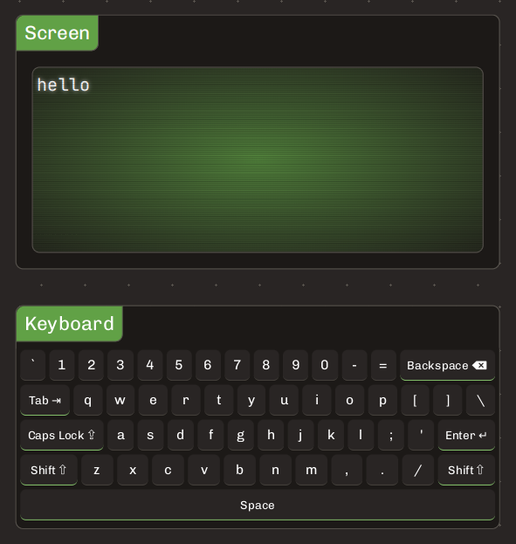
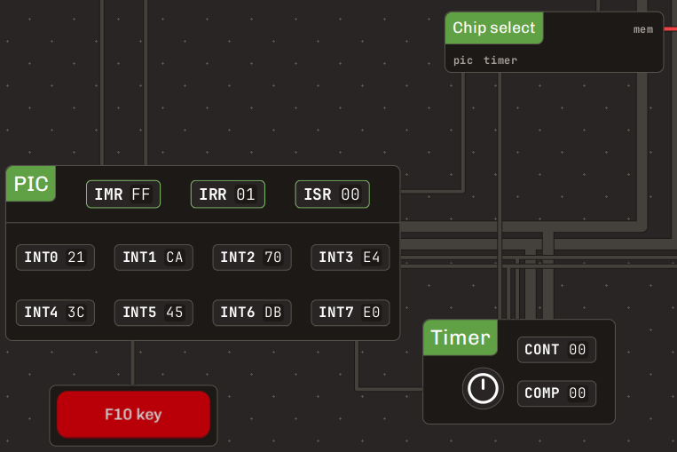
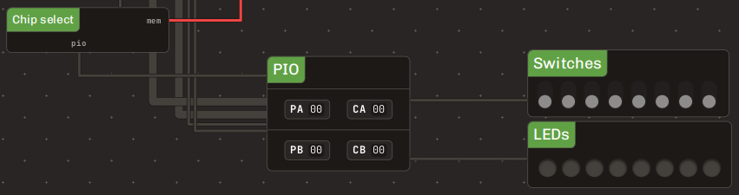

Device I/O
Keyboard & Screen
PIC
→ Timer
→ F10 Button
→ HANDSHAKE
PIO
→ LEDs & Switches
→ Printer
HANDSHAKE
→ Printer
Notes:
The simulator features a rich set of Input/Output Devices such as a keyboard, screen, switches, leds and a printer, with different connection configurations.
These can be accessed via different internal devices, using either hardware interrupts or polling.

Slide 8
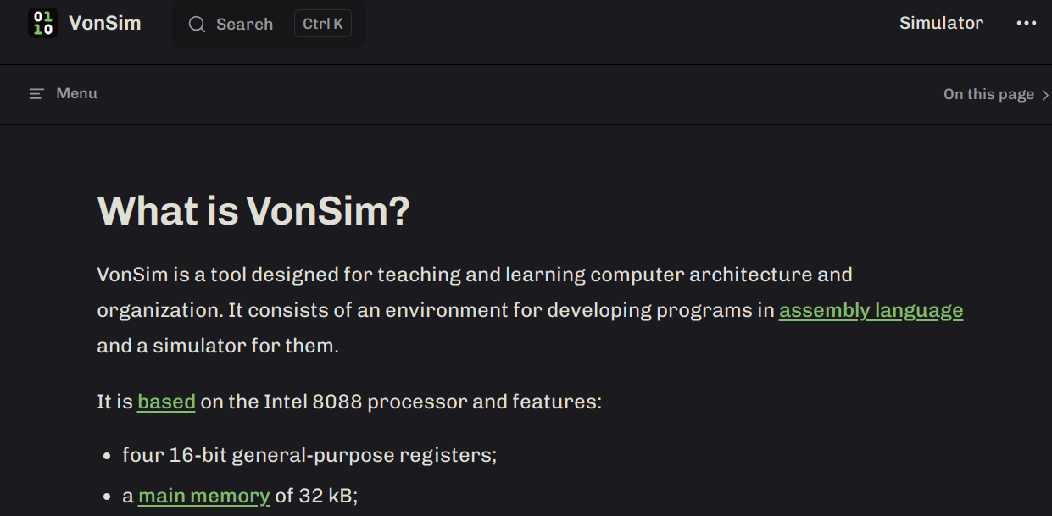
VonSim 2 Docs
https://vonsim.github.io/en/
Notes:
For both teachers and students, VonSim has a thorough and easy to read documentation, in english and spanish.

Slide 9

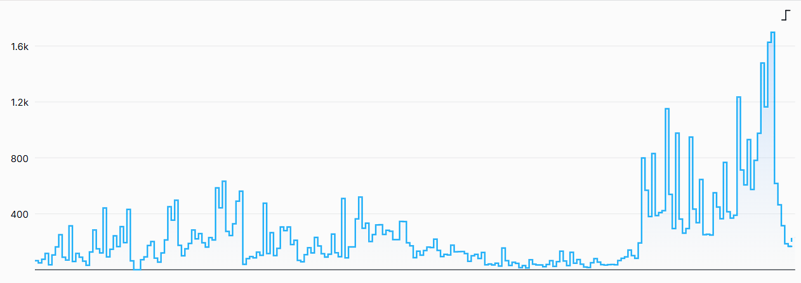
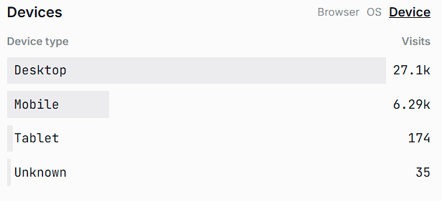
VonSim 2 Usage statistics
Via OneDollarStats (2025/03 - 2025/10)
Visits per day
Devices
Visitas
2021
Día
2022
Notes:
VonSim is used everyday by hundreds of students!
Almost one-fourth of them use mobile devices.

Slide 10



VonSim 2 Team
Facundo Quiroga
https://github.com/facundoq
Juan Seery
https://github.com/JuanM04
https://github.com/vonsim/vonsim
Notes:
VonSim was originally developed by Facundo Quiroga in 2017. In 2023, Juan Seery rewrote the entire application in TypeScript using the React framework, introducing many quality of life features such as animations, code export and color themes.
Juan is also the current maintainer.
VonSim is open-source and free to use. Thank you for your interest!

