Slide 1
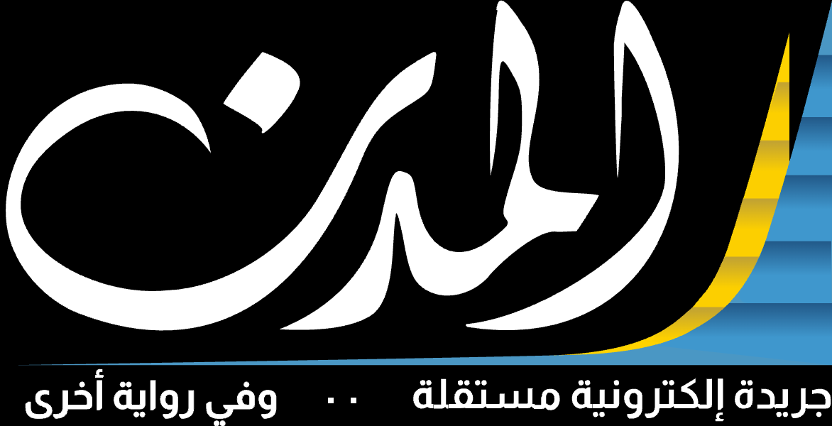

One Almodon.
More ways to engage
Bring discovery, programs and video playback into the main Almodon experience.
REUSE THE ASSET
UNIFY THE JOURNEY
PROVE THE IMPACT
Existing Almodon Plus programs, episodes and shorts.
Homepage, programs hub and related shorts placements.
Test video engagement without harming news consumption.
Notes:
Open with the ask: approve a controlled MVP that brings Almodon Plus programs, episodes and shorts into the main Almodon experience. Approval covers MVP delivery subject to player, CMS and analytics feasibility checks; it is not a full platform rebuild.

Slide 2
BUSINESS RATIONALE
02 / 11
Why bring Almodon Plus inside Almodon?
TODAY
PROPOSED EXPERIENCE
Two connected destinations
01
02
03
News on Almodon; video programming on Almodon Plus. The journey between formats needs to be easier.
READ
DISCOVER
WATCH
Reach
Engagement
Brand
Expose existing video to Almodon readers.
Build cross-format journeys and watch depth.
Present journalism and video as one offer.
Notes:
Today news lives on Almodon and video programming on Almodon Plus. The proposal connects them into one journey: read, discover, watch, continue. We keep the current Plus infrastructure unless migration is justified later. Benchmark signal: Al Jazeera Net and The Guardian surface video within their news environments; that is a design pattern, not proven uplift.

Slide 3
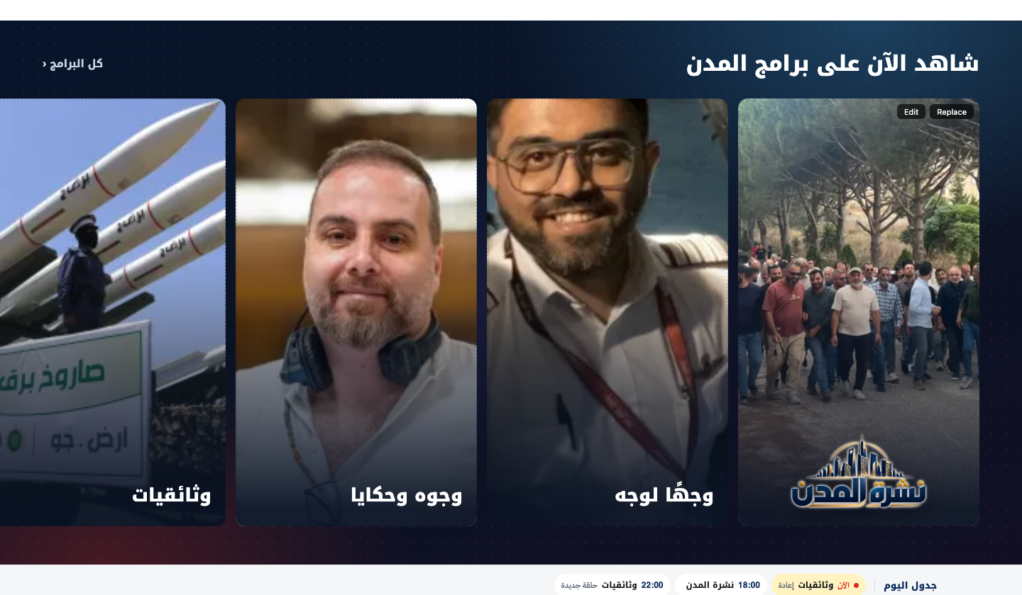
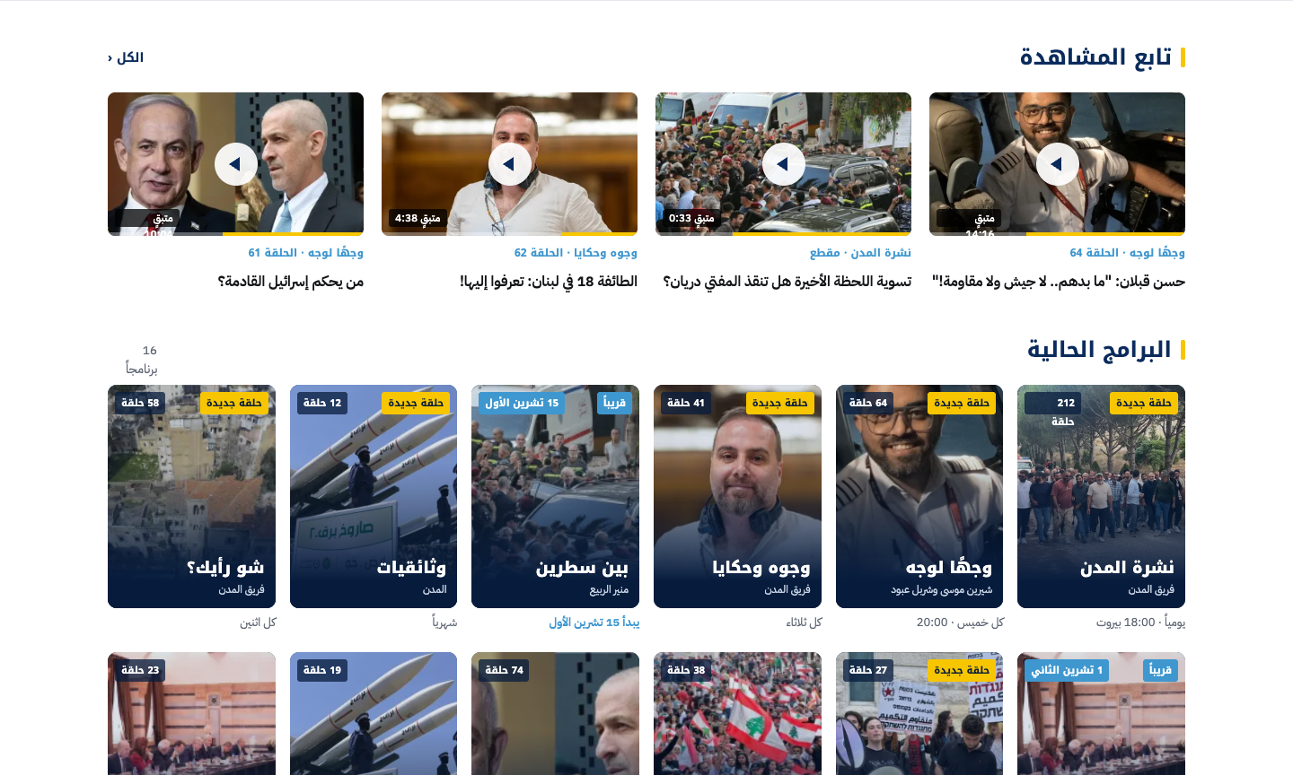
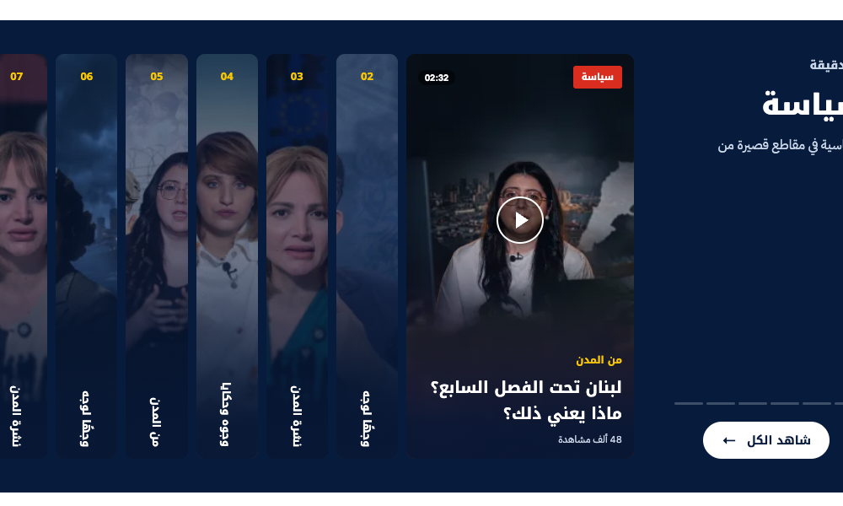
PROPOSED UX & CONCEPT
03 / 11
Three placements, one on-site viewing experience
01
02
03
Homepage
Programs hub
Articles
Featured programs, shorts carousel and All Programs CTA.
Browse shows, seasons and episodes.
News
Notes:
Three placements share one on-site viewing experience. Homepage: featured programs, shorts carousel and an All Programs CTA. Programs hub: browse shows, seasons and episodes. Articles: relevant embedded videos chosen by editors. Every video plays on almodon.com with no redirect.

Slide 4
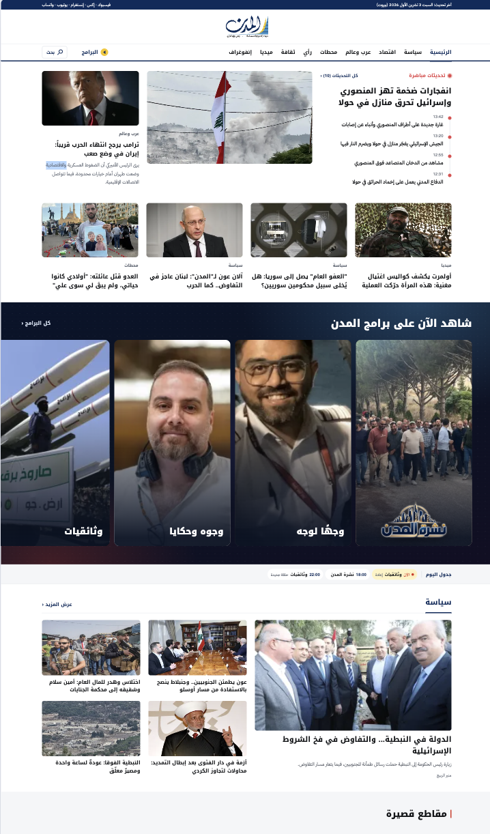
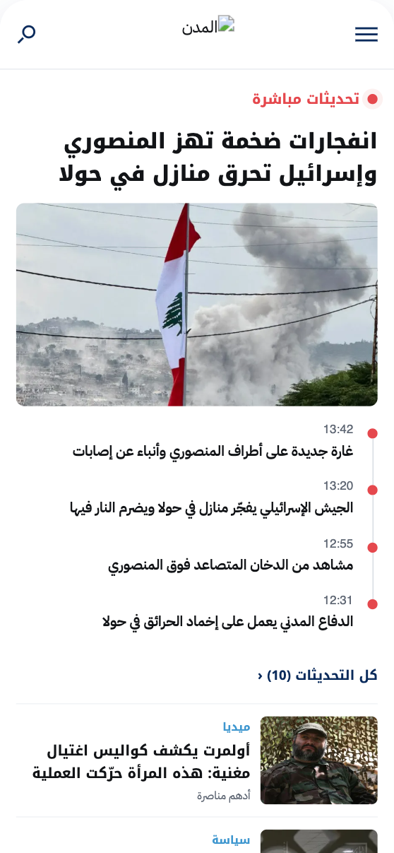
CONCEPT DESIGN · HOMEPAGE
04 / 11
Homepage: programs and shorts beside the news
almodon.com
The lead story and live updates stay first. Programs and shorts follow as curated modules, on desktop and mobile.
Live updates beside the lead story
Featured programs
Shorts carousel
Notes:
The homepage keeps the news lead story with live updates on top, then brings in the Almodon Plus programs module, followed by a shorts carousel under the politics section. On mobile the same modules become swipe rows.

Slide 5
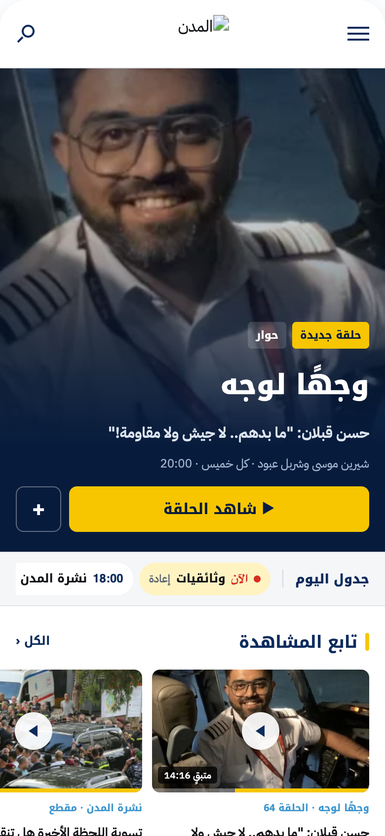
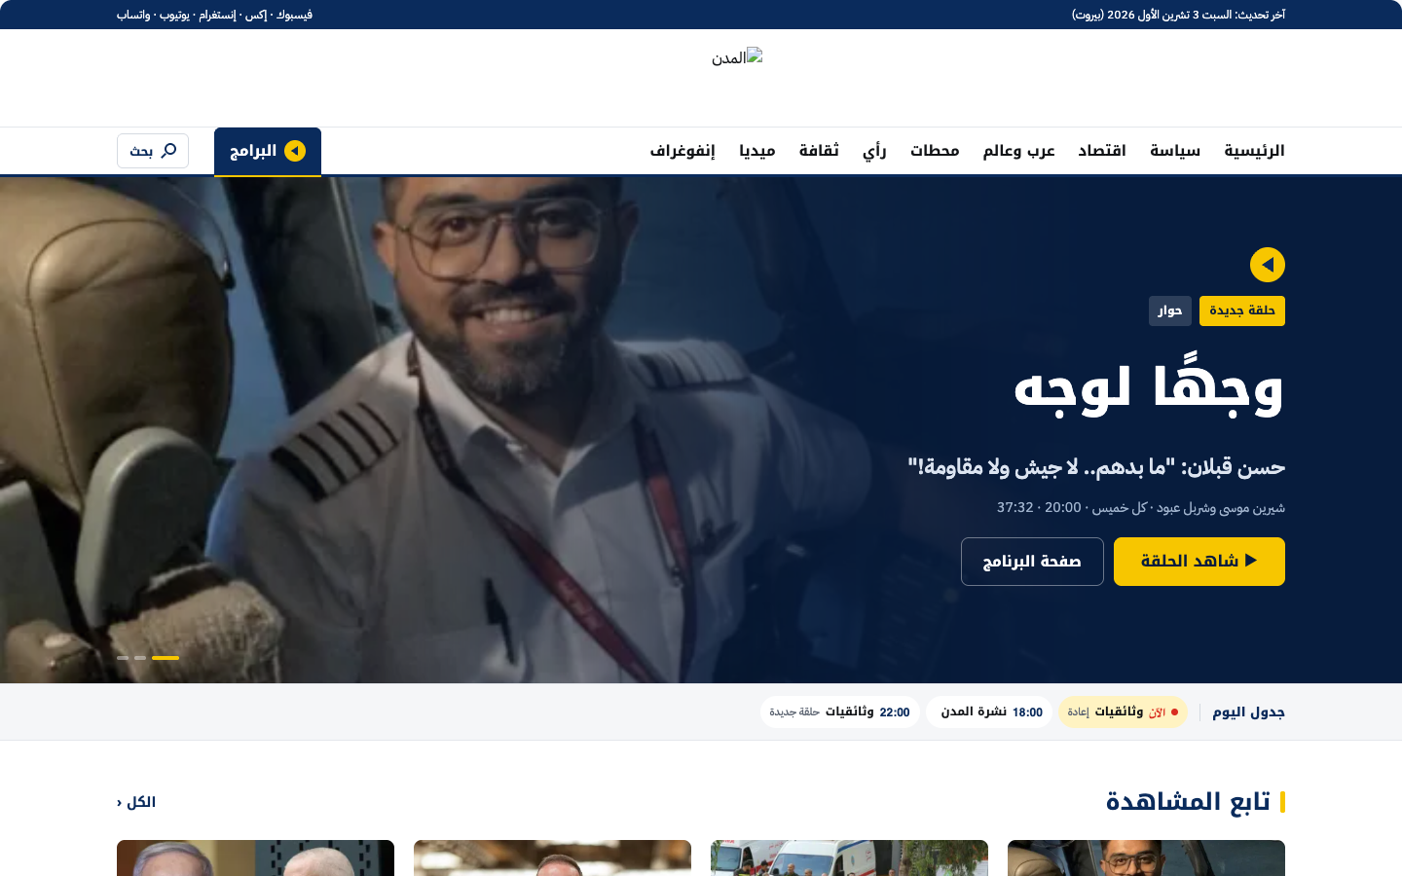
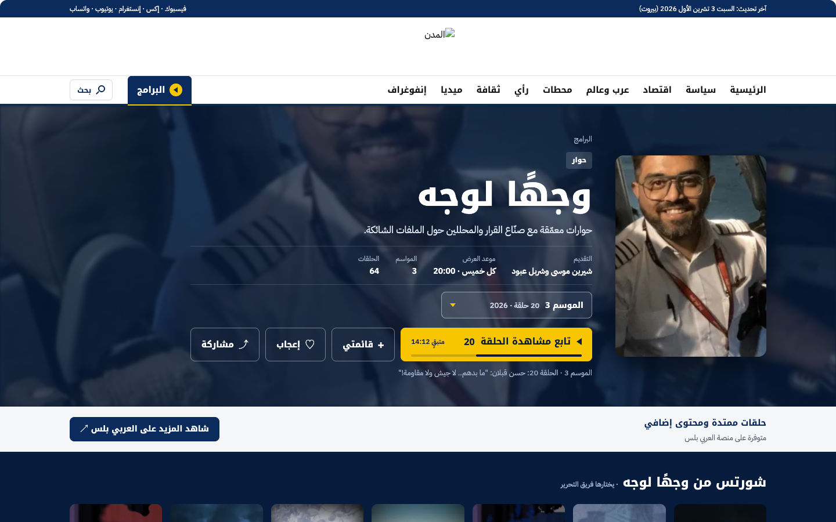
CONCEPT DESIGN · PROGRAMS
05 / 11
Programs hub and show pages
almodon.com/programs
almodon.com/programs/wajhan-li-wajh
Notes:
The programs hub opens with a featured show, then continue watching, current programs and recommendations. Each show page carries synopsis, seasons and the ordered episode list, plus that show’s shorts.

Slide 6
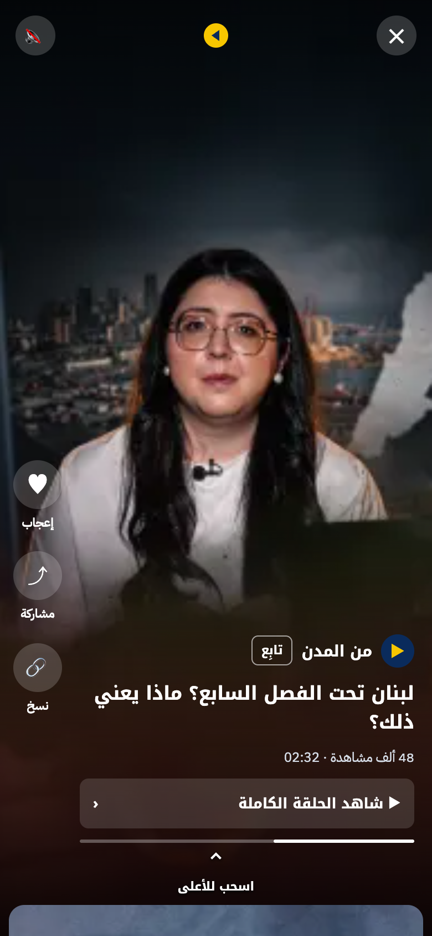
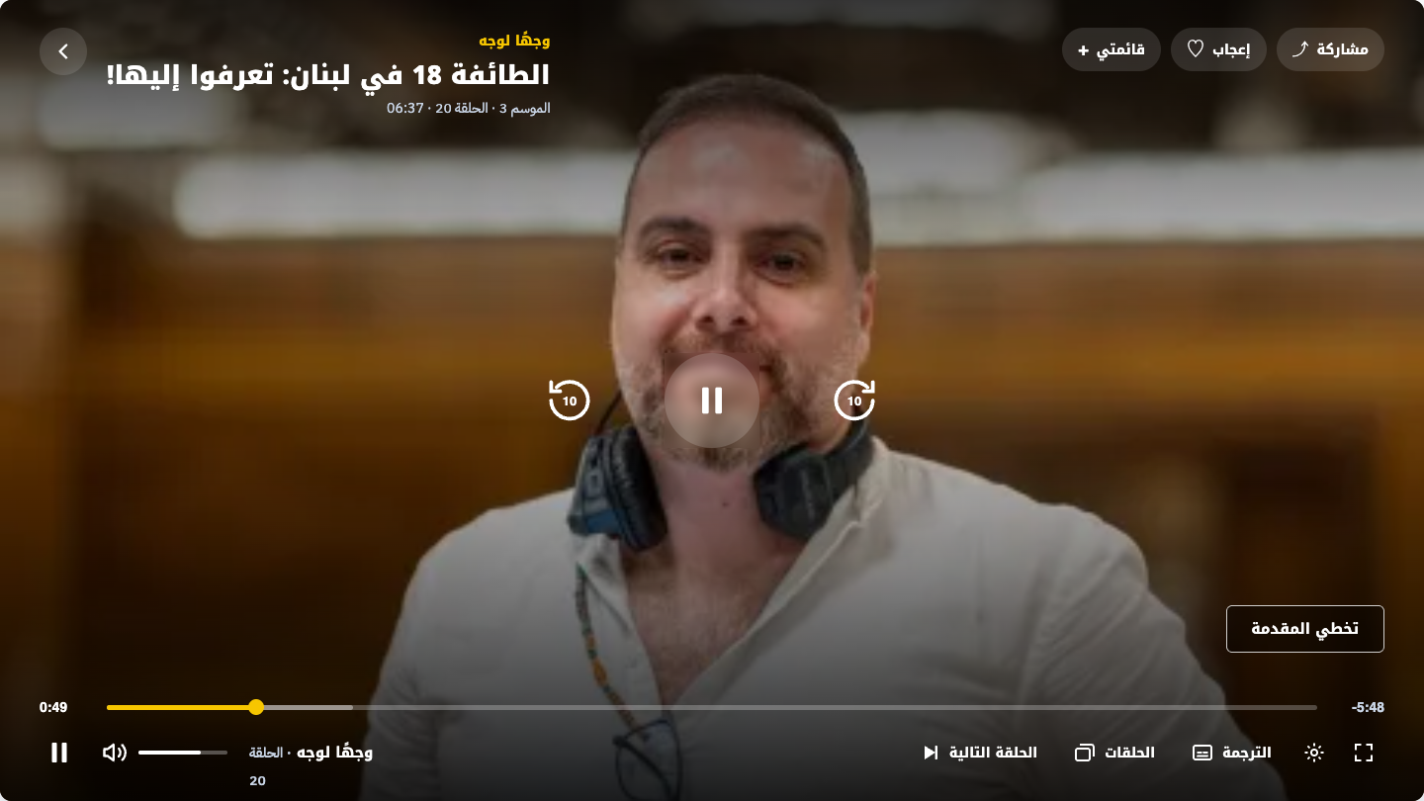
CONCEPT DESIGN · VIEWING
06 / 11
On-site player and shorts viewer
almodon.com/watch
Responsive playback and error states
Portrait shorts with up-next
No redirect to play
Notes:
Episodes open in an on-site player with standard controls, next episode, episodes list and captions. Shorts open in a portrait viewer with up-next and a link to the full episode. No user leaves Almodon to watch.

Slide 7
DELIVERY SCOPE · COMMITTED
07 / 11
MVP: 12 features required to launch
Discovery & viewing
Editorial, context & quality
M01
M02
M03
M04
Almodon Progrms(Almodon Plus) navigation
Homepage featured module
Programs directory
Program detail & episodes
Visible entry point in the main site navigation.
Show cards, imagery, latest content, responsive layout.
Curated programs and shorts; mobile swipe; all-programs CTA.
Synopsis, seasons and ordered episode collection.
M05
M06
M07
M08
Shorts discovery
On-site player
Article video placements
Related content & sharing
Portrait-friendly cards and in-site viewing.
Responsive playback, standard controls, error states.
Editors attach relevant shorts or episodes to stories.
Next and related videos, program links, share controls.
Immersive vertical shorts
M09
M10
M11
M12
Analytics & controlled pilot
Track impressions, starts, watch depth and site impact.
Notes:
Twelve features are required to launch. M01 to M06 cover discovery and viewing; M07 to M12 cover editorial, context and quality. Acceptance gate: no user is redirected away from Almodon to play a selected video.

Slide 8
FUTURE ROADMAP · NOT APPROVED SCOPE
08 / 11
After MVP: 12 opportunities to prioritise from evidence
VIEWER EXPERIENCE
P01
Personalized discovery
P02
Continue watching
P03
Follow programs & alerts
P04
P05
Autoplay next / smart queue
P06
Advanced video search
EDITORIAL INTELLIGENCE & GROWTH
P07
Dynamic article recommendations
P08
AI transcripts & translation
P09
Player convenience
P10
Video advertising formats
P11
Experiments & targeting
P12
CMS/platform consolidation
PRIORITISATION RULE ·
Evaluate post-MVP items using viewing data, editorial effort and cost, not design appeal alone.
Notes:
Not approved scope. After the MVP, twelve opportunities to prioritise from evidence. Viewer experience: personalised discovery, continue watching, follows and alerts, immersive vertical shorts, autoplay next, advanced search. Editorial intelligence and growth: dynamic article recommendations, AI transcripts and translation, picture-in-picture and background audio, video advertising after commercial approval, experiments and targeting, and CMS consolidation only with proven operational benefit.

Slide 9
BRAND · LATER PHASE
09 / 11
A rebrand is planned for a later phase
LATER PHASE
MVP LAUNCHES UNDER
TBD
Notes:
Rebranding is planned for a later phase. The MVP launches under the current Almodon and Almodon Plus identities; the move to Fadaat is a separate phase and not part of the approved MVP scope. This deck already previews the Fadaat palette: navy, gold and blue with the square motif.

Slide 10
EXECUTIVE DECISION
11 / 11
Approve a scoped MVP, then scale on evidence
APPROVAL REQUESTED
01
DISCOVER
Authorise MVP design and development.
Player, rights, CMS/feed, analytics and effort sizing
02
DESIGN
Homepage, directory, articles, mobile and video UX
Conditional on technical feasibility, engineering sizing and agreed release criteria.
03
BUILD + QA
Integration, curation, responsive playback and events
Out of MVP: subscriptions, accounts, full OTT rebuild, CMS migration.
04
PILOT + DECIDE
Measure qualified viewing against news-site guardrails
Notes:
The approval requested is to authorise MVP design and development, conditional on technical feasibility, engineering sizing and agreed release criteria. Four phases: discover, design, build and QA, then pilot and decide. Out of MVP: subscriptions, accounts, full OTT rebuild and CMS migration. No costs, delivery dates or engagement uplift are assumed before discovery and measurement.

