Slide 1
WEB SECURITY FOR CLOUD BASED PASSWORD MANAGEMENT SYSTEM.
By
Ugorji Sunday Kalu.
2014/195275
Being A B.Sc Project Report Submitted In Partial Fulfillment Of The Requirements For The Award Of A Bachelor Of Science Degree In Computer Science Of The University Of Nigeria.
Supervisor: Mr. I. A. Adeyemo
July, 2018.

Slide 2
Introduction
Abstract
Even with more sophisticated and modern forms of authentication, passwords are still the most popular form of user authentication. An environment where
Multiple passwords are used (multiple-password environment) causes many issues with regard to information security. Password managers may be one way to improve password management by storing.
This work is aimed at developing a .that stores user’s password, encrypt the password and saves it on the cloud which enables the user to be free from memorizing passwords or writing them down
METHODOLOGY:
The methodology used in the course of this work is Object-Oriented Analysis and Design Methodology (OOADM).
It is a technical approach implemented in the design of a system through the application of the Object-Oriented paradigm and concepts, including visual modeling.
It helps to ensure better product quality when applied throughout the development life-cycle of the system.

Slide 3
PROBLEM STATEMENT
Online users forget passwords easily and there is a need for a system to help the user or authority in accessing, protecting and storing passwords.
Meanwhile browser based password management is attracted using phishing and java scripts. In this research / project a design and web security for cloud-based password management would be considered.

Slide 4
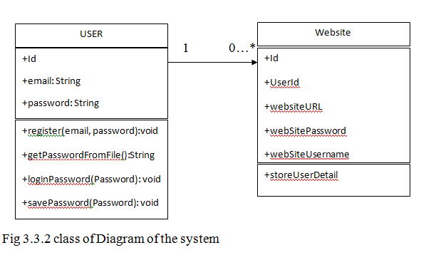
DESIGN OF THE PROPOSED SYSTEM
CLASS DIAGRAM:
A Class Diagram is the most common diagram used in Unified Modeling Language (UML). It models the static structure of a system, showing the relationships between classes, objects, attributes and operations.
The purpose of the class diagram is to model the static view of an application. The class diagrams are the only diagrams which can be directly mapped with object-oriented languages, hence they are widely used at the time of construction.

Slide 5
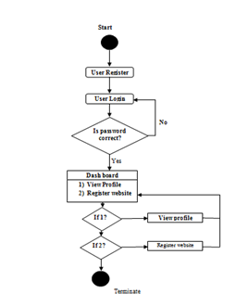
DESIGN OF THE PROPOSED SYSTEM
ACTIVITY DIAGRAM:
A graphical representation of workflow of activities or actions with support for choices, iteration and concurrency. In the Unified Modeling Language, Activity Diagrams are intended to model both computational and organizational processes (i.e workflow).

Slide 6
ACHIEVEMENTS
This project has successfully brought various software technologies together to present a password storage system.
This storage system can store user password and serve as a password bank.
User need not to remember his passwords again.
This system is able to save users login details, encrypt them before sending to the cloud server.
It does not save users details on the local devices.

Slide 7
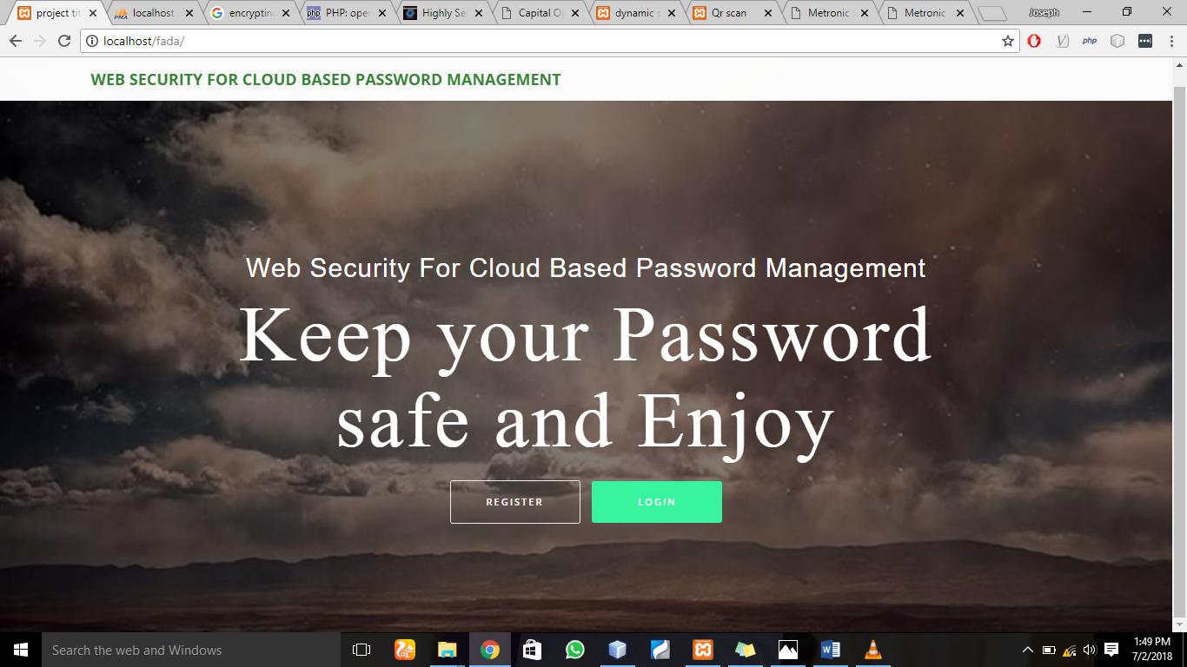
SCREEN SHOTS OF THE INDEX PAGE

Slide 8
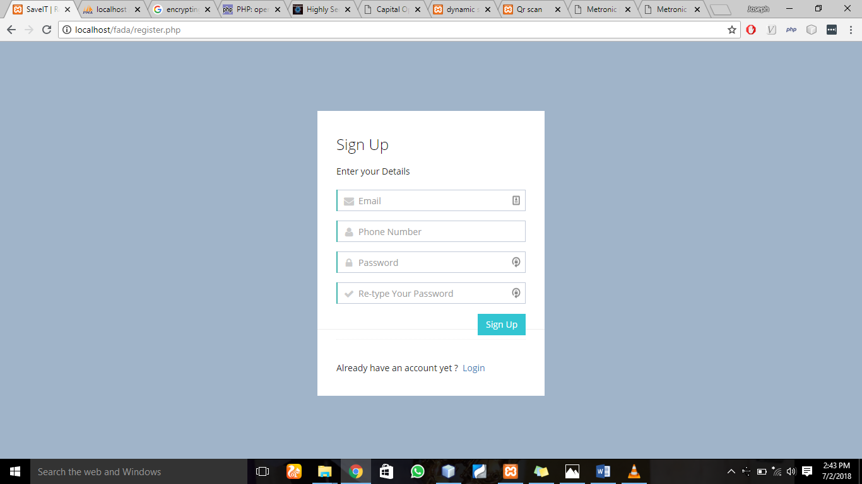
SCREEN SHOT OF THE REGISTRATION PAGE

Slide 9
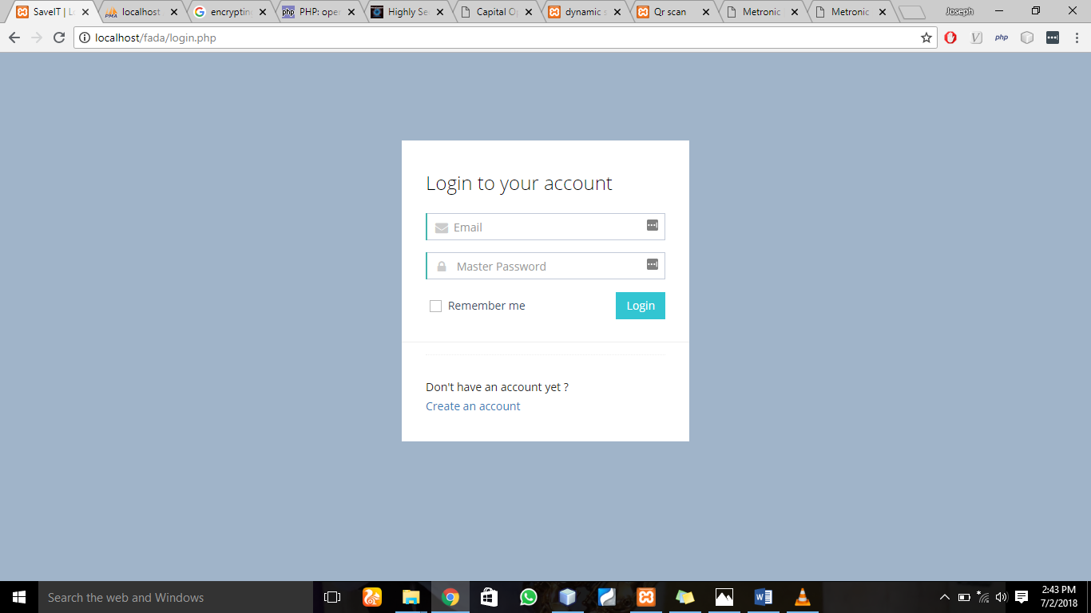
SCREEN SHOT OF THE LOGIN PAGE

Slide 10
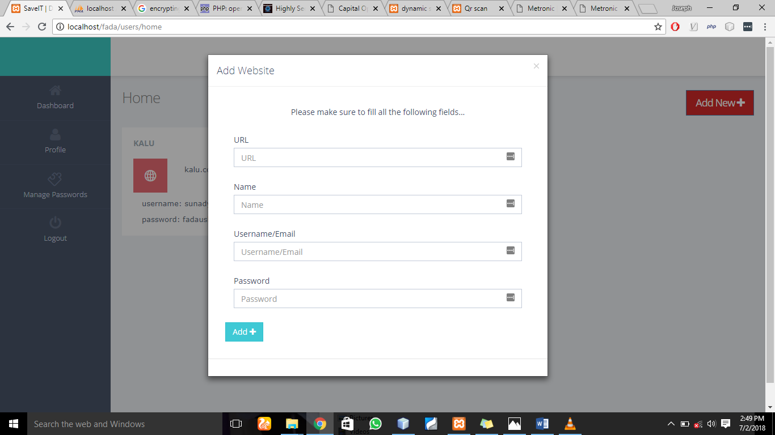
Screen Shot Of Add Website Page

Slide 11
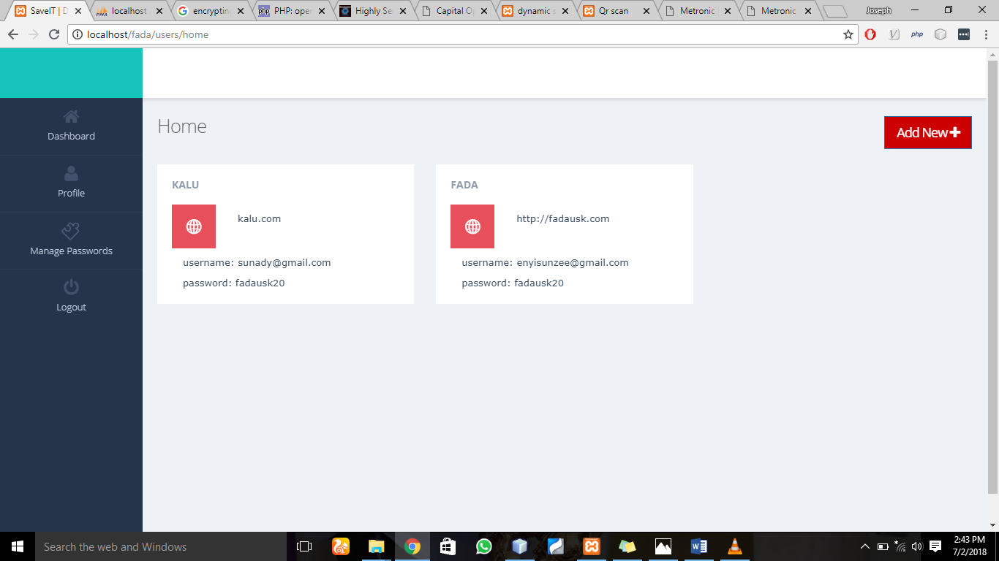
Screen Shot of The Dashboard

Slide 12
List of references:
[1] Adams, A., & Sasse, M. A. (1999). Users are not the enemy. Communications of the ACM, 42(12), 40-46.
[2] S. Komanduri, R. Shay, P.G. Kelley, M.L. Mazurek, L. Bauer, N. Christin, L.F Cranor and S. Egelman, “of passwords and people: Measuring the effect of password- composition policies , in Proc of CH1, 2011.
[3] Zhang, J., Luo, X., Akkaladevi, S., & Ziegelmayer, J. (2009). Improving multiplepassword recall: an empirical study. European Journal of Information Systems, 18, 165-176.
[4] Grawemeyer, B., & Hilary, J. (2011). Using and managing multiple passwords: A week to a view. Interacting with Computers, 23, 256-267.
[6] R. Morris, K. Thompson, Password security: a case history, Commun.
ACM 22 (11) (1979) 594–597.
[7] D. C. Feldmeier, P. R. Karn, Unix password security – ten years later,
in: Proceedings of the Annual International Cryptology Conference (CRYPTO), 1989, pp. 44–63.
[8] A. Adams, M. A. Sasse, Users are not the enemy, Commun. ACM 42 (12)
(1999) 40–46.
[9] M. Wu, R. C. Miller, G. Little, Web wallet: preventing phishing at-
tacks by revealing user intentions, in: Proceedings of the Symposium on
Usable Privacy and Security (SOUPS), 2006, pp. 102–113.
[10]. Samlinson, E.; Usha, M., "User-centric trust based identity as a service for federated cloud environment," in Computing, Communications and
Networking Technologies (ICCCNT),2013 Fourth International Conference on , vol., no., pp.1-5, 4-6 July 2013
[11]. Yan Yang; Xingyuan Chen; Guangxia Wang; Lifeng Cao, "An Identity and Access Management Architecture in Cloud," in Computational
Intelligence and Design (ISCID), 2014 Seventh International Symposium on, vol.2, no., pp.200-203, 13-14 Dec. 2014
[12] Rui Zhao and Chuan Yue, Toward A Secure and Usable Cloud-based Password
Manager for Web Browsers, 2014, pp11-15

Slide 13
THANK YOU

