Slide 1
Is there a link between restaurants in a city and the city’s obesity rates?

Slide 2
Datasets

Slide 3
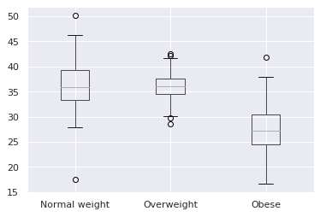
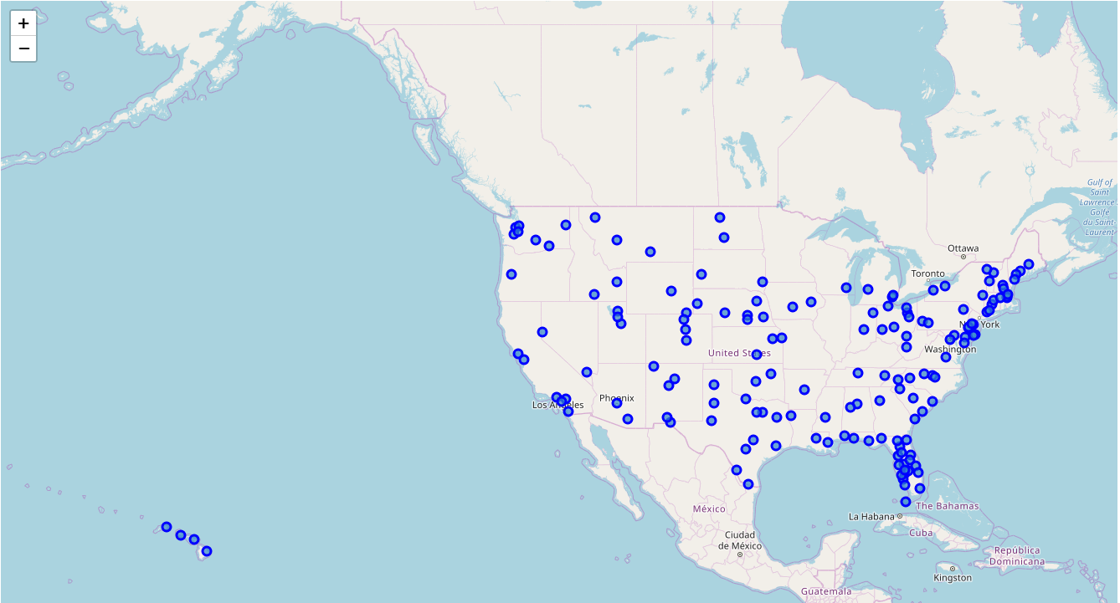
Obesity rates & Geographical data
2 Initial datasets…
Obesity rates of 192 American cities
Data follows a normal distribution, with 2 outlier cities
Census data of 28,889 incorporated US cities & towns
…combined into a final dataset
The following data for 160 cities:
- Normal weight, % of population
- Overweight, % of population
- Obese, % of population
- Latitude
- Longitude

Slide 4
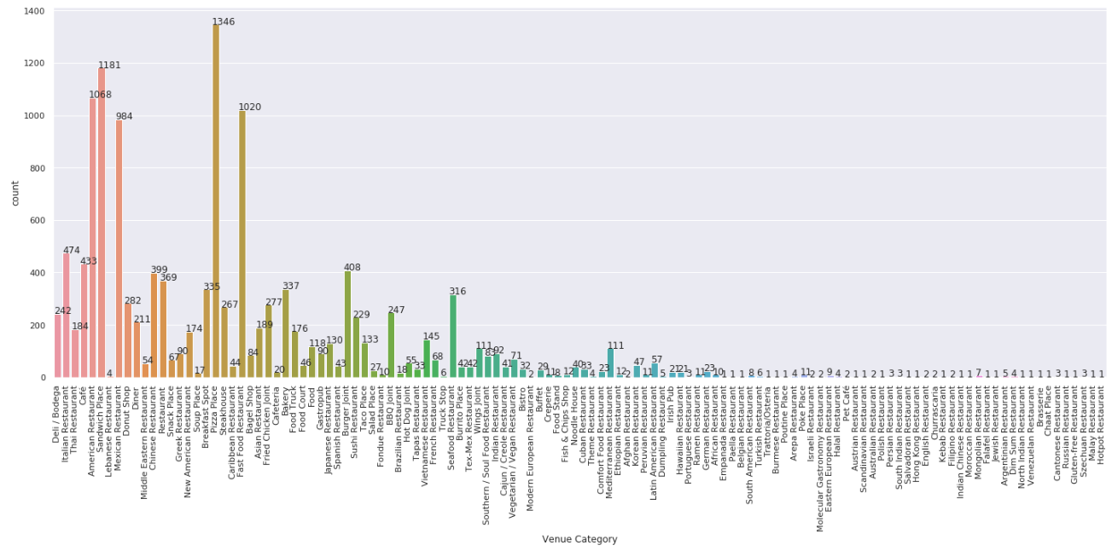
Restaurant dataset
13,568 results across 160 cities
120 different restaurant categories - Most common category is Pizza place
Between the 160 cities, 8 categories come back as the most common ones:
American | Fast Food
Café | Mexican
Sandwich Place | Bakery
Vietnamese | Pizza Place

Slide 5
Analysis

Slide 6
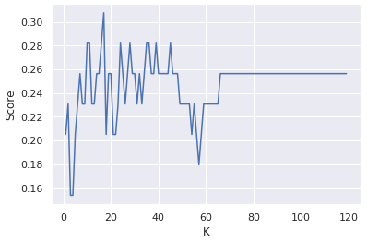
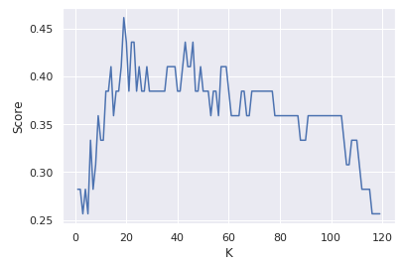
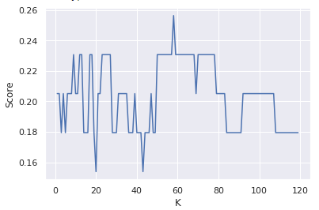
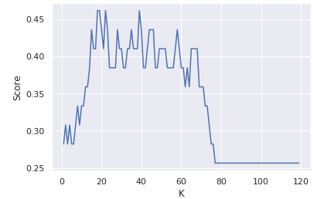
Algorithm evaluation & performance
Algorithm | Score without GPS coordinates as input variables | Score with GPS coordinates as input variables
K-Nearest neighbors, uniform weights | K: 17 Score: 0.308 | K: 18 Score: 0.462
K-Nearest neighbors, distance weights | K: 58 Score: 0.256 | K: 19 Score: 0. 462
Naïve Bayes Gaussian | 0.308 | 0.385
Decision Tree | 0.256 | 0.282
K-Nearest neighbors, uniform weights, with K = 18 yields the best results
Final results
F1 score:
4/8 categories have a score of 0
2/4 between 0 and 0.5
2/4 ~0.62
Jaccard index | array([0. , 0. , 0. , 0.28571429, 0.46153846, 0.44444444, 0.22222222, 0. ])
F-1 score | array([0., 0. , 0. , 0.44444444, 0.63157895, 0.61538462, 0.36363636, 0.])

Slide 7
Conclusion

Slide 8
Future work
Other input variables to consider
Physical activity of city’s population
2nd & 3rd most common restaurant types

