Slide 1

PREDICTION THE BREAST CANCER TYPE USING MACHINE LEARNING WITH PYTHON
By : Muhammad fadel asyahid

Slide 2
I created the machine learning model from ‘Breast Cancer Winsconsin’ dataset and deploy it using Flask
What?
https://www.kaggle.com/uciml/breast-cancer-wisconsin-data
* Source :

Slide 3
This Machine Learning model could assist the doctor to predict the breast cancer type easily
Why?

Slide 4
User can easily input the mean of radius,texture,area, smoothness, compactness, concavity, concave points, and symmetry
How?

Slide 5
Machine Learning Model Accuracy?
I used Random Forest Classifier in this Machine Learning Model which has 95 % accuracy
*evaluation metrics using classification report

Slide 6
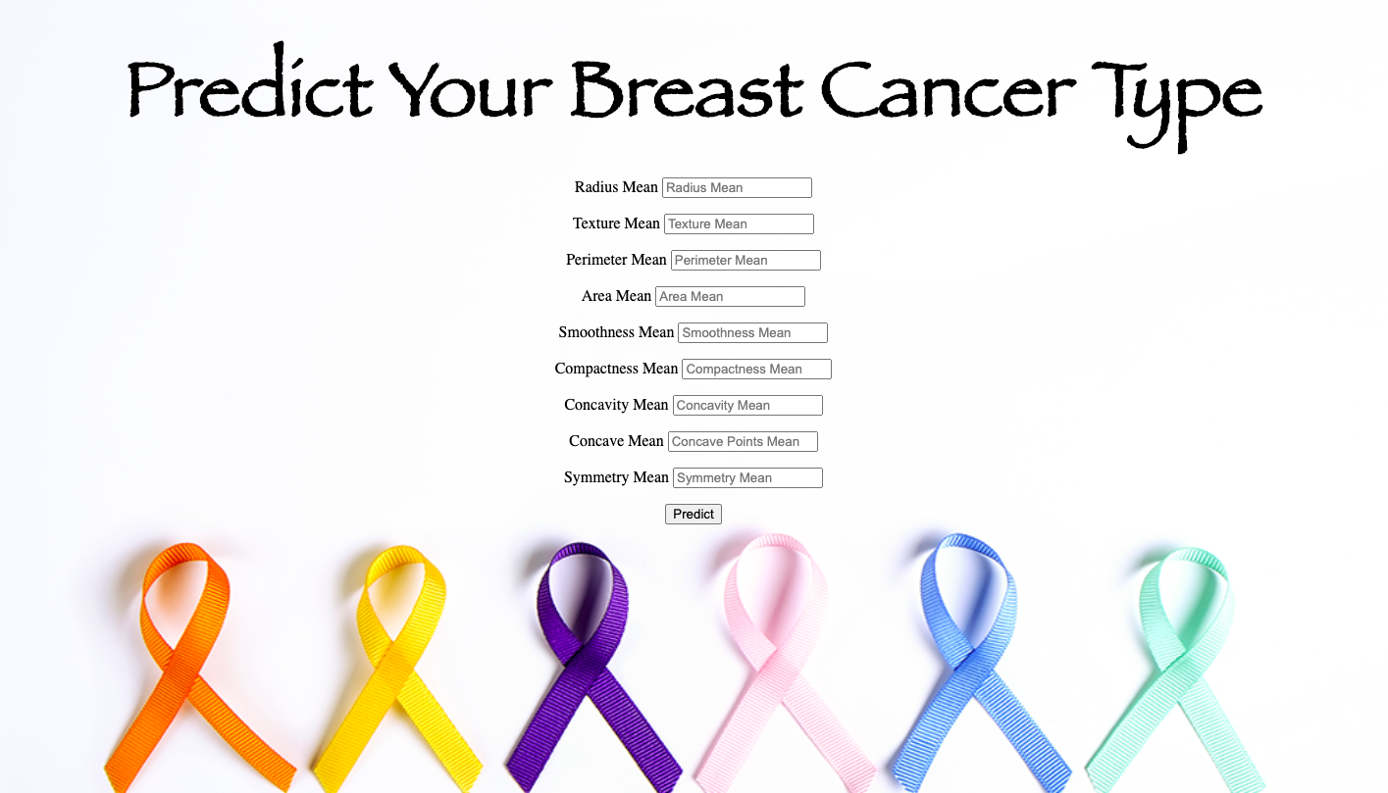
How is the dashboard?

Slide 7
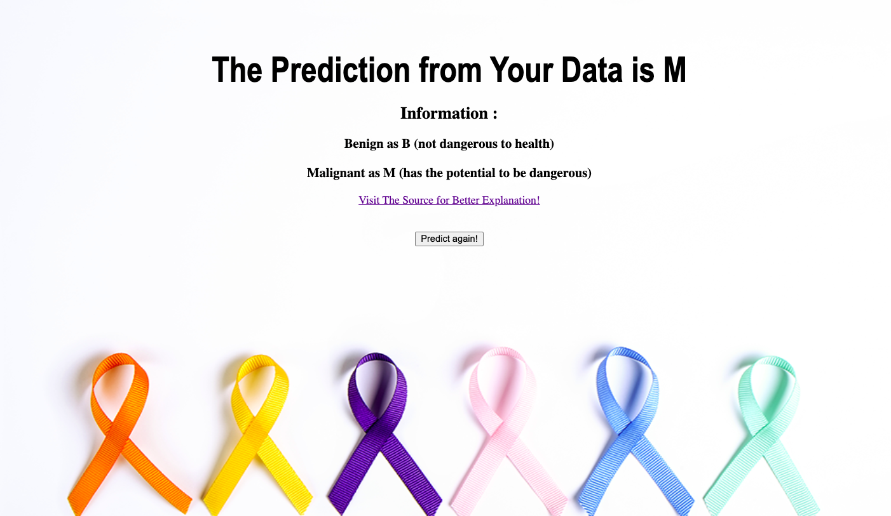
How is the result?

Slide 8
Do you wanna try?

Slide 9

Kindly Check my Github repositories and run the Flask
Source :
https://github.com/fadelasyahid/Deploy_Machine_Learning_dengan_Flask

Slide 10
THANK YOU

