Slide 1
Decentralized Access Control
夏里宾

Slide 2
CALYPSO: Private Data Management for Decentralized Ledgers
Contribution:
Enabling the auditable management of secrets
Prevent front running attack
Decentralized role-based access control
Three case-study applications
Technique:
Publicly Verifiable Secret Sharing (PVSS)
Skipchain (track configuration changes of a decentralized authority or cothority)
Blinded Key Exchange (receiver anonymity)
Limitation:
No privacy on skipchain
Low expressivity for access control policy
Access control only for data
Reputation-based trustee

Slide 3
SMACS: Smart Contract Access Control Service
Contribution:
Access control for smart contract security
Updatable and sophisticated Access Control Rules (ACRs) for smart contracts
Lightweight token-based access control with off-chain infrastructure
Technique:
Access control token
Access control rules (ACRs)
Limitation:
No privacy
Centralized Access control
Token service is trusted third party

Slide 4
Droplet: Decentralized Authorization and Access Control for Encrypted Data Streams
Contribution:
Decentralized data access control service
Fine-grained stream-specific access policies
Three case-study applications
Technique:
Efficient Key Management
Binary Hash Tree (BHT)
Dual-Key Regression
Dual-Key Stealth Addresses
Limitation:
Access control only for data stream
Complexity of key management
Integration and compatibility to existing IoT devices

Slide 5
LedgerView: Access-Control Views on Hyperledger Fabric
Contribution:
Adds access control views to permissioned blockchains
Revocable and irrevocable views
Support Role-Based Access Control (RBAC)
Technique:
Encryption-based Methods
Irrevocable Permissions (EI)
Revocable Permissions (ER)
Hash-based Methods
Irrevocable Access Permissions (HI)
Revocable Permissions (HR)
Limitation:
View scalability
Storage overhead
Revocation overhead

Slide 6
ZEBRA: Anonymous Credentials with Practical On-chain Verification and Applications to KYC in DeFi
Contribution:
Efficient access control on permissionless blockchains
Balances user privacy with the need for accountability
Support for Auditability and Revocation
Batched Verification
Technique:
Zero knowledge proof
Limitation:

Slide 7
Unus pro omnibus: Multi-Client Searchable Encryption via Access Control
Contribution:
multi-writer, multi-reader searchable encryption schemes
access control, updates, and searches across multiple users
Forward privacy
Technique:
Shiftable Multi-Recipient Encryption (SME)
Identity-Based Encryption (IBE)
PRF (Pseudorandom Function)

Slide 8
EIP
ERC-5982: Role-based Access Control
ERC-7432: Non-Fungible Token Roles
https://github.com/ethereum/EIPs/issues/1481
https://github.com/ethereum/EIPs/pull/1812
https://github.com/ethereum/eips/issues/1261
https://github.com/ethereum/EIPs/issues/780
https://github.com/ethereum/eips/issues/735

Slide 9
Our Work
Motivation:
Decentralized access control (DAC) service for Smart Contract
DAC based on anonymous credential
Technique:
Publicly Verifiable Timed Secret Sharing (PVTSS)
Anonymous credential (AC)
Identity-Based Encryption (IBE)
Proxy re-encryption (PRE)
Zero-knowledge contingent payment (ZKCP)
Contribution:
Expressive access control policy (role-based => credential-based)
Privacy-preserving (skipchain => DID)
Usability (reputation-based trustee => credential-based trustee)
Extension (DAC for data => DAC for smart contract)

Slide 10
System Model

Slide 11



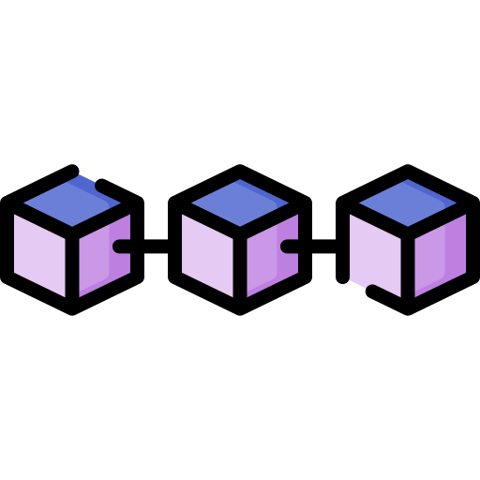

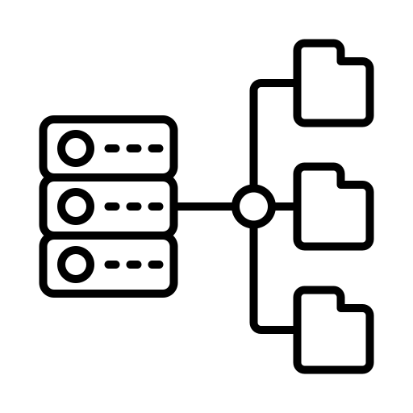



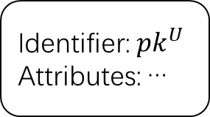

Strawman Protocols
CA
Policy
Encrypt
3
Service Provider
4
Identifier: ${pk}^{U}$
Attributes: …
$$U, {pk}^{U}$$
1
2
Secret Share
5
Blockchain
6
7
User
Reconstruct
Proof
8
Decrypt
Access Controller

Slide 12



Heimdall Protocols
CA
Blockchain
Service Provider
Credential
2
3
− Policy
Credential
Secret Share
− Off-chain data
+ Time Primitive
1
2
+ Garbled Policy
− Proof
+ Off-chain service
Attributes
5
4
7
+ Encoded Attributes
+ Proof
5
6
Reconstruct
User
Access Controller

Slide 13

Heimdall Protocols
Service Provider
CA
Policy
Credential
3
Secret Share
1
2
$$U, {pk}^{U}$$
4
Verify
Proof
5
6
Reconstruct
User
7
Access Controller

Slide 14
Challenges
Policy update: Add, revoke and update policies flexibly in smart contracts.
Service type: most works focus on on-chain service (conducted by smart contracts), only a few works focus on off-chain service (Calypso: off-chain data access control). However, no other service types.
Front running: Adversary may collude with access controllers and learn the information earlier than honest users. (Calypso: barrier point)
Deny of Service: Access controllers may refuse to reconstruct the secret unless they get paid. (Calypso: incentive)
Solutions
Policy update: Sparse Merkle tree/Merkle Mountain Tree to support policy storage and flexible update; Time stamps to guarantee atomicity.
Service type: Adaptor signature to support signature service; Proxy re-encryption to support encryption service; FHE to support computation service.
Front running: PVTSS to guarantee the fair access.
Deny of Service: PVTSS to prevent the DoS.

Slide 15
System Goals
• Data Confidentiality: A system for decentralized access control ensures confidentiality if it is infeasible for an unauthorized adversary to obtain information about dU i from the ciphertext cU i .
• Anonymity: Anonymity requires that no adversary should be able to distinguish which consumer C 2 CA accessed the data item dU i , unless requested by an audit. Accordingly, the data consumer C should remain anonymous during AUTHENTICATE and ACCESS.
• Auditability: A system for decentralized access control supports auditability if any invocation of AUTHENTICATE and ACCESS is publicly observable. In practice, this is achieved by emitting a transaction on the ledger L upon invocation of either AUTHENTICATE or ACCESS, which yields an auditable trace for auditability.
• Policy Confidentiality: A system for provides policy confidentiality, if the policy is only observable by the authorized set of data consumers CA. When an access policy p is stored on-chain in plaintext, the system does not support policy confidentiality [66].
• Fair access: Fairness is essential to prevent attacks that rely on information asymmetry (e.g., frontrunning [68]). Fair access indicates that data consumers simultaneously obtain the secret from access controllers.
• Access Revocation: A system for decentralized access control supports access revocation, if an authorized data consumer may be revoked at any time.

Slide 16
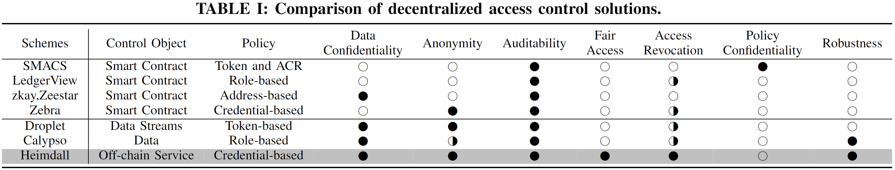
Comparison – Access control for Blockchain
Notes:
Anonymity: Stealth address

Slide 17
Comparison – Access control for Blockchain
 | Decentralization | Revocation | Selective Privacy | Auditable | Expressivity | Expandability | Permissionless
Calypso | √ | × | × | √ | × | × | ×
Droplet | √ | × | × | × | × | × | ×
SMACS | × | × | × | × | √ | √ | √
Zebra | × | √ | √ | √ | × | × | √
LedgerView | × | √ | × | × | √ | √ | ×
Our work | √ | √ | √ | √ | √ | √ | √

