Slide 1
Secure Inference for GPT
夏里宾
2024年7月5日

Slide 2
01
GPT隐私推断概述

Slide 3
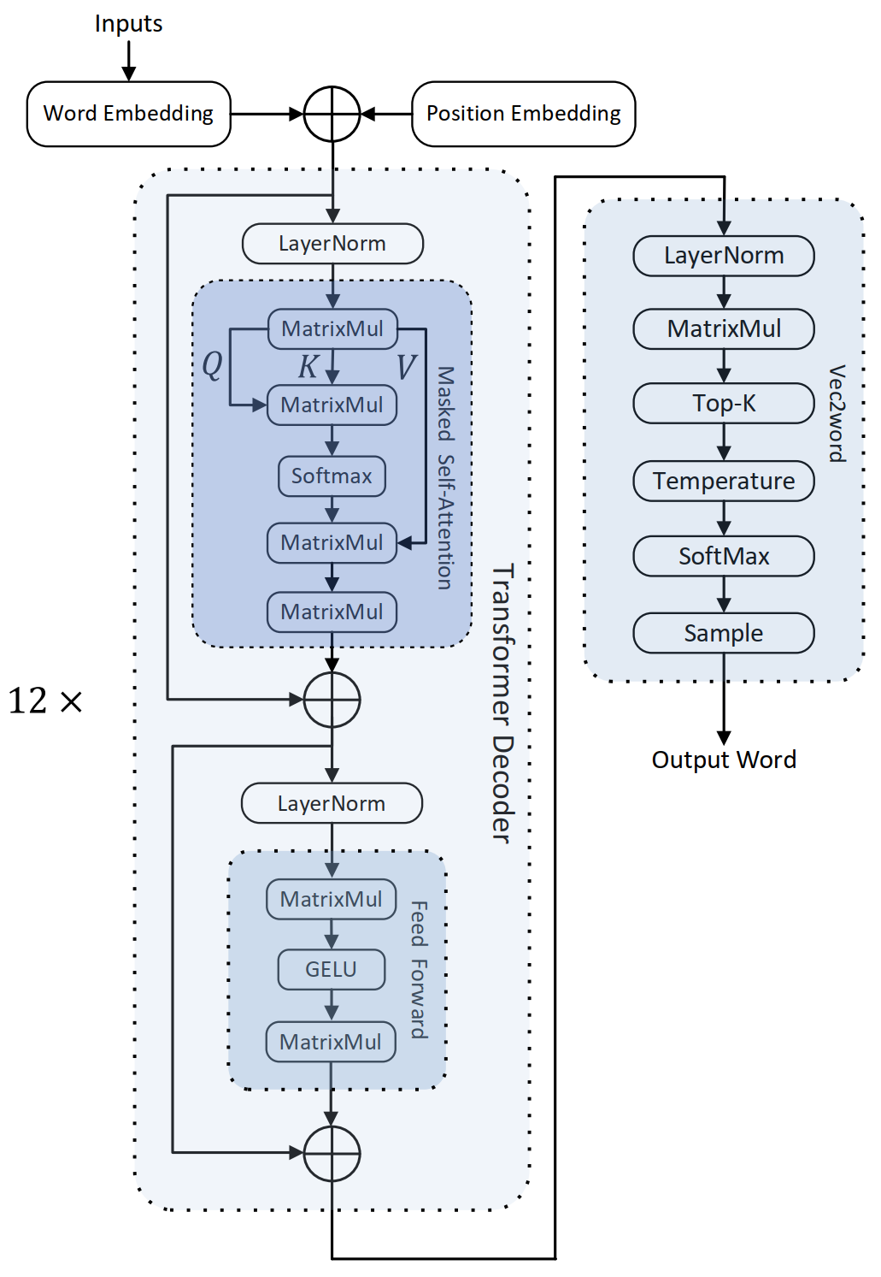
ChatGPT + 隐私计算
两方隐私推断：客户端不泄露输入的prompt，服务端不泄露模型参数，但是双方能共同计算出GPT生成的结果。
具体实现则是将GPT中的所有计算模块都用隐私计算的算法替代，其中最主要的几个计算模块：
MatrixMul（线性运算）：线性的矩阵乘法，一般使用全同态加密（BFV）实现。可以使用VOLE或者SIMD技术进行并行运算。
GELU，SoftMax，LayerNorm（非线性运算）：复杂的非线性激活函数，分类函数，归一化函数，一般使用高阶多项式或者分段线性函数拟合，再使用秘密分享等安全多方计算的算法实现。
Top-K：隐私的洗牌算法，加隐私的快排算法。
Sample：隐私的采样算法。
图11：GPT系统架构
Notes:
刚刚提到的密态计算技术不仅能用于联盟链，还能用于ChatGPT的隐私推断，即客户端不泄露输入数据，服务端不泄露模型信息，但双方能共同计算出推断结果。
具体实现是利用全同态加密和并行运算技术进行矩阵的密态计算，利用秘密分享和多项式拟合技术进行非线性函数的密态计算。

Slide 4
ChatGPT + 隐私计算
现有方案的缺陷
推断速度太慢：在单线程CPU的基准测试框架下，安全的GPT-2模型生成一个字符所需的时间是20分钟。通过硬件上的并行，和增加网络带宽的方式提高响应速度。例如通过GPU加速和预计算处理，单个字符的生成时间被缩短到2秒以内。在不需要实时响应且数据安全非常重要的场景下，如医疗问诊和财务规划，安全GPT还是有应用前景的。
只支持半诚实模型：现有的方案大多假设用户会遵守计算协议，只是希望知道模型数据。但现有研究表明，恶意用户可以通过模型提取攻击得到服务端的整个模型数据。
解决方案
使用混淆电路：使用算数混淆电路替代秘密分享进行非线性运算，并将线上计算的步骤转移到预计算阶段。
使用malicious security密码学原语：例如使用消息验证码来确保秘密分享过程的正确性，或者使用零知识证明来保证同态加密过程的正确性。可以进一步利用批处理的方式提升证明验证的效率。
Notes:
现有方案主要面临两个缺陷，一是计算速度慢，通信开销大；二是不支持恶意用户的威胁模型。
对于第一个缺陷，可以使用混淆电路，并将线上计算的开销转移到预计算阶段。
对于第二个缺陷，可以使用消息验证码和零知识证明保证输入数据的正确性。
ChatGPT安全是目前很火的方向，不论是申请项目还是发论文都相对更容易。

Slide 5
02
Bicoptor

Slide 6
Motivation
Heavy overhead of non linear function computation
ReLU function
3 + log2l communication rounds and 45l bits of bandwidth [ABY3]
A2B-CMP-B2A, Randommasking-CMP, and MSB-decomposition-CMP: O(log l) communication rounds.
GC-based-CMP: constant communication rounds but highest bandwidth cost.
Maxpool function
Repeated comparison
Binary search

Slide 7
Related Work
Preprocessing phase
Input independent phase + online phase
Secure comparison methods
A2B-CMP-B2A: O(log l) rounds and O(1) or O(l) bits
GC-based-CMP
Yao’s Garbled Circuit
EMP takes 18κl − 6κ = 61440 bits
Random-masking-CMP: O(log l) rounds and O(1) or O(l) bits
MSB-decomposition-CMP: 5 + logl rounds and 80l bits
Find maximum element
Repeated comparison: O(n) rounds
Binary search: O(log n) rounds

Slide 8
Contribution
Propose a novel and more efficient sign determination protocol
Use truncation protocol of [SecureML]
Show how to use it with error
Show the maximum numbers of truncations required
Extend the DReLU protocol to other non-linear functions in PPML
carefully merging the multiplication operation(s) into the DReLU operation
Implement and evaluate under LAN settings
Low overhead
GPU friendly

Slide 9


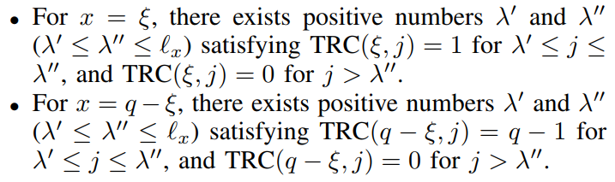
DReLU Protocol - repeated truncations
Truncation protocol
Lemma 1. For positive input error is +1 for negative input error is -1.
Lemma 2. If x = ξ and r’ < ξ’ there is +1 error, if x = q−ξ and r’ + ξ’ ≥ 2^k there is -1 error.
Lemma 3. If TRC(x, λ − 1) or TRC(x, λ) is 1 input is positive, if it’s q-1 input is negative.
Lemma 4. TRC(x, λ − 1) and TRC(x, λ) is included in the result array {TRC(x, 1); · · · ; TRC(x, λ − 1); TRC(x, λ); · · · ; TRC(x, l_x)}.
Theorem 1.

Slide 10
DReLU Protocol
Mask and shuffle the shares of the array
Compute the share of TRC(x, i)−1
Multiply a random element
Shuffle the array
Privacy issues
Leak the sign of DReLU result to P2
Leak the range of x due to the possibility of continuous zero
Omit the corner case: x = 0 or x = 1
Improvement
Mask the output of DReLU result with random negation
Send the summation of subarrays
Append [x] itself to the beginning of the array as u0
Define u∗ := (−1)^t and v∗ := u∗ + 3 · u0 − 1

Slide 11


Protocols for Other Non-linear Functions
Equality(x，y) = 1 − DReLU(x − y) ⊕ DReLU(y − x)
ABS(x) = (2 · DReLU(x) − 1) · x
ReLU
Optimize the communication rounds to two
Dynamic ReLU, MAX2, MIN2 and Funnel ReLU can derive from ReLU Algorithm
Piecewise Linear Unit (PLU)
Binary-tree-based Maxpool invoke the MAX2 for O(n) time
2-round Maxpool use the unblind CMP and matrix to compute the result
MIN, SORT, and MED Protocols can be derived from MAX protocol

Slide 12
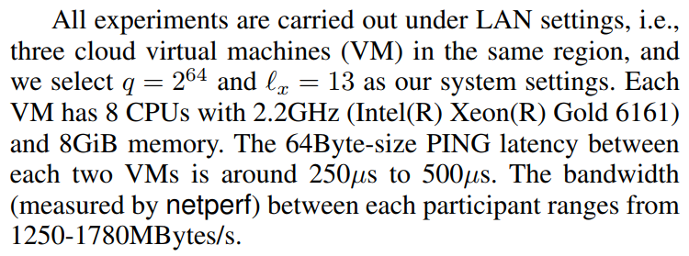
Evaluation and Experiments
Evaluation
We calculate the theoretical communication overhead
Experiments
Setting
Test the performance of ReLU, DReLU, Maxpool and so on.

Slide 13
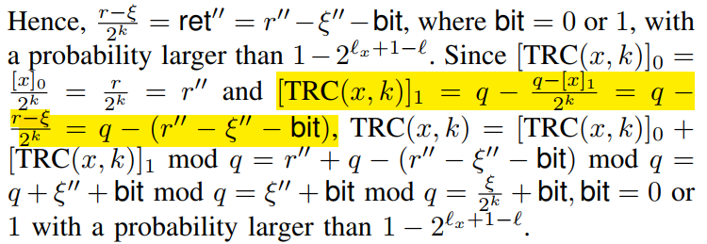
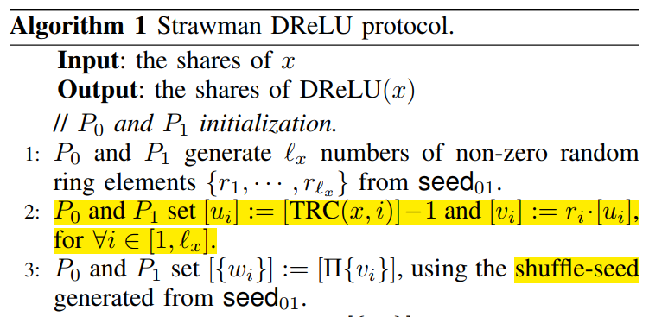
问题
关于Lemma 1的证明，在Appendix C 第17页中，为什么黄框的公式成立？
已知 x = ξ, r > ξ, [x]_1 = x – r, 那么 q – (q – [x]_1)/2^k = q – (q + r - ξ)/2^k，但是黄框中的公式少了一个q。
关于结果会出现连续的0的可能性
考虑到P0和P1会将TRC后的结果打乱，那么出现连续零的可能性很小，而且也无法判断x的范围。

Slide 14
可能的改进方向
本文由于不知道具体的λ，需要计算复杂度为O(l_x)的截断数组。或许可以考虑牺牲一定的安全性计算更少的截断数组，来提升效率。
在实际的机器学习模型中，ReLU函数的计算应该是串行的，所以难以进行批处理的设计。可以考虑设计一个与输入无关的预计算协议，以便进行并行计算。
在协议中引入零知识证明技术，设计并实现能防范恶意行为的安全模型，确保参与方即使在恶意情况下也不能泄露隐私数据。

Slide 15
02
Bicoptor2.0

Slide 16
Motivation
Probabilistic truncation protocols.
non-interactive/less-interactive property.
1-bit error issue, which is referred to as e0.
Another error, e1, which can directly cause truncation failure.
Deterministic truncation protocols.
Require interaction and the communication overhead is heavy.
1-bit error issue, which is referred to as e0.
The efficiency issue of PPML

Slide 17
Contribution
Analysis of probabilistic truncation protocol.
Insights into e1 elimination.
Provide a solution of truncate-then-multiply instead of multiply-then-truncate.
Proposing a new non-interactive deterministic truncation protocol.
Choose smaller rings to reduce communication costs.
Non-interactive modulo-switch protocol.
Use key bits optimization to achieve high performance.
E2E PPML inference implementation and evaluation on GPU.

Slide 18
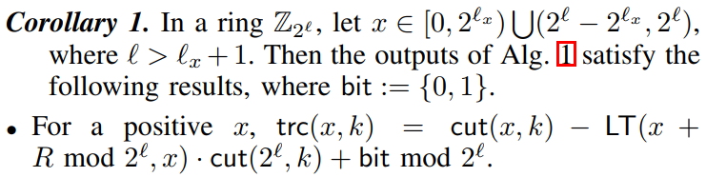

In-depth Analysis of e1 in Probabilistic Truncation Protocols
所谓的e1就产生于随机数的选择上，当环足够大时，即l >> lx，那么这一错误出现的概率可以忽略不计。

Slide 19
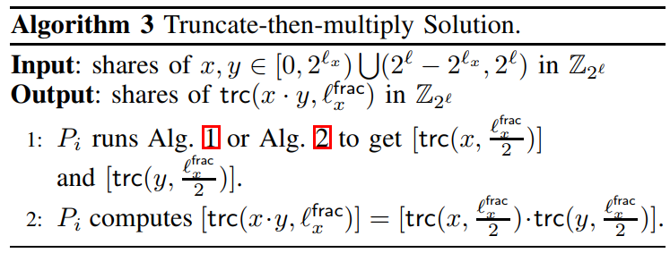
Impact of e1 on Accuracy in PPML and Proposed Solutions
The Implementation Bug Related to e1 in Existing Works
Existing works using fixed number R to avoid e1.
The parameters chosen are inappropriate which may lead to e1 in high probability.
Solution to Address the Implementation Bug

Slide 20
Impact of e1 on Efficiency in PPML and Proposed Solutions
Non-interactive Deterministic Truncation Protocol.
To eliminate the e1, we can module the cut function by 2^(l-k).
To generalize the truncation protocol, we design the function that can cut the first few bits and last few bits.
The Principle of Sign Determination
Replace the truncation function from trc to trc’.
Modulo-switch Protocol
To prevent the parity leak.
Non-zero output remain non-zero.
DReLU Protocol
The length of truncation number reduce from l to lx.
Remove u∗ as it will not effect the E2E PPML inference.
Replace the summation with adjacent pairwise addition.

Slide 21
Performance Evaluation
Ultimate Performance: Key Bits.
This trade-off is highly efficient with low accuracy lost.
Only applied in the DReLU protocol.
Bicoptor 2.0 DReLU/ReLU Unit Experiments
Evaluate the performance of DReLU and ReLU protocols with different batch sizes in various network environments.
E2E PPML Inference Experiments
The gap between the PPML inference and plaintext inference is only a factor of 20.
the cost of ReLU layer accounts for around 80% of the total inference cost.

Slide 22
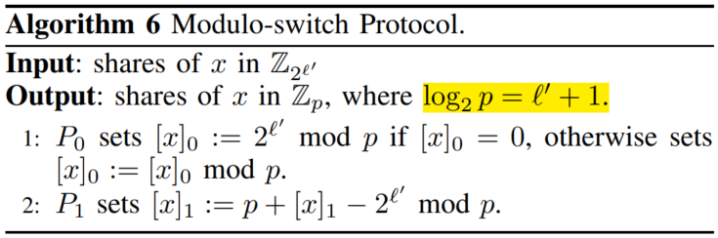
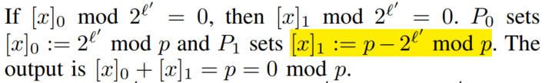
问题
Module switch
前面提到p是素数，但是右图中log2p = l’ + 1，并不是素数。
右图中[x]1 mod 2^l’ = 0，并不意味着[x]1 mod p = 0

Slide 23
03
SecretFlow-SPU

Slide 24
Motivation
Developing efficient PPML programs with MPC techniques is a great challenge for users without cryptography backgrounds.
EzPc, ABY, MP-SPDZ design domain-specific languages for MPC compilers, but not for ML compiler.
Existing solutions require users to manually rewrite the entire program.
TF Encrypted and CrypTen provide general ML interfaces with MPC implementations.
These frameworks rely on TensorFlow or PyTorch as their underlying runtime.

Slide 25
Contribution
SPU includes a frontend compiler and a backend MPC runtime.
The frontend compiler converts the ML program to intermediate representation (IR).
The compiler backend will further transform IR into hardware-dependent machine code.
Designing an MPC-specific IR, i.e., PPHLO and implementing MPC-specific optimizations at both frontend and backend.
Design and implement several compiler passes to generate more efficient IR.
Implement strategies such as vectorization and streaming to reduce MPC communication overhead.
Employ inter- and intra-operation concurrency to execute PPHLO efficiently.

Slide 26
04
EzPC - Orca: FSS-based Secure Training and Inference with GPUs

Slide 27
Related work and Motivation
PIRANHA makes several MPC-friendly approximations to ML.
Replacing maxpools with average pools
Truncating shares locally (unsecure stochastic truncations)
Approximating exponentiations with piecewise-linear functions
Falcon also trade-offs security for efficiency.
Reveals intermediate values during softmax computation
Motivation
The approximations lead to a significant loss in model accuracy.
PIRANHA approximations fail on small models.
Most prior works use local truncations that are cheap but insecure.
The training and inference of previous works are slow.

Slide 28
Contribution
Accelerating FSS-based 2PC with GPUs.
Function secret sharing (FSS) reduces online communication while increasing compute (large number of AES evaluations) and storage (reads huge FSS keys).
System optimizations based on GPU micro-architecture.
Using GPU’s scratchpad memory for faster AES computation
Optimize data layout to improve GPU cache hit rates
Utilize GPU’s lockstep execution by groups of threads to optimally pack intermediate results
Cryptographic improvements.
Provide the first secure protocol for stochastic truncations
Create new cryptographic protocols to reduce FSS key size
Compute exponentiations with precise floating-point algorithm

Slide 29
Accelerating FSS on a GPU
Faster AES computation (follows previous work)
Evaluating a DCF over x ∈ UN requires 2n invocations of AES
Replicas of the lookup table are placed in different banks of the scratchpad
Optimized data layout for cache locality
Layout of correction words in the memory impacts performance
CPU layout : laying out n correction words for a DCF computation contiguously in the memory
GPU layout : placing the correction words for a given round of PRG across all threads in a warp contiguously
Optimizing memory footprint
Using DCFs with smaller payloads, e.g., 1-bit instead of 64-bit
32 threads of a warp write their 1-bit DCF output into a 32-bits integer in a lockstep fashion.

Slide 30
Reducing time to read FSS keys
Bypassing OS page cache.
Since an FSS key is used only once, there is no reuse.
Overlapping key read with computation.
we overlap the computation of the ith training iteration with the reading of the key for the (i + 1)th iteration.
New cryptographic technique to limit key size
construct new FSS protocols to reduce keysize in popular non-linearities like ReLU and maxpool

Slide 31
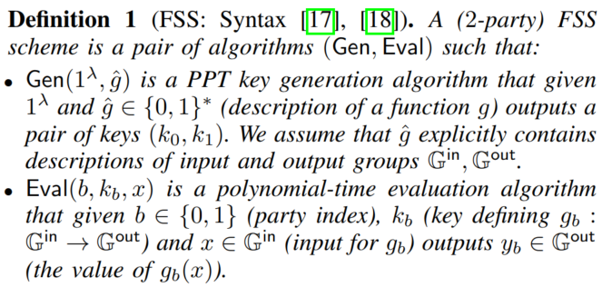



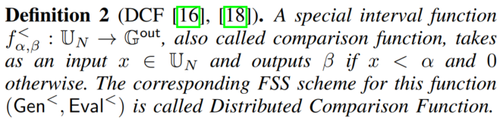
Function Secret Sharing and DCFs
Offline Phase. (trusted dealer)
Generate random mask r_i.
generate FSS keys
for the offset function,
Online Phase.
Calculate masked value
Use Eval to obtain the share of masked output
Subtract the mask to obtain the clear output

Slide 32



Function Secret Sharing
First, for every wire j in C, the dealer picks a random mask rj from the corresponding group.
The online phase evaluates the circuit gate-by-gate in a topological order.
Invariant: for every wire value wj in C, both parties learn the masked value wj + rj.
$$ε 𝔾^{in}$$
g
$$ε 𝔾^{out}$$

Slide 33
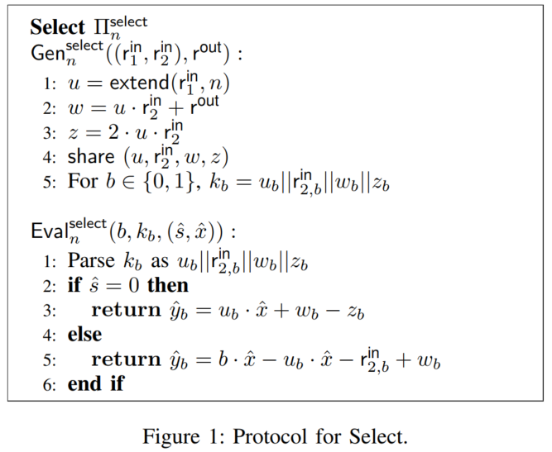
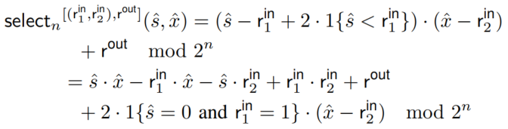
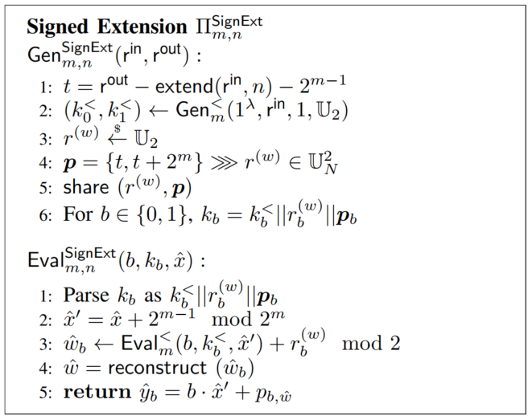
Protocols for Basic Building Blocks
Select function.
Signed Extension.
Provide a protocol with a smaller key size at the cost of an additional round and 2 bits of online communication.

Slide 34
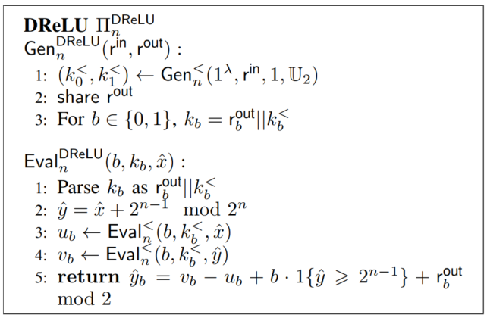



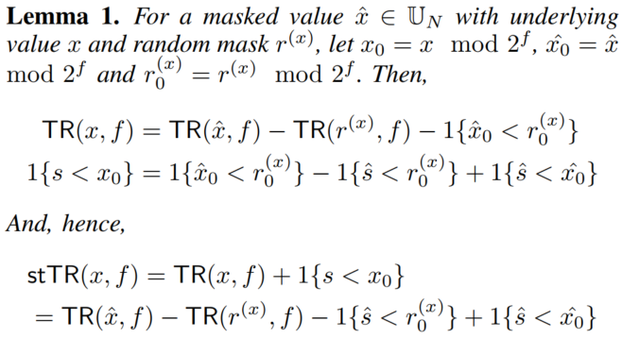


Protocols for Secure Training
ReLU.
Stochastic Truncate-Reduce.
Stochastic Truncation.

Slide 35
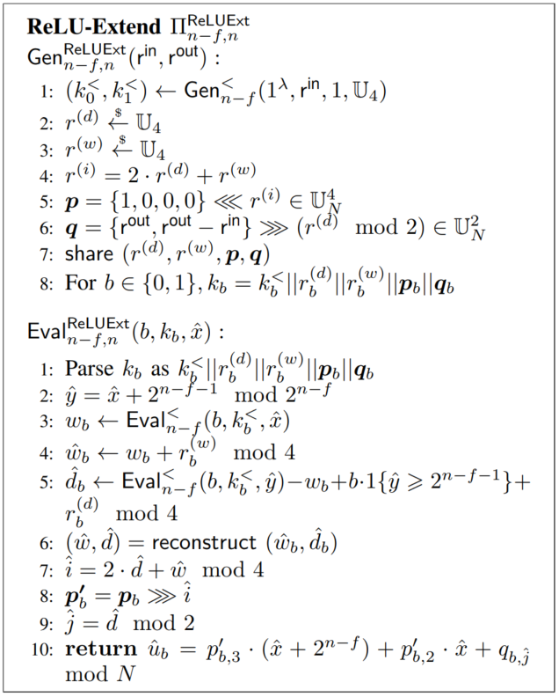



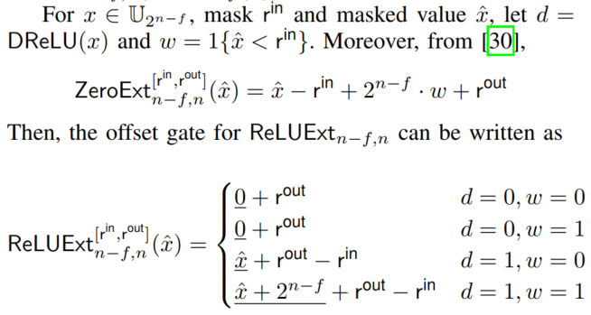
Protocols for Secure Training
Stochastic Truncation + Activations.
We can switch the order of ReLU and extension.
Since ReLU output is always non-negative, we can use zero extension.

Slide 36
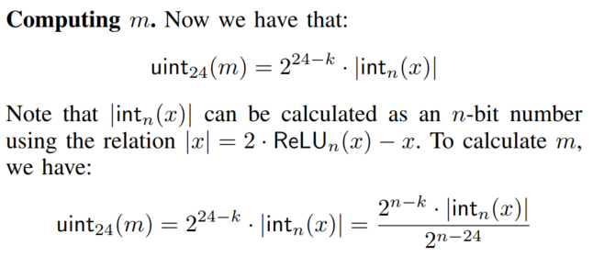
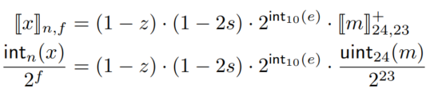

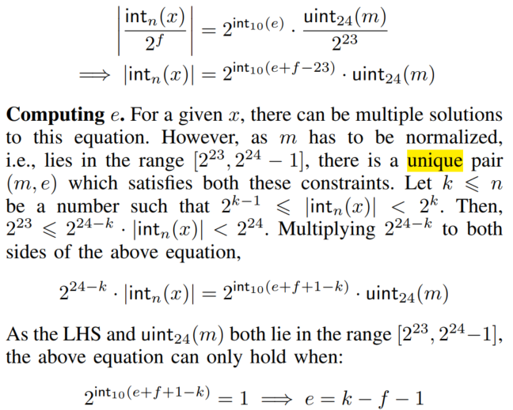

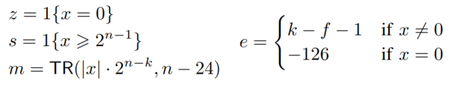

Protocols for Softmax
FixToFloat/FloatToFix.
Computing e.

Slide 37
Implementation
Implement ORCA as a C++ library.
Contains optimized GPU kernels for the FSS gates.
Matrix multiplication, Convolutions, DCF, DReLU, Select, Bitwise AND
Some parts of the framework run on the CPU.
Use SECFLOAT to compute softmax in floating point
FixToFloat and FloatToFix
Optimized implementation of the software stack.
Leverage CUDA memory pools, to reserve GPU memory for fast allocation/de-allocation of keys.
Pre-allocate host-side communication buffers on the CPU.
Use multiple CPU threads to overlap the CPU tasks of reading keys from the SSD to the CPU DRAM.

Slide 38
Evaluation - overview
ORCA beats the accuracy of PIRANHA generated models in 4 − 26× less time and with 43−98× less communication.
On identical training and inference tasks, ORCA outperforms PIRANHA by up to 10× in latency and up to 14× in communication.
ORCA’s GPU-based protocols are up to 19× more efficient than their CPU counterparts.
The size of FSS keys required by ORCA’s protocols is up to 3× lower than LLAMA.

Slide 39
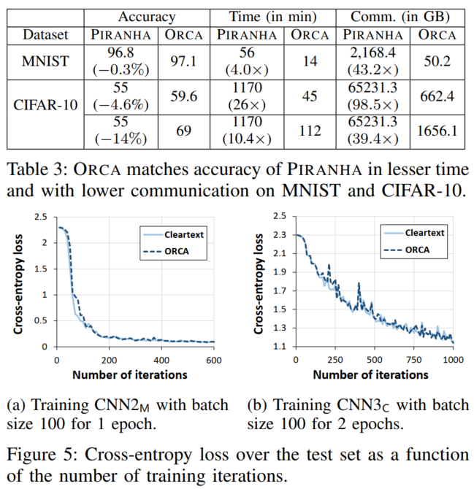
End-to-end training with ORCA
On the MNIST dataset, Table 3 shows that ORCA matches this accuracy with 4× less time and 43× less communication.
On the CIFAR dataset, which is a harder classification problem than MNIST, the improvements are even more pronounced.
There are no accuracy gaps between (PyTorch) cleartext training and secure training

Slide 40
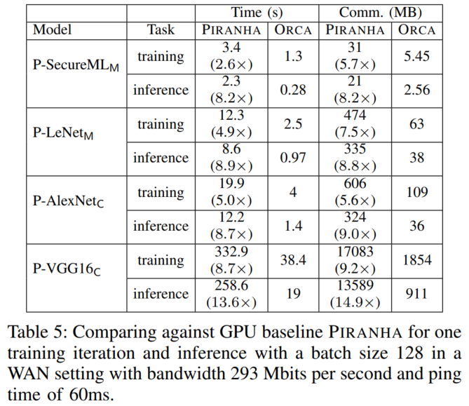
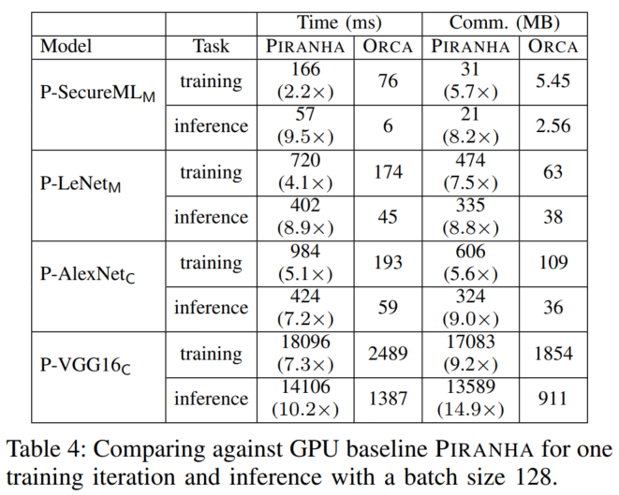
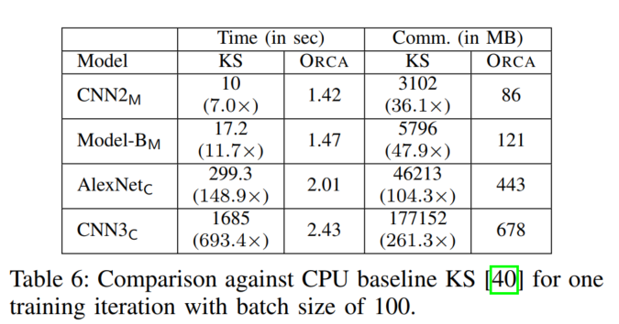
Comparison with baselines
PIRANHA use average pools, linear approximations for softmax, and local truncations.
KS use stochastic truncations, maxpools and floating-point softmax.

Slide 41
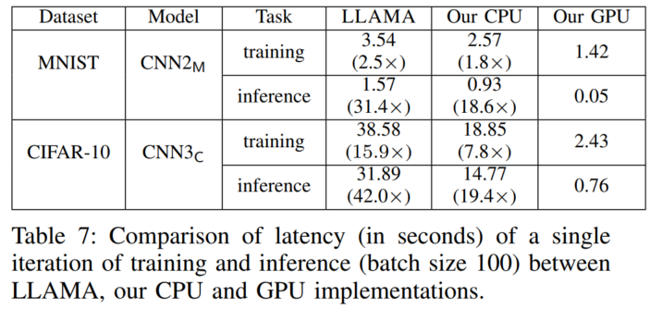
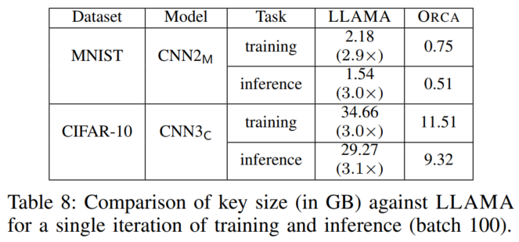
Improvements breakup
Investigate the individual contributions of protocols and GPUs to the overall speedups in runtime over LLAMA.
Provide roughly 3× reduction in key size over LLAMA (see Table 8) and lower number of AES calls.

Slide 42
改进方案
FSS的offline阶段需要用到trusted dealer，引入了额外的信任假设，或许可以用MPC的方案来替代trusted dealer。
文章主要针对非线性函数进行优化，针对矩阵的运算只是使用beaver triple，或许可以采用其他更高效的并行算法。
文章主要针对单GPU做优化，或许可以扩展协议以支持多GPU并行计算。
虽然文章说到FSS的communication overhead比较小，但是DCF的keysize=O(λn)，因此如果算上预处理的话，开销相比bicoptor还是偏大的。

Slide 43
05
Sigma: Secure GPT Inference with Function Secret Sharing

Slide 44
Contribution
ORCA beats the accuracy of PIRANHA generated models in 4 − 26× less time and with 43−98× less communication.
On identical training and inference tasks, ORCA outperforms PIRANHA by up to 10× in latency and up to 14× in communication.
ORCA’s GPU-based protocols are up to 19× more efficient than their CPU counterparts.
The size of FSS keys required by ORCA’s protocols is up to 3× lower than LLAMA.

