Slide 1
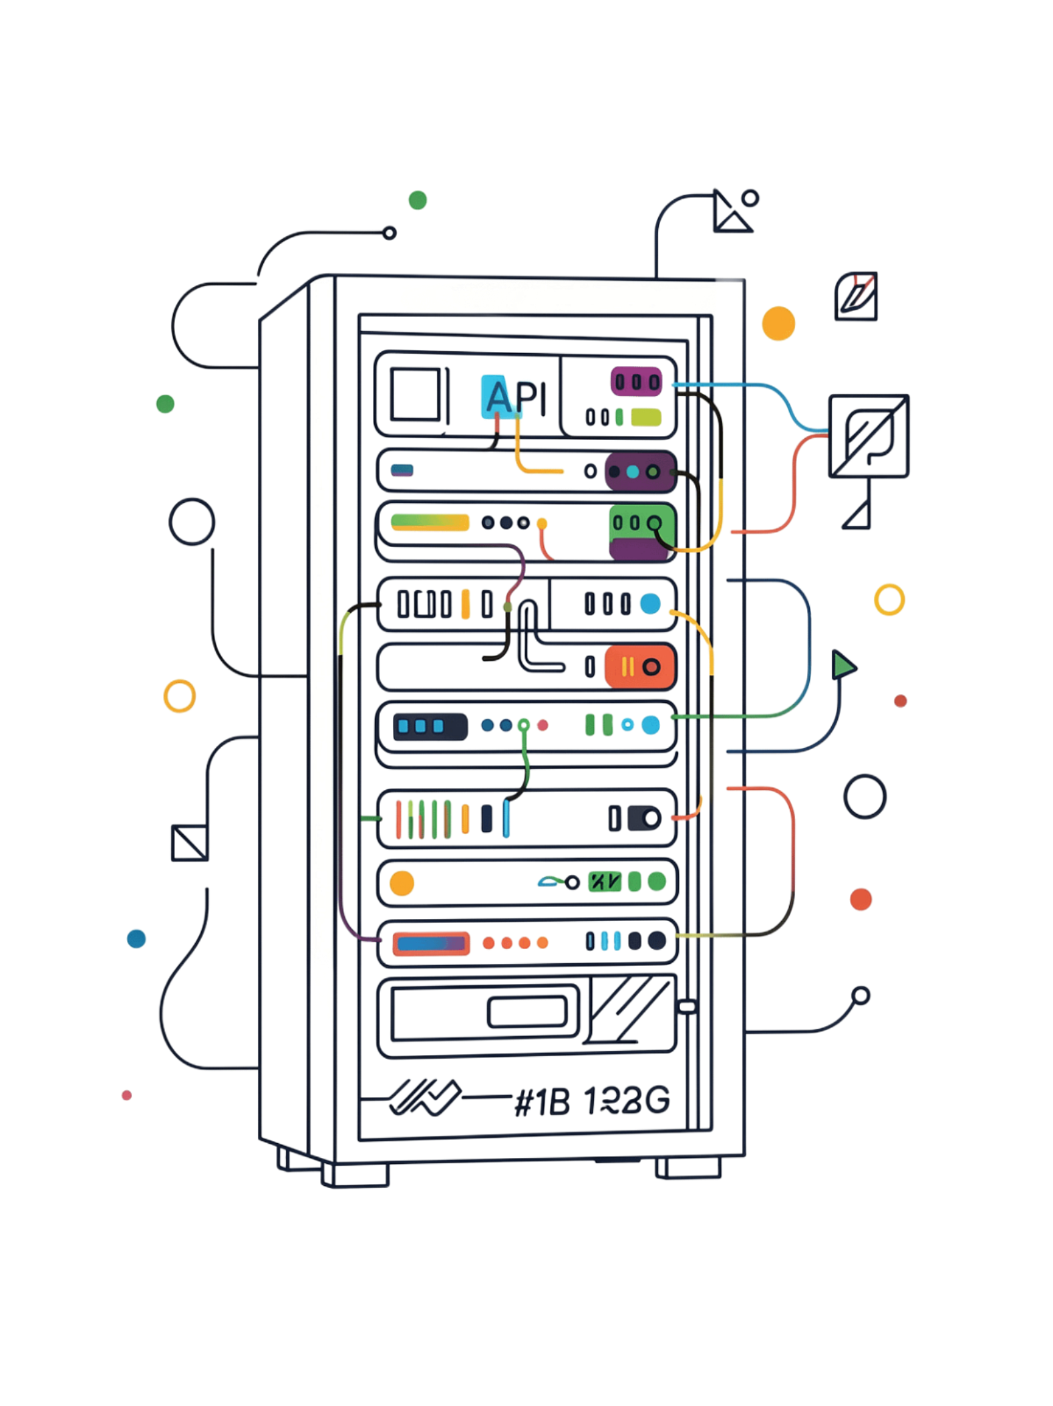
Spring Boot E-Commerce Platform API
A robust Spring Boot REST API for managing e-commerce core workflows. It features full domain models for product inventory, customer checkout flows, digital wallet balance updates, and targeted promotional discount systems.

Slide 2
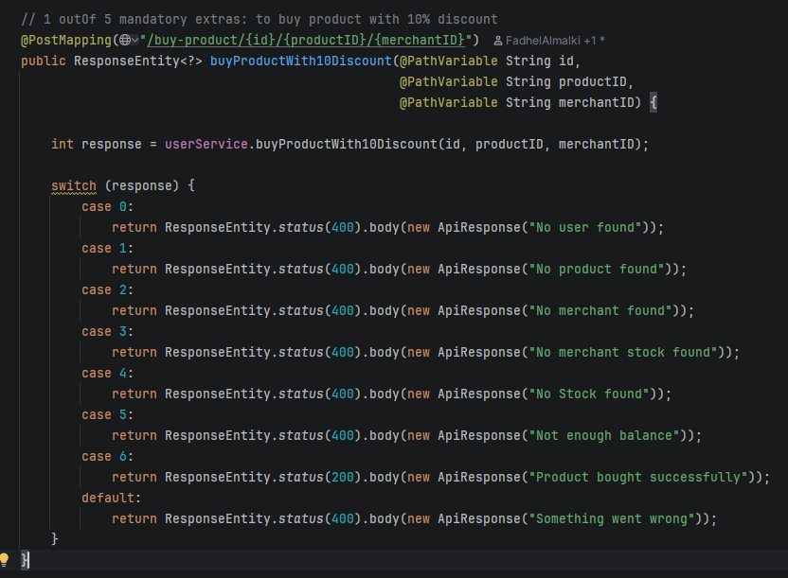
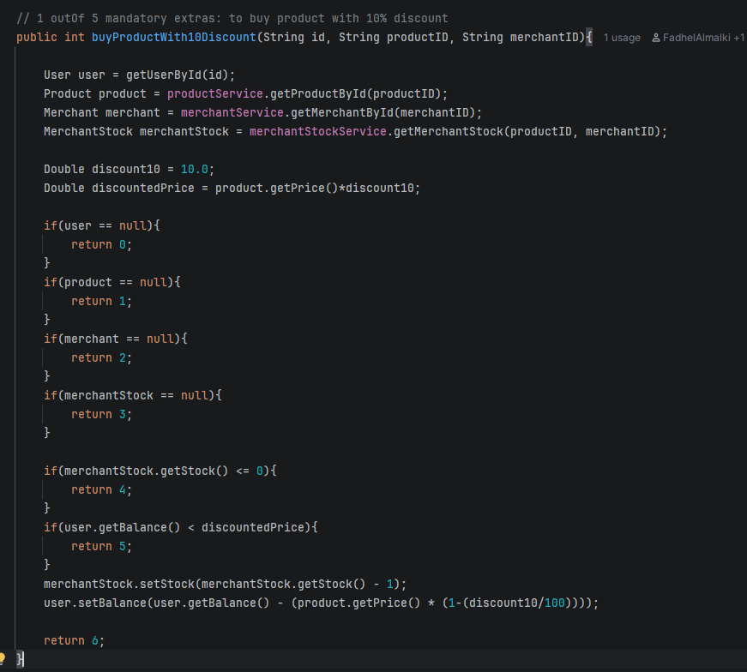
(1/5) @PostMapping("/buy-product/{id}/{productID}/{merchantID}")

Slide 3
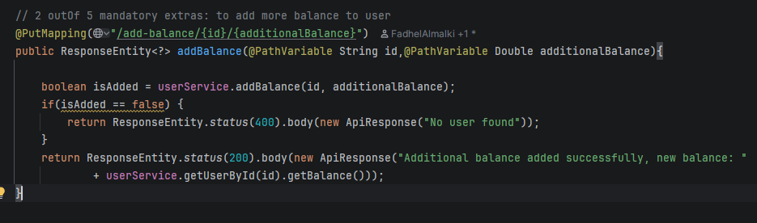
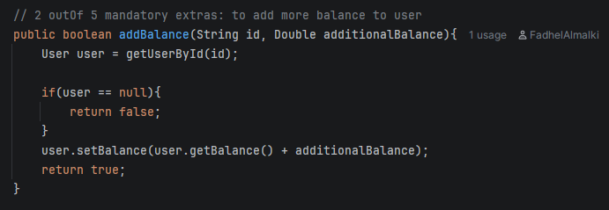
(2/5) @PutMapping("/add-balance/{id}/{additionalBalance}")

Slide 4
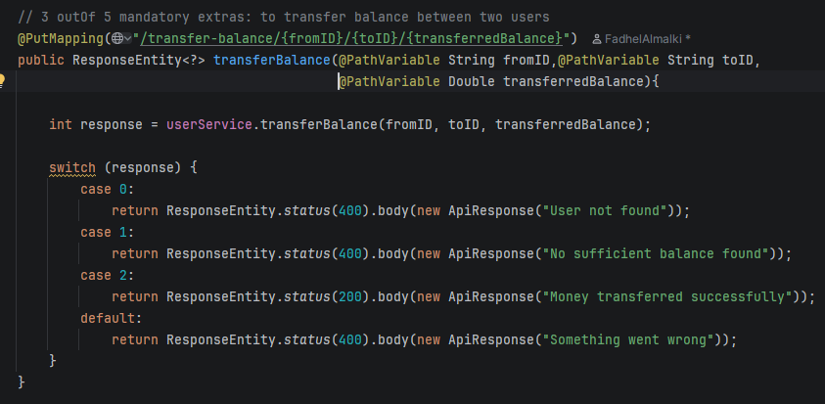
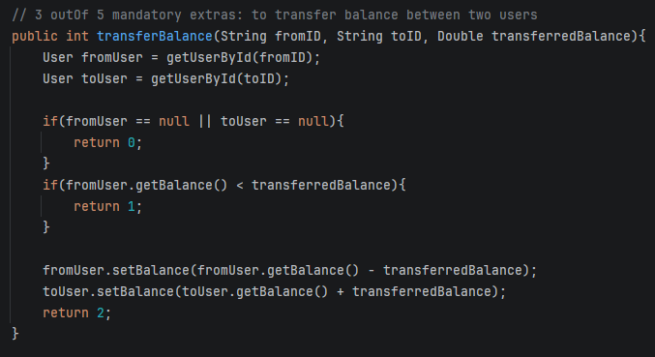
(3/5) @PutMapping("/transfer-balance/{fromID}/{toID}/{transferredBalance}")

Slide 5
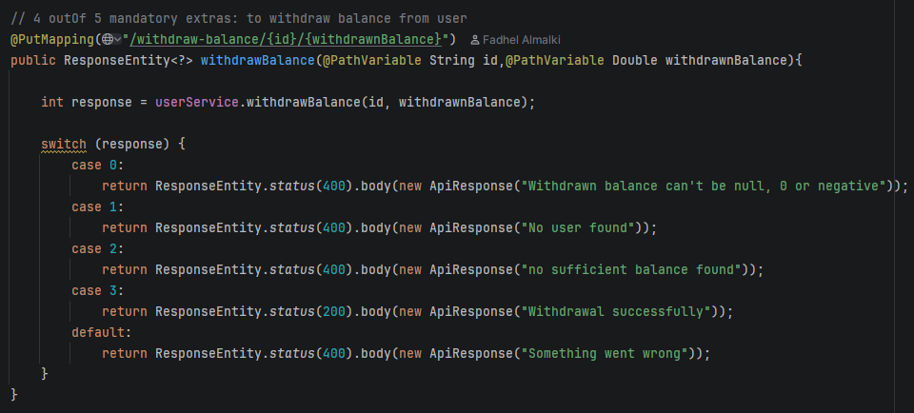
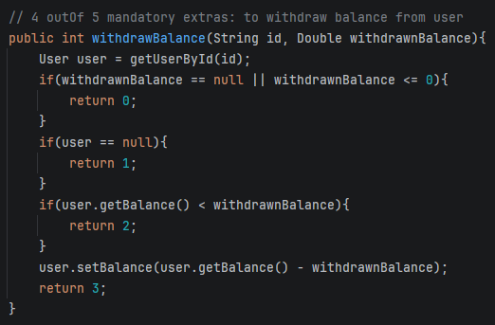
(4/5) @PutMapping("/withdraw-balance/{id}/{withdrawnBalance}")

Slide 6
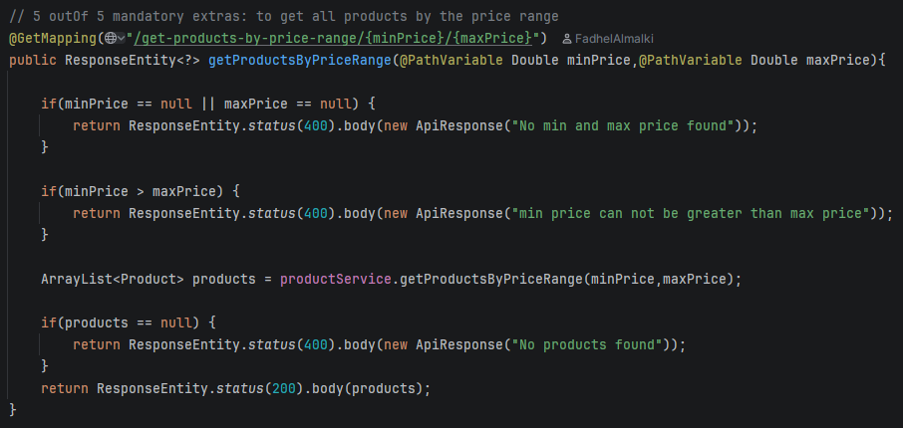
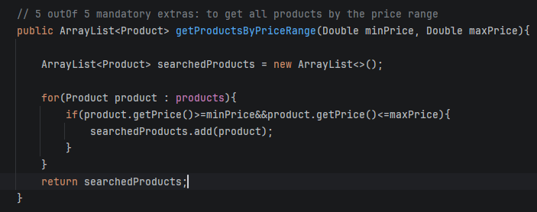
(5/5) @GetMapping("/get-products-by-price-range/{minPrice}/{maxPrice}")

Slide 7
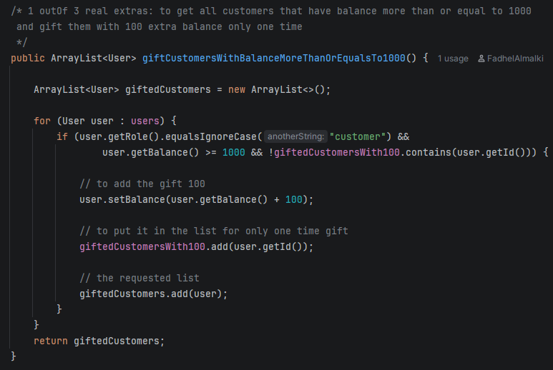
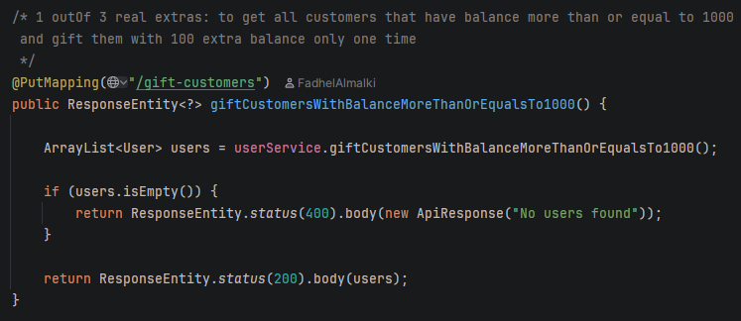
(1/3) @PutMapping("/gift-customers")

Slide 8
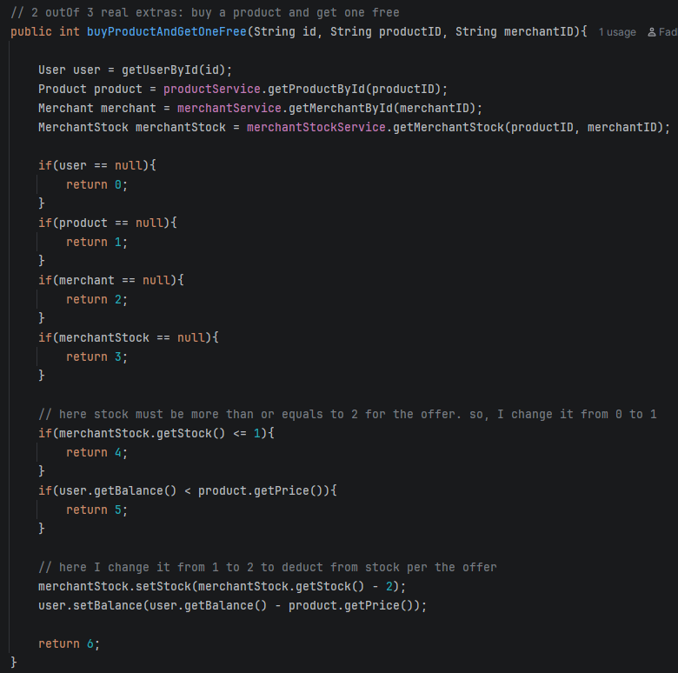
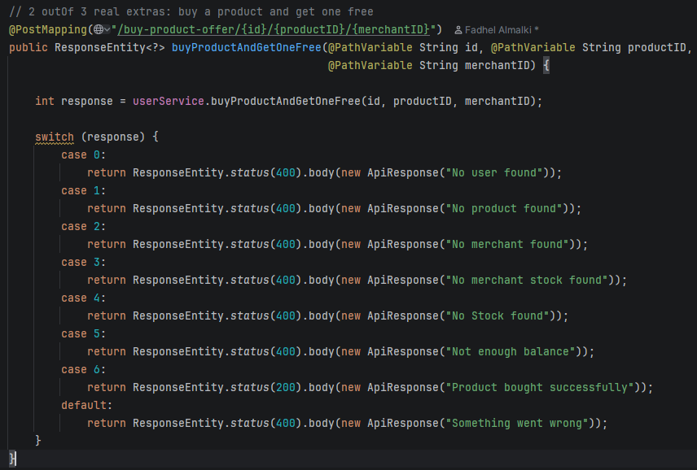
(2/3) @PostMapping("/buy-product-offer/{id}/{productID}/{merchantID}")

Slide 9
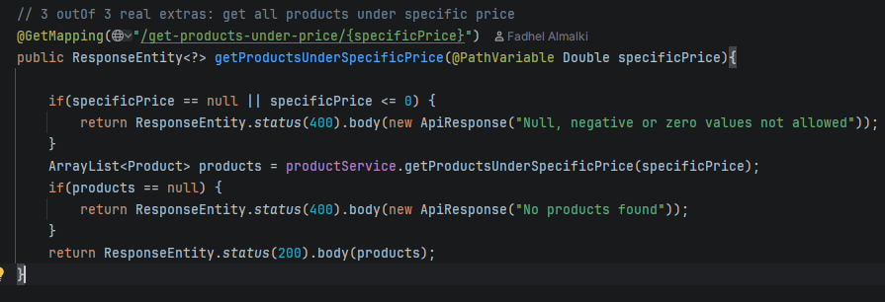
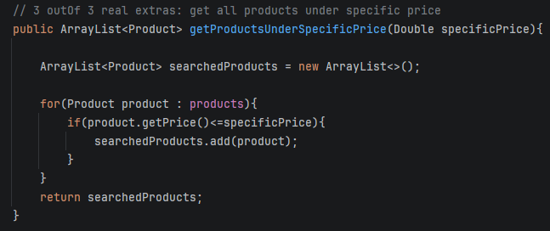
(3/3) @GetMapping("/get-products-under-price/{specificPrice}")

