Slide 1
SAMSUNG INNOVATION CAMPUS
Technical Assignment
Kelompok 58
MAN 2 Kota padang

Slide 2
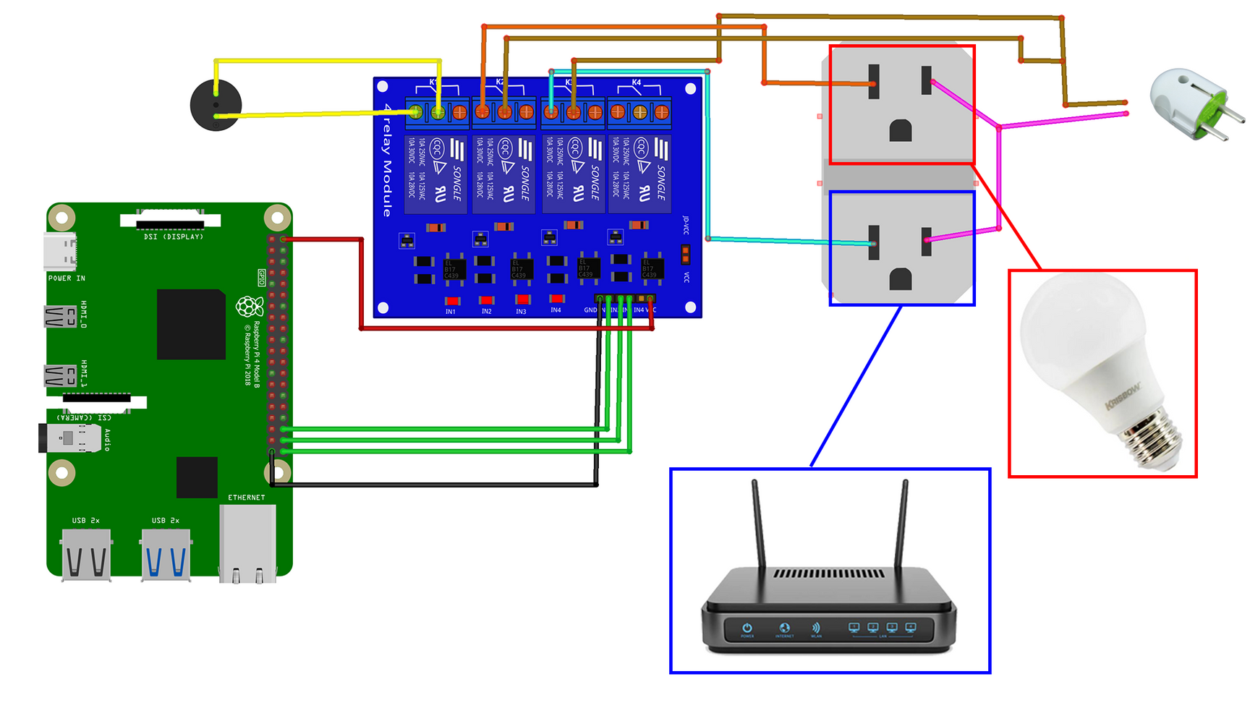
Electronic Schematic

Slide 3


Hardware Design

Slide 4
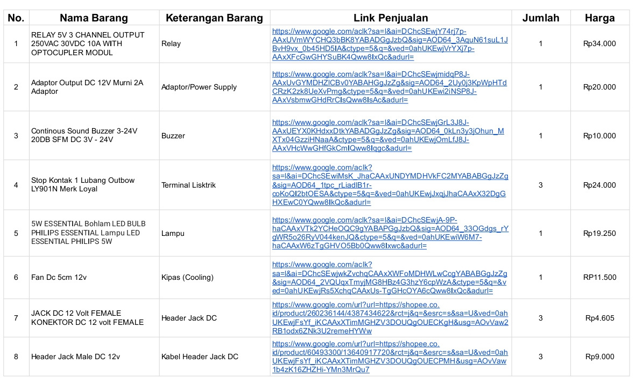
Bills Of Material (BOM)

Slide 5
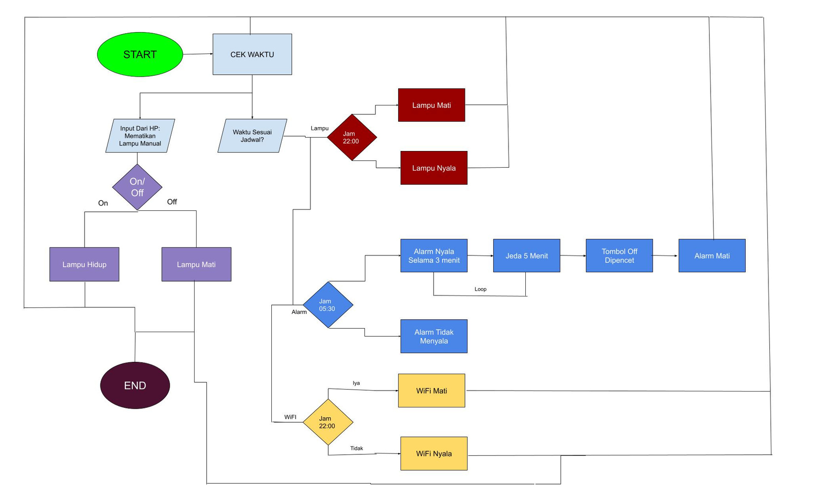
Proces Flow

