Slide 1
Hybrid Machine Learning System for Multi-Threat Probabilistic Forecasting and Budget-Constrained Intervention Recommendation in Nigerian National Parks
ConserveAI
Student: Fadhlullah Olusola Abdulazeez
Supervisor: Mr. Emmanuel Adjei
Department: Software Engineering
University: African Leadership University
Presentation Date: [ add date ]
AFRICAN LEADERSHIP UNIVERSITY

Slide 2
Problem Context
Background
Problem Statement
• Nigeria has 30+ protected areas covering 99,292 km2, under rising fire, drought and vegetation pressure from climate change.
• Conservation has been reactive: patrols and post-incident reporting, with thin, inconsistent coverage.
• Managers cannot anticipate threats or plan interventions within tight budgets - damage is addressed only after it occurs.
• Supervised ML needs labelled data these parks do not maintain (<300 species records per park).
Stakeholders
Evidence of Need
• Park managers & rangers - primary users; they absorb the cost of a wrong forecast.
• National park administration - the authority to act stays with them.
• Communities around parks - affected, deliberately not represented in the data (privacy).
• African protected areas lost ~59% of large mammals (1970-2005).
• Only 1.71% of Nigeria's protected land has ever been evaluated for management effectiveness.
• SMART is retrospective; PAWS needs incident histories and covers poaching only.
ConserveAI | Mission Capstone Defense | African Leadership University
2

Slide 3
Project Objectives and Scope
Main Goal
Develop a live system that produces daily 30-day probabilistic forecasts for fire, drought and vegetation degradation across six Nigerian national parks, and recommends budget-constrained, zone-level interventions - using only free environmental data.
Specific Objectives
Scope
• Assemble a daily multi-source dataset (2020-2025) and construct three binary 30-day threat labels per park-date.
• Build the solution: pipeline; RF / XGBoost / LSTM / Transformer (supervised + semi-supervised); ILP recommender; React + FastAPI app; daily cron; deployed to free-tier cloud.
• Evaluate with imbalance-aware metrics: F2, ROC-AUC, Brier, lead time, a persistence baseline, and per-park bootstrap CIs.
• Included: 6 parks, 3 threats, 30-day horizon, zone-level recommendation, free public APIs only.
• Excluded: poaching and grazing (not remotely observable), field testing with park staff, national-level budget allocation.
ConserveAI | Mission Capstone Defense | African Leadership University
3

Slide 4
Literature Review & Gap Identification
~90 peer-reviewed papers (2016-2026) reviewed thematically; the two closest systems compared below.
System | Approach | Threats | Predictive? | Budget optimisation
SMART | Ranger patrol logging | Whatever rangers observe | No (retrospective) | No
PAWS | Game-theoretic patrols | Poaching only | Yes (needs incident history) | Patrol routing, not budget
ConserveAI | ML forecast + ILP | Fire, drought, vegetation | Yes (30-day forecast) | Yes (budget-constrained, zone-level)
Identified Gap
• Semi-supervised multi-threat probabilistic forecasting is under-applied in African, data-scarce conservation.
• ILP-based budget allocation has not been integrated with such forecasts in the published literature.
• No existing system serves Nigerian park managers with predictive, transparent, budget-aware decision support.
ConserveAI | Mission Capstone Defense | African Leadership University
4

Slide 5
System Requirements
Functional Requirements
Non-Functional
• Role-based login (admin / park manager), park-scoped access control.
• National risk overview - Nigeria map, per-park risk, threat lens.
• Per-park 30-day forecast with driver (SHAP) explanations.
• Budget-constrained, zone-level intervention recommender.
• Daily scheduled job that refreshes forecasts automatically.
• Admin provisioning of manager accounts (emailed temp password).
• Performance: sub-second warm responses; ILP solves in <60 ms.
• Security: bcrypt hashing, JWT httpOnly cookies, park-scoping.
• Reliability: unattended operation on free-tier cloud.
• Transparency: auditable, explained recommendations.
[ PASTE DIAGRAM ]
Use Case Diagram
ConserveAI | Mission Capstone Defense | African Leadership University
5

Slide 6
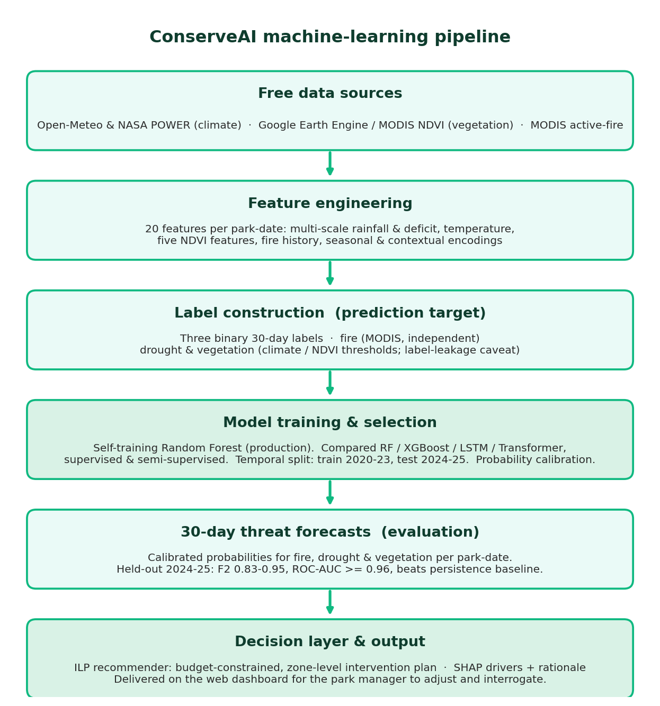
System Analysis, Design & Methodology
[ PASTE DIAGRAM ]
System Architecture (5-layer)
[ PASTE DIAGRAM ]
ERD (PostgreSQL schema)
[ PASTE DIAGRAM ]
Class Diagram
ML pipeline (proposed model)
Methodology: applied design science; iterative agile SDLC - each 2-week iteration a deployable artefact.
ConserveAI | Mission Capstone Defense | African Leadership University
6

Slide 7
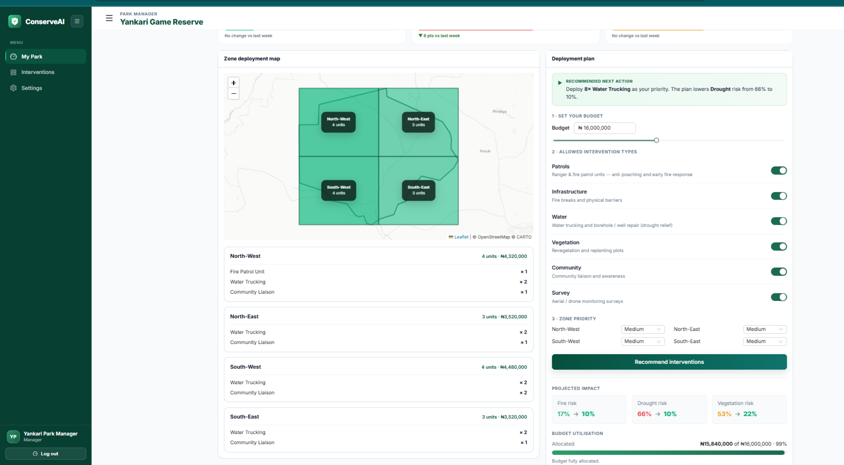
Implementation & Live Demo
Frontend
Backend
Data & ML
React (Vite), Ant Design, Leaflet maps, Recharts
FastAPI, SQLAlchemy, PuLP (ILP), SHAP, APScheduler / GitHub Actions
PostgreSQL (Neon); scikit-learn, XGBoost, PyTorch; Vercel + Fly.io
Key Implementation Details
• Production model: self-training (semi-supervised) Random Forest, calibrated probabilities.
• ILP recommender maximises probability-weighted threat reduction within budget and capacity.
• SHAP driver panel explains every forecast; JWT + bcrypt, park-scoped auth.
• Daily GitHub Actions cron keeps the database current; deployed and verified live.
• Live: conserve-ai.vercel.app | API: conserveai-api.fly.dev/docs
LIVE DEMO - park console: forecast, budget, zone recommendation
ConserveAI | Mission Capstone Defense | African Leadership University
7

Slide 8
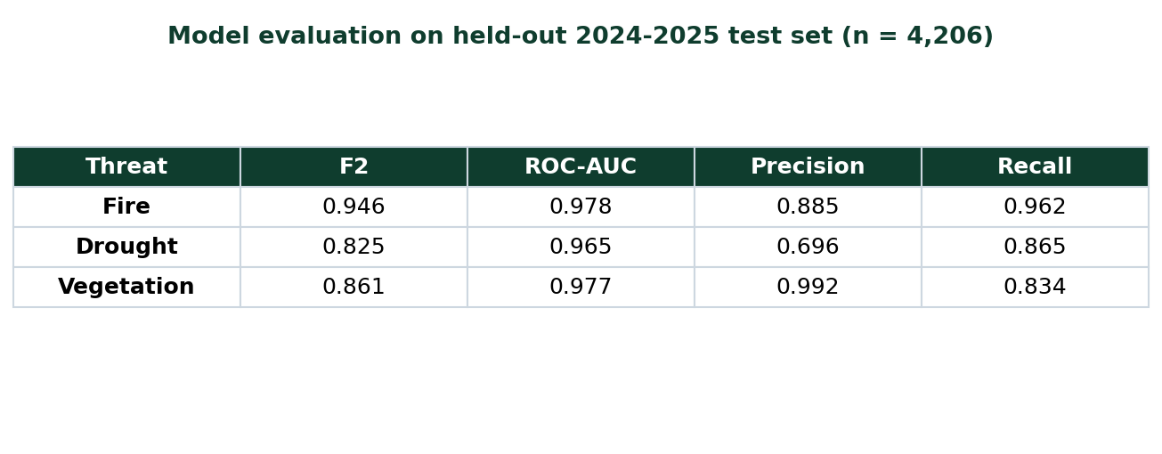
Model Selection & Benchmark
Four architectures x supervised/semi-supervised, all against a persistence baseline. Selected: self-training Random Forest.
Model | Fire | Drought | Veg | Mean F2
RF self-train (selected) | 0.95 | 0.83 | 0.86 | 0.88
XGBoost self-train | 0.94 | 0.83 | 0.63 | 0.80
LSTM (FixMatch) | 0.92 | 0.71 | 0.57 | 0.74
Transformer (FixMatch) | 0.94 | 0.61 | 0.57 | 0.71
Persistence baseline | 0.78 | 0.35 | 0.71 | 0.61
Modality ablation (RQ1)
• Fused (all): mean F2 0.872 - best overall.
• Climate only 0.856 | Satellite (NDVI) 0.821 | Fire history 0.797.
• Each threat is best on its own modality, so fusion buys breadth, not per-threat optimality.
Benchmark findings
• Beats the baseline on every threat - by a wide margin on drought (0.83 vs 0.35).
• Tree models beat deep models when events are scarce (literature-consistent).
• Semi-supervision helped only RF (+0.02) and Transformer (+0.02); it hurt XGBoost and LSTM - reported honestly.
Held-out evaluation (n = 4,206)
ConserveAI | Mission Capstone Defense | African Leadership University
8

Slide 9
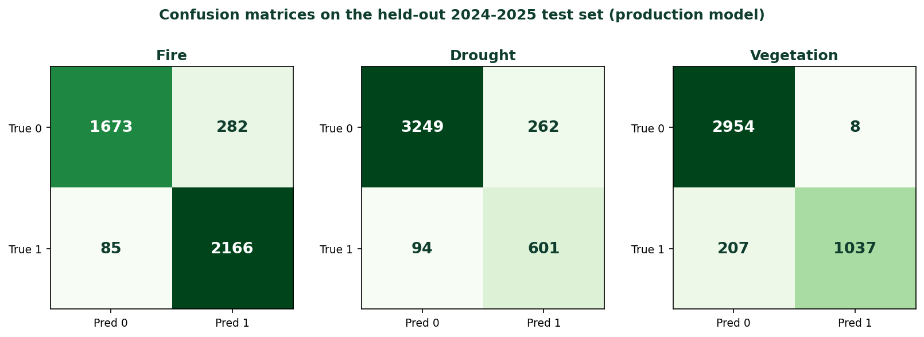
Testing & Evaluation
Unit
Integration
System / E2E
Model eval
19 pytest (optimiser + auth)
Live API endpoints
Browser user journey
Held-out 2024-2025
Metric | Target | Achieved | Status
Fire F2 | >= 0.90 | 0.95 (AUC 0.98) | Pass
Drought F2 | beat baseline | 0.83 (base 0.35) | Pass
Vegetation F2 | >= 0.80 | 0.86 (AUC 0.98) | Pass
Unit tests | all pass | 19 / 19 | Pass
Cloud latency | < 1 s warm | 0.27 s forecast | Pass
Confusion matrices - held-out test set
Validation: strict temporal train/test split, persistence baseline, bootstrap CIs.
ConserveAI | Mission Capstone Defense | African Leadership University
9

Slide 10
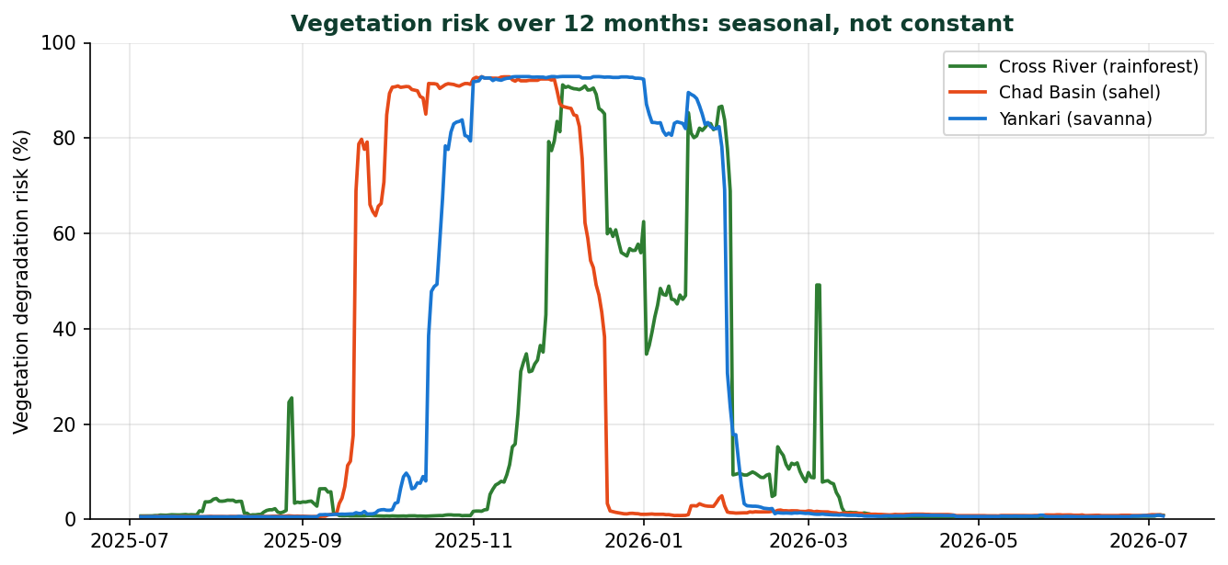
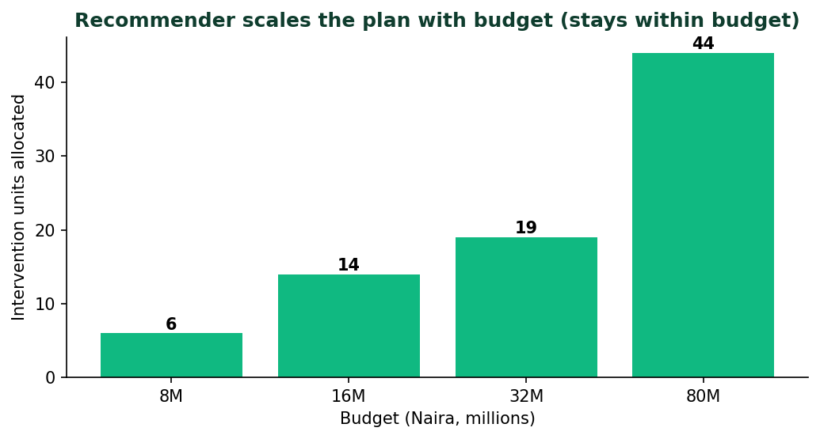
Results, Analysis & Real-World Validation
Main Outcomes
• Live, deployed system; F2 0.95 / 0.83 / 0.86, ROC-AUC > 0.96 on all three threats.
• Recommender scales the plan with budget and never exceeds it; solves in < 60 ms.
• Runs unattended via a daily cron - verified end-to-end against the live URLs.
Per-park & ecosystem (fairness)
Vegetation risk over 12 months - seasonal, not constant
Reliability varies by ecosystem: mean F2 0.96 (Sahel) -> 0.77 (rainforest). Reported per park with 95% CIs so the model cannot silently under-serve one park type.
Iterative real-world validation
Diagnosed a degenerate vegetation output live, moved training + serving to the MOD13Q1 composite: vegetation ROC-AUC 0.77 -> 0.98.
Recommender scales with budget
ConserveAI | Mission Capstone Defense | African Leadership University
10

Slide 11
Conclusion, Ethics & Future Work
Conclusion
Ethics & Responsible AI
• Met the main objective: a live, transparent decision-support system from open data alone.
• Self-training RF beat the baseline on all three threats; strongest on fire and vegetation.
• Contribution is methodological: open data -> forecast -> costed plan -> explanation, running unattended.
• Decision support, not automation - the human retains the decision (NDPA Section 37).
• Per-park fairness reporting; no individual or community data collected.
• SHAP transparency; EULA + Privacy Policy in-app; ethics review submitted before any pilot.
Future Work
• Replace climate-derived drought/vegetation labels with independent ground truth (removes label-leakage risk).
• Add a Sentinel-1 radar backup that sees through cloud, plus a low-confidence flag when coverage is poor.
• Add deployment logging so the system learns from real field outcomes; make the optimiser intervention-aware and multi-period.
• Widen the threat set toward poaching and grazing using ranger patrol records.
ConserveAI | Mission Capstone Defense | African Leadership University
11

Slide 12
Thank You
Questions & Answers
ConserveAI - conserve-ai.vercel.app
Fadhlullah Olusola Abdulazeez | Supervisor: Mr. Emmanuel Adjei

