Slide 1

Supervised ML Algorithms - Classification
Logistic Regression

Slide 2
Logistic Regression
Logistic Regression is one of the basic and popular algorithms to solve a binary classification problems
For each input, logistic regression outputs a probability that this input belongs to one of the 2 classes
Set a probability threshold boundary and that determines which class the input belongs to
Binary classification problems (2 classes):
Emails (Spam / Not Spam)
Credit Card Transactions (Fraudulent / Not Fraudulent)
Loan Default (Yes / No)

Slide 3
Logistic Regression
Now, you may ask why don’t we use Linear Regression? Why do we need a new algorithm?
Well, you would find all the answers in the video in the next slides.
The video in the next slide is a must watch, the instructor has brilliantly explained about logistic regression!

Slide 4
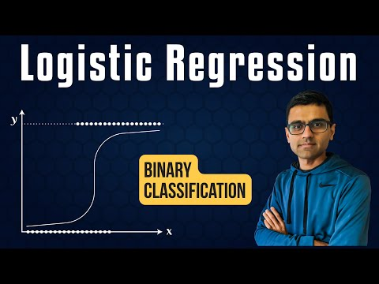
Must Watch Understanding Logistic Regression

Slide 5
Linear Regression vs Logistic
Linear regression is used to solve regression problems with continuous values
Logistic regression is used to solve classification problems with discrete categories
Binary classification (Classes 0 and 1)
Examples:
Emails (Spam / Not Spam)
Credit Card Transactions (Fraudulent / Not Fraudulent)
Loan Default (Yes / No)

Slide 6
Linear Regression vs Logistic
Let’s say a data scientist named John want to predict that whether a customer will buy insurance or not
Remember that linear regression is used to predict a continuous value where the output (y) may vary between +∞ (positive infinity) to -∞ (negative infinity) whereas in this case, the target variable (y) takes only two discrete values, 0 (No insurance) and 1 (Yes, got the insurance).
John’s decides to extend the concepts of linear regression to fulfil his requirement. One approach is to take the output of linear regression and map it between 0 and 1, if the resultant output is below a certain threshold (say 0.5), classify it as No (didn’t buy the insurance) whereas if the resultant output is above a certain threshold, classify it as bought the insurance (yes)

Slide 7
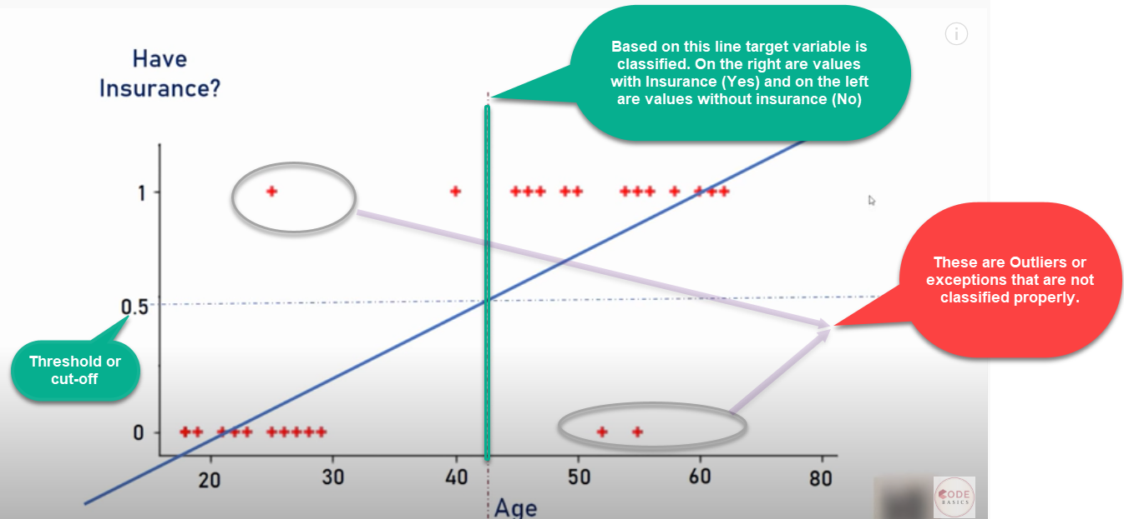
Linear Regression vs Logistic
We then plot a simple linear regression line and set the threshold as 0.5
Negative class (Insurance = No)– Age on the left side
Positive class (Insurance = Yes) – Age on the right side

Slide 8
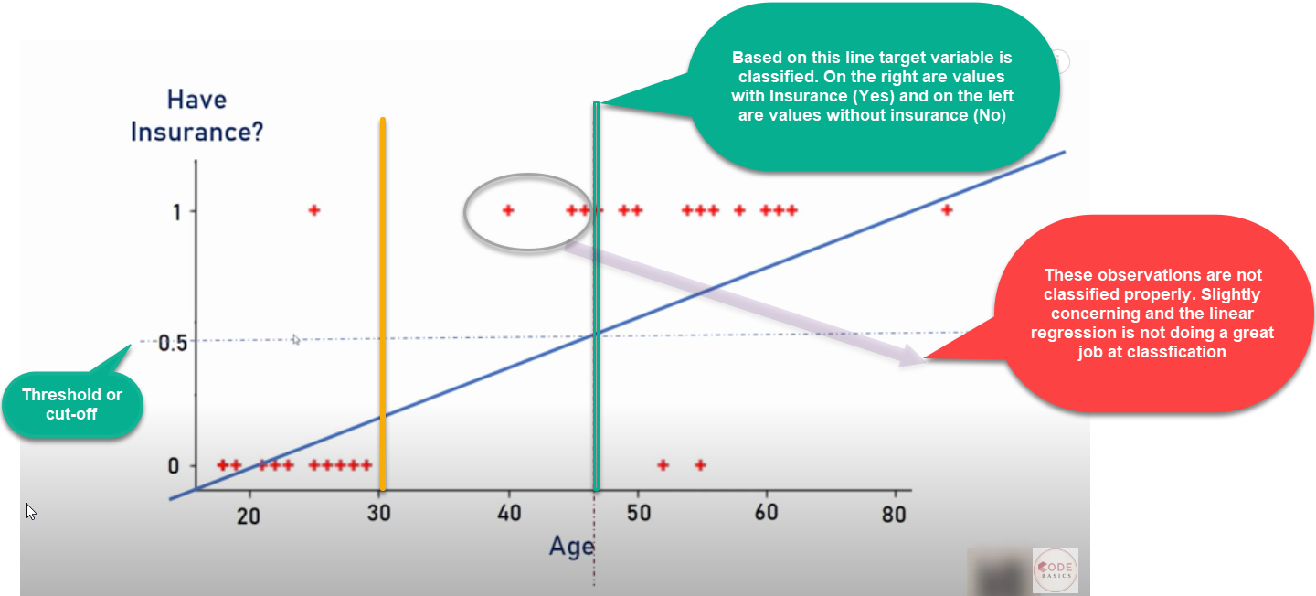
Imagine there is an outlier to towards right
Additional outlier that distorted the regression line
As we can see outlier in the data and will distort the whole linear regression line.
Clearly the line is unable to differentiate the classes with the linear line fit
The line should have been at the vertical yellow line which is able to divide the positive and negative classes i.e yes or no for insurance

Slide 9

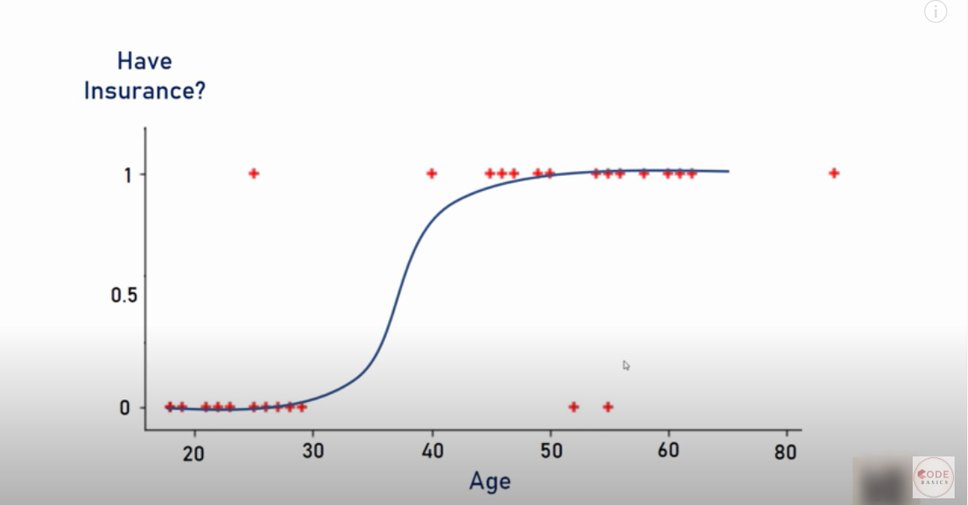
Happy John! (Data Scientist)
Well, life would be much simpler if we had a algorithm that
would fit the points like below right? It is a much better fit compared to regression line!

Slide 10
Solution
Solution – Transform linear regression to a logistic regression curve
Logistic regression is a Sigmoid function
Now what does this sigmoid function do?
Sigmoid function takes in any real value and gives a output probability between 0 and 1

Slide 11
Logistic vs Linear Regression
Linear regression is used to solve regression problems with continuous values
Logistic regression is used to solve classification problems with discrete categories
Binary classification (Classes 0 and 1)
It can be used for multi-classification problems too

Slide 12
Let’s understand some maths behind it! It is alright if you don’t understand, just try to understand the intuition given in the previous slides

Slide 13
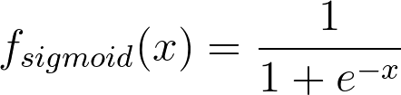
What are we doing in Logistic Regression?
We will use the real-valued output obtained from a linear regression model between 0 and 1 and classify a new example based on a threshold value. The function used to perform this mapping is the sigmoid function
The Sigmoid Function is represented by the formula:
There’s no need to go into the depth of how we obtained this formula right now.

Slide 14
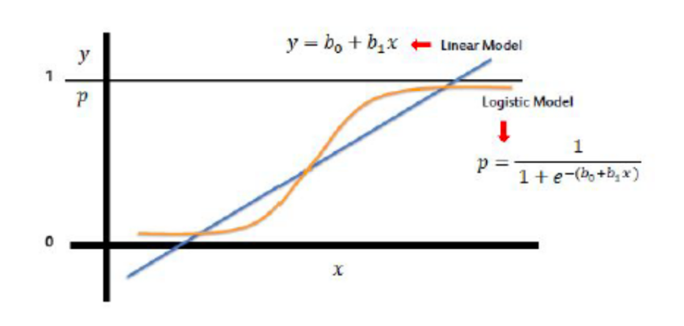
Sigmoid Function (Logistic Function/ Logit)
Take linear regression function and put it into the Sigmoid function
Sigmoid function outputs probability between 0 and 1

Slide 15
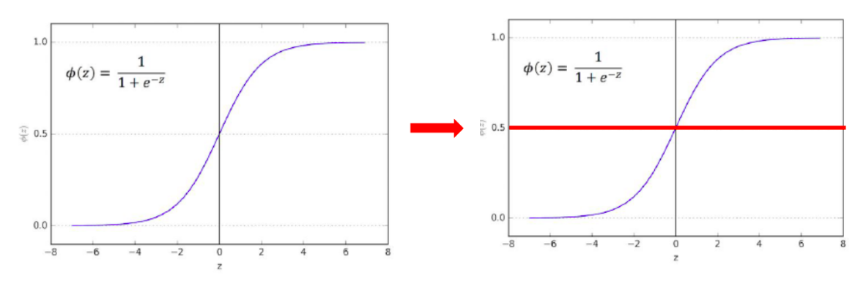
Sigmoid Function (Logistic Function/ Logit)
Sigmoid function outputs probability between 0 and 1
Default probability threshold is set at 0.5 typically
Class 0 – Below 0.5
Class 1 – Above 0.5

Slide 16
Types of Logistic Regression
Logistic Regression model can be classified into three groups based on the target variable categories:
Binary Logistic Regression
The target variable has two possible categories.
Common examples : 0 or 1, yes or no, true or false, spam or no spam, pass or fail, Transactions (Fraudulent / Not Fraudulent), Medical Condition (Diseased/ Not diseased)
Multi- Class Logistic Regression
Multinomial Logistic Regression
The target variable has three or more categories which are not in any particular order. So, there are three or more nominal categories.
Examples: Fruits (apple, mango, orange and banana), profession (e.g., with five groups: surgeon, doctor, nurse, dentist, therapist)
Ordinal Logistic Regression
The target variable has three or more ordinal categories. So, there is intrinsic order involved with the categories.
For example, the student performance can be categorized as poor, average, good and excellent.

Slide 17
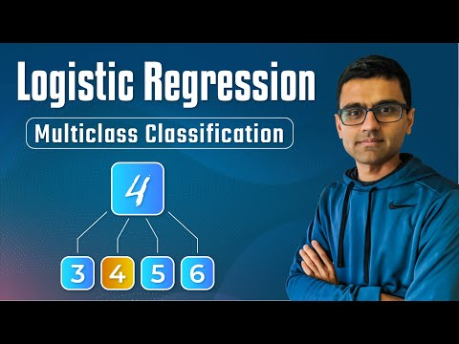
Understanding Multi-Class Logistic Regression

Slide 18
Notebooks for practice
https://dphi.tech/notebooks/899/manish_kc_06/basic_logistic_model
https://dphi.tech/notebooks/861/manish_kc_06/logistic-regression-advertisement
https://dphi.tech/notebooks/862/manish_kc_06/logistic-regression-heart-disease
https://dphi.tech/notebooks/891/manish_kc_06/logistic_regression_insurance

Slide 19
Slide Download Link
You can download these slides from the below link:
https://docs.google.com/presentation/d/15-VDhUWLY51U8eG9UvhyMeqOIrXejZQfTSSgmfBQxck/edit?usp=sharing

Slide 20

That’s it for this unit. Thank you!
Feel free to post any queries on Discuss.

