Slide 1

Supervised ML Algorithms - Classification
Logistic Regression: Multi-Class Logistic Regression

Slide 2

What is Multi-Classification?
It is as simple as dividing waste into 4 categories - plastic, glass, metal, paper

Slide 3
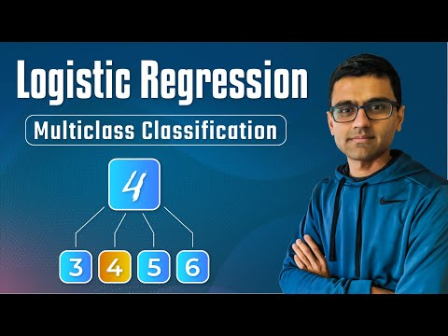
Understanding Multi-Class Logistic Regression

Slide 4
Notebook for practice
https://dphi.tech/notebooks/893/manish_kc_06/multiclass_logistic_regression

Slide 5
Slide Download Link
You can download these slides from the below link:
https://docs.google.com/presentation/d/1vowTeCPusyzz1KN7I3rXpLd0ZarEvK1uS5OtBA0D6Bk/edit?usp=sharing

Slide 6

That’s it for this unit. Thank you!
Feel free to post any queries on Discuss.

