Slide 1

Supervised ML Algorithms - Classification
Evaluating the performance of a Classification Model

Slide 2

Learning Objectives
Why not Accuracy?
Evaluating the Performance of Logistic Regression model
Which metrics to use when?

Slide 3
Evaluating the Performance of Logistic Regression model
Model Evaluation is a very important part in any analysis to answer the following questions:
How well does the model fit the data?, Which predictors are most important?, Are the predictions accurate?
Guess what, evaluating a Classification model is not as simple as Linear Regression.
But why?
You must be wondering ‘Can’t we just use accuracy of the model as the holy grail metric?’

Slide 4



Accuracy
Classification Accuracy is what we usually mean, when we use the term accuracy. It is the ratio of number of correct predictions to the total number of input samples.
Actual Labels:
Task at hand - Separate Yellow and pink balls
Predicted Labels:
Colors predicted by our model
Correctly predicted = 4
Total Predictions = 6
Accuracy = 4/6 = 66.7%

Slide 5
Why not Accuracy?
Accuracy is very important, but it might not be the best metric all the time. Let’s look at why with an example -:
Let’s say we are building a model which predicts if a transaction is fraudulent or not
Let’s imagine, we build a basic model which always predicts that a transaction is not fraudulent. Guess what would be the accuracy of this model?
~99% !! (You may ask why? Well, less than 1% transactions are usually fraudulent and there is a huge class imbalance. So even if you fit a wrong model that always predicts a transaction to be not fraudulent, the accuracy will remain 99% owing to class imbalance)
Impressive, right? Well, the probability of a bank buying this model is absolute zero. 😆
In a problem where there is a large class imbalance, a model can predict the value of the majority class for all predictions and achieve a high classification accuracy.
While our model has a stunning accuracy, this is an apt example where accuracy is definitely not the right metric.

Slide 6
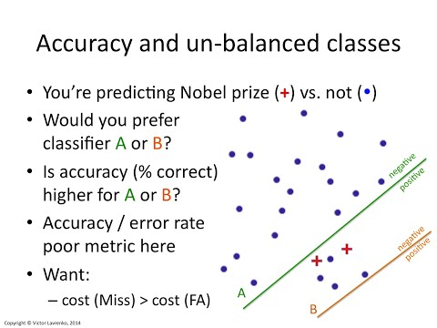
Why not Accuracy?
Watch till 1 min 14 secs to understand why accuracy is bad metric for model performance

Slide 7
Evaluating the Performance of Logistic Regression model
Logistic Regression employs different sets of metrics than Linear Regression. Here, we deal with probabilities and categorical values.
In the following slides, we describe a few of the evaluation metrics used for Logistic Regression:

Slide 8
Is confusion matrix confusing or it resolves the confusion?
You decide!

Slide 9
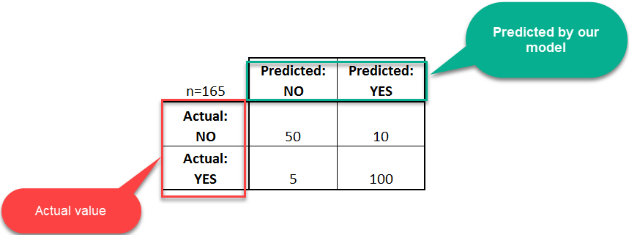
Confusion Matrix
A confusion matrix is a table that is often used to describe the performance of a classification model (or "classifier") on a set of test data for which the true values are known. The confusion matrix itself is relatively simple to understand, but the related terminology can be confusing.
Let's start with an example confusion matrix for a binary classifier for disease prediction (though it can easily be extended to the case of more than two classes):

Slide 10
Confusion Matrix
Let's now define the most basic terms, which are whole numbers (not rates):
true positives (TP): These are cases in which we predicted yes (they have the disease), and they do have the disease.
true negatives (TN): We predicted no, and they don't have the disease.
false positives (FP): We predicted yes, but they don't actually have the disease. (Also known as a "Type I error.")
false negatives (FN): We predicted no, but they actually do have the disease. (Also known as a "Type II error.")
I know these seem hard to memorise. One thing that has helped me remember these are by putting it in a better way:
false positives = falsely classified as being positive.

Slide 11
Confusion Matrix
This is a list of rates that are often computed from a confusion matrix for a binary classifier:
Precision: Correctly predicted as positives compared to total predicted as positives
Precision = TP/(TP+FP) = 100/110 = 0.91
Sensitivity/Recall: Correctly predicted as positives compared to total number of positives
= TP/(TP + FN) = 100/(100+5) = 0.95
Note: Mostly we have to pick one over other, it’s almost impossible to have both high Precision and Recall.
Specificity: Correctly predicted as negatives compared to total number of negatives = TN/(TN + FP) = 50/(50+10) = 0.83

Slide 12

Understanding Precision and Recall
Think about the search box on Amazon home page.
The precision is the proportion of relevant results( correctly predicted yes) in the list of all returned search results(total predicted yes).
The recall is the ratio of the relevant results( correctly predicted yes) returned by the search engine to the total number of the relevant results that could have been returned (total actual yes).

Slide 13
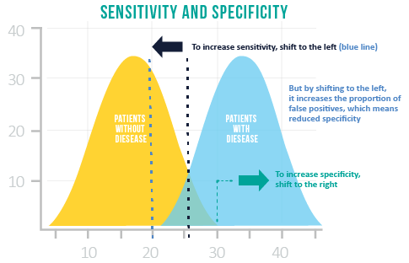
Choosing between Sensitivity and Specificity
Often, the sensitivity and specificity of a test are inversely related. Selecting the optimal balance of sensitivity and specificity depends on the objective of the problem that needs to be solved.
If correctly identifying positive class is important for us, then we should choose a model with higher Sensitivity. However, if correctly identifying negative class is more important, then we should choose specificity as the measurement metric.

Slide 14
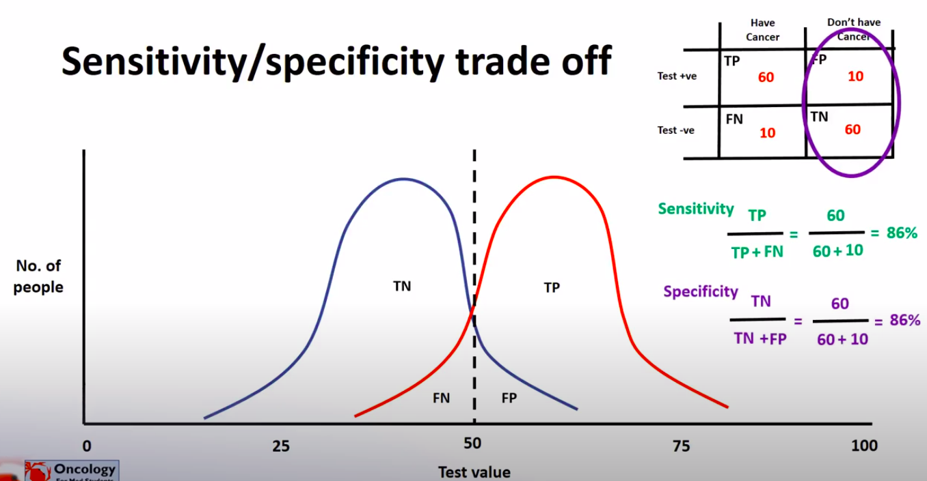
Sensitivity or Specificity - an example
Let’s say we are predicting if a patient has cancer or not. The default probability threshold is kept at 0.5 i.e
Class 0 (No cancer) – Below 0.5
Class 1 (Cancer) – Above 0.5

Slide 15
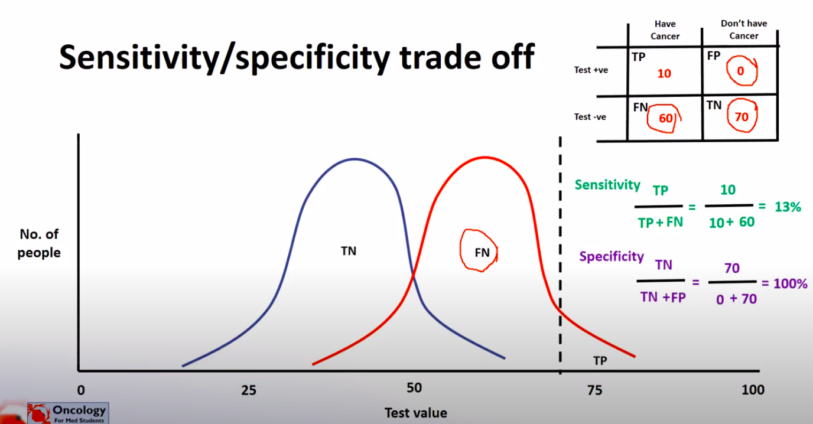
Case 1: Higher Specificity
Suppose we want to predict Class 1 (Ci.e patient has cancer) only if we are VERY confident. (To avoid giving the patient a shock and to avoid unnecessary treatment)
We can instead change this threshold to 0.7. Thus, we’ll tell someone they have cancer only if we think they have greater than or equal to 70% chance of having a cancer.
Look at the graph below. SInce the threshold has shifted to the right, so the number of people correctly guessed as having cancer have decreased. Thus, the specificity has increased. ( We are being very specific with declaring patients with cancer).

Slide 16
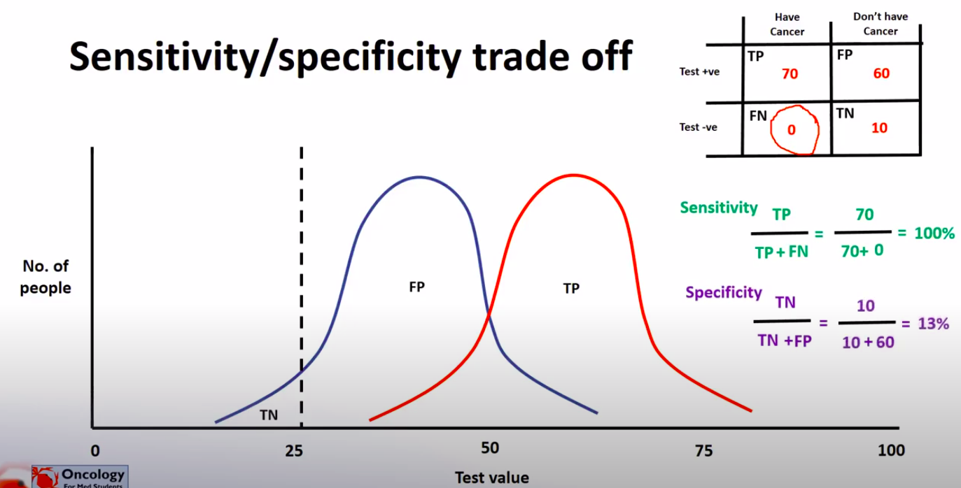
Case 2: Higher Sensitivity
Suppose we want to avoid missing too many cases of cancer ( avoid false negatives). If a person with cancer is told that he’s well, it can cause a delay in treatment and affect the health badly).
In this case we can set a lower threshold, say 0.25. Even if a patient has 25% chance of having cancer, we’ll inform him/her.
Looking at the graph you can see that the threshold has shifted to the left. Most of the people with cancer will be detected in advance in this case. We have completely (or almost) eliminated False Negatives. It will thus result in higher Sensitivity/ Recall. (We are being sensitive in detecting a disease i.e a really sensitive test).

Slide 17
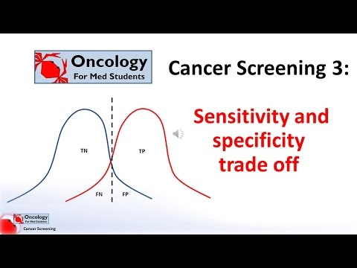
You can watch this video from 00:58 to 5:32 explaining the Sensitivity and Specificity trade off

Slide 18

Confusion Matrix
Talking about accuracy, our favourite metric!
Accuracy is defined as the ratio of correctly predicted examples by the total examples.
Accuracy: Overall, how often is the classifier correct?
= (TP+TN)/total = (100+50)/165 = 0.91
Remember, accuracy is a very useful metric when all the classes are equally important.
But this might not be the case if we are predicting if a patient has cancer. In this example, we can probably tolerate FPs but not FNs.
If a cancerous patient is wrongly reported as being fine, it can result in delaying of treatment. Which is not good!

Slide 19
Confusion Matrix
So you’ve already learnt how to calculate Precision and Recall and how changing the threshold can affect their values. (SImilar to Sensitivity, Specificity threshold)
But do we necessarily need to spend time on varying the threshold to get the perfect Precision and Recall? Or is there a way to choose this threshold automatically?
Let’s take 3 algorithms and try to find a metric for combining Precision and Recall.
How about taking an average of Precision and Recall? (P+R)/2
 | Precision (P) | Recall (R) | Average
Algorithm 1 | 0.5 | 0.4 | 0.45
Algorithm 2 | 0.7 | 0.1 | 0.4
Algorithm 3 | 0.02 | 1.0 | 0.51

Slide 20
F1 Score
Average tells us that Algorithm 3 is the best (highest value). Whereas Algorithm 3 is a dumb model that predicts y=1 each time and thus gives a recall of 1 (FN =0, TP=1).
That means average isn’t a good metric.
Researchers found a metric that solves our purpose: The F1 Score!

Slide 21
F1 Score
Let’s apply F1 Score to our problem:
The F1 score tells us that Algorithm 1 is the best (highest F1 Score).
For F1 Score to be large, both P and R need to be large.
It’ll be highest(1) when both P and R are 1
Accuracy can be used when the class distribution is similar while F1-score is a better metric when there are imbalanced classes.
 | Precision (P) | Recall (R) | Average | F1 Score
Algorithm 1 | 0.5 | 0.4 | 0.45 | 0.444
Algorithm 2 | 0.7 | 0.1 | 0.4 | 0.175
Algorithm 3 | 0.02 | 1.0 | 0.51 | 0.0392

Slide 22


ROC (Receiver Operator Characteristic) Curve
An ROC curve is a commonly used way to visualize the performance of a binary classifier, meaning a classifier with two possible output classes.
It shows the performance of a classification model at all threshold values.
It plots 2 parameters:
True positive rate /Recall (TPR)
False Positive rate (FPR)

Slide 23
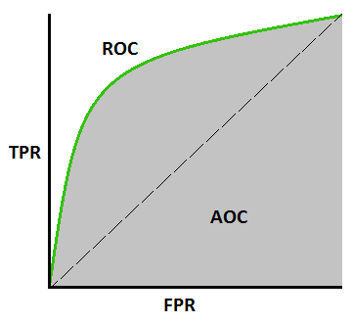
AUC Curve
AUC stands for "Area under the ROC Curve." That is, AUC measures the entire two-dimensional area underneath the entire ROC curve
AUC provides an aggregate measure of performance across all possible classification thresholds.

Slide 24

ROC and AUC Explained

Slide 25
Reading Material
MUST READ
An excellent article explaining Threshold, ROC and AUC in a simple manner: https://towardsdatascience.com/understanding-the-roc-and-auc-curves-a05b68550b69

Slide 26
Which metrics to use when?

Slide 27
Which metrics to use when?
This is an important question and we get used to learning these measures over time. Sharing some resources with you all so that it helps you understand what metrics to be used in the context of solving a regression problem.
5 Classification Metrics every data scientist must know
https://towardsdatascience.com/the-5-classification-evaluation-metrics-you-must-know-aa97784ff226
https://medium.com/usf-msds/choosing-the-right-metric-for-evaluating-machine-learning-models-part-2-86d5649a5428

Slide 28
Slide Download Link
You can download these slides from the below link:
https://docs.google.com/presentation/d/1WD8LUvNn3extytjsYszpiGiUWLgaqVi_zgO7ppRhj3o/edit?usp=sharing

Slide 29
That’s it for this unit. Thank you!
Feel free to post any queries on Discuss.

