Slide 1

Supervised ML Algorithms - Classification
Decision Tree/ Classification Tree

Slide 2
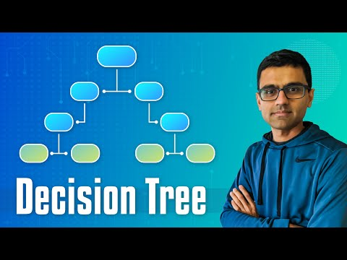
Decision Trees for Classification -Classification Trees

Slide 3

Decision Trees
Classification tree methods (i.e., decision tree methods) are recommended when the task contains classifications or predictions of outcomes, and the goal is to generate rules that can be easily explained and translated into SQL or a natural query language.
A Classification tree labels, records, and assigns variables to discrete classes. A Classification tree can also provide a measure of confidence that the classification is correct.

Slide 4
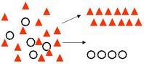
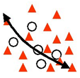
CART
You might encounter the term ‘CART’ while building ML models. It’s actually nothing new but the same old Decision Tree.
CART = Classification and Regression Trees, an umbrella term for:
Classification Trees: where the target variable is categorical and the tree is used to identify the "class" within which a target variable would likely fall into.
Regression Trees: where the target variable is continuous and tree is used to predict it's value.

Slide 5
Resources on Decision Tree Classification
Implementation of Decision Tree Classification: https://www.datacamp.com/community/tutorials/decision-tree-classification-python
Notebooks:
https://dphi.tech/notebooks/857/manish_kc_06/day-1-notebooks-intro-to-model-building
https://dphi.tech/notebooks/895/manish_kc_06/titanic_dataset_improvised_model

Slide 6
Slide Download Link
You can download these slides from the below link:
https://docs.google.com/presentation/d/10bDZPbCa--g0jraKUqvlD-56Ib__osWbPWS4xJ4AYpk/edit?usp=sharing

Slide 7
That’s it for this unit. Thank you!
Feel free to post any queries on Discuss.

