Slide 1
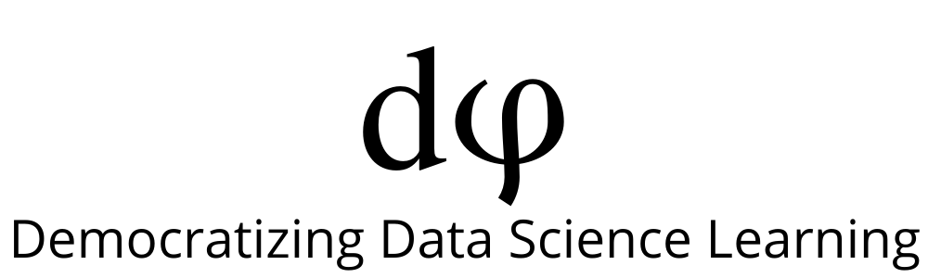
Supervised ML Algorithms - Classification
Support Vector Machine (SVM)

Slide 2
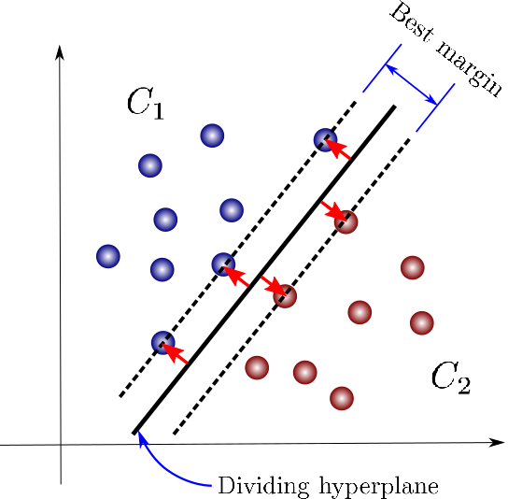
SVM’s Objective
The objective of SVMs is to categorize data into two classes. It does so by finding a separating hyperplane(decision boundary), where the distance between itself and the closest data points for both categories is maximized.
Look at how the hyperplane lies exactly between the nearby blue and red points
(maximising the margin)

Slide 3

Simple Visual Explanation of SVM
https://medium.com/towards-artificial-intelligence/support-vector-machine-svm-a-visual-simple-explanation-part-1-a7efa96444f2

Slide 4
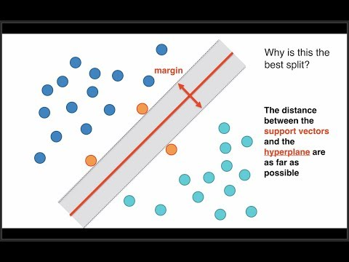
Support Vector Machine (SVM)

Slide 5
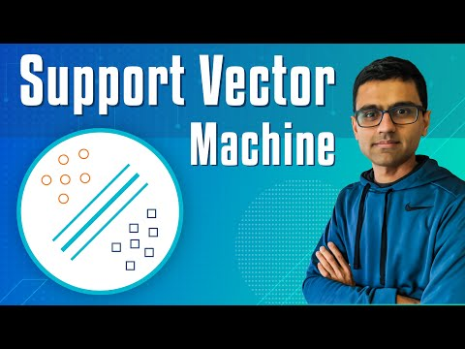
SVM Implementation

Slide 6
Kernels
SVM algorithms use a set of mathematical functions that are defined as the kernel.
The function of kernel is to take data as input and transform it into the required form.
Different SVM algorithms use different types of kernel functions. These functions can be different types.
For example linear, nonlinear, polynomial, radial basis function (RBF), and sigmoid.
The most used type of kernel function is RBF. It is also the default kernel

Slide 7
Slide Download Link
You can download these slides from the below link:
https://docs.google.com/presentation/d/1GRjDVrIk9OyJkrC64p8OqW5fgC15FA2v_3rRmJ9VcqE/edit?usp=sharing

Slide 8
That’s it for this unit. Thank you!
Feel free to post any queries on Discuss.

