Slide 1

Supervised ML Algorithms - Classification
Random Forest

Slide 2
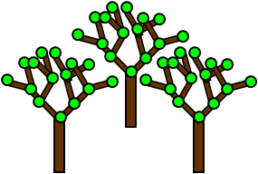
Random Forest
Random forest is a flexible, easy to use machine learning algorithm that produces, a great result most of the times even without hyper-parameter tuning.
It is also one of the most used algorithms, because of its simplicity and diversity (it can be used for both classification and regression tasks).
Random forest builds multiple decision trees and merges them together to get a more accurate and stable prediction.

Slide 3
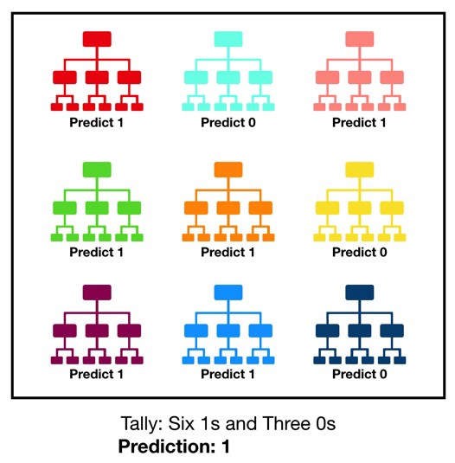
Random Forest: Ensemble tree based algorithm
It is an ensemble tree-based learning algorithm. The Random Forest Classifier is a set of decision trees from randomly selected subset of training set. It aggregates the votes from different decision trees to decide the final class of the test object.
You’ll learn about ensemble models in detail in the next unit.

Slide 4
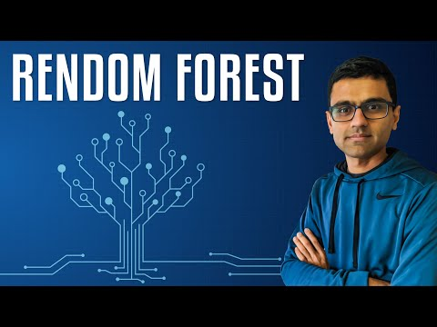
Random Forest: Ensemble tree based algorithm

Slide 5

Applications
The random forest algorithm is used in a lot of different fields, like banking, the stock market, medicine and e-commerce.
In finance, for example, it is used to detect customers more likely to repay their debt on time, or use a bank's services more frequently. In this domain it is also used to detect fraudsters out to scam the bank. In trading, the algorithm can be used to determine a stock's future behavior.
In the healthcare domain it is used to identify the correct combination of components in medicine and to analyze a patient’s medical history to identify diseases.
Random forest is used in e-commerce to determine whether a customer will actually like the product or not.

Slide 6
Resources on Random Forest Classification
Implementation of Random Forest Classification: https://www.datacamp.com/community/tutorials/random-forests-classifier-python
Notebooks: https://dphi.tech/notebooks/864/manish_kc_06/random-forest

Slide 7
Slide Download Link
You can download these slides from the below link:
https://docs.google.com/presentation/d/1JHykw1oENBmrWH8o2lgX4Cj_s3XI0isL_TLBxU6v2S8/edit?usp=sharing

Slide 8
That’s it for this unit. Thank you!
Feel free to post any queries on Discuss.

