Slide 1

Supervised ML Algorithms - Classification
Naive Bayes Classifier

Slide 2

Naive Bayes
Naive Bayes is the most straightforward and fast classification algorithm, which is suitable for a large chunk of data.
Naive Bayes classifier is successfully used in various applications such as spam filtering, text classification, sentiment analysis, and recommender systems.
It uses Bayes theorem of probability for prediction of unknown class.

Slide 3
Advantages and Disadvantages
Advantages:
This algorithm requires a small amount of training data to estimate the necessary parameters. Naive Bayes classifiers are extremely fast compared to more sophisticated methods.
Disadvantages: Naive Bayes is known to be a bad estimator.

Slide 4

In-depth explanation & Implementation

Slide 5
Multinomial Gaussian NB for spam detection
Note:
In the next video, the instructor has used the spam detection example that involves some operations around text (NLP).
You don’t need to worry about those parts and instead just focus on the parts revolving around Naive Bayes.

Slide 6
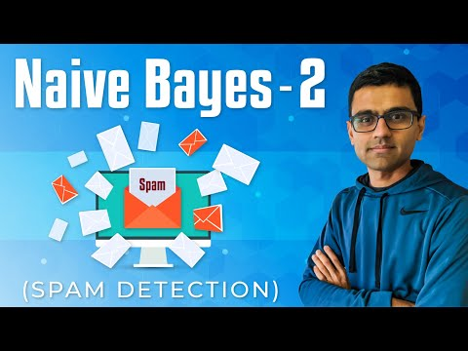
Multinomial Gaussian NB for spam detection

Slide 7
Naive Bayes Classification using Scikit-learn
https://www.datacamp.com/community/tutorials/naive-bayes-scikit-learn

Slide 8
Slide Download Link
You can download these slides from the below link:
https://docs.google.com/presentation/d/1T6I0h5JQeXryys3UjALbHZElIdE0oRX4NcEim37T4vM/edit?usp=sharing

Slide 9
That’s it for this unit. Thank you!
Feel free to post any queries on Discuss.

