Slide 1

Model Deployment
Data Cleaning and Building a model

Slide 2
Learning Objectives
Data Cleaning
Feature Engineering
Outlier Detection and Removal
Building a ML Model

Slide 3
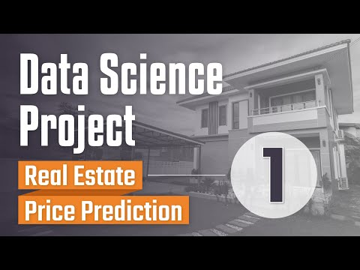
Getting Started

Slide 4
Dataset
We’ll be working with the house price data of a city in India - Bengaluru (also known as Bangalore).
https://www.kaggle.com/amitabhajoy/bengaluru-house-price-data
Instead of downloading it, you can access it directly with this link:
https://raw.githubusercontent.com/dphi-official/Datasets/master/Bengaluru_House_Data.csv
This dataset is unstructured, messy and somewhat resembles the kind of data you’ll get in a real-world setup.

Slide 5
Notebook Link
We’ll be following along the series of the whole Data Science pipeline by the instructor. It is interesting to note the kind of functions he is creating to tackle Data Cleaning.
The code from all the videos of the series can be found in a single notebook:
https://github.com/codebasics/py/blob/master/DataScience/BangloreHomePrices/model/banglore_home_prices_final.ipynb
Make sure you spend enough time on each step to understand what is happening.

Slide 6
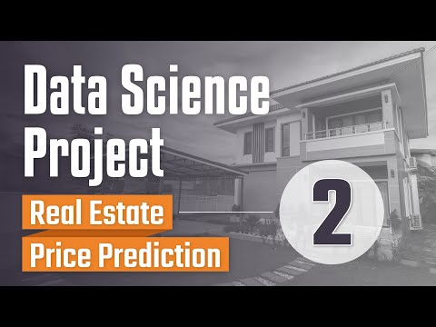
Data Cleaning

Slide 7
Data Cleaning
In the video, you’ll observe that the instructor has removed some columns(mostly categorical or text-based).
Instead of doing that, it’s always better to perform feature selection techniques to determine the important as well as non-important features.
Also, instead of removing the rows with missing values from the DataFrame, they can instead be substituted using the handling missing values techniques we discussed earlier.
You’ll also find some functions to handle data cleaning of different features and that’s quite a feasible way to process all rows of the DataFrame.

Slide 8

Data Cleaning cntd. + Feature Engineering

Slide 9
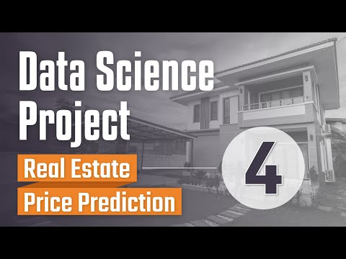
Outlier Detection and Removal

Slide 10
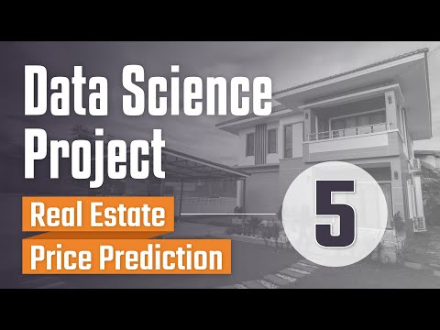
Building a ML Model

Slide 11
At the end of building a model, he saved it using pickle.
He also saved the location and column information to a JSON file
Let’s understand what it is in-depth along with its other alternatives in the next unit.

Slide 12
Slide Download Link
You can download this unit from the below link:
https://docs.google.com/presentation/d/1pSsaUc7y99g1-kuahTNs38ZsQG6YPuFMF0KpzJjk-00/edit?usp=sharing

Slide 13
That’s it for this unit. Thank you!
Feel free to post any queries on Discuss.

