Slide 1

Model Deployment
Deploying the model with Heroku

Slide 2
Learning Objectives
What is Heroku?
Gunicorn
Create the required Heroku files
Making a git repository and committing changes
Push your app to the web
Debugging Errors

Slide 3
At this point, you have a functioning web app running on your local machine. However, it is hard to share this — your machine might be behind a firewall, your IP address might change often or the machine isn’t always on.
Luckily, it’s possible to deploy Flask apps to an online platform that will make it much easier for people to access your app. We’ll do this using Heroku.

Slide 4
What is Heroku?
Heroku is a container-based cloud Platform as a Service (PaaS). Developers use Heroku to deploy, manage, and scale modern apps. The platform is elegant, flexible, and easy to use, offering developers the simplest path to getting their apps to market.
Heroku offers a free version to host your app.

Slide 5
Requirements
The minimum things you need to do for the current task:
Sign up for a free Heroku account at https://signup.heroku.com/signup/dc
Make sure you have git installed, to push your app to Heroku.
Install the Heroku CLI tool.
NOTE: If you face a path error after installing the Heroku CLI Tool, you need to add path manually. To do this, you can follow the procedure to add path as shown at 1:20 in the video in the next slide.

Slide 6

Fixing the Path Error in Heroku CLI

Slide 7
Files
The repository consisting of all the required files for the application can be found here:
https://github.com/dphi-official/Micro-Courses/tree/master/Introduction_Model_Deployment

Slide 8

Gunicorn: A better web server
The Flask web framework feature convenient built-in web servers that we’ve been working with till now, but these servers only process a single request at a time. If you deploy with one of these servers on Heroku, your resources will be underutilized and your application will feel unresponsive.
Gunicorn is a pure-Python HTTP server for WSGI applications(i.e Flask). It allows you to run any Python application concurrently by running multiple Python processes within a resource. It provides a perfect balance of performance, flexibility, and configuration simplicity.
In simple terms, Gunicorn is a tool or an interface that takes care of everything that happens in-between the web server and your web application
You can install Gunicorn with pip:

Slide 9
Create the required Heroku files
1. Procfile - this tells Heroku what kind of app you are running and how to serve it to users. It is a single line and should look like this:
web: gunicorn app:app
The first app represents the name of the python file that runs your application or the name of the module it is in. In our case, we have a server.py file inside server folder. So we’ll be editing this in the next slide.
The second app represents your app name i.e from this line in our server.py file: app = Flask(__name__)
The Procfile is always a simple text file that is named Procfile without a file extension. For example, Procfile.txt is not valid.
The Procfile must live in your app’s root directory. It does not function if placed anywhere else.

Slide 10
Create the required Heroku files
Since our app is inside the server folder, we’ll have to modify the Procfile as follows:
web: gunicorn server.server:app

Slide 11
Create the required Heroku files
2. requirements.txt - this tells Heroku which packages to install for your web app.
Instead of manually specifying the packages to be installed, pipreqs package can be used to generate a requirement.txt file based on the import statements of the project.
To get setup with the pipreqs, you need to install the pipreqs package using the following command:
pip install pipreqs
Usage of the pipreqs is very easy. You just need to provide the root location of your project and pipreqs automatically generate a requirements.txt file in root folder.
pipreqs /path/to/project

Slide 12

Create the required Heroku files
For eg, for creating a requirements.txt file from my folder named House_Price_Application that contains all the files related to this project, I’m doing the following:
A requirements.txt file now magically appears in my root folder (House_Price_Application)!
PS. There are other methods to create requirements.txt file like pip freeze as well. However, it works better when you have created a virtual environment for your project. Otherwise, it lists all the packages installed in your system.

Slide 13
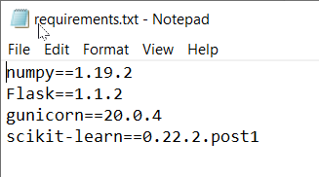
Create the required Heroku files
These should be the constituents of your requirements.txt file (the versions may be different). If any of these are not added automatically, ensure that you add them.

Slide 14
Make a git repository for your web app
Inside the root folder, run the following command to create a new repository.
git init

Slide 15
Add files to repository
While in the root folder, use the following command to add all your web app's files to the git repository:
git add .
PS. There’s a gap between add and .

Slide 16
Commit files
Now, we’ll commit all the added files to GitHub. This can be done with the command:
git commit -m “initial commit”

Slide 17
Authenticate with Heroku
Once this is done, you can log into your Heroku account using the CLI.
heroku login
It’ll display the message:
Press any key, Enter. A new browser window will appear from which you can log in to your Heroku account.
Then come back to the terminal and press Ctrl+C and Y in order to get the terminal back to its normal state.

Slide 18
Create a new Heroku app
You can create a heroku app using the command (don’t implement this one):
heroku create
By default, this will make an app with a random name.
If you want to choose your own name, simply pass it as an argument (implement this). For example:
heroku create blr-house-price
The above command creates an app with the name blr-house-price.
Note: You need to choose a unique app name that hasn’t been used before.

Slide 19
Push your app to the web
Just one more command and your web app will be online. During this process, Heroku will upload your app files, install the packages it needs and start the app running.
git push heroku master
If everything goes as expected, you’ll see output showing things being installed and uploaded.

Slide 20
Check out the deployed app!
You can use the heroku open command to open your completed app in the web browser.
Alternatively, just go to https://blr-house-price.herokuapp.com/ (replacing blr-house-price with your app's name, of course).
You can share that link with whoever you want to see your model.

Slide 21
Important Note
The method of Flask app creation used in the Bengaluru Home Price prediction video series is valid but a little outdated. The series was however more detailed and great for diving into.
The more recent methods make use of Flask’s render_template functionality to render the HTML file.
Although we have incorporated that in the instructor’s code, we would like you to go through the video in the next module that covers the whole process quickly.
When you get a proper understanding from the detailed videos + get updated with the newest method in the short video, you’ll be able to create amazing applications on your own!

Slide 22
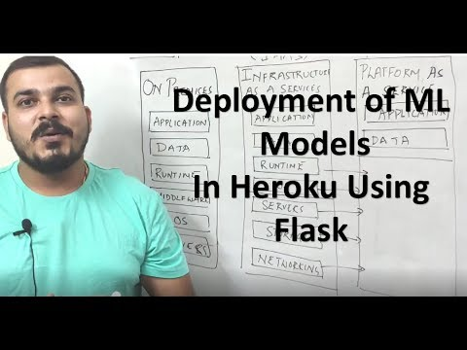
Walkthrough of the whole process

Slide 23
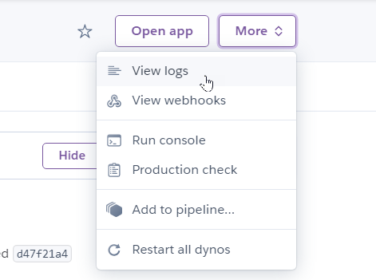
Debugging Errors
If your app’s URL shows that some error has occurred, you can
go to https://dashboard.heroku.com/apps
Select your app
Select More at the top right corner and click on View logs.
Often the logs are helpful enough to debug where the problem lies.

Slide 24
Debugging Errors
If you figure out the error and want to correct it in the files, after correcting, just perform steps from git add . until git push heroku master.
Your app will get updated and possibly deployed successfully!

Slide 25
Congratulations! :D
Now that you’re at the end of this unit, we hope you have actually been able to deploy the app.
What more can you do now?
Maybe try out your hand in CSS and make the app prettier.
Or try out how you can improve your model with hyperparameter tuning.
We’ve kept the projects by keeping in mind that not all might be familiar with Deep Learning. But Deep Learning + Model Deployment make some excellent projects you can create to make your portfolio shine!

Slide 26
References
https://blog.cambridgespark.com/deploying-a-machine-learning-model-to-the-web-725688b851c7

Slide 27
Slide Download Link
You can download this unit from the below link:
https://docs.google.com/presentation/d/1JLYDVZTOY15em9SJTv87xgnsvtXNcIXEdNCDLWXsLx0/edit?usp=sharing

Slide 28
That’s it for this unit. Thank you!
Feel free to post any queries on Discuss.

