Slide 1

Supervised ML Algorithms - Regression
Multiple Linear Regression

Slide 2
Learning Objectives
Simple vs. Multiple Linear Regression
Linear Regression with Multiple Variable
Notebook for practice

Slide 3
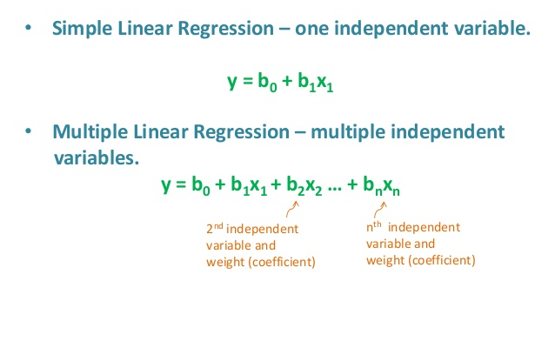
Simple vs. Multiple Linear Regression

Slide 4
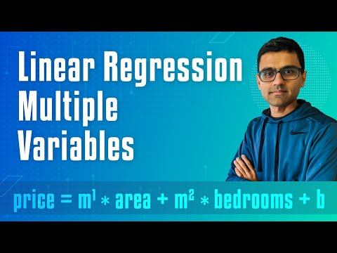
Linear Regression with Multiple Variable

Slide 5
Notebook for practice
https://dphi.tech/notebooks/860/manish_kc_06/multiple-linear-regression

Slide 6
Slide Download Link
You can download these slides from the below link:
https://docs.google.com/presentation/d/1SbUUVzFq4xm3KmLDkO0wuDwcGQeNwaS3kg0To3BSlSg/edit?usp=sharing

Slide 7
That’s it for this unit. Thank you!
Feel free to post any queries on Discuss.

