Slide 1

Supervised ML Algorithms - Regression
Decision Tree/ Regression Tree

Slide 2
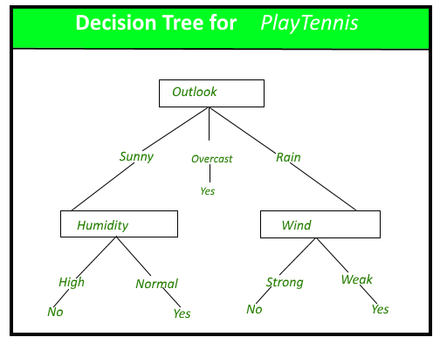
Decision Trees
Decision tree is the most powerful and popular tool for classification and prediction.
A Decision tree is a flowchart like tree structure, where:
each internal node denotes a test on an attribute/feature,
each branch represents an outcome of the test, and
each leaf node (terminal node) holds a class label (Yes and No in this case).

Slide 3
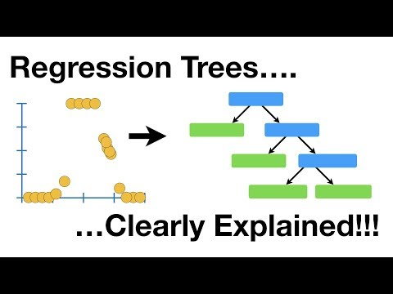
Decision Trees for Regression -Regression Trees

Slide 4
Decision Trees
Regression tree analysis is used when the predicted outcome can be considered a real number (e.g. the price of a house, or a patient's length of stay in a hospital).

Slide 5
Resources on Decision Tree Regressor
Implementation of Decision Tree Regression: https://heartbeat.fritz.ai/implementing-regression-using-a-decision-tree-and-scikit-learn-ac98552b43d7

Slide 6
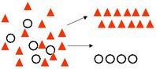
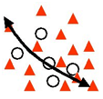
CART
You might encounter the term ‘CART’ while building ML models. It’s actually nothing new but the same old Decision Tree since it can be used for both Classification and Regression
CART = Classification and Regression Trees, an umbrella term for:
Classification Trees: where the target variable is categorical and the tree is used to identify the "class" within which a target variable would likely fall into.
Regression Trees: where the target variable is continuous and tree is used to predict it's value.

Slide 7
Slide Download Link
You can download these slides from the below link:
https://docs.google.com/presentation/d/1CtBAKtKnI3iN0ml-vzah9TNKlpDySGpcZai4FJAtLJI/edit?usp=sharing

Slide 8
That’s it for this unit. Thank you!
Feel free to post any queries on Discuss.

