Slide 1
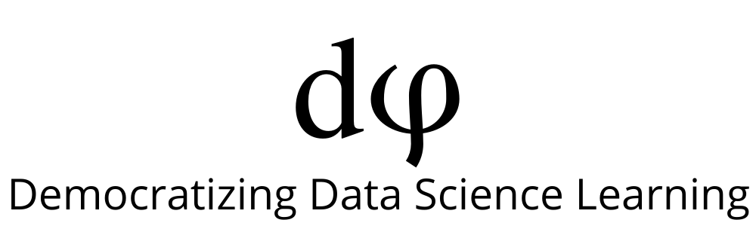
Supervised ML Algorithms - Regression
Support Vector Regressor

Slide 2
Support Vector Regressor
Support Vector Machines (SVMs) are well known in classification problems. However, the use of SVMs in regression is not as well documented. These types of models are known as Support Vector Regression (SVR).
SVR gives us the flexibility to define how much error is acceptable in our model and will find an appropriate line to fit the data.

Slide 3
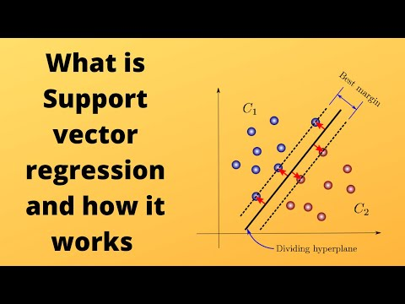
Support Vector Regressor

Slide 4
Kernels
SVM algorithms use a set of mathematical functions that are defined as the kernel.
The function of kernel is to take data as input and transform it into the required form.
Different SVM algorithms use different types of kernel functions. These functions can be different types.
For example linear, nonlinear, polynomial, radial basis function (RBF), and sigmoid.
The most used type of kernel function is RBF. It is also the default kernel

Slide 5
Support Vector Regression Implementation
https://www.analyticsvidhya.com/blog/2020/03/support-vector-regression-tutorial-for-machine-learning/

Slide 6
Slide Download Link
You can download these slides from the below link:
https://docs.google.com/presentation/d/17geHykDZnwjcO3KkPlvJdeMXSfwHOBCS4yb9JMyFl-Q/edit?usp=sharing

Slide 7
That’s it for this unit. Thank you!
Feel free to post any queries on Discuss.

