Slide 1

Supervised ML Algorithms - Regression
Random Forest/ Regression Forest

Slide 2
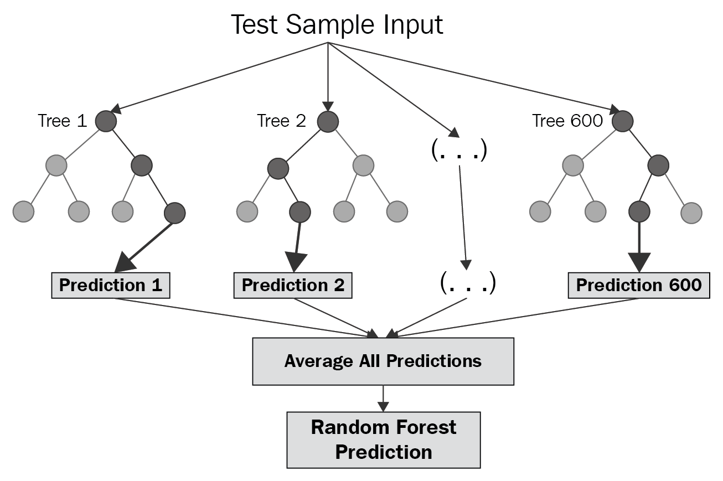
Random Forest for regression - Regression Forest
Random forest builds multiple decision trees and merges them together to get a more accurate and stable prediction.
Regression Forests (or Random forest Regressors) are an ensemble (combination) of different regression trees (decision trees for regression). Each leaf contains a distribution for the continuous output variable/s.

Slide 3
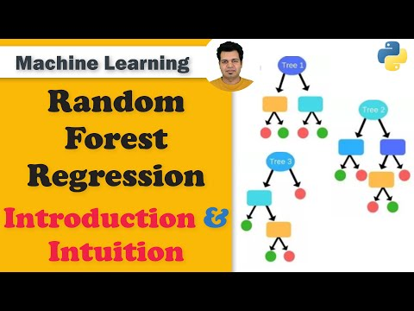
Random Forest for regression - Regression Forest

Slide 4
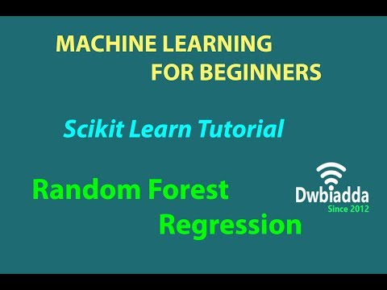
Regression Forest - Implementation

Slide 5
Slide Download Link
You can download these slides from the below link:
https://docs.google.com/presentation/d/1zW4IU6j5XJC0QGDdFxWpvZMgra60ftpnCfZAFZpInTQ/edit?usp=sharing

Slide 6
That’s it for this unit. Thank you!
Feel free to post any queries on Discuss.

