Slide 1

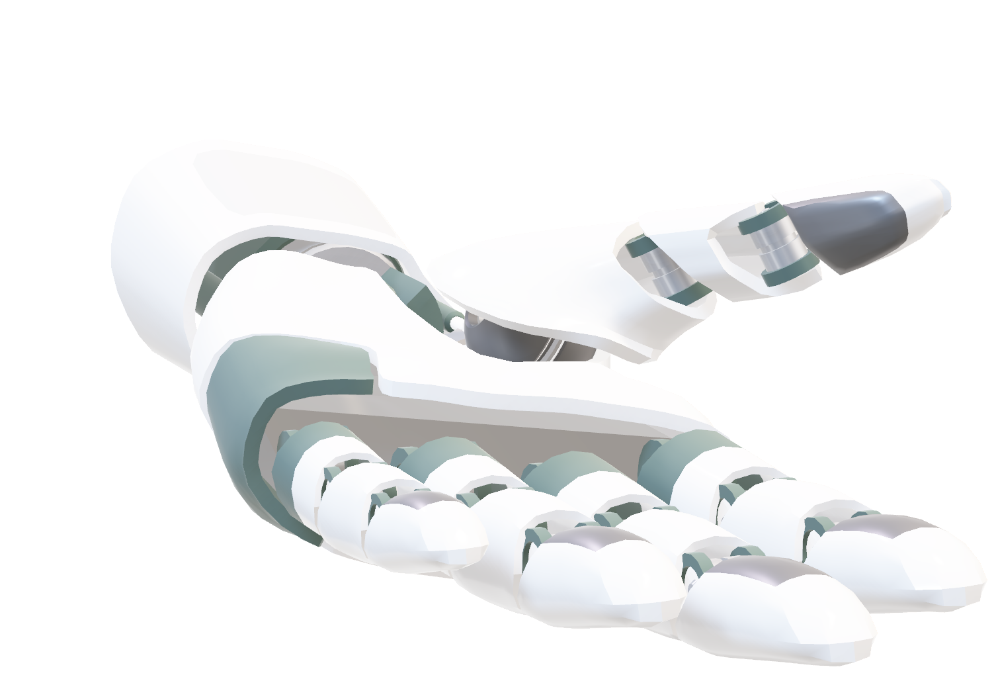
Welcome

Slide 2
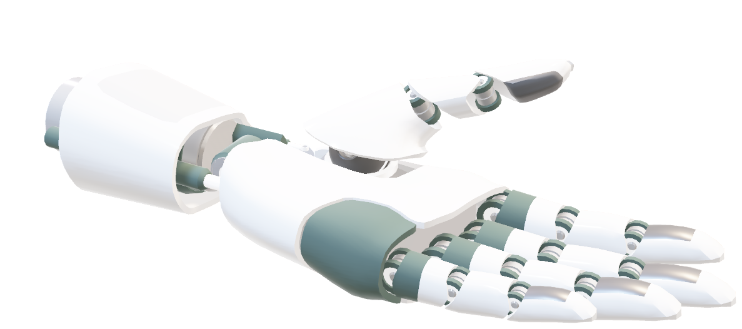
AI-Powered Healthy Indoor Environment

Slide 3
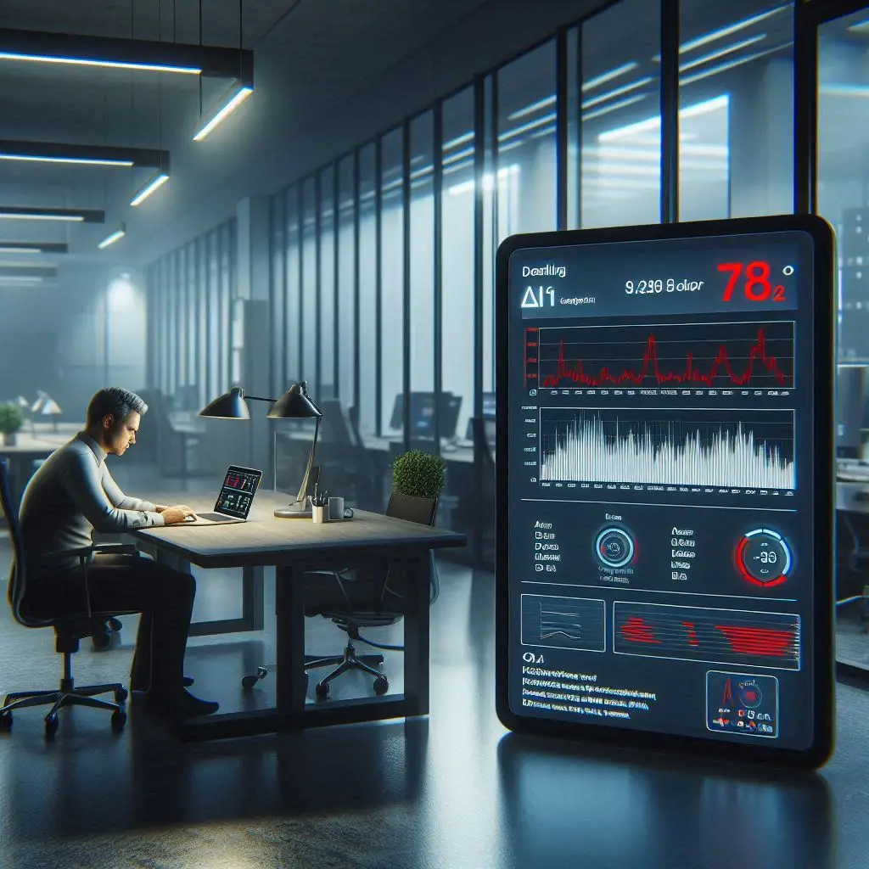


Problem Statement & Motivation
No fast or real-time method to assess indoor air quality
People rely on feelings/experience → risk of late detection
Air quality affected by humidity, CO₂, temperature, occupancy
Unsafe conditions cannot be predicted early

Slide 4

Why AI?
Complex, dynamic environment
Real-time analysis
Predictive capabilities
Personalized recommendations

Slide 5
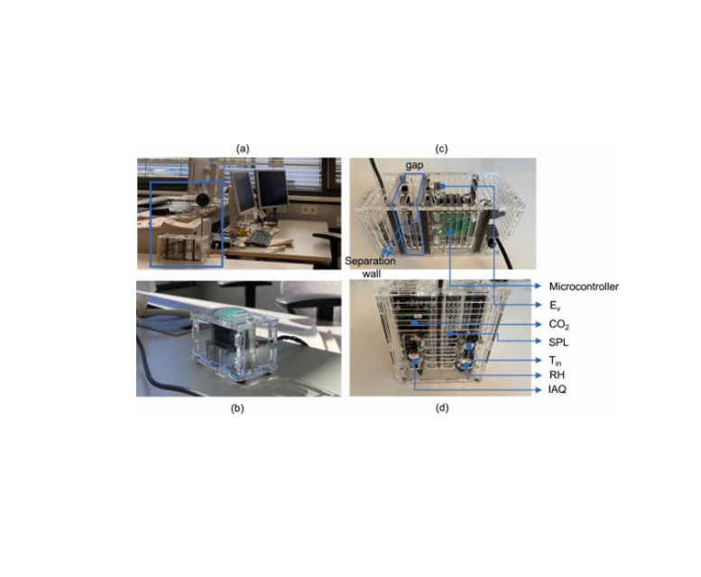
Dataset used
“Non-intrusive indoor environmental data in two double-occupied offices”
Study conducted at Munich University of Applied Sciences, Germany
Offices equipped with:
Manually operable windows
Exterior shading
Heating system

Slide 6



Sensors
IoT sensors installed at desk level near occupants
Recorded physical variables:
Air temperature
CO₂ concentration
Indoor Air Quality (IAQ) index
Illuminance
Relative humidity
Sound pressure level
Air speed
Window status

Slide 7

Raw Data Files
Data distributed as two CSV files:
office_A.csv
office_B.csv
Each file corresponds to one office
Downloaded from Mendeley Data repository

Slide 8

Why Merge the Two Datasets
Both offices: Same structure, sensor types, and methodology
Reasons to merge:
Increase dataset size → improves model generalization and accuracy
Introduce variability → more representative environmental and occupant behaviors
Simplify workflow → easier preprocessing, analysis, and model development

Slide 9

Data Cleaning & Column Removal
Removed redundant/uninformative columns:
Unnamed: 0 → auto-generated index, no analytical value
DAY & TIME → not needed, no time-series modeling
Ev → constant value, does not help model learning

Slide 10

Data Standardization & validation
Converted MONTH text column → numeric MONTH_NUM (1–12)
All columns are now numeric → ready for modeling
Checked for missing values → none found
Some duplicate sensor values detected → timestamps differ, valid readings

Slide 11
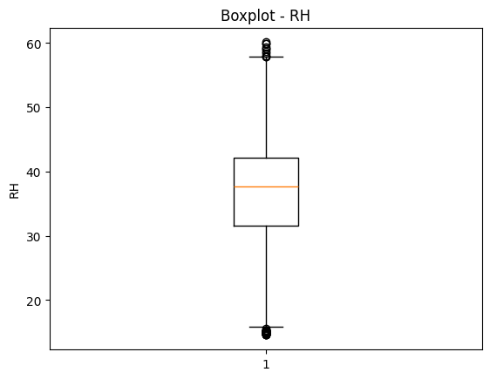

Outlier Analysis & Validity Checks
Outlier detection using IQR method (CO₂, RH, Tin, IAQ)
Outliers not removed → represent real environmental events
Validity checks:
OCCUPANCY & WINDOW: 0/1 values
RH in [0–100]
CO₂ > 0
IAQ in [0–500]

Slide 12
Feature Engineering & Interaction Features
Created interaction features to improve model insight:
CO2_x_OCCUPANCY → CO₂ when room occupied
CO2_x_WINDOW → CO₂ when window open
WINDOW_x_OCCUPANCY → room occupied & window open
Temp_x_RH → indoor temp × humidity → proxy for discomfort

Slide 13
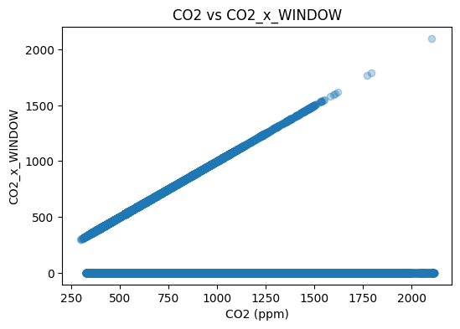
Feature Engineering & Interaction Features

Slide 14
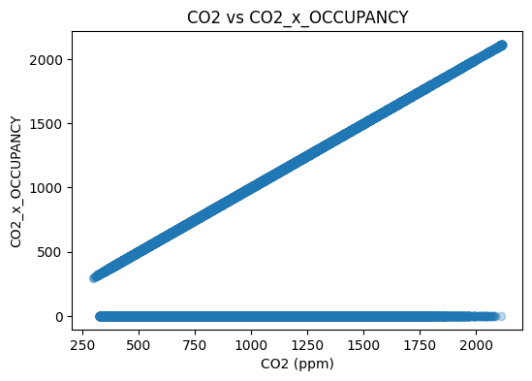
Feature Engineering & Interaction Features

Slide 15
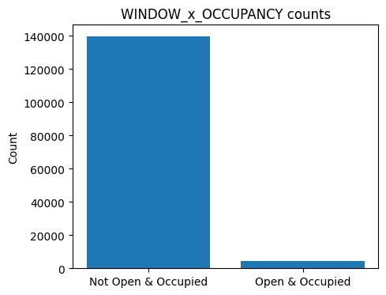
Feature Engineering & Interaction Features

Slide 16
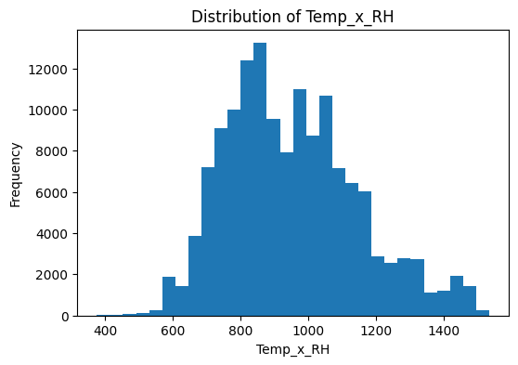
Feature Engineering & Interaction Features

Slide 17
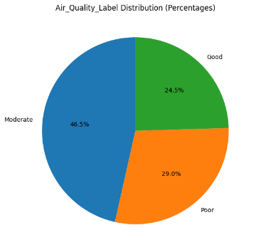
Target Variable – IAQ
IAQ (Indoor Air Quality) Index used as ground truth
Computed using Bosch BSEC algorithm (BME680/BME688 sensors)
Normalized score: 0–500
IAQ values mapped into 3 categories:
Good: 0–100 Moderate: 101–200 Poor: >200

Slide 18
Whats Next?
• Building the model
• Training the model
• Testing and evaluation

Slide 19
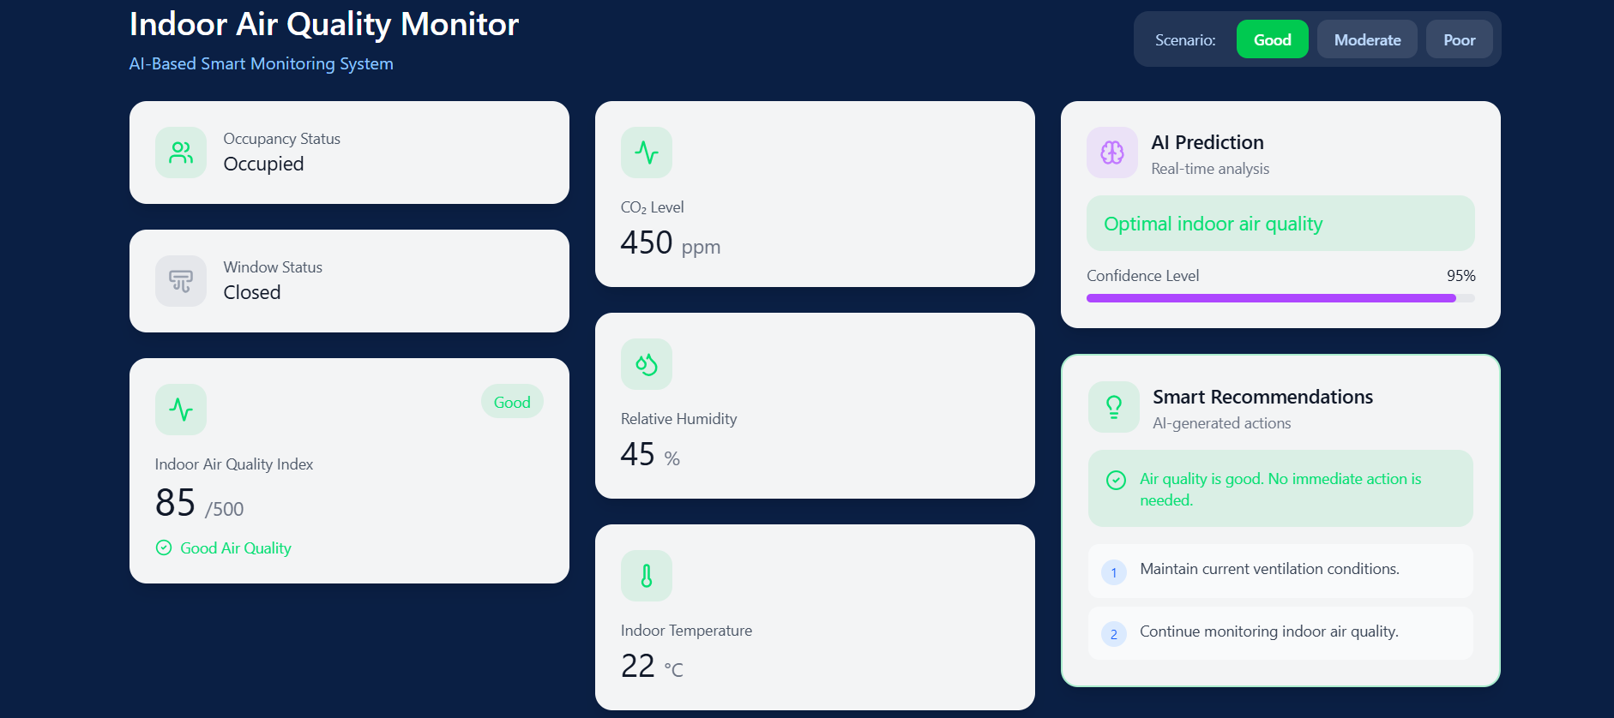

Slide 20
Thank you all

