Slide 1
RESULTS
Notes:
The first three slides shows several results on different condition of generated h_ext.
h__ext(xx), the xx shows the seed used to produce that h_ext events.
The 5th slide shows that the model’s top band rule still tend to locked the collective opinion from fluctuating. I asked claude to look for seed which gives h_ext event able to pull the collective M from the top band. Yet, it did not find any seed that produce that (the collective opinion still locked after reaching top band).
Hence, I revise the middle and top band rule to be the newest one. Instead of exponential, the top band now has rule D= Do(3 + k. dM). Similar to the top band, the middle band rule is D= Do(1 + k. dM).
k=4 is used because it produce a rule-base D which gives a visible brake effect but not locking the collective opinion to the point it is very hard to pull or push it back from the top band.
The result of the new D-rules can be seen started from the 6th slide.

Slide 2
RESULTS
I tested several conditions of external field on different D values:
  D=0 (constant)
  D=-0.5 (constant)
  D=D(M) (rule-based)
This experiment section is conducted to:
  Show and compare the braking effect of different D values.
  Compare how different h_ext sequences affect the capability of M to shift from the top band (where the resistance is high). [This is observed better in the section where the D-rule has been revised].

Slide 3
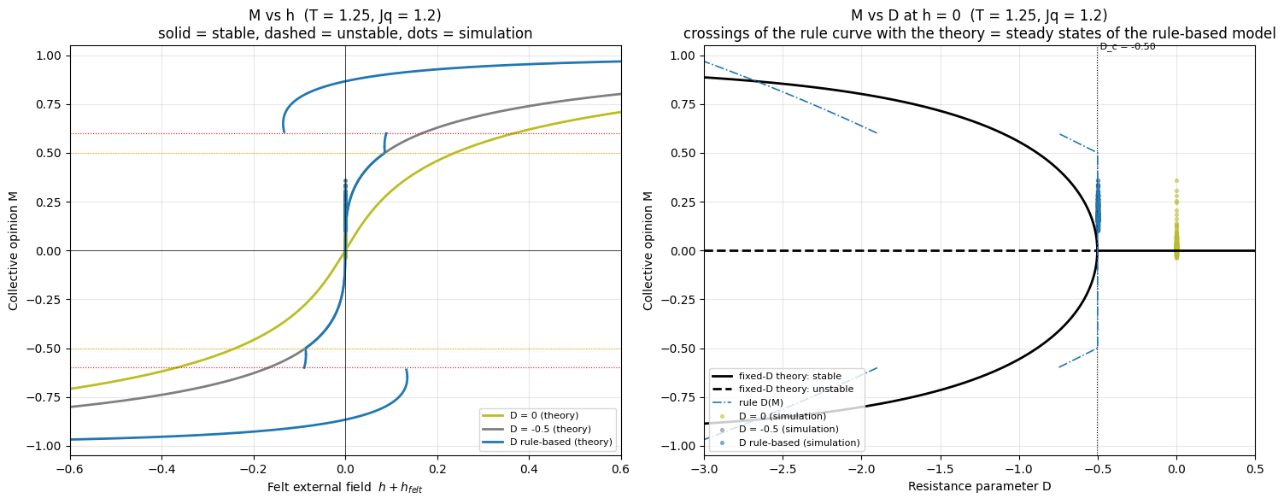
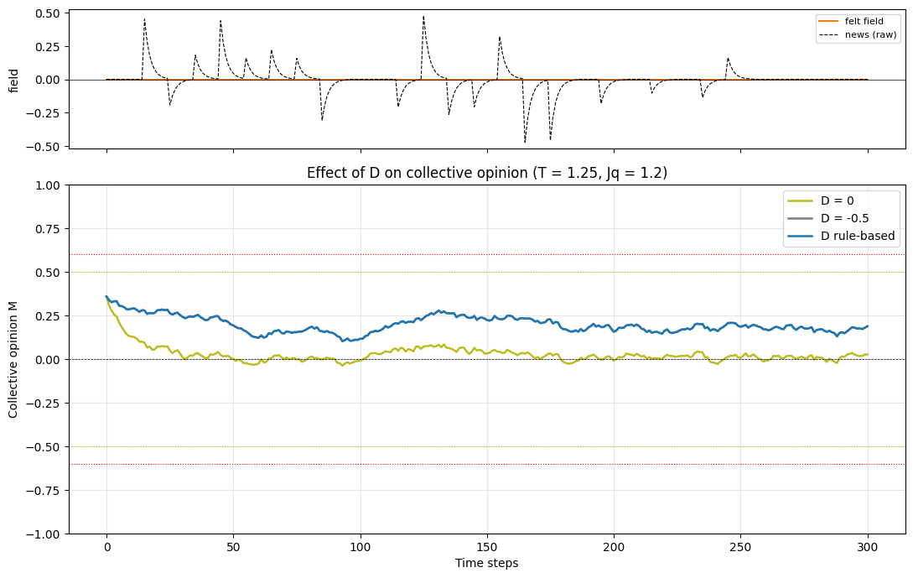
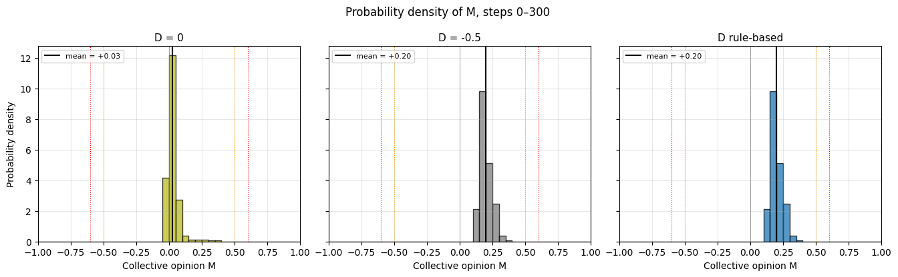
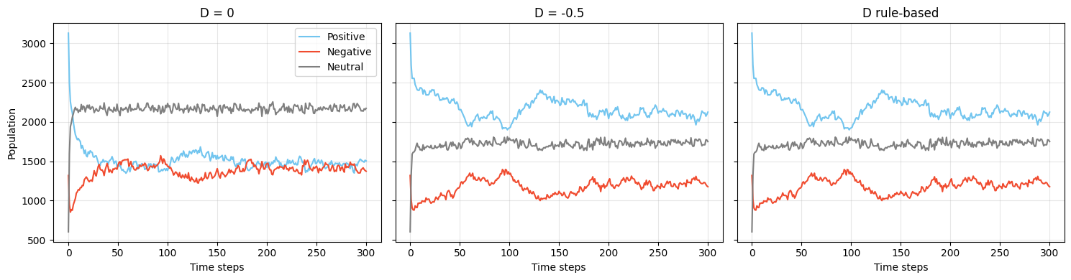
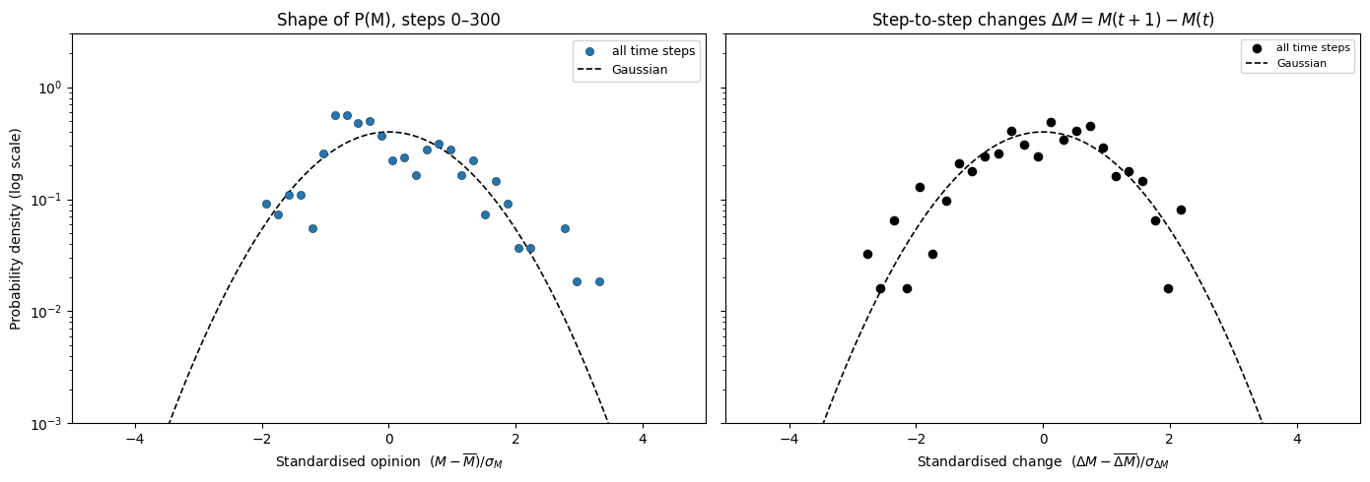
h_felt=0 (no external field)

Slide 4
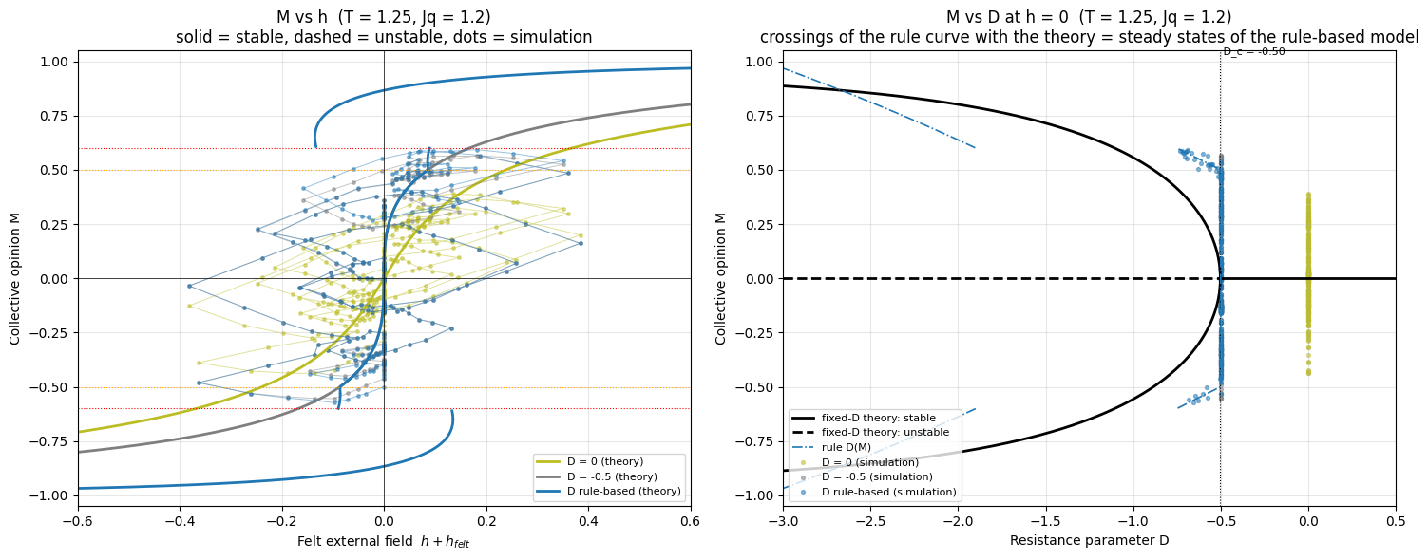
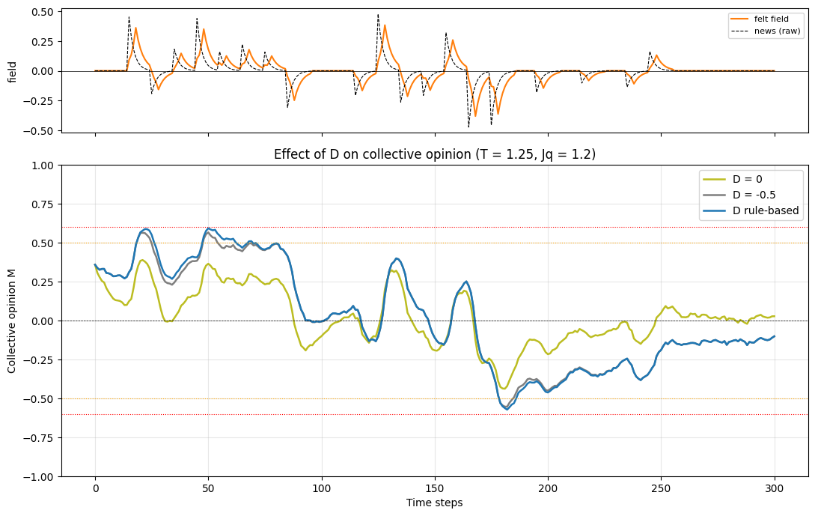
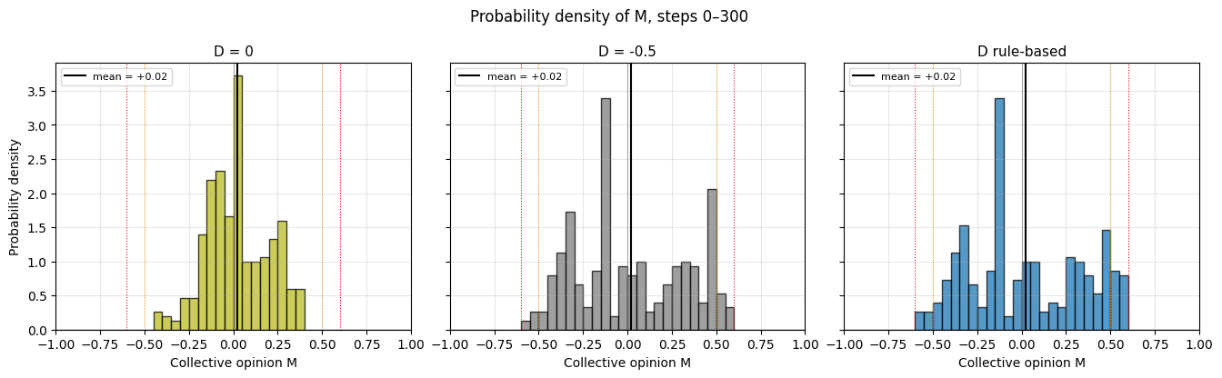
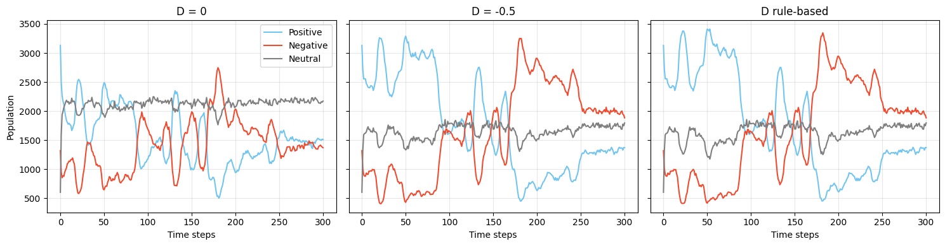
h_felt (58)

Slide 5
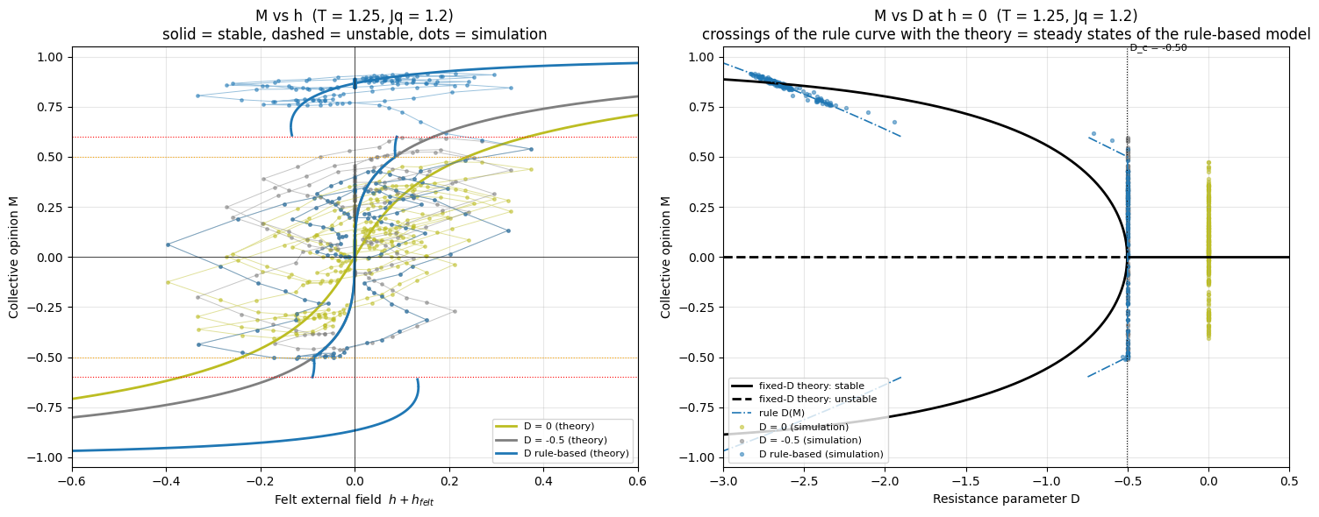
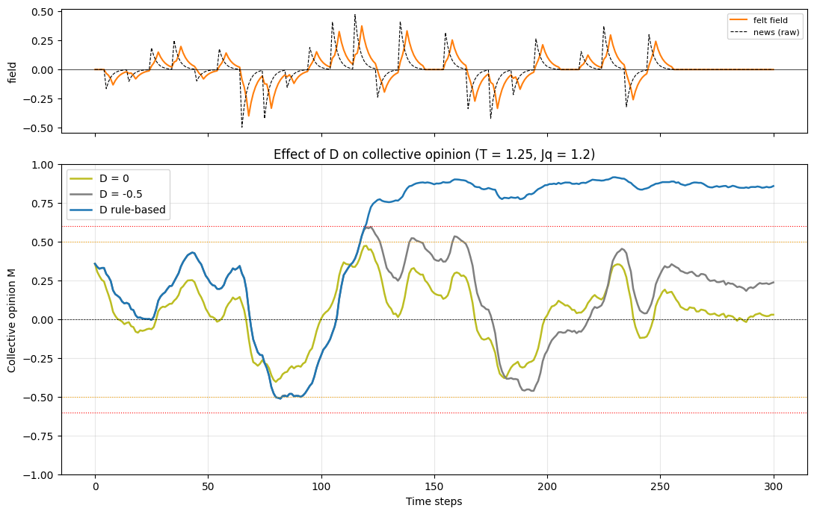
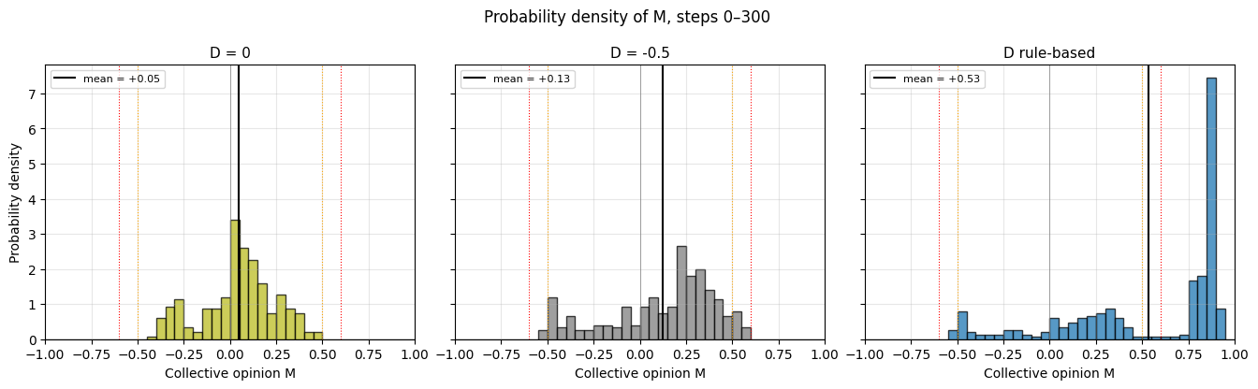
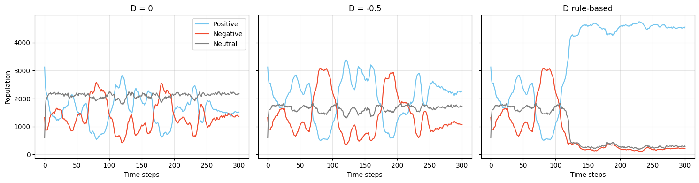
h_felt(25)

Slide 6
RESULTS
NEW BAND RULE

Slide 7
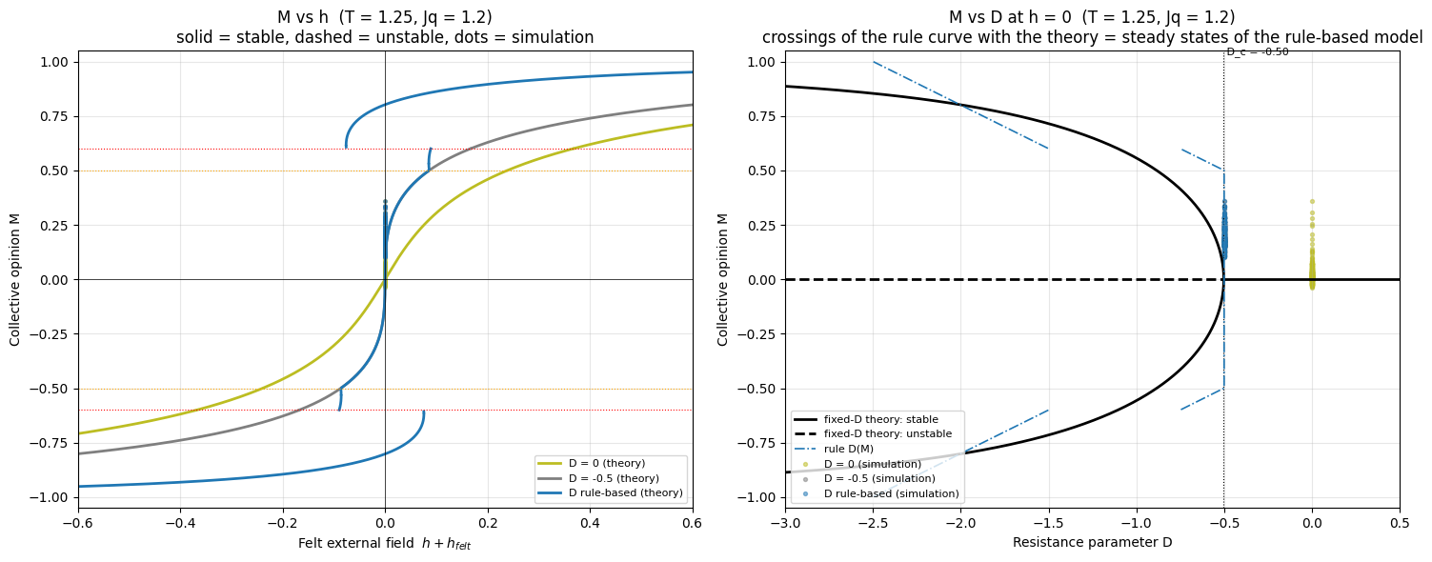
h_felt=0 (no external field)

Slide 8
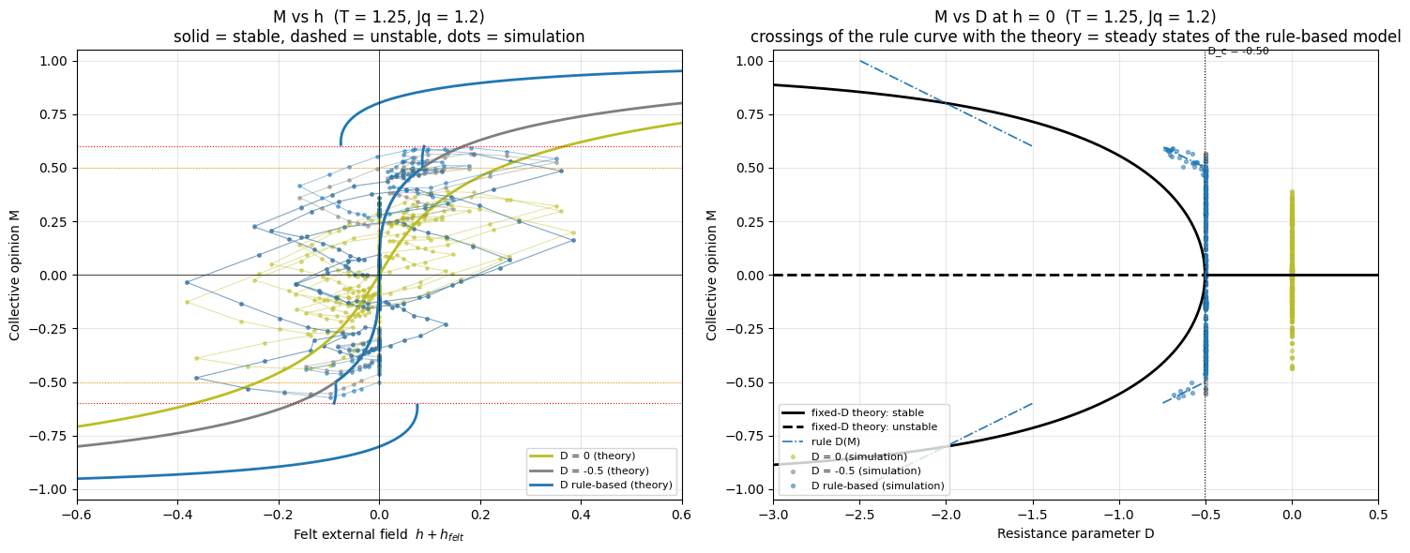



h_felt(58)

Slide 9
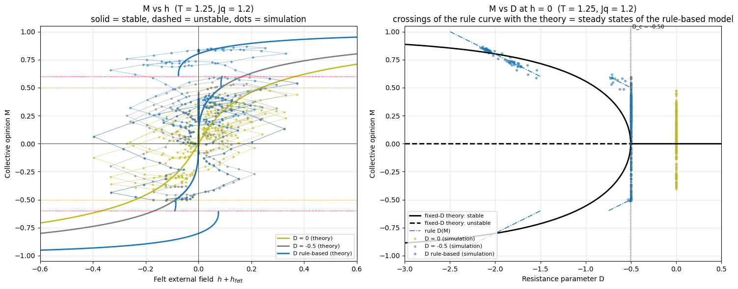
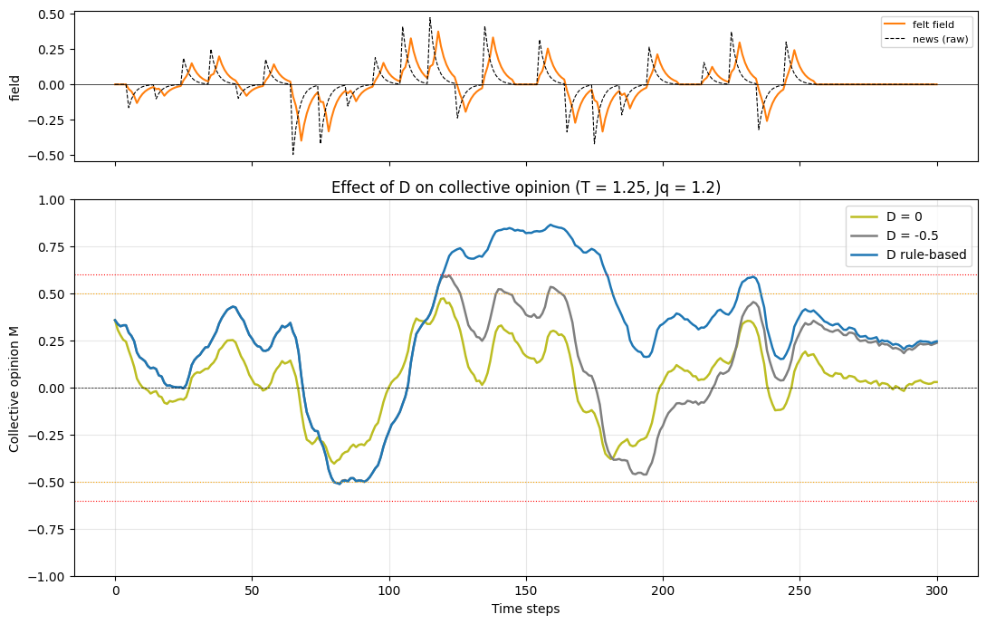
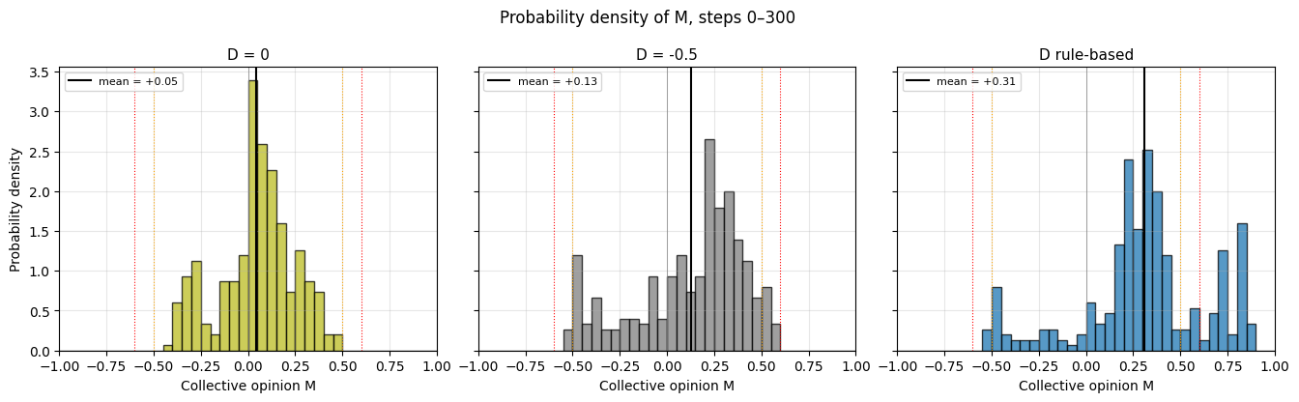
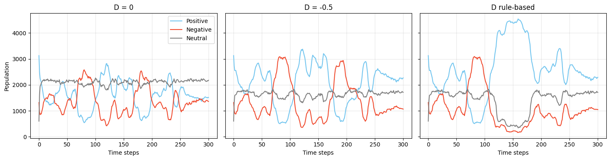
h_felt(25)

Slide 10
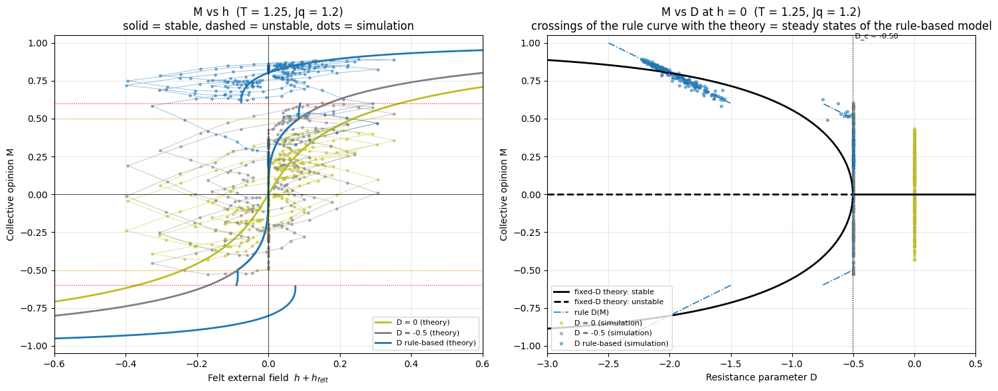
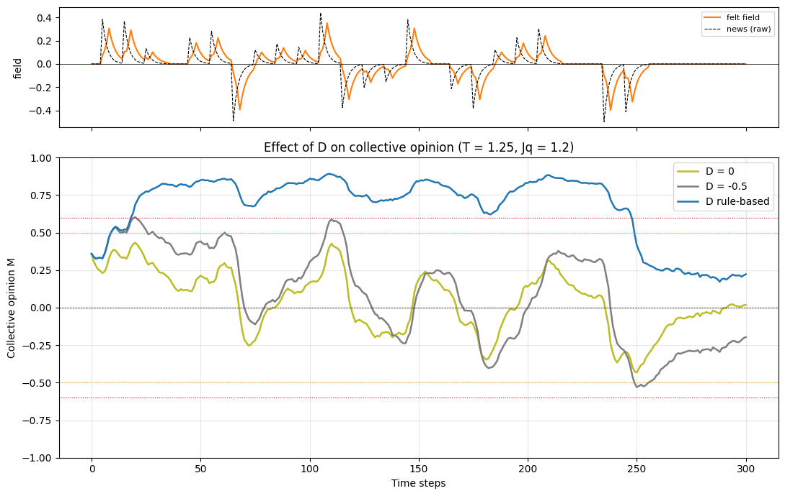
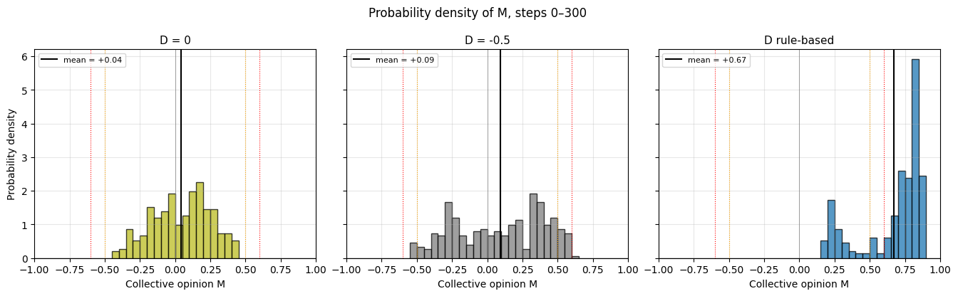
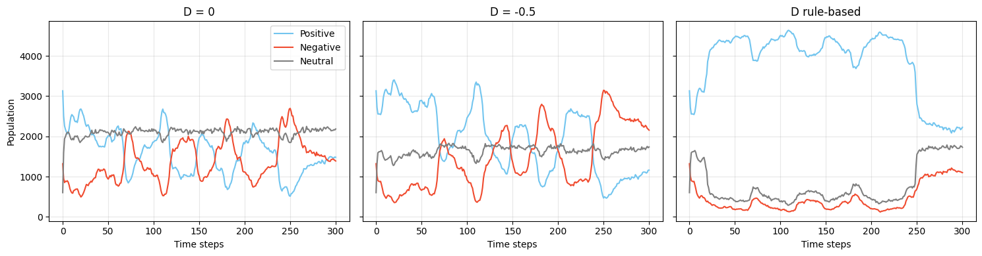
h_felt(37)

