Slide 1
ADULT ECHOCARDIOGRAPHY / A TEACHING DECK FOR FELLOWS
Echo
Essentials
What the guidelines say, why they say it, and where readers go wrong.
Dr. Elfadil Bilal Abdelrahman
Consultant Cardiologist and Echocardiographer, Prince Mohammed bin Abdulaziz Hospital, Riyadh
Notes:
Welcome. By the end of the session the fellows should be able to grade aortic stenosis including very severe disease and both low-flow states, and quantify AR, MS, MR and TR with integrated criteria.

Slide 2
LEARNING OBJECTIVES
By the end of this session
Quantify LV size, mass and ejection fraction the way the guidelines expect.
Estimate left atrial pressure and apply the ASE 2025 diastology approach.
Assess the right ventricle and the probability of pulmonary hypertension.
Grade aortic stenosis including very severe disease and both low-flow states.
Integrate parameters for AR, MS, MR and TR.
Report with a conclusion that answers the clinical question.
FOUR NUMBERS
Gradient, area, flow, ejection fraction. If they do not tell one coherent story, a measurement is wrong.
SOURCES
ASE/EACVI 2015, 2017, 2025. ESC/EACTS 2025. ACC/AHA 2020 where it differs.
ECHO ESSENTIALS
2
Notes:
Two minutes. State the order: LV, diastology, right heart, then aortic stenosis as the longest block, then the other valves, then two cases.

Slide 3
CHAMBER QUANTIFICATION
Measuring the left ventricle
 | Men | Women
LVEF | 52 to 72% | 54 to 74%
LV end-diastolic diameter | 42 to 58 mm | 38 to 52 mm
LV end-systolic diameter | 25 to 40 mm | 22 to 35 mm
LV mass index (2D) | 50 to 102 g/m² | 44 to 88 g/m²
Relative wall thickness | 0.42 or less | 0.42 or less
LA volume index | 16 to 34 mL/m² | 16 to 34 mL/m²
EF CATEGORIES
Mildly reduced 41 to 51 (men), 41 to 53 (women). Moderate 30 to 40. Severe below 30.
STRAIN
Abnormal when less negative than about −16%. A relative fall above 15% matters in cardio-oncology. Name the vendor.
ECHO ESSENTIALS
3
Notes:
Stress biplane Simpson, contrast when two or more contiguous segments are poorly seen, and foreshortening as the commonest error.

Slide 4
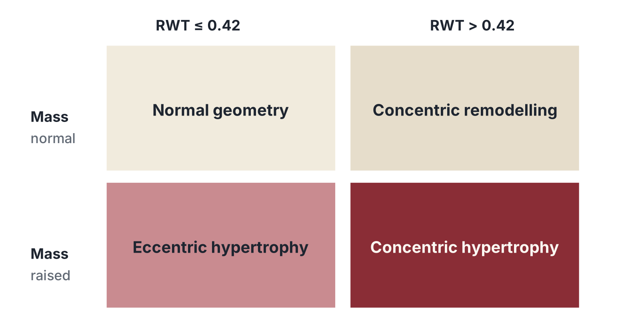
CHAMBER QUANTIFICATION
Geometry in one picture
Normal geometry mass normal, RWT 0.42 or less
Concentric remodelling mass normal, RWT above 0.42
Concentric hypertrophy mass raised, RWT above 0.42
Eccentric hypertrophy mass raised, RWT 0.42 or less
THINK
Concentric hypertrophy in an older patient: hypertension, aortic stenosis, or amyloid. Rarely just one.
ECHO ESSENTIALS
4
Notes:
Combine mass and relative wall thickness before you say hypertrophy. The same mass can reflect pressure overload or volume overload.

Slide 5
ASE 2025
Left atrial pressure and diastology
Parameter | Suggests raised LAP
Septal e′ | Below 7 cm/s
Lateral e′ | Below 10 cm/s
Average E/e′ | Above 14
TR peak velocity | Above 2.8 m/s
LA volume index | Above 34 mL/m²
Mitral E/A | 2 or more (0.8 or less with E at or below 50: normal)
ATRIAL FIBRILLATION
Septal E/e′ 11 or more, DT 160 ms or less, IVRT 65 ms or less, TR above 2.8 m/s.
WHERE IT GOES WRONG
E/e′ in moderate to severe MAC, mitral stenosis, mitral prosthesis or severe primary MR.
ECHO ESSENTIALS
5
Notes:
Underline that the 2025 update asks you to decide whether left atrial pressure is raised first, then grade, and adds an HFpEF diagnostic section. Show the published flow chart if you have it.

Slide 6
RIGHT HEART
The right ventricle
Parameter | Abnormal when
TAPSE | Below 17 mm
S′ (tissue Doppler) | Below 9.5 cm/s
Fractional area change | Below 35%
Free-wall strain | Less negative than about −20%
Basal diameter | Above 41 mm
Right atrial area | Above 18 cm²
UNCOUPLING
TAPSE to PASP ratio below 0.55 mm/mmHg: a worse prognosis.
WHERE IT GOES WRONG
Reporting a pressure from a faint TR envelope. Enhance with agitated saline and say so.
ECHO ESSENTIALS
6
Notes:
Use at least two measures, one longitudinal and one global. Disagreement between them is informative.

Slide 7
RIGHT HEART
Probability of pulmonary hypertension
TR peak velocity | Other PH signs | Probability
2.8 m/s or less, or not seen | None | Low
2.8 m/s or less | Present | Intermediate
2.9 to 3.4 m/s | None | Intermediate
2.9 to 3.4 m/s | Present | High
Above 3.4 m/s | Not required | High
RIGHT ATRIAL PRESSURE
3 mmHg: IVC 21 mm or less, collapses over 50%. 15 mmHg: IVC over 21 mm, collapses under 50%. 8 mmHg: between.
Other signs: RV to LV basal ratio above 1.0, septal flattening, RVOT acceleration time under 105 ms, PR early diastolic velocity above 2.2 m/s, PA diameter above 25 mm, IVC over 21 mm, RA area above 18 cm².
ECHO ESSENTIALS
7
Notes:
PASP is 4 times the TR velocity squared plus estimated right atrial pressure. ESC/ERS 2022 prefers probability to a single pressure cut-off.

Slide 8
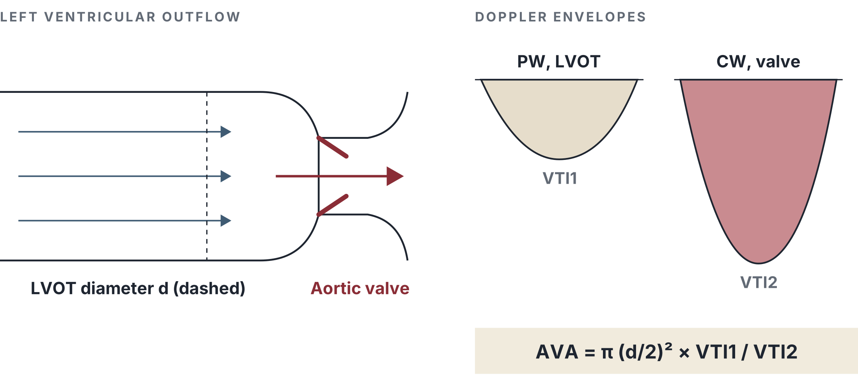
AORTIC STENOSIS
Aortic stenosis: measure it right
Vmax several windows, dedicated probe, report the highest
Mean gradient from the same envelope
AVA continuity; LVOT diameter is squared
DVI LVOT VTI over aortic VTI; severe at 0.25 or less
SVi low flow is below 35 mL/m²
RULE
Misalignment always underestimates velocity.
ECHO ESSENTIALS
8
Notes:
Ask what a 1 mm error in the LVOT diameter does to the area. Because the diameter is squared, the area changes by roughly 0.2 cm2.

Slide 9
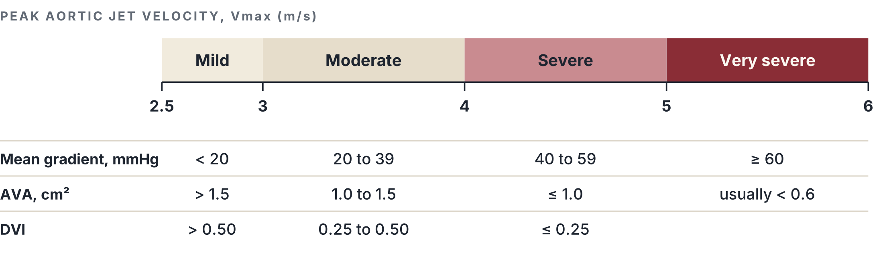
AORTIC STENOSIS
Grading severity
AVAi for severe AS: 0.6 cm²/m² or less. Source: ESC/EACTS, ASE/EACVI 2017, ACC/AHA 2020.
ECHO ESSENTIALS
9
Notes:
Severe is concordant across ESC/EACTS, ASE/EACVI and ACC/AHA. Mild and moderate bands follow ACC/AHA staging.

Slide 10
AORTIC STENOSIS
Critical aortic stenosis
DEFINITION
NEONATES
In adults, critical or very severe AS means a peak velocity of 5.0 m/s or more and / or a mean gradient of 60 mmHg or more, usually with an AVA below 0.6 cm².
ACC/AHA 2020 says very severe. ESC/EACTS treats a velocity above 5.0 m/s as a marker that supports early intervention even without symptoms.
Report the numbers, not only the label.
Critical AS in a newborn is a duct-dependent systemic circulation. Adult cut-offs do not apply.
MIND THE FLOW
A very narrow valve with low stroke volume can give a modest gradient.
ECHO ESSENTIALS
10
Notes:
Spend time here. There is no single universal definition for the word critical. Adult usage is Vmax 5 m/s or more and/or MG 60 mmHg or more. State the numbers in your report. In neonates, critical AS is a separate, duct-dependent condition.

Slide 11
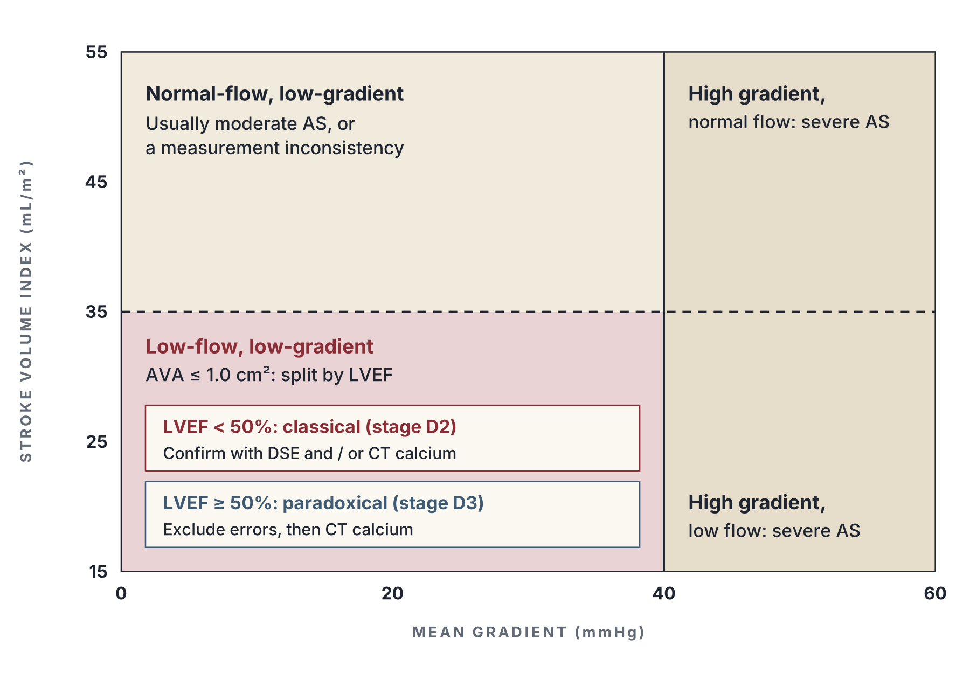
AORTIC STENOSIS
When the numbers disagree
Flow first SVi below 35 mL/m² defines low flow, regardless of LVEF.
Then LVEF it separates the two low-flow types.
Then confirm DSE, CT calcium, or both.
THIRD GROUP
Normal-flow, low-gradient: usually moderate AS or a measurement inconsistency.
ECHO ESSENTIALS
11
Notes:
About a third of patients with an AVA of 1.0 cm2 or less have a mean gradient below 40. Ask about flow first, then ejection fraction.

Slide 12
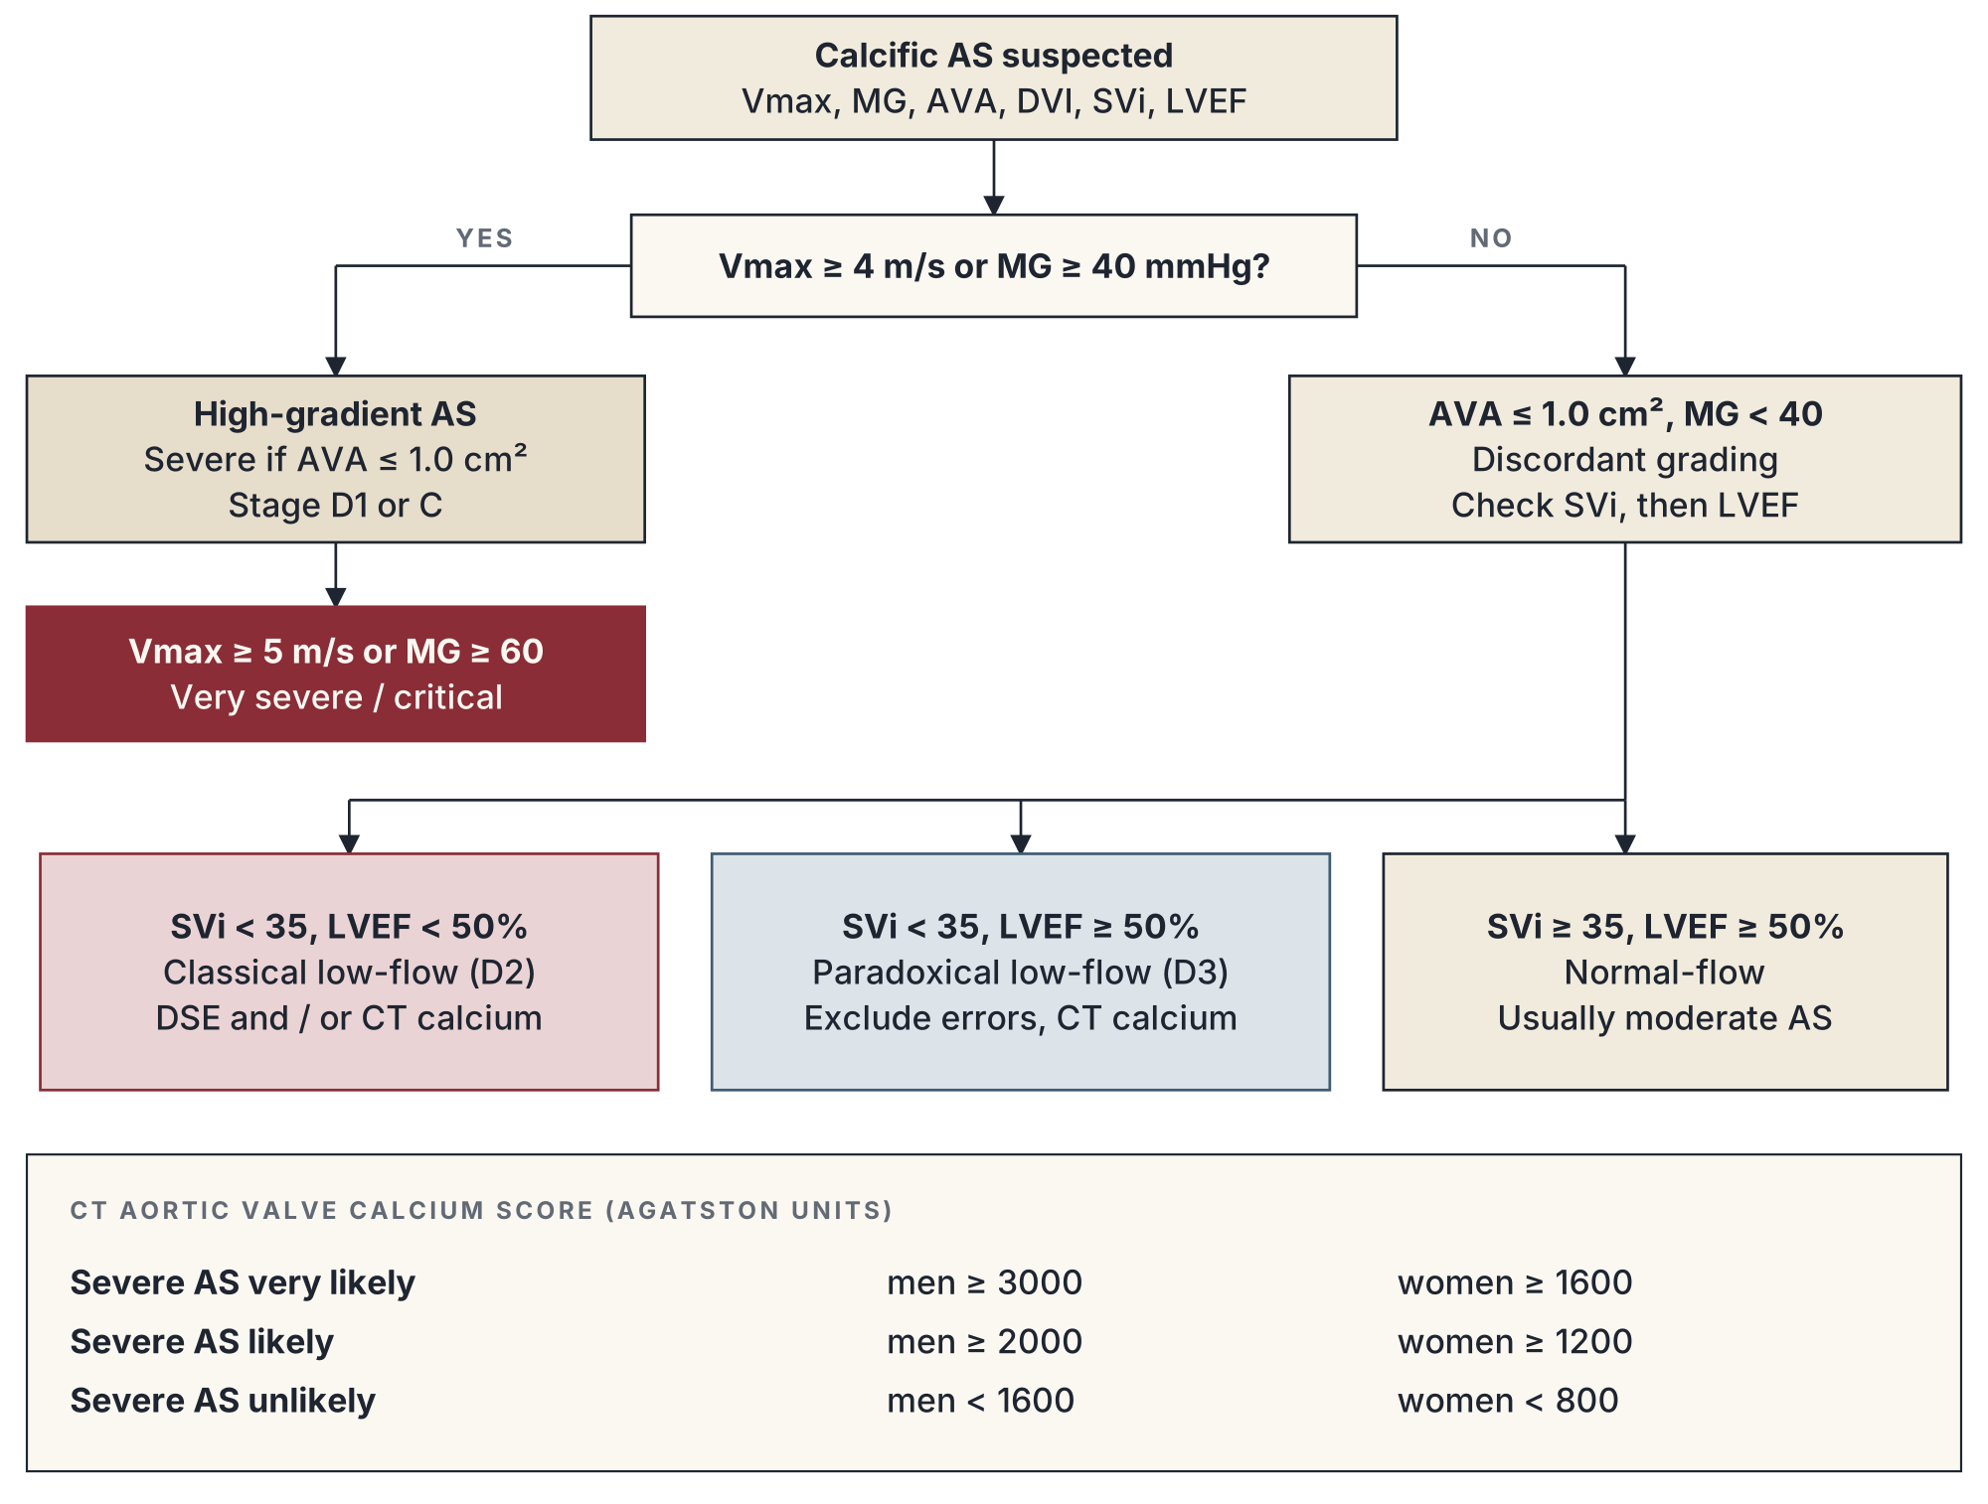
AORTIC STENOSIS
A working algorithm
READ
Flow decides the branch.
ECHO ESSENTIALS
12
Notes:
Walk it top to bottom. Stages follow ACC/AHA 2020. Calcium thresholds are the sex-specific values in ESC/EACTS.

Slide 13
AORTIC STENOSIS
Classical low-flow, low-gradient AS
Definition AVA 1.0 or less, MG below 40, LVEF below 50%, SVi below 35 (stage D2).
The question true-severe, or a weak ventricle with a moderate valve?
DSE 2.5 to 5, up to 20 µg/kg/min.
Flow reserve stroke volume rise of 20% or more.
True-severe AVA stays 1.0 or less with Vmax 4 m/s or more.
Pseudo-severe AVA rises above about 1.0 to 1.2; gradient stays low.
No flow reserve use CT calcium; replacement still helps.
PROJECTED AVA
AVA(rest) + [AVA(peak) − AVA(rest)] / [Q(peak) − Q(rest)] × (250 − Q(rest)). Severe if below 1.0 cm².
MANAGEMENT
Confirmed severe: valve replacement. TAVI is often favoured when surgical risk is high.
ECHO ESSENTIALS
13
Notes:
Explain true-severe versus pseudo-severe. Flow reserve means stroke volume rises by at least 20 percent with low-dose dobutamine.

Slide 14
AORTIC STENOSIS
Paradoxical low-flow AS
Definition AVA 1.0 or less (AVAi 0.6 or less), MG below 40, LVEF 50% or more, SVi below 35 (stage D3).
Typical older women, small hypertrophied LV, hypertension, atrial fibrillation.
Prognosis comparable with high-gradient severe AS.
Test exclude errors, then CT calcium. Dobutamine cannot raise flow in a small stiff LV.
Check first
Blood pressure | Systolic below 140
LVOT area | 3D echo or CT
Body size | Use AVAi
Rhythm | Average 5 beats in AF
Mimics | Amyloid, MR, MS, AR
WHY IT MATTERS
Missing this group leaves symptomatic patients with severe disease untreated.
ECHO ESSENTIALS
14
Notes:
This is the second low-flow type. The ejection fraction looks fine; the ventricle is small, thick and stiff, and the stroke volume is low.

Slide 15
AORTIC STENOSIS
CT calcium score
Agatston units | Men | Women
Severe AS very likely | 3000 or more | 1600 or more
Severe AS likely | 2000 or more | 1200 or more
Severe AS unlikely | Below 1600 | Below 800
REMEMBER
Calcium confirms burden. It does not replace haemodynamics.
ECHO ESSENTIALS
15
Notes:
Calcium is independent of flow, which is why it helps exactly when echo is discordant. Severe AS can occur with less calcium in younger, bicuspid or rheumatic valves.

Slide 16
AORTIC STENOSIS
From numbers to decisions
Situation | Typical recommendation
Symptomatic, high-gradient severe AS | Intervention (class I). TAVI or surgery by age, risk, anatomy, Heart Team
Symptomatic, classical LFLG | Intervention (class I) with flow reserve; with CT calcium support if none
Symptomatic, paradoxical LFLG | Intervention once confirmed (ESC 2021 IIa; ACC/AHA 2020 class I)
Asymptomatic, LVEF below 50% | Intervention (class I). Check the 2025 LVEF cut-off
Asymptomatic, symptoms on exercise test | Intervention (ESC class I)
Asymptomatic, Vmax 5 m/s or more | Consider intervention in low-risk patients (IIa)
Asymptomatic, BNP over 3x, rapid progression, marked calcium | Consider intervention (IIa)
ECHO ESSENTIALS
16
Notes:
Always check the class and level in the current text. EARLY TAVR, AVATAR and RECOVERY have shifted practice for asymptomatic patients.

Slide 17
REGURGITANT LESIONS
Aortic regurgitation
 | Mild | Moderate | Severe
Vena contracta | Below 3 mm | 3 to 6 mm | Above 6 mm
Jet width / LVOT | Below 25% | 25 to 64% | 65% or more
Pressure half-time | Above 500 ms | 200 to 500 | Below 200 ms
EROA | Below 0.10 | 0.10 to 0.29 | 0.30 cm² or more
Regurgitant volume | Below 30 mL | 30 to 59 | 60 mL or more
Regurgitant fraction | Below 30% | 30 to 49% | 50% or more
SURGERY, CHRONIC SEVERE
ESC 2021: LVESD above 50 mm or LVEF 50% or less. ACC/AHA 2020: LVEF 55% or less. Check root and ascending aorta.
ACUTE AR
The LV is not dilated. Short PHT and early mitral closure. Urgent surgery.
ECHO ESSENTIALS
17
Notes:
No single parameter grades AR. Remind fellows that colour jet width underestimates eccentric jets.

Slide 18
REGURGITANT LESIONS
Mitral stenosis
 | Moderate | Clinically significant
Valve area | 1.0 to 1.5 cm² | 1.5 cm² or less; very severe 1.0 or less
Pressure half-time | 150 to 219 ms | 150 ms or more; very severe 220 or more
Mean gradient | 5 to 10 mmHg | Above 10 at HR 60 to 80
Systolic PA pressure | 30 to 50 mmHg | Above 50 mmHg
BEFORE COMMISSUROTOMY
Exclude LA thrombus on TEE and more than mild MR. Wilkins 8 or less favours success.
PHT PITFALLS
Unreliable in AF, tachycardia, after valvotomy, and with significant AR. Prefer planimetry.
ECHO ESSENTIALS
18
Notes:
Wilkins score: mobility, thickening, calcification and subvalvular thickening, each 1 to 4.

Slide 19
REGURGITANT LESIONS
Mitral regurgitation
 | Mild | Moderate | Severe
Vena contracta | Below 3 mm | 3 to 6.9 | 7 mm or more
EROA (primary) | Below 0.20 | 0.20 to 0.39 | 0.40 cm² or more
Regurgitant volume | Below 30 mL | 30 to 59 | 60 mL or more
Regurgitant fraction | Below 30% | 30 to 49% | 50% or more
Pulmonary vein | Systolic dominant | Blunted | Systolic reversal
PRIMARY: OPERATE
Symptoms; LVESD 40 mm or more; LVEF 60% or less; new AF; PASP above 50; LAVI 60 or more.
SECONDARY
ESC: EROA 0.20 cm² or more, or RVol 30 mL or more. COAPT enrolled EROA above 0.30.
ECHO ESSENTIALS
19
Notes:
Primary versus secondary first. Thresholds are lower in secondary MR because the orifice is elliptical.

Slide 20
REGURGITANT LESIONS
Tricuspid regurgitation: five grades
 | Mild | Moderate | Severe | Massive | Torrential
Vena contracta | Below 3 mm | 3 to 6.9 | 7 to 13 | 14 to 20 | 21 mm or more
EROA (mm²) | Below 20 | 20 to 39 | 40 to 59 | 60 to 79 | 80 or more
Regurgitant volume (mL) | Below 30 | 30 to 44 | 45 to 59 | 60 to 74 | 75 or more
SUPPORTIVE SIGNS
WHERE IT GOES WRONG
Dense triangular CW signal, hepatic vein systolic reversal, E above 1.0 m/s, annulus above 40 mm.
A low TR velocity does not mean low PA pressure. It may mean equalised pressures.
ECHO ESSENTIALS
20
Notes:
Introduce massive and torrential grades. They stratify outcome and select patients for transcatheter therapy.

Slide 21
REPORTING, ASE 2025
The report that drives the decision
Indication quality, rhythm, heart rate, BP, BSA
LV size, mass, geometry, EF method, regional motion, strain
Diastology is LAP raised, and how do you know
RV size, function, PASP, PH probability
Valves mechanism, severity, parameters, consequence
Conclusion three to five lines, compared with the prior study
THE FIVE-LINE AS REPORT
Morphology. Vmax, MG, AVA, AVAi, DVI. SVi. LVEF and strain. One sentence on severity, flow and action.
ECHO ESSENTIALS
21
Notes:
Close the loop. The first line of the conclusion answers the clinical question.

Slide 22
CHECK YOURSELF
Case 1
A 78-year-old woman with exertional dyspnoea and hypertension. Small LV cavity, LVEF 62%.
Vmax 3.4 m/s, mean gradient 32 mmHg, AVA 0.8 cm², AVAi 0.55 cm²/m², DVI 0.22, SVi 28 mL/m².
What is the diagnosis, and what is your next step?
THINK
Flow? EF? Blood pressure during the scan? LVOT area? Sex-specific calcium threshold?
ECHO ESSENTIALS
22
Notes:
Answer: paradoxical low-flow, low-gradient AS (stage D3). Exclude measurement error (blood pressure, LVOT area), then CT calcium. For a woman, 1200 AU or more makes severe AS likely, 1600 or more very likely.

Slide 23
CHECK YOURSELF
Case 2
A 62-year-old man with ischaemic cardiomyopathy, LVEF 30%, NYHA class III.
Vmax 3.3 m/s, mean gradient 28 mmHg, AVA 0.8 cm², SVi 24 mL/m².
How do you decide whether the valve is truly severe?
THINK
Flow reserve? AVA at high flow? Calcium score? Surgical risk and the Heart Team?
ECHO ESSENTIALS
23
Notes:
Answer: classical low-flow, low-gradient AS (stage D2). Low-dose DSE. Stroke volume rise of 20% or more means flow reserve; AVA staying at or below 1.0 with Vmax 4 or more confirms true-severe. If no reserve, CT calcium (men 2000 AU or more: severe likely).

Slide 24
TAKE-HOME
Say the flow in every discordant AS case.
There are two low-flow types: reduced EF and preserved EF.
Critical AS: Vmax 5 m/s or more and / or MG 60 mmHg or more. State the numbers.
Never grade regurgitation from one parameter.
The report must drive a decision.
Dr. Elfadil Bilal Abdelrahman / Echo Essentials / Verify thresholds against current guideline editions.

