Slide 1
Code Testing in Python
By Aaron Khan

Slide 2
Code Testing
The process verifying/checking software to assess how functional the coding is. It helps to make sure the code is meeting the requirements and allows for software developers to find any errors or flaws in their code.
There are many types of code testing such as unit testing, integration testing and system testing.

Slide 3
Forms of Testing
Unit testing- It is the form of testing that isolates certain sections of the code such as methods and run tests or trials in order to make sure it meets the requirements and is running at an optimal pace.
Integration testing- This would test multiple components of a code ensuring they all work in unison or can properly work together when given an objective.
System testing- This will run the entire set of code and studying it to make sure it is fulfilling detailed requirements otherwise it would have to be readjusted.

Slide 4
Tools For Testing
Instead of utilizing pythons build in packages for unittest or doctest, you can download pytest
Py.test- is an alternative testing feature that allows for simple syntax and can be answered by just calling assert in the test function.
Hypothesis- the library which will comprise test that are both simple and complex for your code, this will allow the code to fail and it can provide feedback on your code (give bugs).
Mock- this would replace parts of code with the mock objects and form assertions about the usage of mock.

Slide 5
Unit Test
The unit test is the most common form of testing included in Pythons standard library. In order to call unittest you would have to first import unittest. Then you would create the test cases by calling the subclass unittest.TestCase (inside the test method parameter).
The unittest has all the tools necessary to construct and run tests on certain portions of the code.

Slide 6
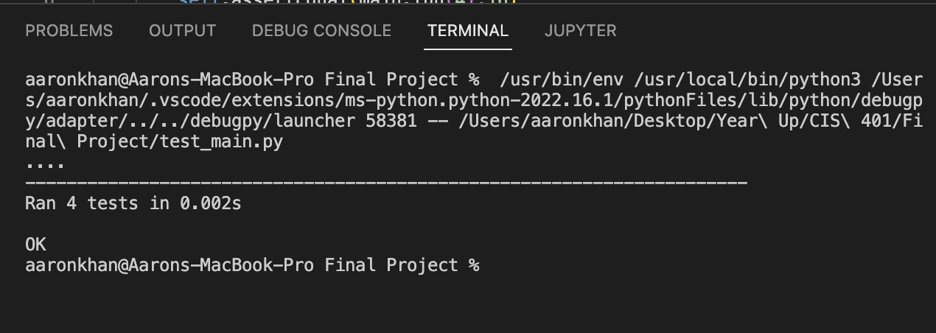
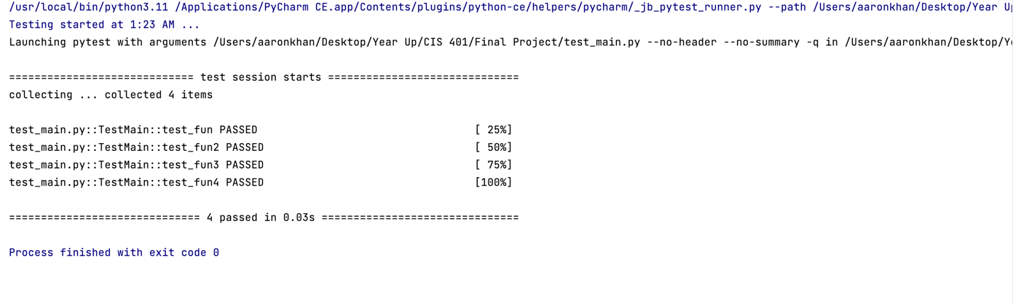
Passing Unit Test Output

Slide 7
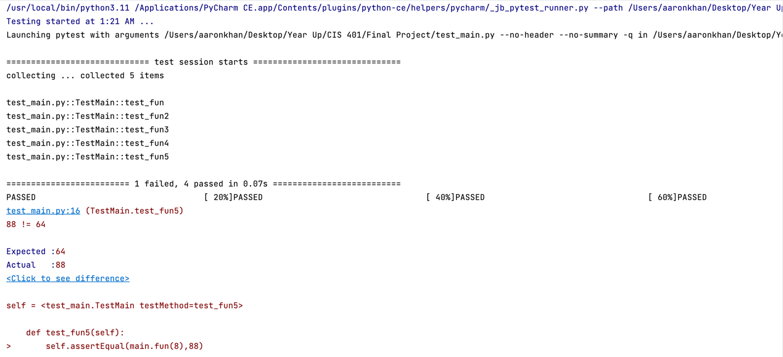
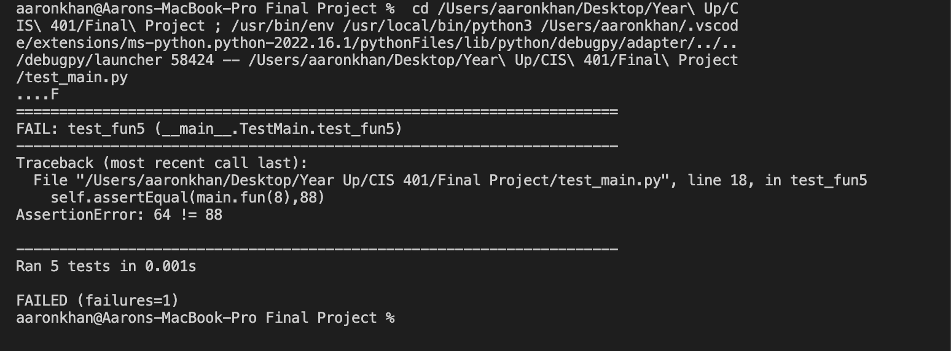
Failing Unit Test Output

Slide 8
Take Aways
The (.) means the method has passed the unittest.
The (F) means the method has failed the unittest.
The tests are measured by methods not the inside of the methods
If you test for multiple positions in one method, it will only return one test instead of multiple.
When failing a test, it will return the line with the exact statement indicating why it failed.

