Slide 1
Transaction Detection
& Risk Monitoring
A Business Intelligence solution for AML transaction monitoring, dashboard-based risk visibility, and analyst decision support.
Business Intelligence
Power BI
AML Monitoring
Machine Learning
Author: Fadi Sarhan (202020144)
Supervisor: Dr. Husam Barham
University of Petra | Graduation Project
Second Semester 2025/2026
From raw transactions
to actionable AML intelligence
Notes:
Slide: Title Speaker notes: Open with the project as a BI consulting-style solution: a data pipeline, dashboard, and ML support for AML monitoring. Estimated speaking time: 30 seconds

Slide 2
The Business Problem
BUSINESS CONTEXT
Suspicious activity is rare, but the cost of missing it is high.
High transaction volume
Rare suspicious behavior
Need for risk prioritization
Banks process large numbers of transactions that cannot all be reviewed manually.
Only a very small fraction of transactions are suspicious, making detection difficult.
Compliance teams need to know which alerts deserve attention first.
This project turns transaction data into risk visibility and decision support.
Transaction Detection & Risk Monitoring
Final BI Graduation Defense
Notes:
Slide: The Business Problem Speaker notes: Explain the challenge in simple terms: AML teams do not need more raw data; they need clearer risk prioritization. Estimated speaking time: 30 seconds

Slide 3
Why This Problem Matters
BUSINESS VALUE
Risk
Compliance
Efficiency
Visibility
Financial and reputational exposure
Supports AML monitoring responsibilities
Reduces manual review pressure
Management-level risk overview
BI contribution
Dashboards and analytics help compliance teams move from reactive investigation to structured, data-driven monitoring.
Transaction Detection & Risk Monitoring
Final BI Graduation Defense
Notes:
Slide: Why This Problem Matters Speaker notes: Connect AML monitoring to compliance, risk, efficiency, and management visibility. Estimated speaking time: 30 seconds

Slide 4
Project Objectives
FROM DATA TO DECISION
1. Prepare trusted data
2. Discover risk patterns
3. Build monitoring dashboards
Clean and structure SAML-D transaction records for analysis.
Analyze payment type, amount, typology, and location behavior.
Create BI visuals that support AML investigation and management review.
4. Test ML support
5. Recommend actions
Evaluate whether transaction features can support risk prioritization.
Translate findings into practical compliance recommendations.
The project follows the BI lifecycle: data preparation → insight discovery → dashboard monitoring → decision support.
Transaction Detection & Risk Monitoring
Final BI Graduation Defense
Notes:
Slide: Project Objectives Speaker notes: Keep this quick. This slide shows the project is not only technical; it is a full BI solution. Estimated speaking time: 30 seconds

Slide 5
Data Acquisition & Dataset Overview
SAML-D DATA FOUNDATION
9.5M
950,486
1,011
0.106%
Original SAML-D transaction scale
Working analysis sample
Suspicious alerts
Suspicious rate
Why not real banking data?
Why SAML-D?
Why it fits this project
Real transaction data is sensitive, regulated, and difficult to access because it contains private customer and financial information.
SAML-D provides a safe synthetic AML dataset with transaction fields, labels, typologies, currencies, and locations suitable for academic research.
It supports BI dashboards, EDA, statistical analysis, and machine learning experiments without exposing real customer data.
Using synthetic data was a deliberate academic choice, not a shortcut.
Transaction Detection & Risk Monitoring
Final BI Graduation Defense
Notes:
Slide: Data Acquisition & Dataset Overview Speaker notes: Justify SAML-D clearly: real banking data is private, so synthetic AML data is appropriate for academic work. Estimated speaking time: 40 seconds

Slide 6
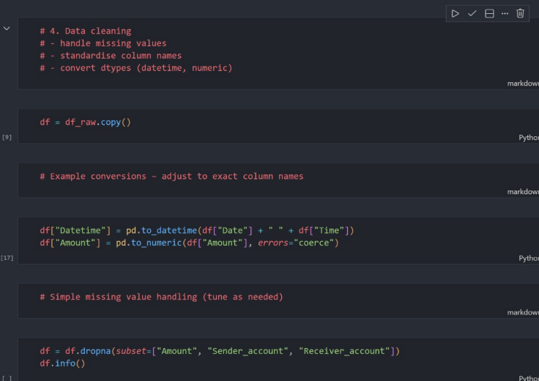
Data Preparation & ETL
DATA QUALITY
Purpose
Convert raw transaction records into a clean and consistent dataset.
Key preparation steps
Standardized fields, converted dates and amounts, removed invalid rows, and prepared data for dashboarding and modeling.
Business value
Reliable BI decisions require trusted data. Bad data would produce misleading KPIs and alerts.
Transaction Detection & Risk Monitoring
Final BI Graduation Defense
Notes:
Slide: Data Preparation & ETL Speaker notes: Show the ETL evidence but explain the business meaning: clean data creates reliable monitoring. Estimated speaking time: 35 seconds

Slide 7
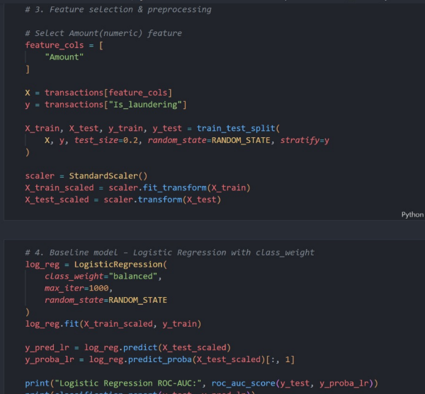
Feature Engineering
CREATING RISK SIGNALS
Baseline feature
Transaction amount was first tested as a simple baseline signal.
Expanded risk context
Payment type, currencies, sender/receiver locations, amount bands, large-transaction flags, and sender risk ratios add more AML context.
Business meaning
AML risk is behavioral. A single value is rarely enough without channel, customer, and corridor context.
Transaction Detection & Risk Monitoring
Final BI Graduation Defense
Notes:
Slide: Feature Engineering Speaker notes: Explain that features translate raw columns into risk signals that models and dashboards can use. Estimated speaking time: 35 seconds

Slide 8
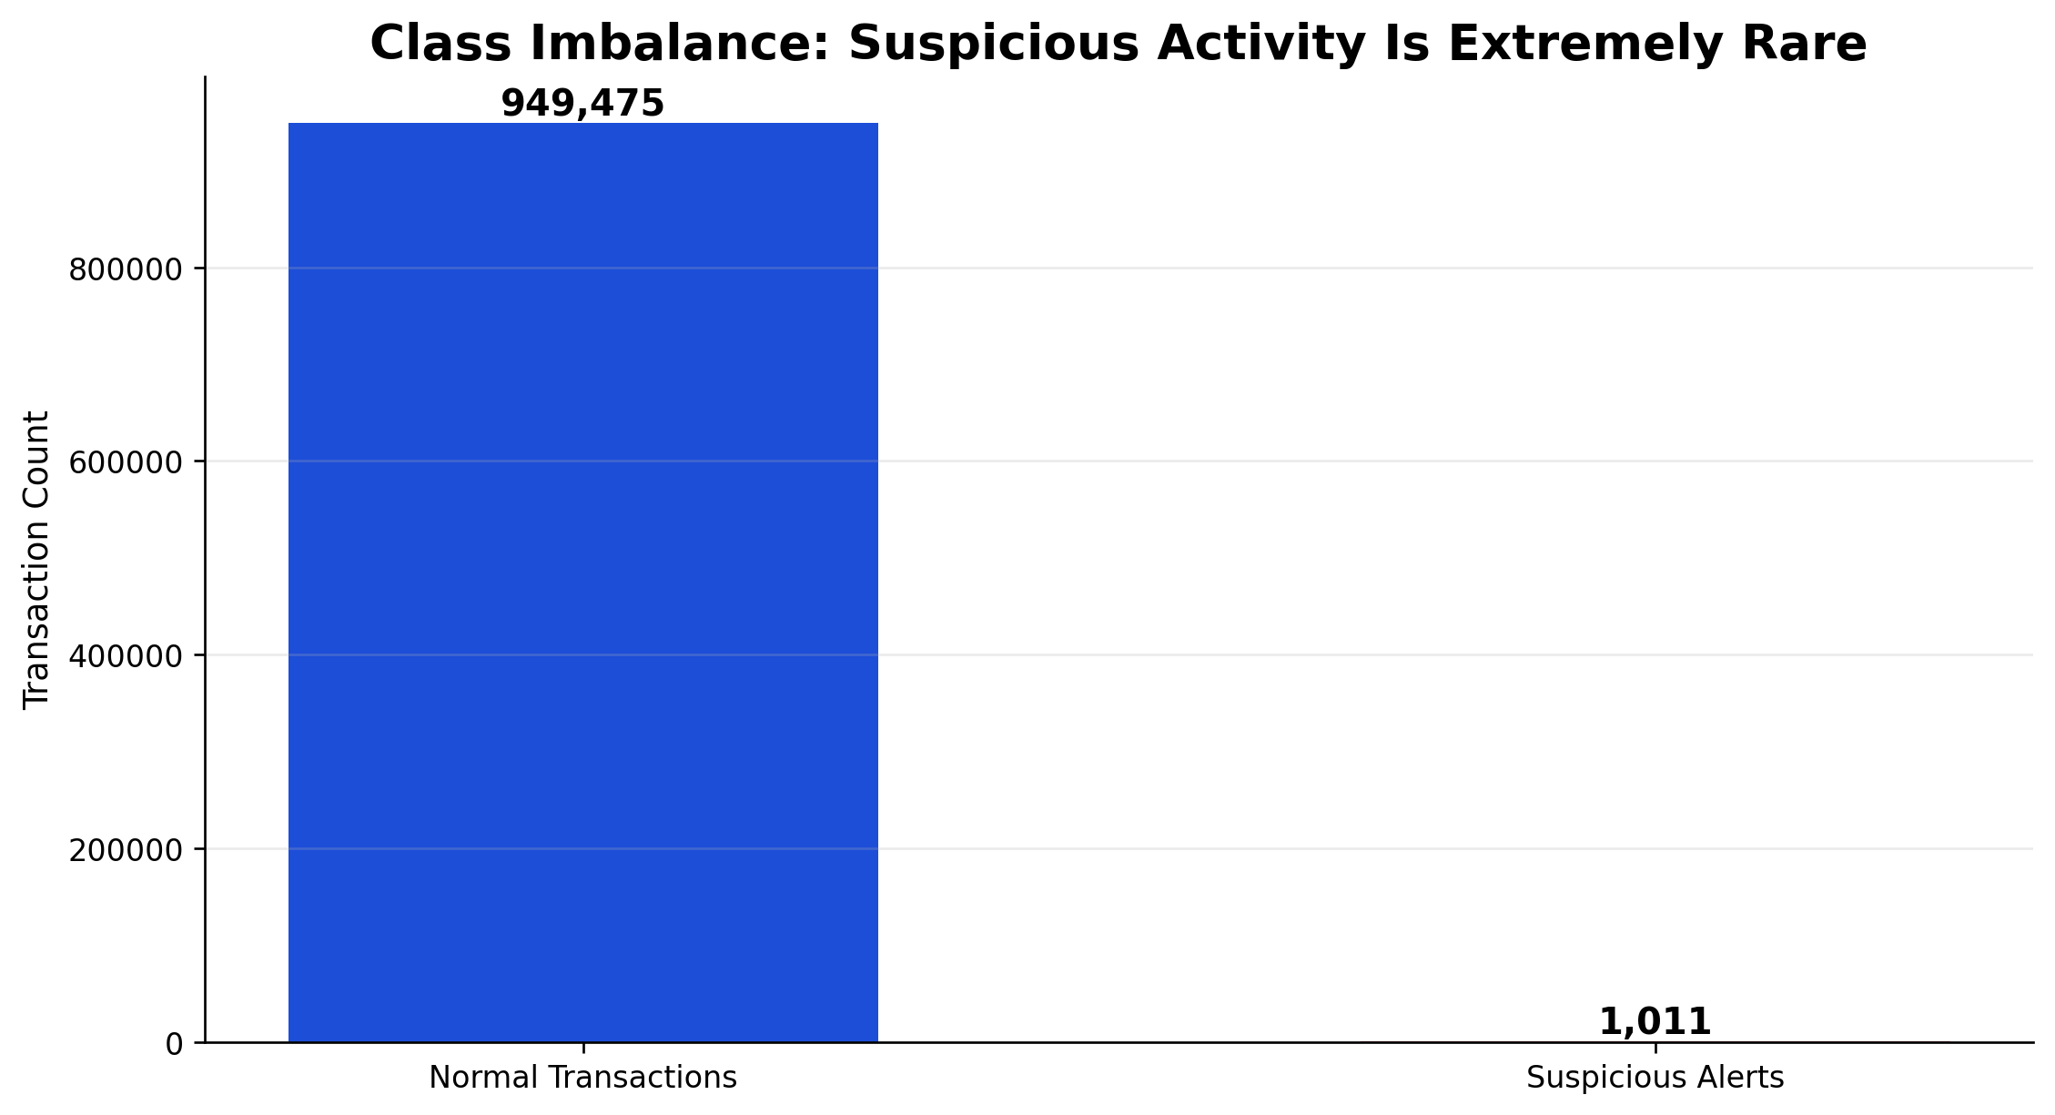
Core Analytical Challenge: Rare-Event Detection
CLASS IMBALANCE
Key insight
Suspicious activity represents only around 0.106% of the analyzed transactions.
So what?
A model can appear accurate by predicting almost everything as normal.
Evaluation focus
Recall, precision, F1-score, ROC-AUC, and analyst prioritization matter more than simple accuracy.
Transaction Detection & Risk Monitoring
Final BI Graduation Defense
Notes:
Slide: Core Analytical Challenge Speaker notes: This slide explains why AML analytics is difficult and prepares the committee for the ML discussion. Estimated speaking time: 40 seconds

Slide 9
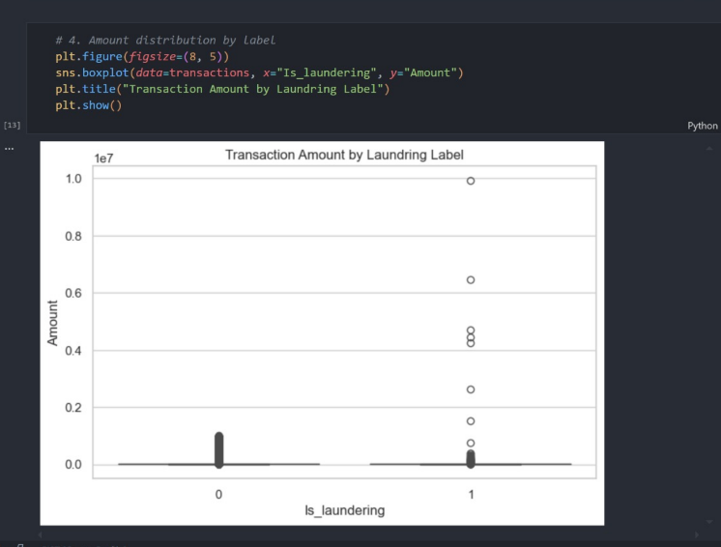
EDA Finding: Transaction Amount Patterns
WHAT THE DATA REVEALED
Insight
Suspicious transactions contain higher-value outliers, but there is still overlap with normal behavior.
Business Impact
Amount is useful as a risk signal, but it should not be used alone to flag suspicious activity.
Decision Support
Use amount thresholds together with typology, payment type, and customer behavior.
Transaction Detection & Risk Monitoring
Final BI Graduation Defense
Notes:
Slide: EDA Finding: Transaction Amount Patterns Speaker notes: Do not describe the chart. Explain the insight: amount matters, but amount alone is not enough. Estimated speaking time: 35 seconds

Slide 10
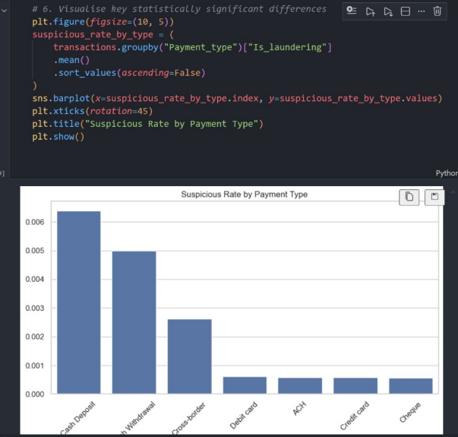
EDA Finding: Risk Differs by Payment Type
CHANNEL RISK
Insight
Some payment channels show higher suspicious density than others.
Business Impact
Monitoring thresholds should be adjusted by payment type rather than applying one rule to all channels.
Decision Support
Compliance teams can prioritize channels with higher suspicious rates.
Transaction Detection & Risk Monitoring
Final BI Graduation Defense
Notes:
Slide: EDA Finding: Risk Differs by Payment Type Speaker notes: This is a strong business insight: volume and risk density are different. Estimated speaking time: 35 seconds

Slide 11
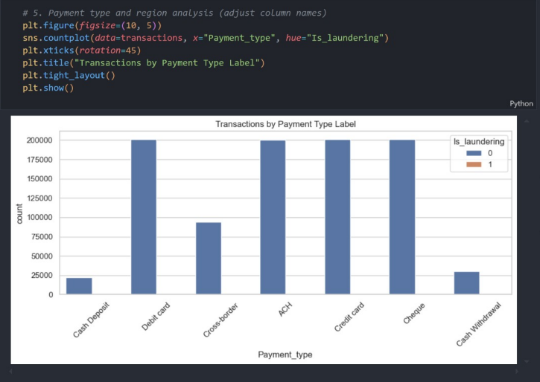
EDA Finding: Volume Does Not Equal Risk
PAYMENT CHANNEL ANALYSIS
Insight
High-volume payment types dominate the dataset, but suspicious cases remain a very small minority.
Business Impact
A bank should monitor both total volume and suspicious rate to avoid missing risk in smaller channels.
Decision Support
Combine volume dashboards with risk-density KPIs.
Transaction Detection & Risk Monitoring
Final BI Graduation Defense
Notes:
Slide: EDA Finding: Volume Does Not Equal Risk Speaker notes: Explain that large channels are important operationally, but not necessarily the highest risk. Estimated speaking time: 35 seconds

Slide 12
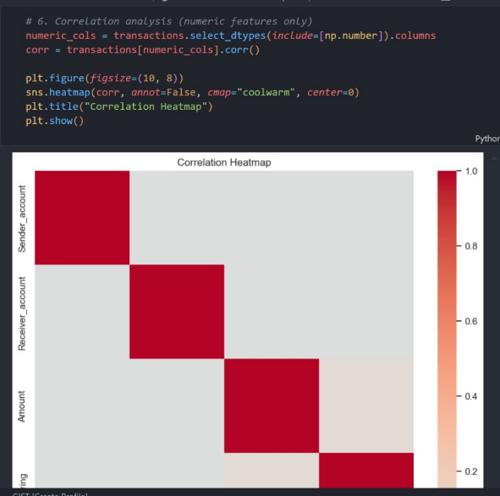
EDA Finding: Numeric Relationships Are Limited
CORRELATION CHECK
Insight
Simple numeric correlations do not fully explain suspicious behavior.
Business Impact
AML risk requires behavioral and categorical context, not only numeric relationships.
Decision Support
Use feature engineering and dashboard segmentation to uncover hidden patterns.
Transaction Detection & Risk Monitoring
Final BI Graduation Defense
Notes:
Slide: EDA Finding: Numeric Relationships Are Limited Speaker notes: Explain why the project needed feature engineering and dashboards, not only correlation. Estimated speaking time: 35 seconds

Slide 13
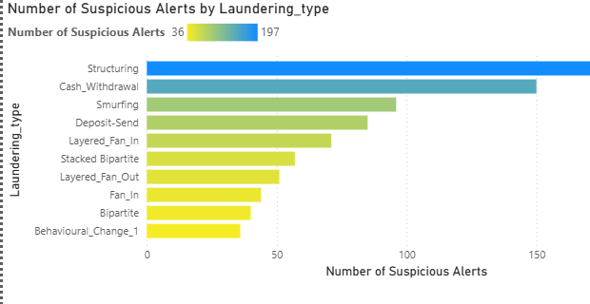
Key Business Finding: Typologies Explain the Alert
TYPOLOGY ANALYSIS
Insight
Structuring is the strongest suspicious typology, followed by cash-withdrawal and smurfing patterns.
Business Impact
Typology analysis helps investigators understand why an alert is risky, not only that it is risky.
Decision Support
Prioritize repeated typologies and design monitoring rules around them.
Transaction Detection & Risk Monitoring
Final BI Graduation Defense
Notes:
Slide: Key Business Finding: Typologies Explain the Alert Speaker notes: Explain typology as the reason behind suspicious activity. This is important for analyst decisions. Estimated speaking time: 35 seconds

Slide 14
Key Business Findings Summary
FROM ANALYSIS TO ACTION
1. Rare-event problem
2. Amount helps, but not alone
3. Channel risk differs
Only ~0.106% of transactions are suspicious, making prioritization essential.
Suspicious transactions include outliers, but overlap with normal behavior.
Payment type changes suspicious density and monitoring priorities.
4. Typologies support investigation
5. Dashboarding makes insights usable
Laundering types explain the suspicious behavior pattern.
Power BI turns findings into continuous monitoring and decision support.
The EDA findings justify the dashboard and machine learning components.
Transaction Detection & Risk Monitoring
Final BI Graduation Defense
Notes:
Slide: Key Business Findings Summary Speaker notes: Use this as the transition from analytics to the dashboard solution. Estimated speaking time: 40 seconds

Slide 15
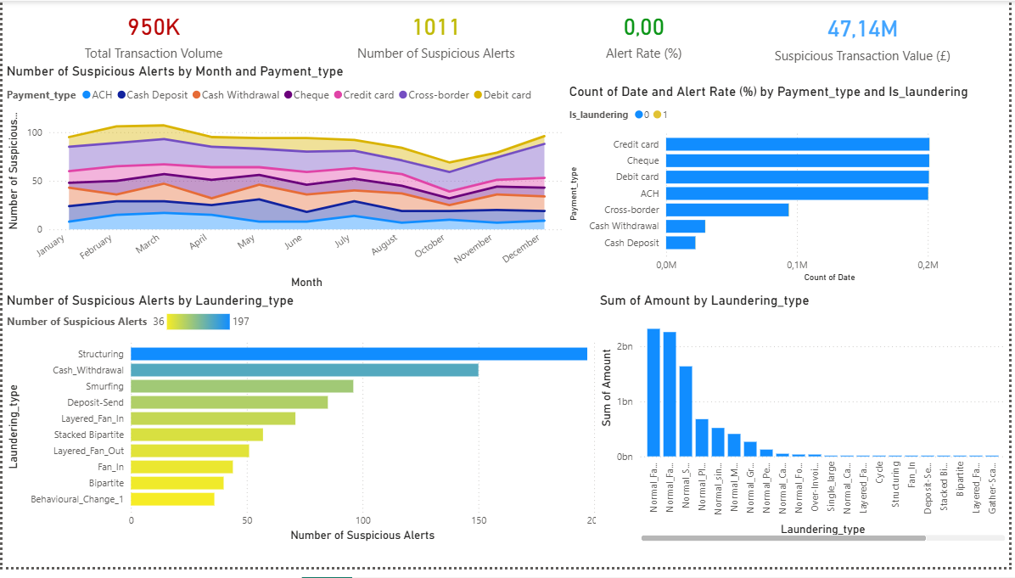
Dashboard Monitoring Solution
POWER BI SHOWCASE
A single monitoring view for KPIs, monthly trends, payment type risk, typologies, and suspicious value exposure.
Transaction Detection & Risk Monitoring
Final BI Graduation Defense
Notes:
Slide: Dashboard Monitoring Solution Speaker notes: Let the dashboard dominate the slide. Explain that it is the main BI deliverable. Estimated speaking time: 40 seconds

Slide 16
Dashboard Component: KPI Monitoring
EXECUTIVE VIEW
950,486
1,011
0.106%
£47.14M
Total Transactions
Suspicious Alerts
Alert Rate
Suspicious Value
Purpose
Business Value
Decision Support
Show the overall AML monitoring status quickly.
Gives management visibility into workload and suspicious exposure.
Helps decide whether investigation capacity or controls need attention.
Transaction Detection & Risk Monitoring
Final BI Graduation Defense
Notes:
Slide: Dashboard Component: KPI Monitoring Speaker notes: Explain the four KPIs and why they matter to a compliance manager. Estimated speaking time: 35 seconds

Slide 17
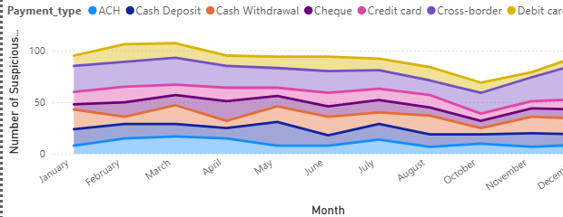
Dashboard Component: Alert Trend Monitoring
TIME-BASED RISK
Purpose
Track suspicious alerts over time by payment type.
Business Value
Monthly patterns help identify spikes, seasonality, or channel-specific changes.
Decision Support
Allocate analyst capacity and investigate sudden increases in specific channels.
Transaction Detection & Risk Monitoring
Final BI Graduation Defense
Notes:
Slide: Dashboard Component: Alert Trend Monitoring Speaker notes: Explain how trends help compliance teams move from static reporting to monitoring. Estimated speaking time: 35 seconds

Slide 18
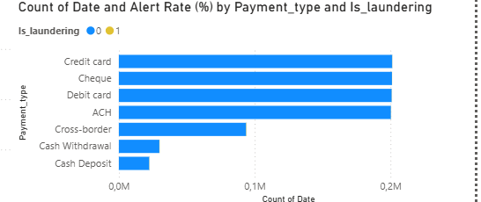
Dashboard Component: Payment Type & Typology
INVESTIGATION PRIORITIZATION
Purpose
Compare suspicious activity by payment channel and laundering pattern.
Business Value
Shows where risk is concentrated and what behavior category is driving alerts.
Decision Support
Prioritize investigation queues by high-risk payment types and repeated typologies.
Transaction Detection & Risk Monitoring
Final BI Graduation Defense
Notes:
Slide: Dashboard Component: Payment Type & Typology Speaker notes: This slide connects dashboard visuals to practical AML investigation prioritization. Estimated speaking time: 35 seconds

Slide 19
Why Machine Learning?
ANALYST SUPPORT
Analysts cannot review everything
Rules may miss hidden patterns
ML supports prioritization
950K transactions require scalable risk prioritization, not manual review of all records.
Static thresholds can miss suspicious behavior that depends on context.
Models can rank transactions so analysts focus on higher-risk cases first.
Raw Data
ETL
Feature
Engineering
Encoding
& Scaling
SMOTE
Model
Training
Evaluation
Risk
Priority
→
→
→
→
→
→
→
Machine learning was used as decision support for analysts — not as an automatic blocking system.
Transaction Detection & Risk Monitoring
Final BI Graduation Defense
Notes:
Slide: Why Machine Learning Speaker notes: Frame ML as a practical business tool for prioritization and scalability. Estimated speaking time: 35 seconds

Slide 20
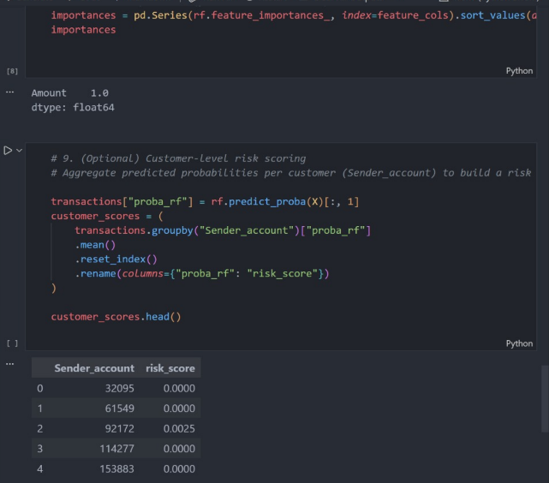
Machine Learning Pipeline
TECHNICAL FLOW, BUSINESS PURPOSE
Raw Data
ETL
Feature
Engineering
Encoding
& Scaling
SMOTE
Model
Training
Evaluation
Risk
Priority
→
→
→
→
→
→
→
Business purpose
Convert transaction features into a risk-prioritization workflow that can support analyst review.
Modeling approach
Logistic Regression and Random Forest were tested with scaling, class weighting, and imbalance-aware evaluation.
Transaction Detection & Risk Monitoring
Final BI Graduation Defense
Notes:
Slide: Machine Learning Pipeline Speaker notes: Explain the workflow simply. The committee should see that the ML work was structured. Estimated speaking time: 35 seconds

Slide 21
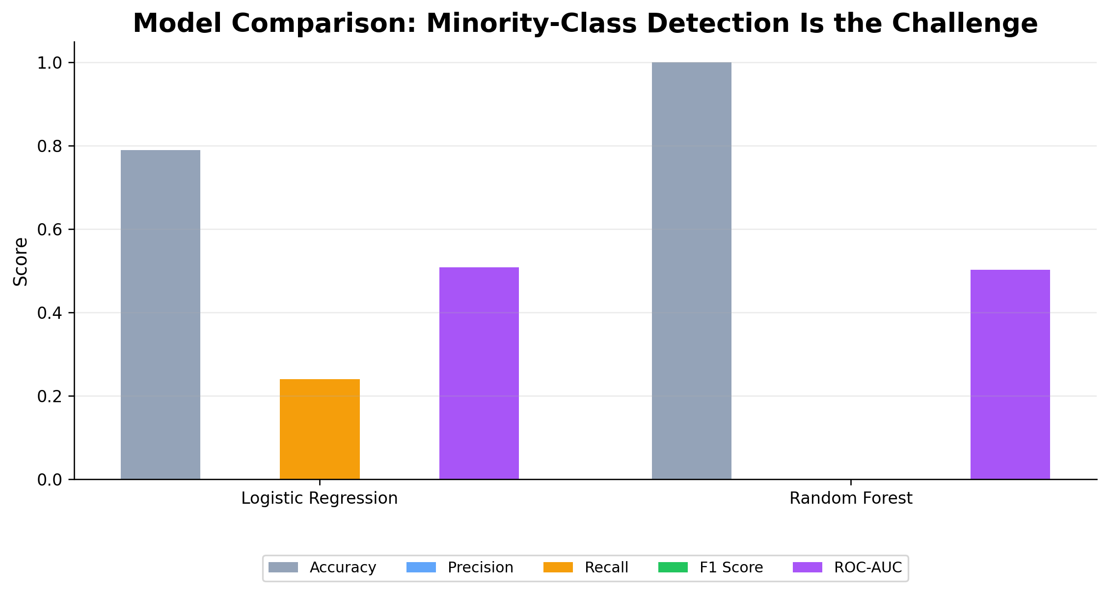
Model Comparison: Accuracy Is Not Enough
ML RESULTS
Main lesson
Random Forest looks highly accurate, but it failed to detect the suspicious class in the baseline test.
Why it matters
In AML, missing suspicious transactions is more important than reporting high overall accuracy.
Best interpretation
Model | Accuracy | Precision | Recall | F1 | ROC-AUC
Logistic Regression | 0.79 | 0.00 | 0.24 | 0.00 | 0.508
Random Forest | 1.00 | 0.00 | 0.00 | 0.00 | 0.502
Gradient Boosting | — | — | — | — | 0.580
The ML stage is a baseline diagnostic experiment showing the need for richer behavioral features.
Transaction Detection & Risk Monitoring
Final BI Graduation Defense
Notes:
Slide: Model Comparison Speaker notes: Present the metrics honestly. High accuracy is misleading because the suspicious class is extremely rare. Estimated speaking time: 45 seconds

Slide 22
Key Lesson: The Model Must Find the Rare Class
MODEL INTERPRETATION
1.00
0.00
0.00
0.502
Random Forest Accuracy
Suspicious Recall
Suspicious F1 Score
ROC-AUC
A model can be accurate and still not useful for AML if it misses the suspicious class.
Business implication
Future ML work should focus on recall, F1-score, ROC-AUC, threshold tuning, richer features, and analyst review.
Transaction Detection & Risk Monitoring
Final BI Graduation Defense
Notes:
Slide: Key Lesson Speaker notes: This is the defense-safe explanation. Do not overclaim the ML model; show that you understand the limitation. Estimated speaking time: 40 seconds

Slide 23
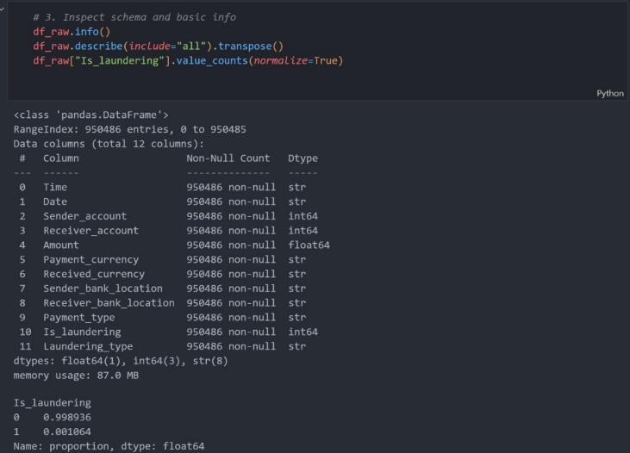
Technical Evidence: Data Pipeline
PROOF OF IMPLEMENTATION
Evidence that the raw dataset was loaded, inspected, cleaned, and prepared before dashboarding and modeling.
Transaction Detection & Risk Monitoring
Final BI Graduation Defense
Notes:
Slide: Technical Evidence: Data Pipeline Speaker notes: Keep this slide short. It proves implementation without turning into a code walkthrough. Estimated speaking time: 30 seconds

Slide 24
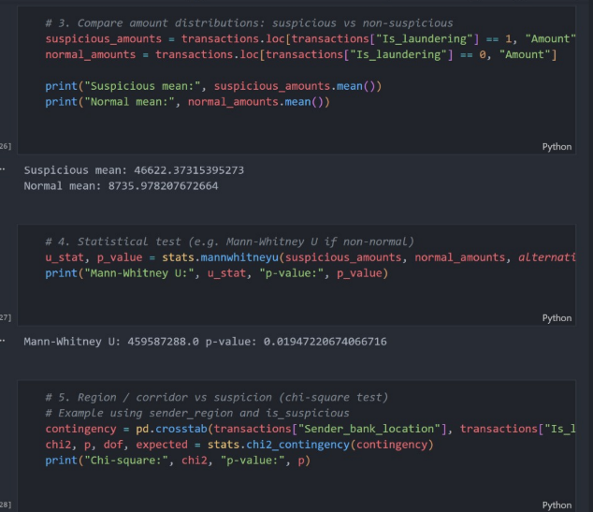
Technical Evidence: Statistical Validation
ANALYTICAL DEPTH
Amount comparison
Suspicious mean amount ≈ 46,622 vs normal mean ≈ 8,736.
Statistical test
Mann-Whitney U p-value ≈ 0.019, indicating a statistically meaningful amount difference.
Business meaning
The statistical test supports amount as a risk signal, while EDA shows it is not enough alone.
Transaction Detection & Risk Monitoring
Final BI Graduation Defense
Notes:
Slide: Technical Evidence: Statistical Validation Speaker notes: Explain that you used statistical validation, not only visual observation. Estimated speaking time: 35 seconds

Slide 25
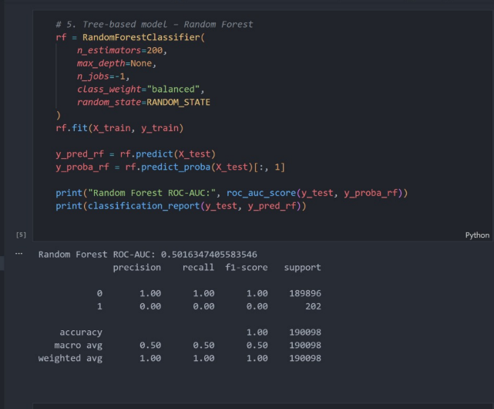
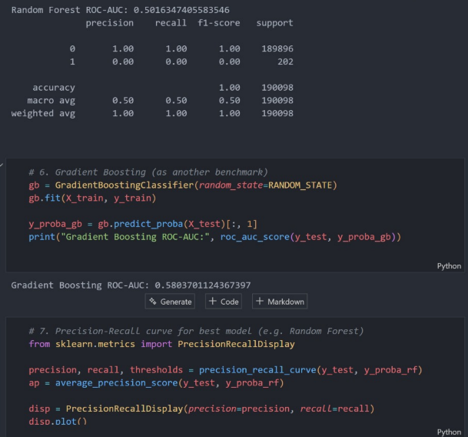
Technical Evidence: ML Pipeline
MODEL IMPLEMENTATION
Evidence of model training and evaluation; results were interpreted carefully because of extreme class imbalance.
Transaction Detection & Risk Monitoring
Final BI Graduation Defense
Notes:
Slide: Technical Evidence: ML Pipeline Speaker notes: Show implementation evidence but stay focused on the lesson: ML requires stronger features and imbalance-aware evaluation. Estimated speaking time: 30 seconds

Slide 26
Business Value, Recommendations & Future Enhancements
FINAL DECISION SUPPORT
Business Benefits
Key Recommendations
Future Enhancements
Faster detection
Better visibility
Risk prioritization
Improved compliance
Decision support
Monitor suspicious rate by payment type
Focus on high-risk typologies
Use KPIs in compliance meetings
Enhance customer-level risk profiling
Maintain analyst review
Real-time transaction scoring
Additional ML models
Banking-system integration
Explainable AI
Network analysis
Final conclusion: the project transforms transaction data into actionable AML intelligence through ETL, EDA, Power BI monitoring, and ML-based prioritization.
Transaction Detection & Risk Monitoring
Final BI Graduation Defense
Notes:
Slide: Business Value, Recommendations & Future Enhancements Speaker notes: Close with business value, clear recommendations, and future direction. End confidently. Estimated speaking time: 45 seconds

Slide 27
FINAL Q&A
Questions & Discussion
Transaction Detection & Risk Monitoring
Thank You
شكرًا لكم
BI Solution
ETL, EDA, Power BI dashboard, and ML support
AML Focus
Risk visibility and suspicious transaction prioritization
Business Value
Better monitoring, faster review, and decision support
Fadi Sarhan (202020144) | Supervised by Dr. Husam Barham | University of Petra
27

