Slide 1
APPRISE
WordPress Notification
Integration Project
Proxmox • Ubuntu Server • Docker • Containerlab • zrok • Telegram
Proxmox
Ubuntu VM
Docker
WordPress + Apprise
Telegram
A practical project combining virtualization, containers, APIs, networking, and public tunneling.

Slide 2
01 How the Project Works
2/9
Complete flow from user request to Telegram notification
User
zrok URL
WordPress
Plugin
Apprise API
Telegram
• Proxmox runs the Ubuntu Server VM.
• Docker Compose starts WordPress, MariaDB, Apprise, and Containerlab containers.
• The WordPress plugin collects title, message, and notification type.
• The plugin sends JSON through HTTP POST to the Apprise API.
• Apprise forwards the message to the Telegram Bot.
• zrok publishes the private WordPress website using a public HTTPS link.

Slide 3
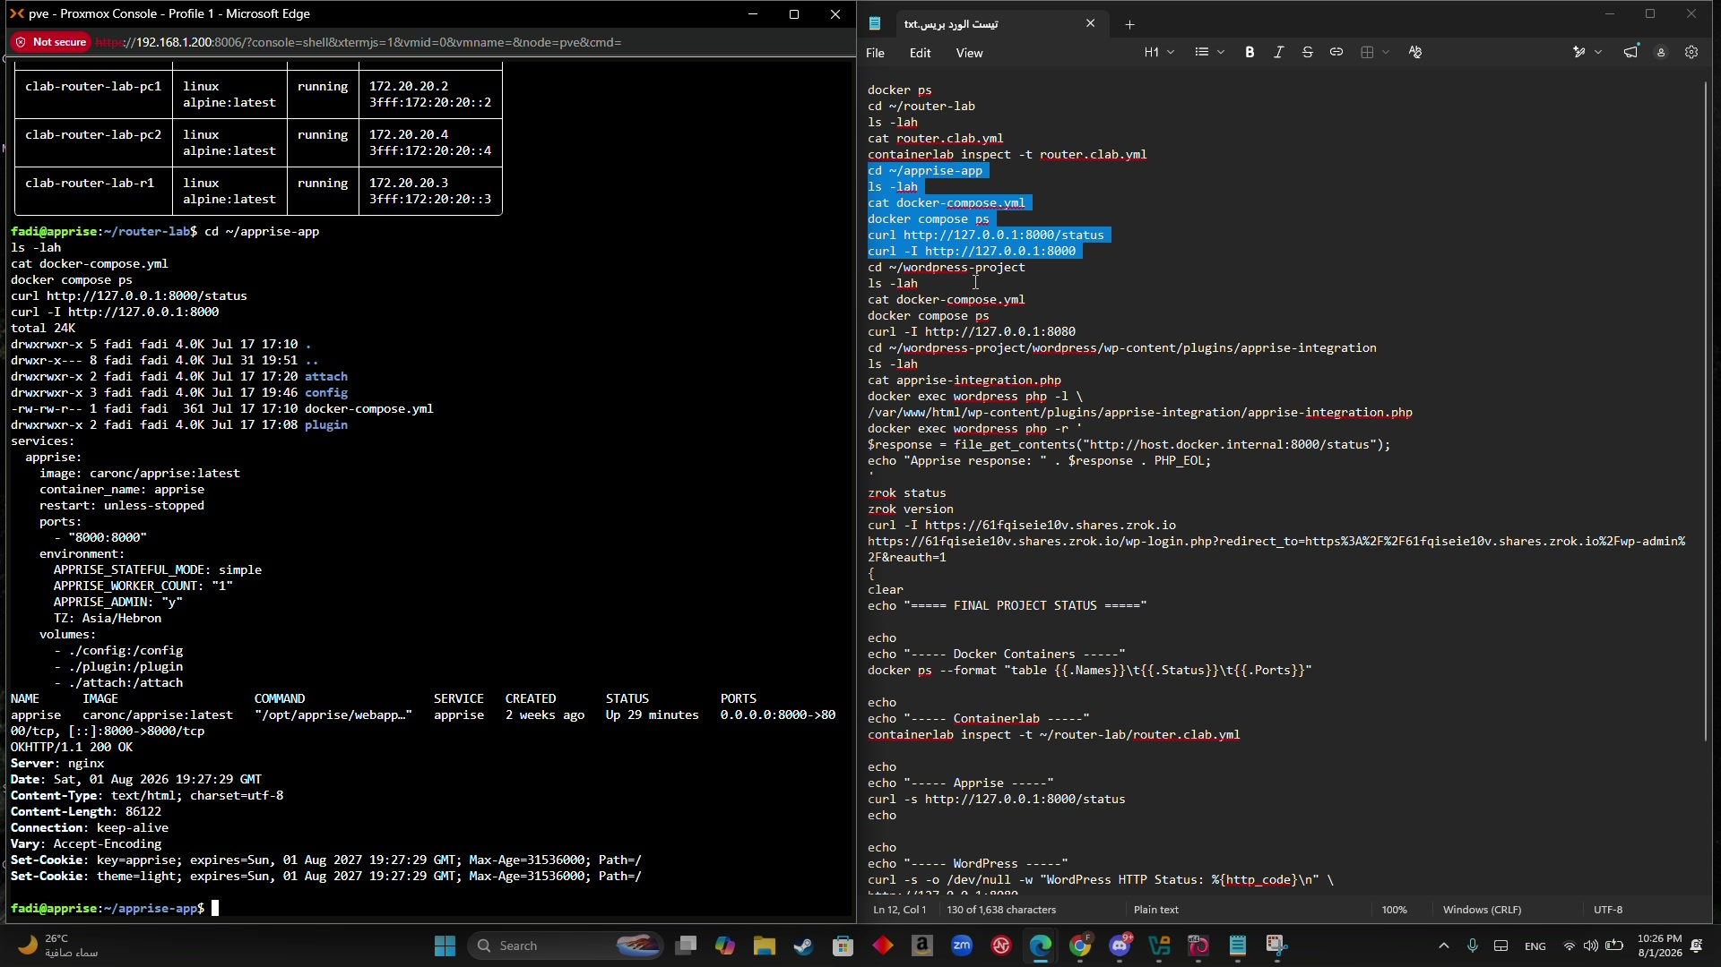
02 Infrastructure and Running Containers
3/9
Evidence from the recorded demo
Services shown in docker ps
• wordpress: Apache/PHP app
• wordpress-db: MariaDB database
• apprise: API on port 8000
• clab-router-lab-pc1/r1/pc2
• External ports: 8080 and 8000
Verification commands
docker ps --format "table {{.Names}}\t{{.Image}}\t{{.Status}}\t{{.Ports}}"
curl -I http://127.0.0.1:8080

Slide 4
03 Containerlab Topology YAML
4/9
Full router.clab.yml used in the project
router.clab.yml
PC1
R1
PC2
name: router-lab
topology:
nodes:
pc1:
kind: linux
image: alpine:latest
exec:
- ip link set eth1 up
- ip addr add 192.168.10.2/24 dev eth1
- ip route replace 192.168.20.0/24 via 192.168.10.1
r1:
kind: linux
image: alpine:latest
sysctls:
net.ipv4.ip_forward: 1
exec:
- ip link set eth1 up
- ip link set eth2 up
- ip addr add 192.168.10.1/24 dev eth1
- ip addr add 192.168.20.1/24 dev eth2
pc2:
kind: linux
image: alpine:latest
exec:
- ip link set eth1 up
- ip addr add 192.168.20.2/24 dev eth1
- ip route replace 192.168.10.0/24 via 192.168.20.1
links:
- endpoints: ["pc1:eth1", "r1:eth1"]
- endpoints: ["r1:eth2", "pc2:eth1"]
192.168.10.2
10.1 / 20.1
192.168.20.2
Two LANs connected by a Linux router with IP forwarding.
Deploy and test
containerlab deploy -t router.clab.yml
containerlab inspect -t router.clab.yml
docker exec clab-router-lab-pc1 ping -c 4 192.168.20.2
• pc1 route goes through 192.168.10.1
• r1 has two interfaces and IP forwarding
• pc2 route goes through 192.168.20.1

Slide 5
04 Docker Compose YAML Files
5/9
Repeatable deployment for Apprise and WordPress
apprise-app/docker-compose.yml
wordpress-project/docker-compose.yml
services:
apprise:
image: caronc/apprise:latest
container_name: apprise
restart: unless-stopped
ports:
- "8000:8000"
environment:
APPRISE_STATEFUL_MODE: simple
APPRISE_WORKER_COUNT: "1"
APPRISE_ADMIN: "y"
TZ: Asia/Hebron
volumes:
- ./config:/config
- ./plugin:/plugin
- ./attach:/attach
services:
database:
image: mariadb:11
container_name: wordpress-db
restart: unless-stopped
environment:
MYSQL_DATABASE: wordpress
MYSQL_USER: wordpress
MYSQL_PASSWORD: ********
MYSQL_ROOT_PASSWORD: ********
volumes:
- db_data:/var/lib/mysql
wordpress:
image: wordpress:latest
container_name: wordpress
restart: unless-stopped
ports:
- "8080:80"
depends_on:
- database
volumes:
- ./wordpress:/var/www/html
restart: unless-stopped allows services to return automatically after Ubuntu and Docker start.

Slide 6
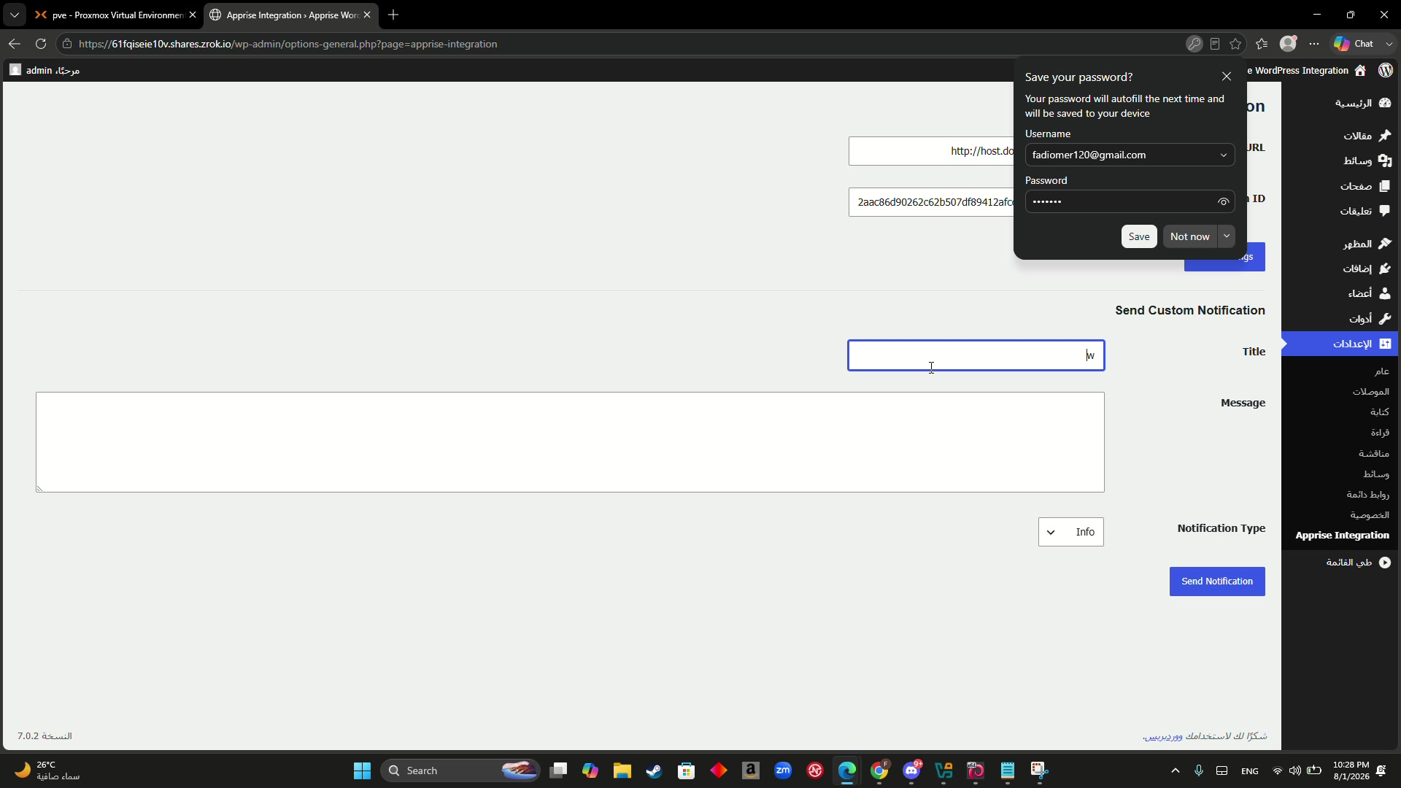
05 Custom WordPress Plugin
6/9
The PHP bridge between WordPress and Apprise
Core HTTP POST logic
function fadi_apprise_send($title, $message, $type='info') {
$api_url = rtrim(get_option(
'fadi_apprise_api_url',
'http://host.docker.internal:8000'
), '/');
$config_key = get_option('fadi_apprise_config_key', '');
$endpoint = $api_url . '/notify/' . rawurlencode($config_key);
return wp_remote_post($endpoint, array(
'timeout' => 20,
'headers' => array('Content-Type' => 'application/json'),
'body' => wp_json_encode(array(
'title' => $title,
'body' => $message,
'type' => $type
))
));
}
What the plugin does
• Reads Apprise API URL and configuration ID.
• Builds /notify/{config-id} endpoint.
• Sends title, body, and notification type as JSON.
• Shows success/error feedback in WordPress.

Slide 7
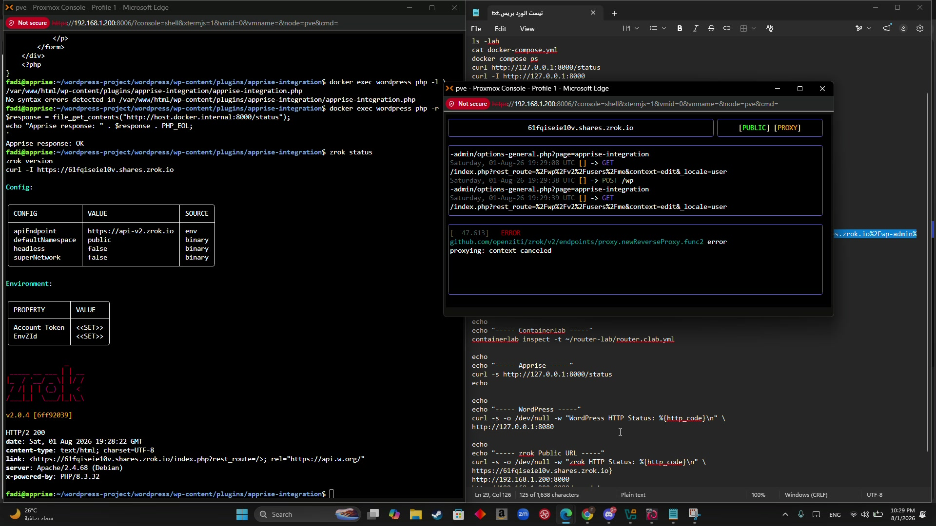
06 Public Access with zrok
7/9
Publishing the private WordPress service to the Internet
zrok command
zrok share public http://127.0.0.1:8080
Public URL example
https://<generated>.shares.zrok.io
• The zrok window must remain open.
• No :8080 is added to the public URL.
• WordPress uses reverse-proxy settings for HTTPS.
wp-config.php reverse-proxy fix
if (!empty($_SERVER["HTTP_HOST"]) &&
strpos($_SERVER["HTTP_HOST"], ".shares.zrok.io") !== false) {
$zrok_host = preg_replace("/:\d+$/", "", $_SERVER["HTTP_HOST"]);
$_SERVER["HTTP_HOST"] = $zrok_host;
$_SERVER["SERVER_PORT"] = 443;
$_SERVER["HTTPS"] = "on";
define("WP_HOME", "https://" . $zrok_host);
define("WP_SITEURL", "https://" . $zrok_host);

Slide 8
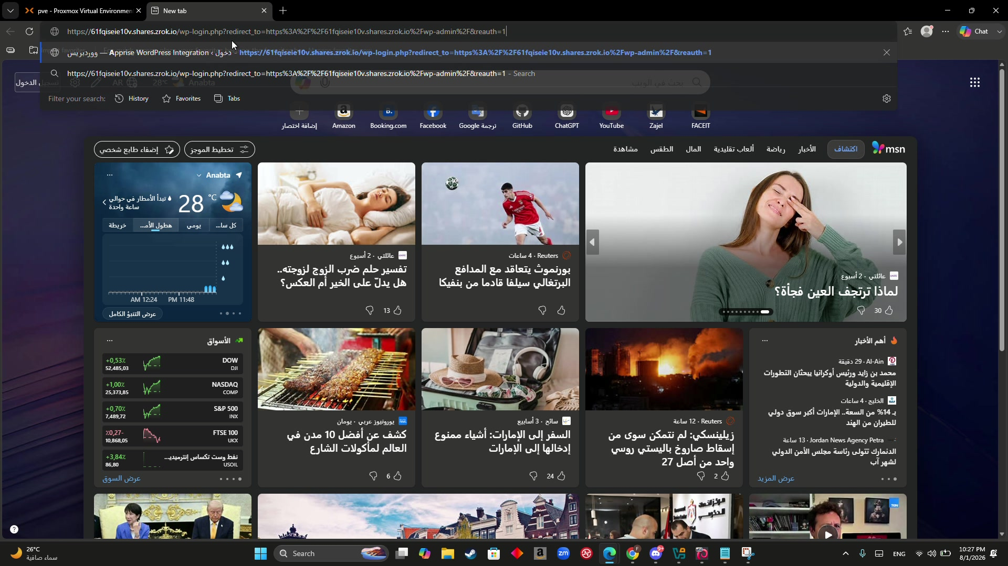
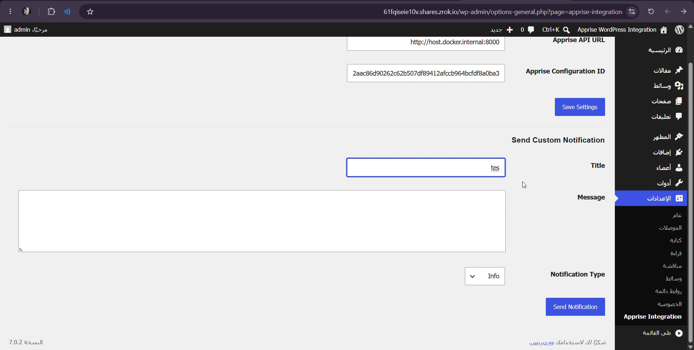
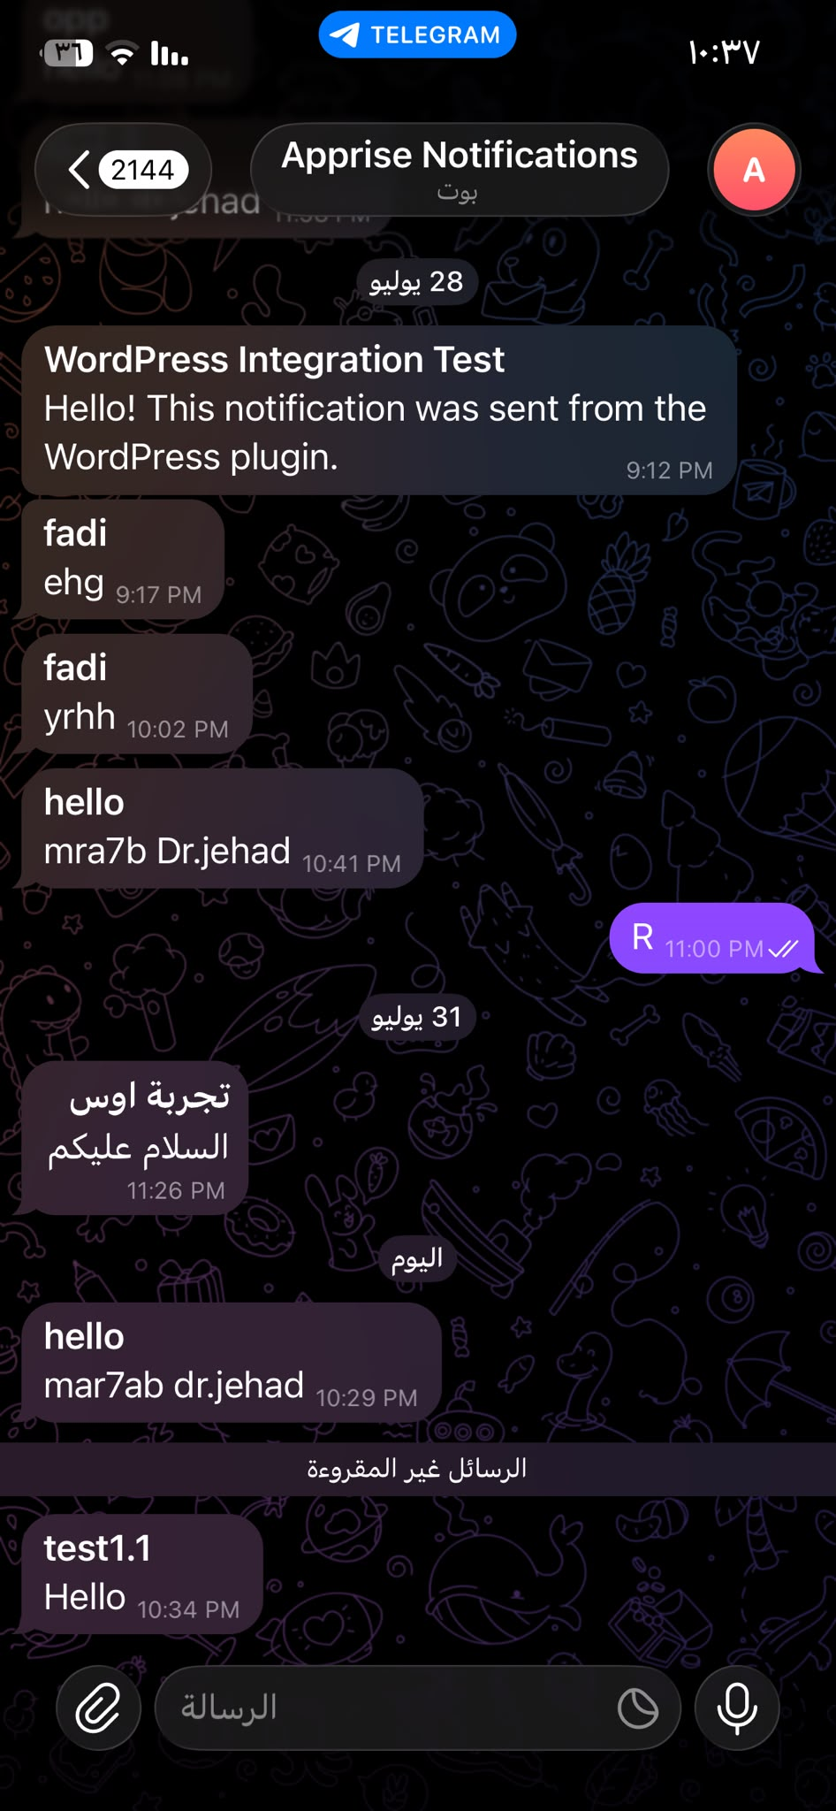
07 Proof that the Project Works
8/9
Results captured from the videos and Telegram screenshot
Observed proof
Key terminal checks
• Plugin form is available in WordPress.
• Telegram receives messages from Apprise.
• zrok link opens WordPress publicly.
• HTTP checks return 200/OK.
HTTP/1.1 200 OK
Apprise response: OK
0% packet loss
HTTP/2 200
No syntax errors detected

Slide 9
08 Short Presentation Script
9/9
Use this as your spoken explanation to the doctor
• The project runs on an Ubuntu Server virtual machine hosted by Proxmox VE.
• Docker Compose deploys WordPress, MariaDB, and Apprise API.
• Containerlab creates PC1, Router R1, and PC2 from router.clab.yml.
• The custom WordPress plugin sends title, message, and type to Apprise.
• Apprise uses the Telegram configuration and delivers the message to the bot.
• zrok publishes WordPress through a public HTTPS URL, so anyone can view the website.
• The demonstration proves the system by showing YAML files, running containers, successful HTTP responses, and Telegram delivery.
Final Result: virtualization + containers + topology + API integration + public access + real Telegram notifications.

