Slide 1
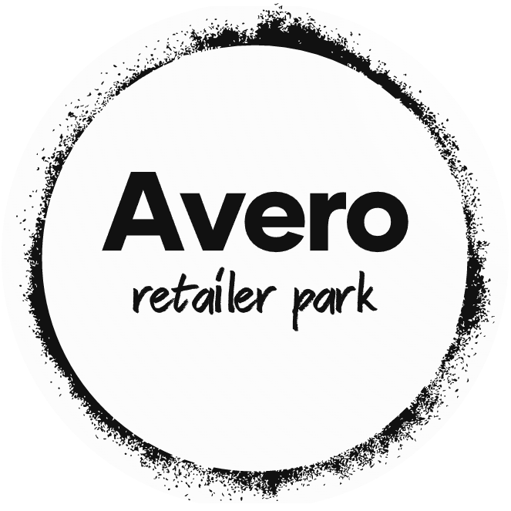
Avero Website
Ahmad Al Kurdi
Ayham Ashor
Supervised by Dr. Fadi Farha

Slide 2
A website to manage the business between a wholesaler and a retailer
Introduction
Programming languages and technologies used
Use cases & ERD diagram
Conclusions and Suggestions
References
2

Slide 3
Introduction
Estimated statistics indicate that by 2040; 95% of purchases will be made through e-commerce. Therefore, it is a human bet on the future.
Looking at the previous works in this field, we see that all of them are general e-commerce systems and have a common character, so in this project, our goal is to design a more specialized system, aimed to regulate the business process between the wholesaler (supplier) and the retailer (consumer) under these difficult circumstances that we live, thus saving time, effort and cost for both.
Any small or large wholesaler looking to provide its services online free and easy can benefit from this system. Also, any retailer can take advantage of this system to request products from those wholesalers.
3

Slide 4
Programming languages and technologies used
Microsoft Visual Studio IDE
Server rendered UI
HTML, CSS, Bootstrap
JavaScript
And sometimes AJAX
C#
ASP.NET Core MVC
SQL
Entity Framework Core
(Object-Relational Mapping (ORM))
ASP.NET Core Identity
Clean Architecture (Onion Architecture)
MVC pattern
Lucidchart
4

Slide 5
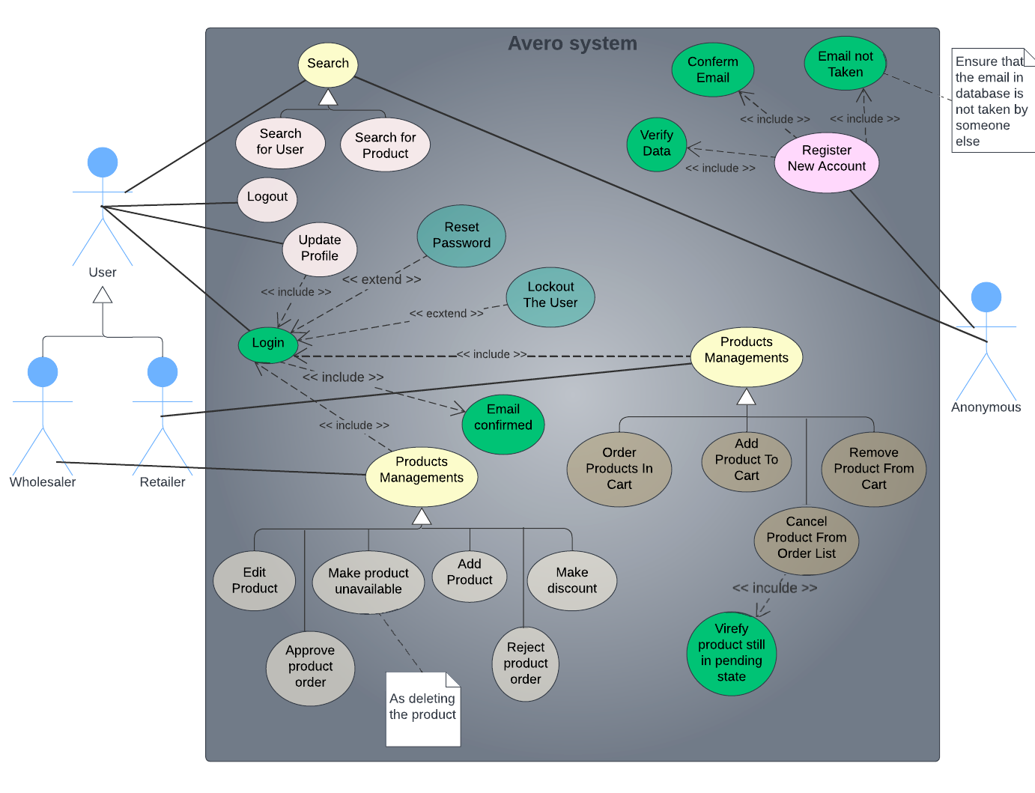
Use Cases diagram
5

Slide 6
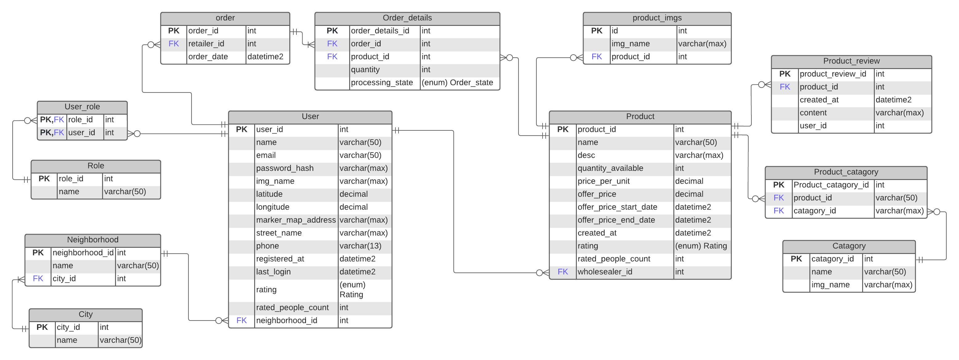
ERD diagram
6

Slide 7
Conclusions and Suggestions
In this project, a lot has been accomplished; First, we achieved our goal by designing the program with the requirements and rules that we set.
For us, most of all, we noticed that by using modern technologies, and implementing the project in a clean architecture; a system was produced that is programmatically robust, scalable and highly efficient, and it follows some important design patterns/principles.
7

Slide 8
We got
Clean, redundancy-free code by following the DRY principle in programming principles.
Portable and scalable code with the Dependency Inversion Principle.
A loosely coupled object-oriented system that is maintainable and testable by Dependency Injection technique.
Clear and understandable code by seeking Separation of Concerns design principle and applying some patterns like MVC.
Cross-platform program.
8

Slide 9
Suggestions
We will not just stop here, but on the contrary, we will seek for more in the future, so we will improve the system or correct errors and produce new versions of the system. Maybe:
Adding a mechanism for chatting and communicating between users.
Adding a rating and review system for users and products.
Support other languages on the website.
Finally, launching a special version for mobile phones of this system.
9

Slide 10
References
Clean Coder Blog. (2012, August 13). Cleancoder. Retrieved August 6, 2022, from https://blog.cleancoder.com/uncle-bob/2012/08/13/the-clean-architecture.html
Common web application architectures. (2022, April 14). Microsoft Docs. Retrieved August 6, 2022, from https://docs.microsoft.com/en-us/dotnet/architecture/modern-web-apps-azure/common-web-application-architectures
Design Patterns. (n.d.). DevIQ. Retrieved August 6, 2022, from https://deviq.com/design-patterns/design-patterns-overview/
Education, I. C. (2021, September 16). Three-Tier Architecture. IBM. Retrieved August 6, 2022, from https://www.ibm.com/cloud/learn/three-tier-architecture
Keskin, S. (2022, July 12). 19 New E-Commerce Statistics You Need to Know in 2022. Drip. Retrieved August 6, 2022, from https://www.drip.com/blog/e-commerce-statistics
Principles. (n.d.). DevIQ. Retrieved August 6, 2022, from https://deviq.com/principles/principles-overview/
10

Slide 11
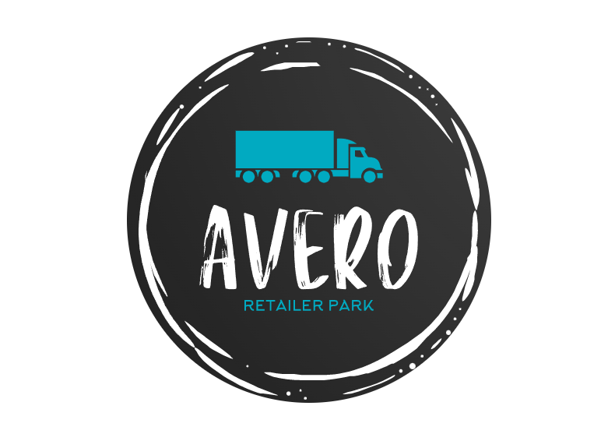
Thank You

