Slide 1
CATHOLIC UNIVERSITY OF RWANDA (CUR)
Machine Learning
Lecturer: Fadl Musa
August 2026

Slide 2
MACHINE LEARNING
Machine Learning
•
A visual and practical introduction to learning from data.
•
Models discover patterns that support predictions or decisions.
Based on the GeeksforGeeks Machine Learning Tutorial.

Slide 3
MACHINE LEARNING
Learning objectives
•
Explain ML and the role of data, features, labels and models.
•
Trace Collect → Clean → Train → Evaluate → Deploy.
•
Distinguish supervised, unsupervised and reinforcement learning.
•
Compare common model families and evaluation measures.
•
Recognize leakage, bias, overfitting, drift and MLOps responsibilities.

Slide 4
MACHINE LEARNING
What is machine learning?
•
ML is a branch of AI in which algorithms learn patterns from examples.
•
A model maps inputs to outputs for cases it has not seen before.
•
Training reduces error on examples; generalization is success on new data.
•
ML is a complete process of problem definition, data, measurement and monitoring.

Slide 5
MACHINE LEARNING
The machine-learning pipeline
•
A reliable workflow turns a question into a maintained decision system.
•
Each stage can send the team back to an earlier stage when evidence is weak.

Slide 6
MACHINE LEARNING
The five stages at a glance
Collect
Clean
Train
Evaluate
Deploy
Question → data → evidence → model → decision → feedback

Slide 7
ML PIPELINE | STAGE DETAIL
1. Collect: a closer look
WHAT HAPPENS
PIPELINE POSITION
Turn a real question into trustworthy observations.
Collect
Clean
Train
Evaluate
Deploy
•
Define target, unit of analysis and time window.
•
Gather representative data and document provenance.
Collect
•
Check permissions, privacy, sampling bias and label quality.
Question, target and representative observations.
OUTPUT
Documented dataset and problem statement.

Slide 8
ML PIPELINE | STAGE DETAIL
2. Clean: a closer look
WHAT HAPPENS
PIPELINE POSITION
Make inputs consistent without silently hiding signal.
Collect
Clean
Train
Evaluate
Deploy
•
Handle missing, duplicate, invalid and inconsistent values.
•
Standardize units, formats and categories.
Clean
•
Investigate outliers and record reproducible transformations.
Reproducible transformations and quality checks.
OUTPUT
Clean data plus an audit trail.

Slide 9
ML PIPELINE | STAGE DETAIL
3. Train: a closer look
WHAT HAPPENS
PIPELINE POSITION
Fit model parameters using training data.
Collect
Clean
Train
Evaluate
Deploy
•
Split before tuning into train, validation and test sets.
•
Fit preprocessing and model parameters on training data only.
Train
•
Compare a baseline; tune using validation evidence.
Parameters learned from training data only.
OUTPUT
Versioned candidate model and configuration.

Slide 10
ML PIPELINE | STAGE DETAIL
4. Evaluate: a closer look
WHAT HAPPENS
PIPELINE POSITION
Measure generalization and understand mistakes.
Collect
Clean
Train
Evaluate
Deploy
•
Use metrics that reflect decisions and error costs.
•
Inspect precision, recall, F1 and the confusion matrix.
Evaluate
•
Keep the test set untouched; check important data slices.
Unseen-data performance and error analysis.
OUTPUT
Evidence about strengths and limitations.

Slide 11
ML PIPELINE | STAGE DETAIL
5. Deploy: a closer look
WHAT HAPPENS
PIPELINE POSITION
Make predictions available and keep the system healthy.
Collect
Clean
Train
Evaluate
Deploy
•
Package preprocessing with the model and expose an API or app.
•
Version data, code and models; monitor latency and failures.
Deploy
•
Watch drift, quality and fairness; retrain when needed.
A service with monitoring and feedback.
OUTPUT
Maintainable service and feedback loop.

Slide 12
MACHINE LEARNING
Supervised learning
•
Uses labeled examples: features are inputs and the label is the target.
•
Classification predicts discrete categories such as spam/not spam.
•
Regression predicts continuous values such as price or demand.
•
The model learns a mapping and is tested on unseen labeled examples.

Slide 13
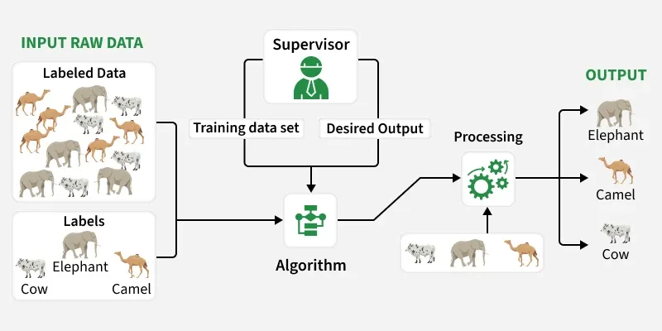
MACHINE LEARNING
Supervised learning: labeled examples

Slide 14
MACHINE LEARNING
Supervised model families
•
Linear regression: a transparent numeric baseline; gradient descent can fit parameters.
•
Logistic regression: converts a score into class probabilities.
•
Decision trees: flowchart-like rules; random forests average many trees.
•
SVM finds separating boundaries; k-NN predicts from nearby examples.
•
Naïve Bayes uses probability assumptions and is effective for text.

Slide 15
MACHINE LEARNING
Unsupervised learning
•
Uses unlabeled data to discover structure rather than predict a supplied target.
•
Clustering groups similar observations: k-means, hierarchical methods and DBSCAN.
•
Association rules reveal co-occurring items in market-basket data.
•
PCA and related methods reduce dimensions while retaining important variation.

Slide 16
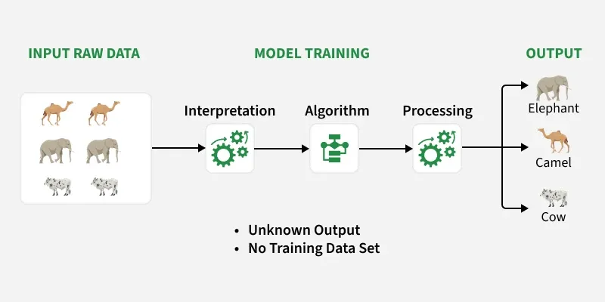
MACHINE LEARNING
Unsupervised learning: discover structure

Slide 17
MACHINE LEARNING
Reinforcement learning
•
An agent observes a state, selects an action and receives a reward.
•
The policy balances exploration of alternatives with exploitation of known actions.
•
Model-free methods learn from experience; model-based methods plan with an environment model.
•
Examples include Q-learning, SARSA, Monte Carlo and actor–critic methods.

Slide 18
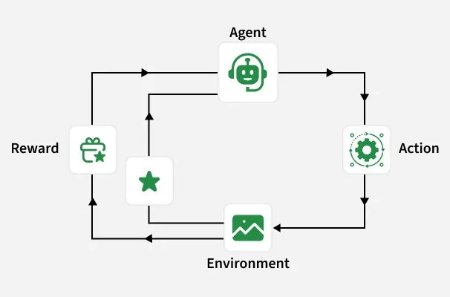
MACHINE LEARNING
Reinforcement learning: action and reward

Slide 19
MACHINE LEARNING
Semi-supervised and self-supervised learning
•
Semi-supervised learning combines a small labeled set with much unlabeled data.
•
It is useful when expert labeling is expensive or slow.
•
Self-supervised learning creates targets from the data itself and is often treated as a form of unsupervised learning.

Slide 20
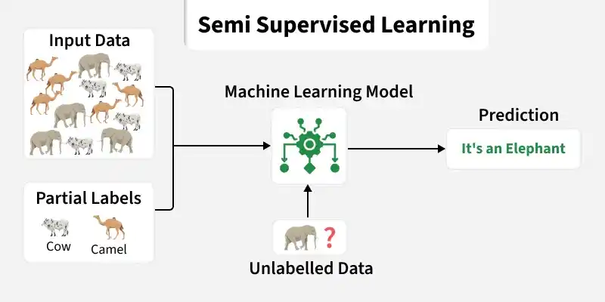
MACHINE LEARNING
Semi-supervised learning

Slide 21
MACHINE LEARNING
Evaluation and model improvement
•
Classification: accuracy, precision, recall, F1 and ROC–AUC answer different questions.
•
Regression: MAE is interpretable; MSE/RMSE penalizes large errors; R² describes explained variation.
•
Cross-validation gives a more stable estimate during comparison.
•
Hyperparameters are set outside fitting; regularization controls complexity.

Slide 22
MACHINE LEARNING
Confusion matrix: make errors visible
Actual ↓ Predicted →
TP
FN
FP
TN

Slide 23
MACHINE LEARNING
Overfitting, underfitting and bias
•
Overfitting memorizes training detail; underfitting is too simple to capture signal.
•
Bias is systematic error from restrictive assumptions; variance is sensitivity to the sample.
•
Use regularization, better features, more data and honest validation to improve generalization.

Slide 24
MACHINE LEARNING
Deployment and MLOps
•
A model becomes useful when integrated into an application, service or workflow.
•
MLOps covers packaging, testing, versioning, deployment, monitoring and rollback.
•
Monitor data drift, concept drift, latency, quality, fairness and user feedback.
•
Deployment is the start of a maintenance cycle, not the finish line.

Slide 25
MACHINE LEARNING
Responsible ML
•
Representativeness: who is included or excluded?
•
Validity: does the target measure what matters?
•
Fairness: do error rates differ across groups?
•
Privacy, security, explainability and recourse matter for high-impact decisions.

Slide 26
MACHINE LEARNING
Worked example: spam filtering
•
Collect labeled messages; clean text and prevent target leakage.
•
Train a baseline such as Naïve Bayes or logistic regression.
•
Evaluate precision and recall according to the costs of blocking good mail or missing spam.
•
Deploy with feedback and monitor new vocabulary and changing spam tactics.

Slide 27
MACHINE LEARNING
Key takeaways
•
ML is a data-to-decision process, not only an algorithm.
•
Collect, clean, train, evaluate and deploy are connected stages.
•
Start simple, validate honestly and choose metrics deliberately.
•
Production requires monitoring, governance and continuous improvement.
Reference: https://www.geeksforgeeks.org/machine-learning/machine-learning/

Slide 28
REFERENCES
References
(1) Jason Brownlee, Data Preparation for Machine Learning: Data Cleaning, Feature Selection, and Data Transforms in Python, Machine Learning Mastery
(2) Laurence Moroney, AI and Machine Learning for Coders: A Programmer's Guide to Artificial Intelligence, O'Reilly Media
(3) GeeksforGeeks.org
Video: https://www.youtube.com/watch?v=Au1OxVSyGas&t=122s

