Slide 1
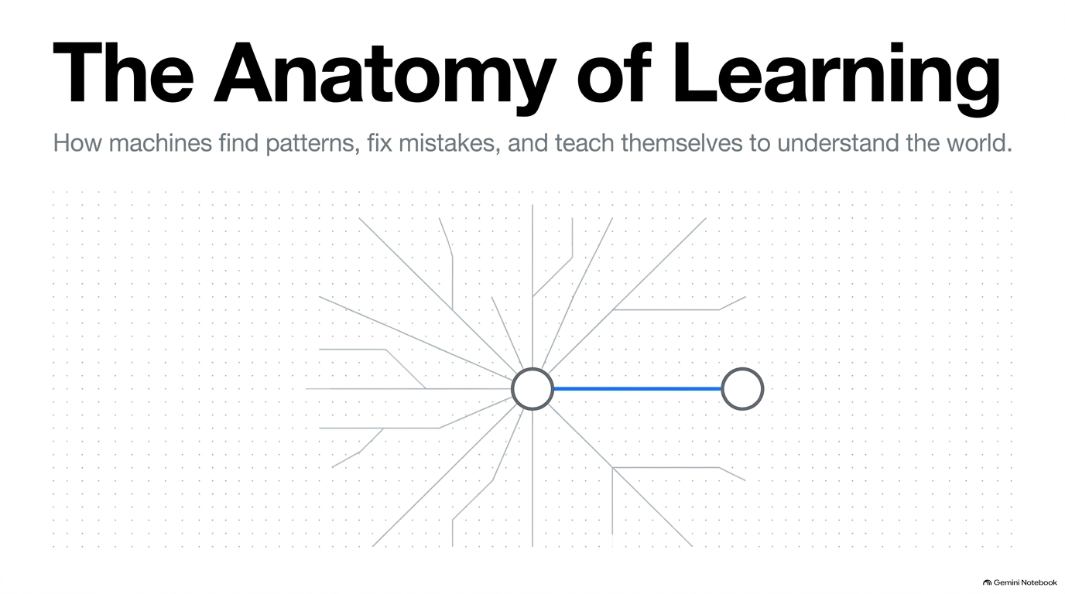

Slide 2
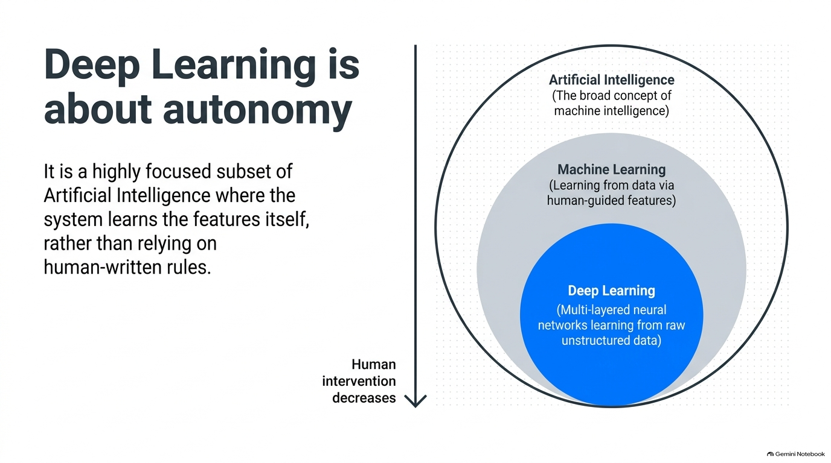

Slide 3
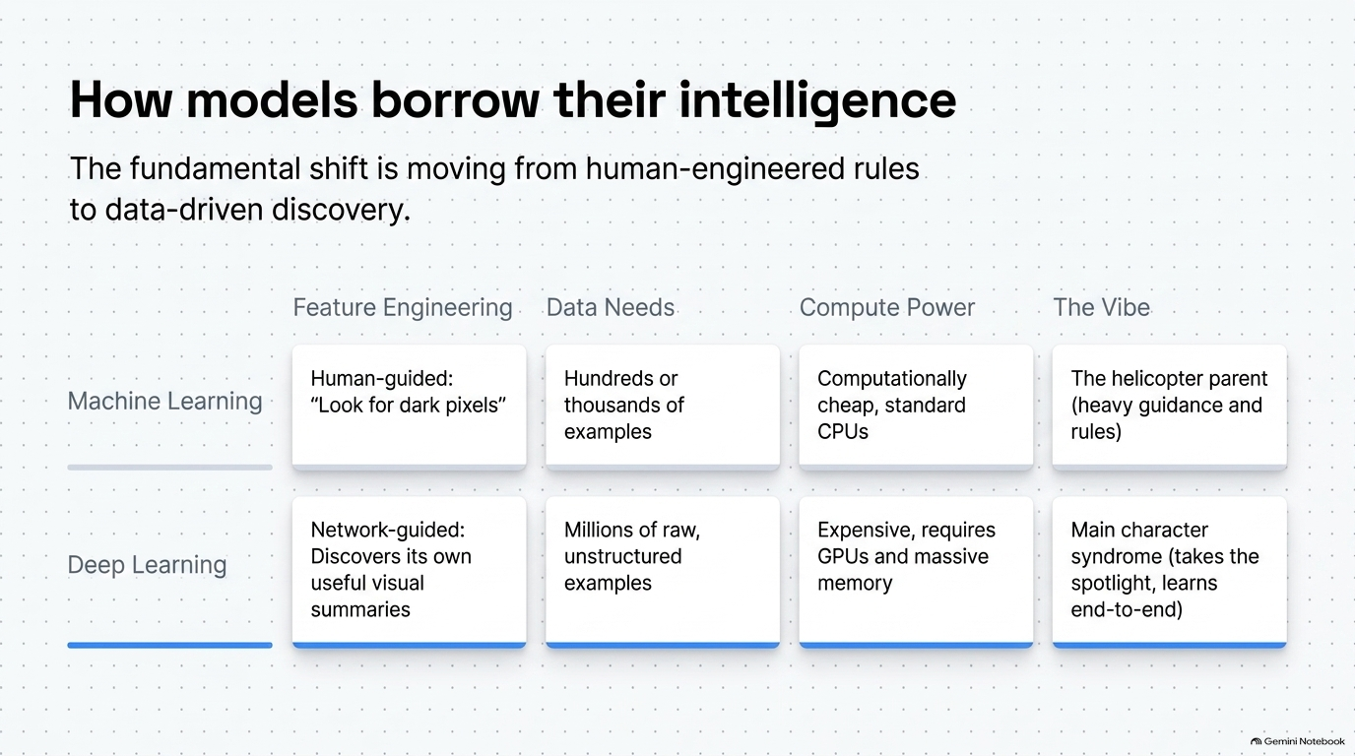

Slide 4
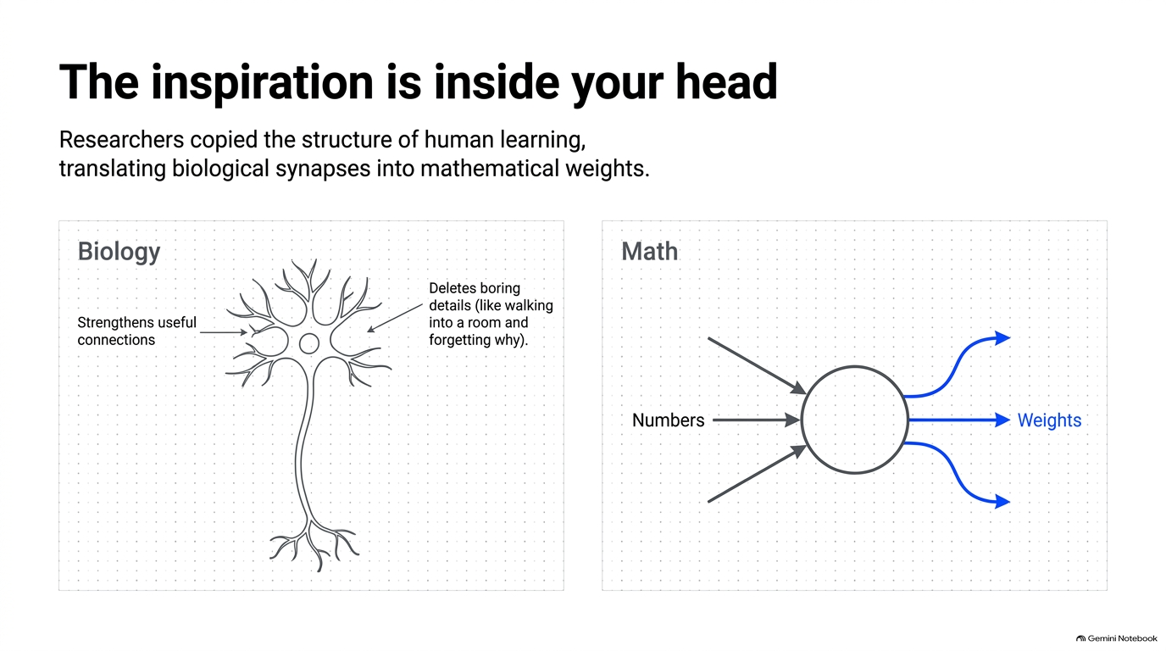

Slide 5
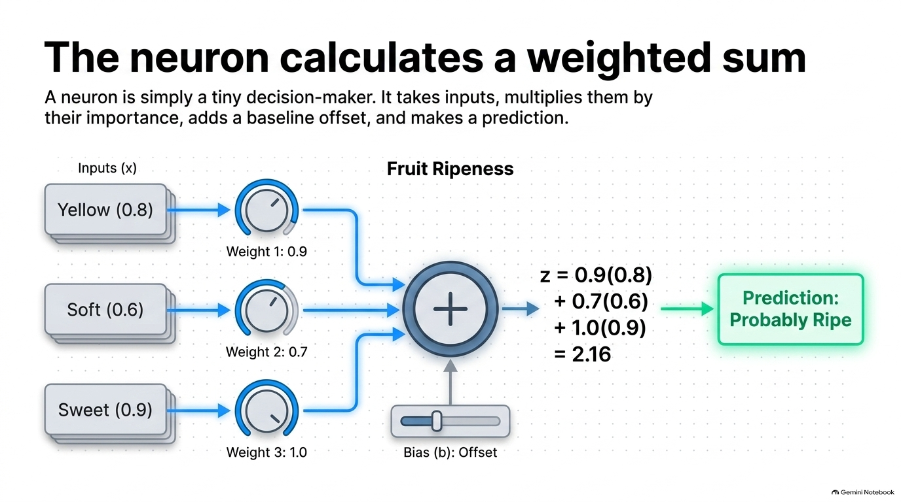

Slide 6
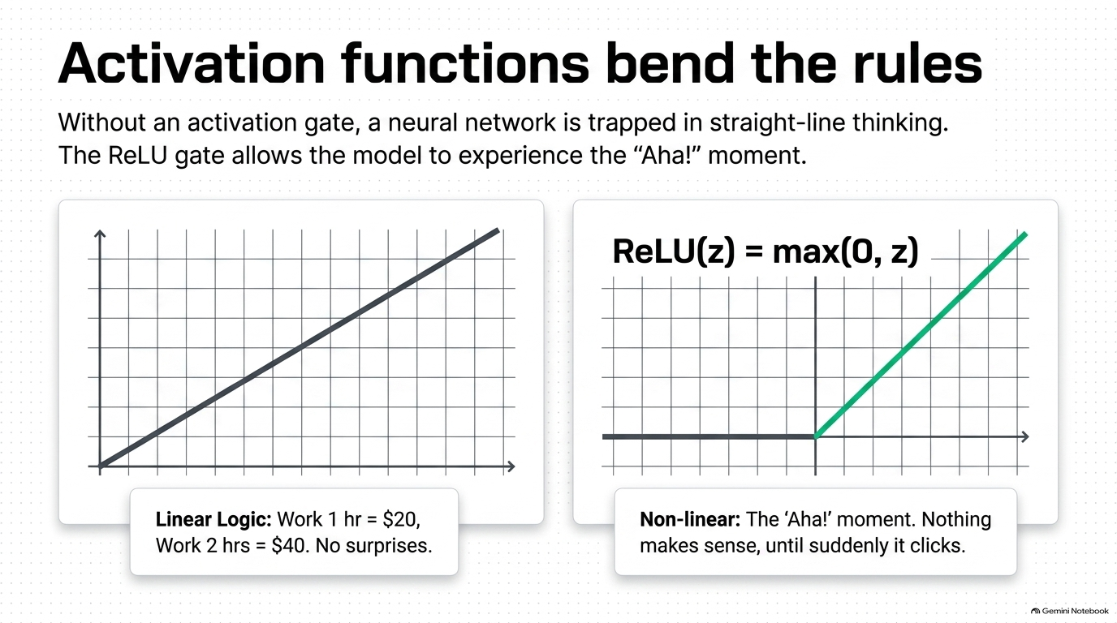

Slide 7

Why ReLU Powers Deep Networks
A simple non-negative threshold that creates sparse, lightning-fast representations without vanishing gradients.
● Range [0, ∞]
● Sparse Activation
● Computational Speed
Outputs strictly non-negative values. Because positive signals pass through unscaled, gradients never saturate or vanish across 50+ stacked layers.
Silences negative neurons to absolute zero. Only a selective subset fires at any time, mimicking biological brain efficiency and preventing co-adaptation.
A simple threshold check max(0, z) avoids costly exponential math, computing 6x faster than sigmoid and significantly cutting training times.
ReLU(z) = max(0, z)
Negative Input (z < 0): Clamped to 0.0 (Neuron stays inactive)
Positive Input (z ≥ 0): Output equals z (Signal passes straight through)
Catholic University of Rwanda (CUR) • Class III
Lecturer: Fadl Musa • September 2026

Slide 8
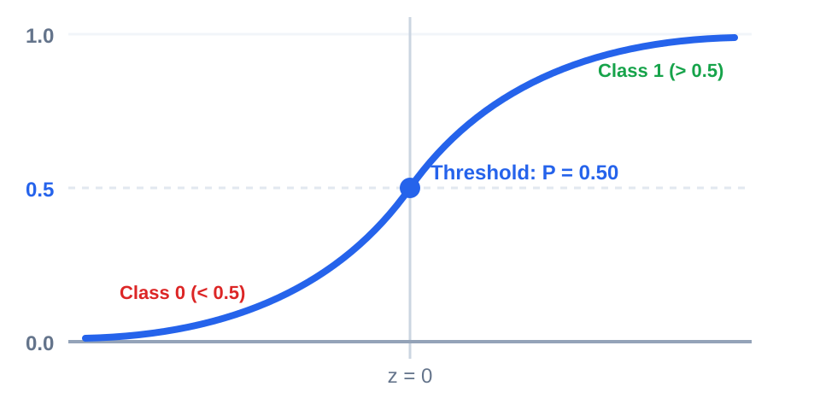
Sigmoid: The Probability Gate
Compresses any real-valued score into a smooth S-curve between 0 and 1, acting as the primary decision threshold for binary outcomes.
Mathematical Gate
σ(z) = 1 / (1 + e⁻ᶻ)
• Range (0, 1): Converts unconstrained numbers into calibrated probabilities.
• Output Specialist: Standard choice for binary classification (Dog vs. Cat, Fraud vs. Normal).
• Smooth Gradient: Differentiable everywhere, providing continuous error slopes for gradient descent.
Catholic University of Rwanda (CUR) • Class III
Lecturer: Fadl Musa • September 2026

Slide 9
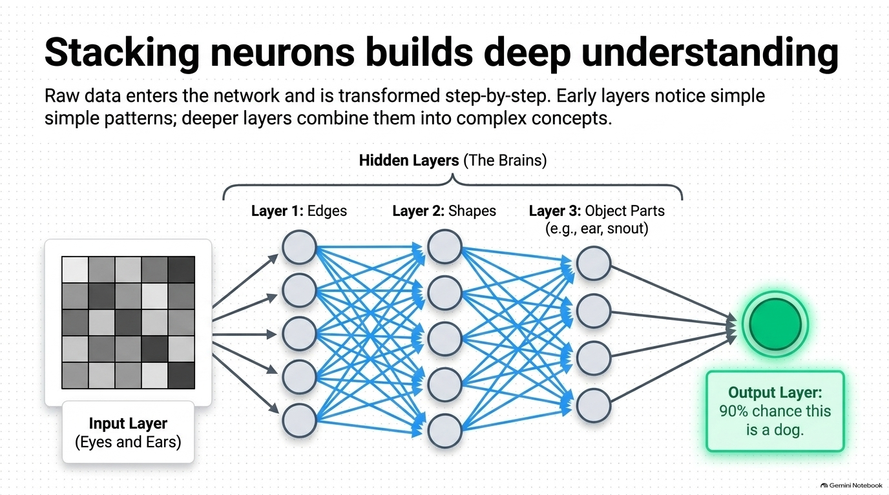

Slide 10
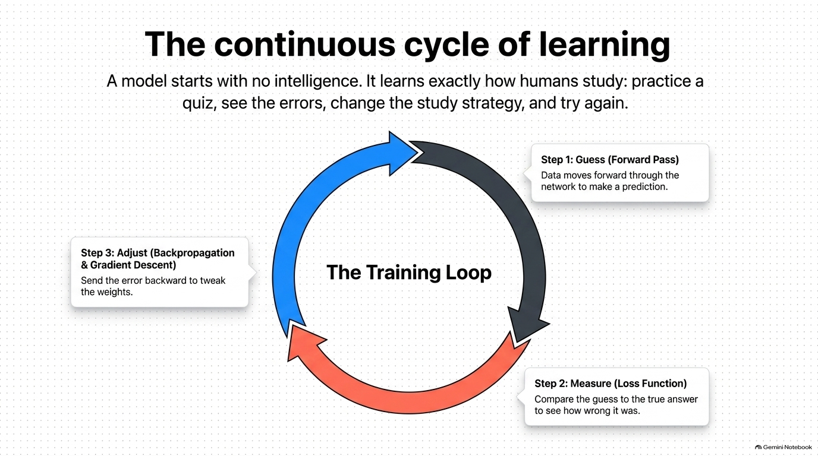

Slide 11
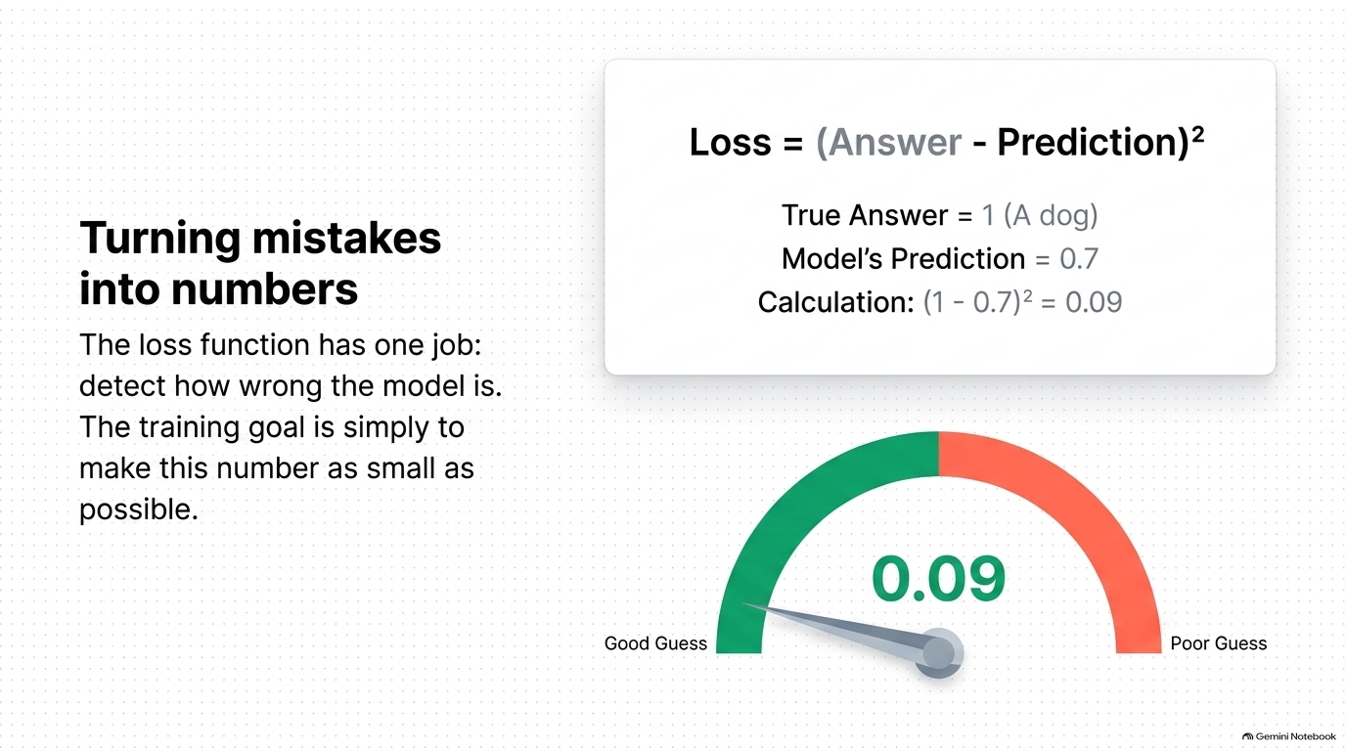

Slide 12
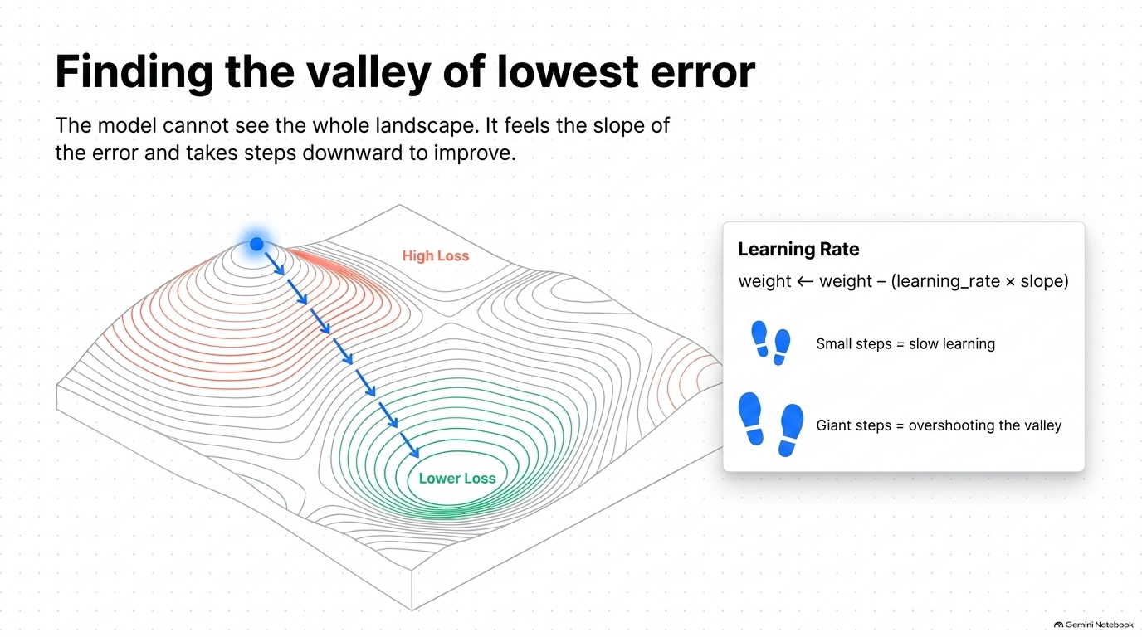

Slide 13
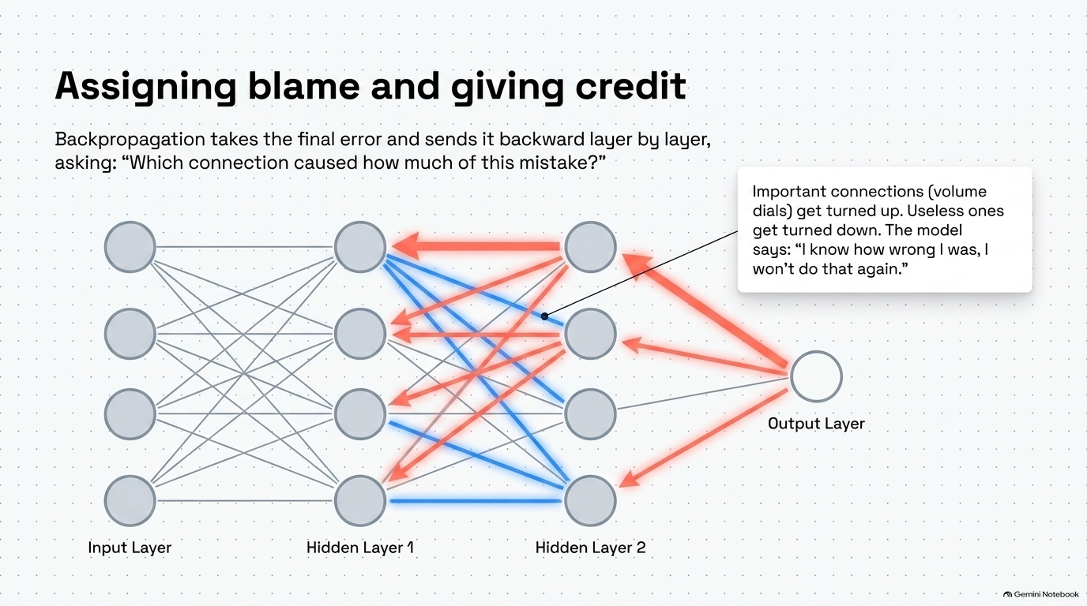

Slide 14
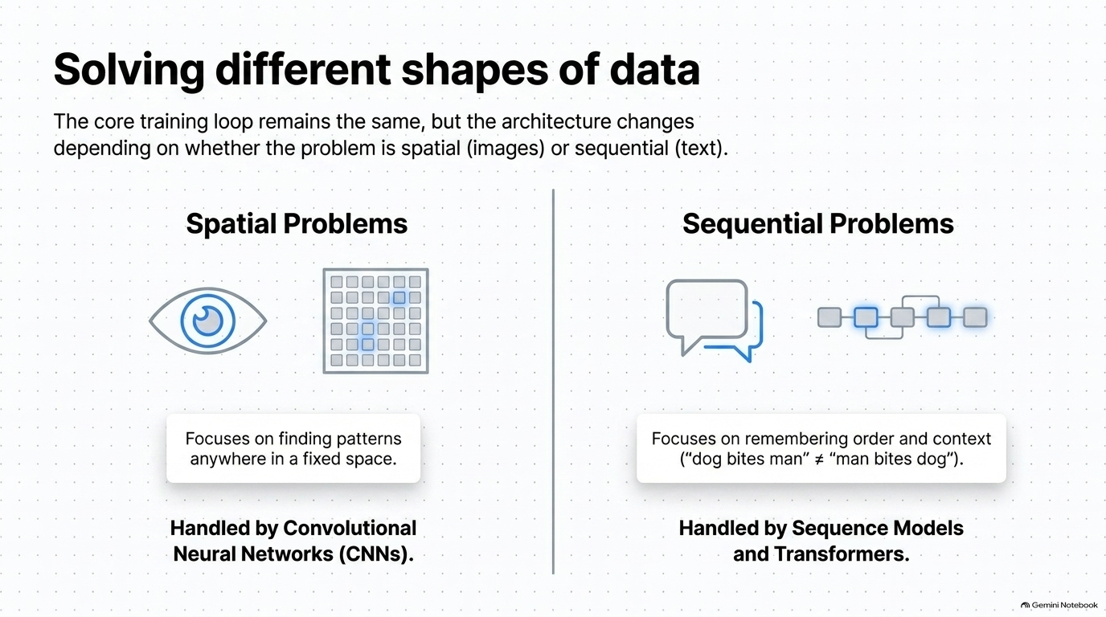

Slide 15
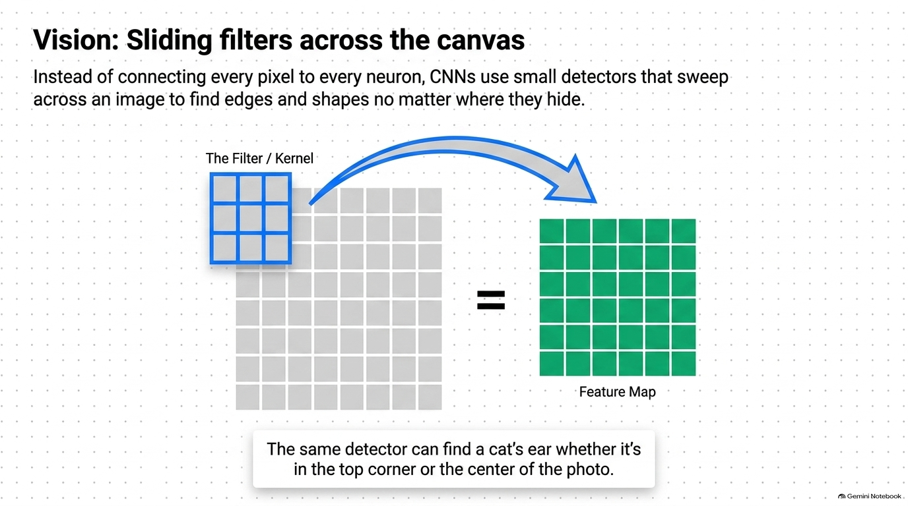

Slide 16
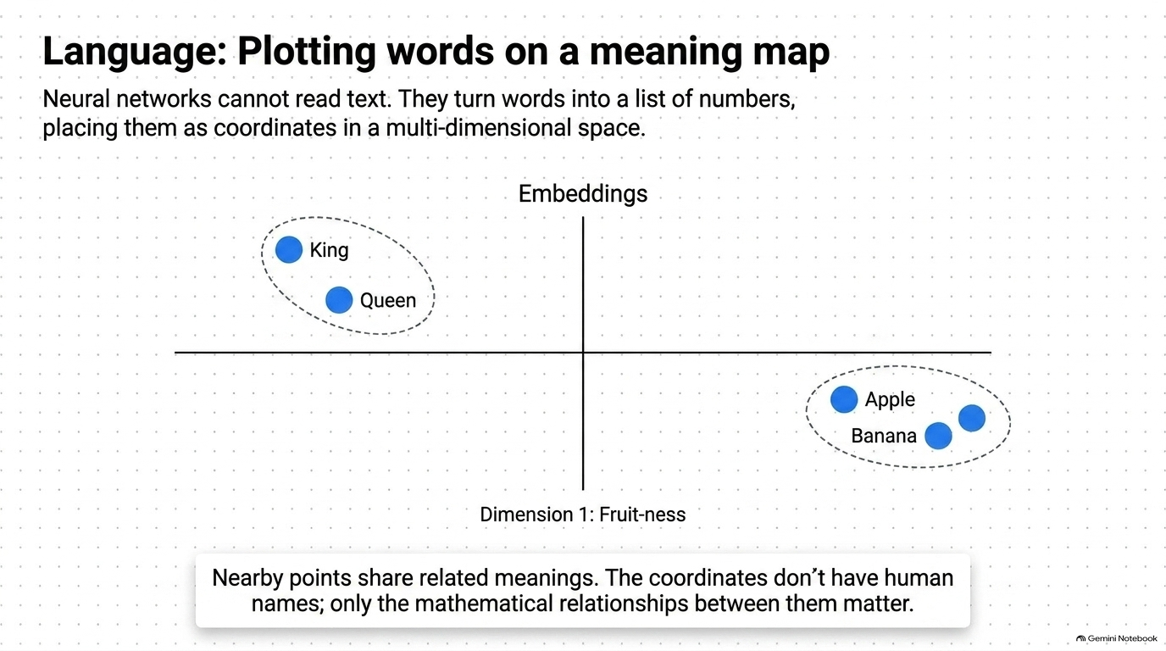

Slide 17
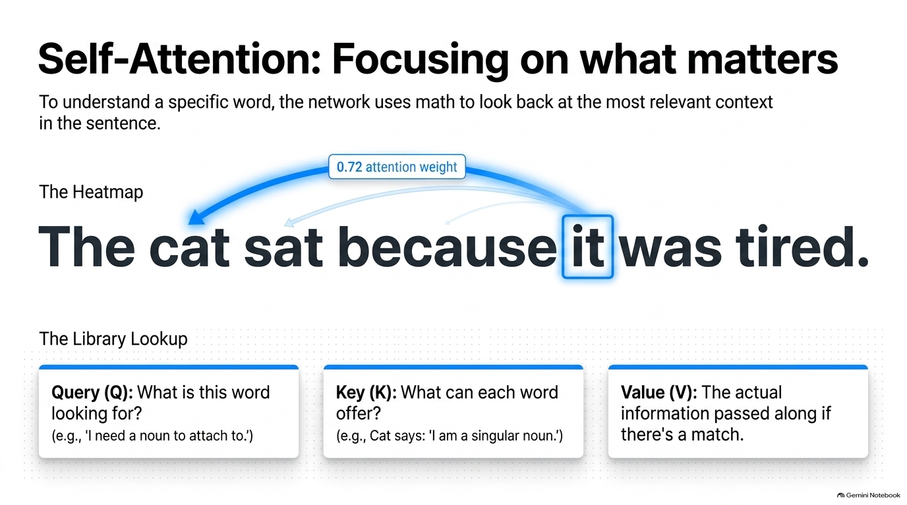

Slide 18
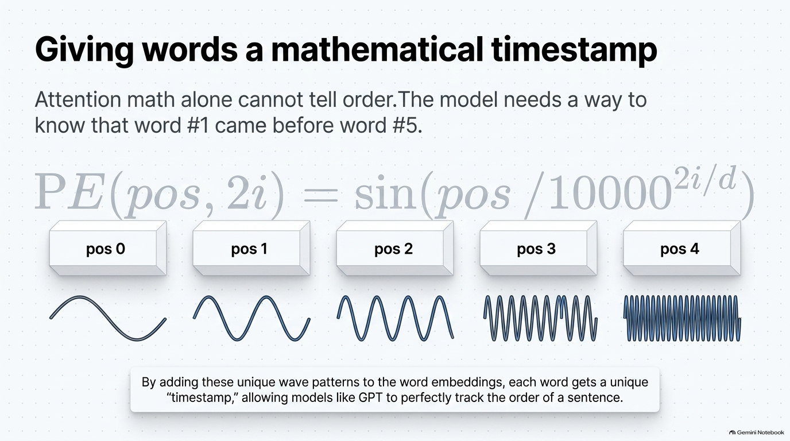

Slide 19
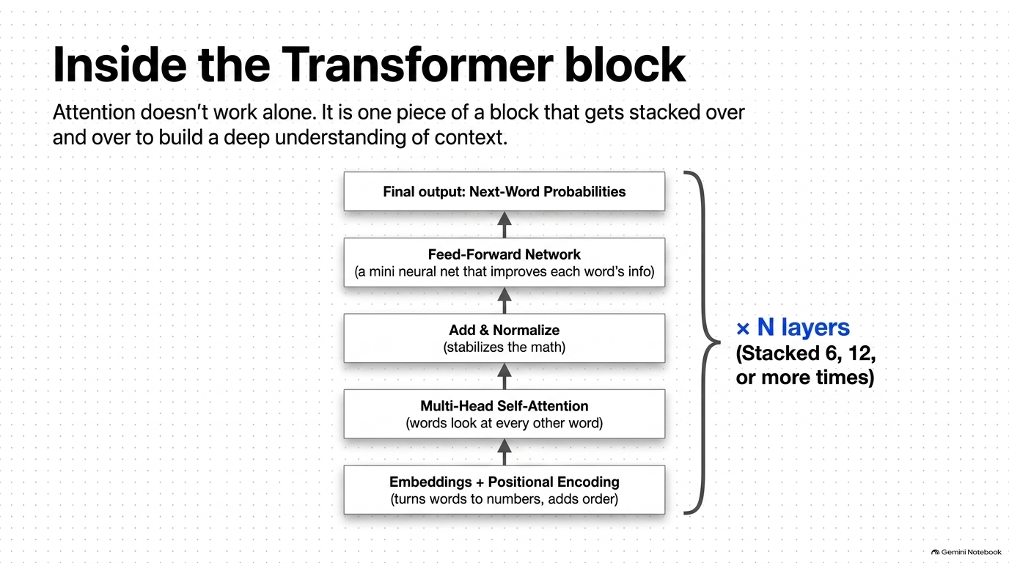

Slide 20
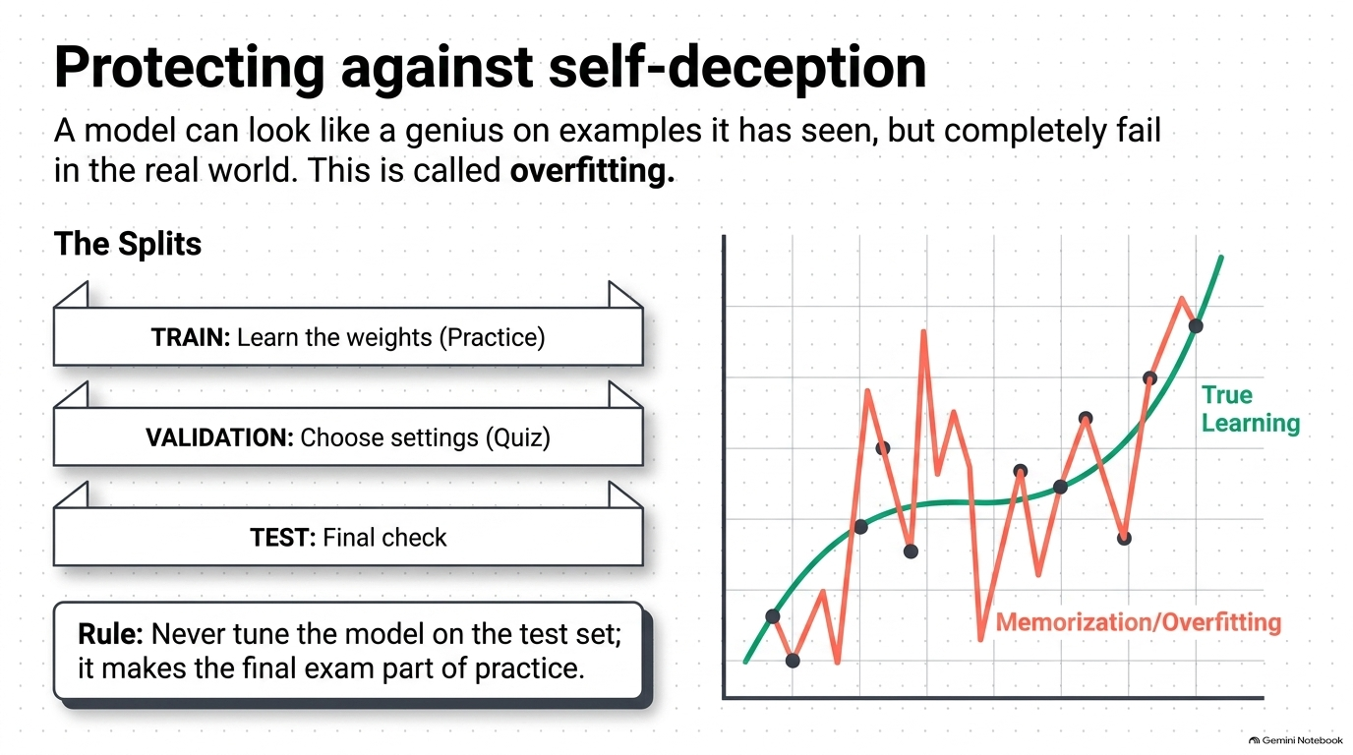

Slide 21
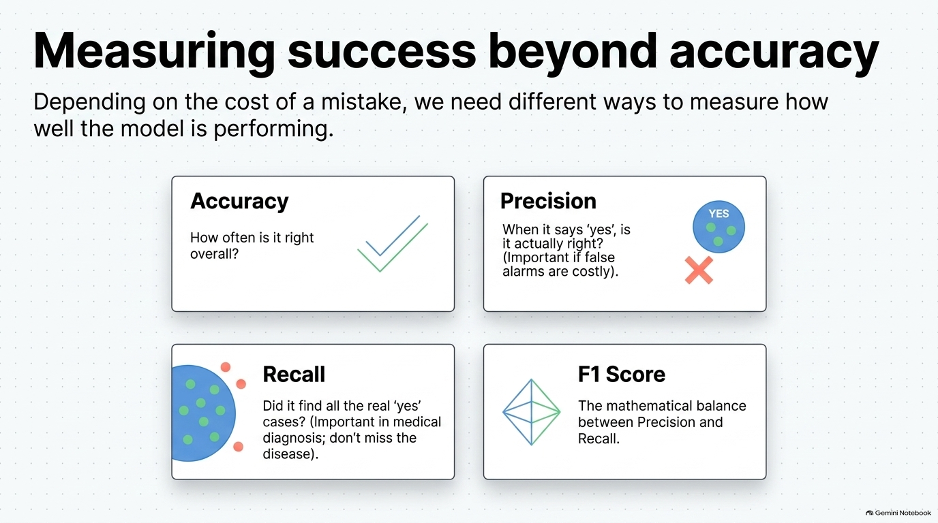

Slide 22
