Slide 1



OBS Studio - Livestream
Md Fadly Ghani
Endeavour Primary School

Slide 2
List of Equipment Required for Livestream
Items | Description | Qty
DSLR Camera / Video Camcorder | High-quality cameras for photos or videos, while camcorders are specialized for video. | 1
OBS Software | Free tool for video recording and live streaming, capturing audio and video from various sources. | 1
Laptop (High-End) | Powerful computer for tasks like video editing and streaming, with a fast processor and good graphics. | 1
HDMI to HDMI Mini Cable | Connects devices with standard HDMI (e.g., laptop) to those with smaller HDMI Mini ports (common in cameras), transferring audio and video. | 1
HDMI Video Capture Card | Connects camera to laptop, converting HDMI output for video capture and streaming. | 1
YouTube Account | Personal channel on YouTube for uploading, sharing, and managing videos, essential for reaching a wider audience. | 1

Slide 3
Media Layout
Youtube
Laptop
HDMI to HDMI Mini Cable
DSLR Camera / Video Cam recorder
Link Together
Video Card Reader
OBS Software

Slide 4
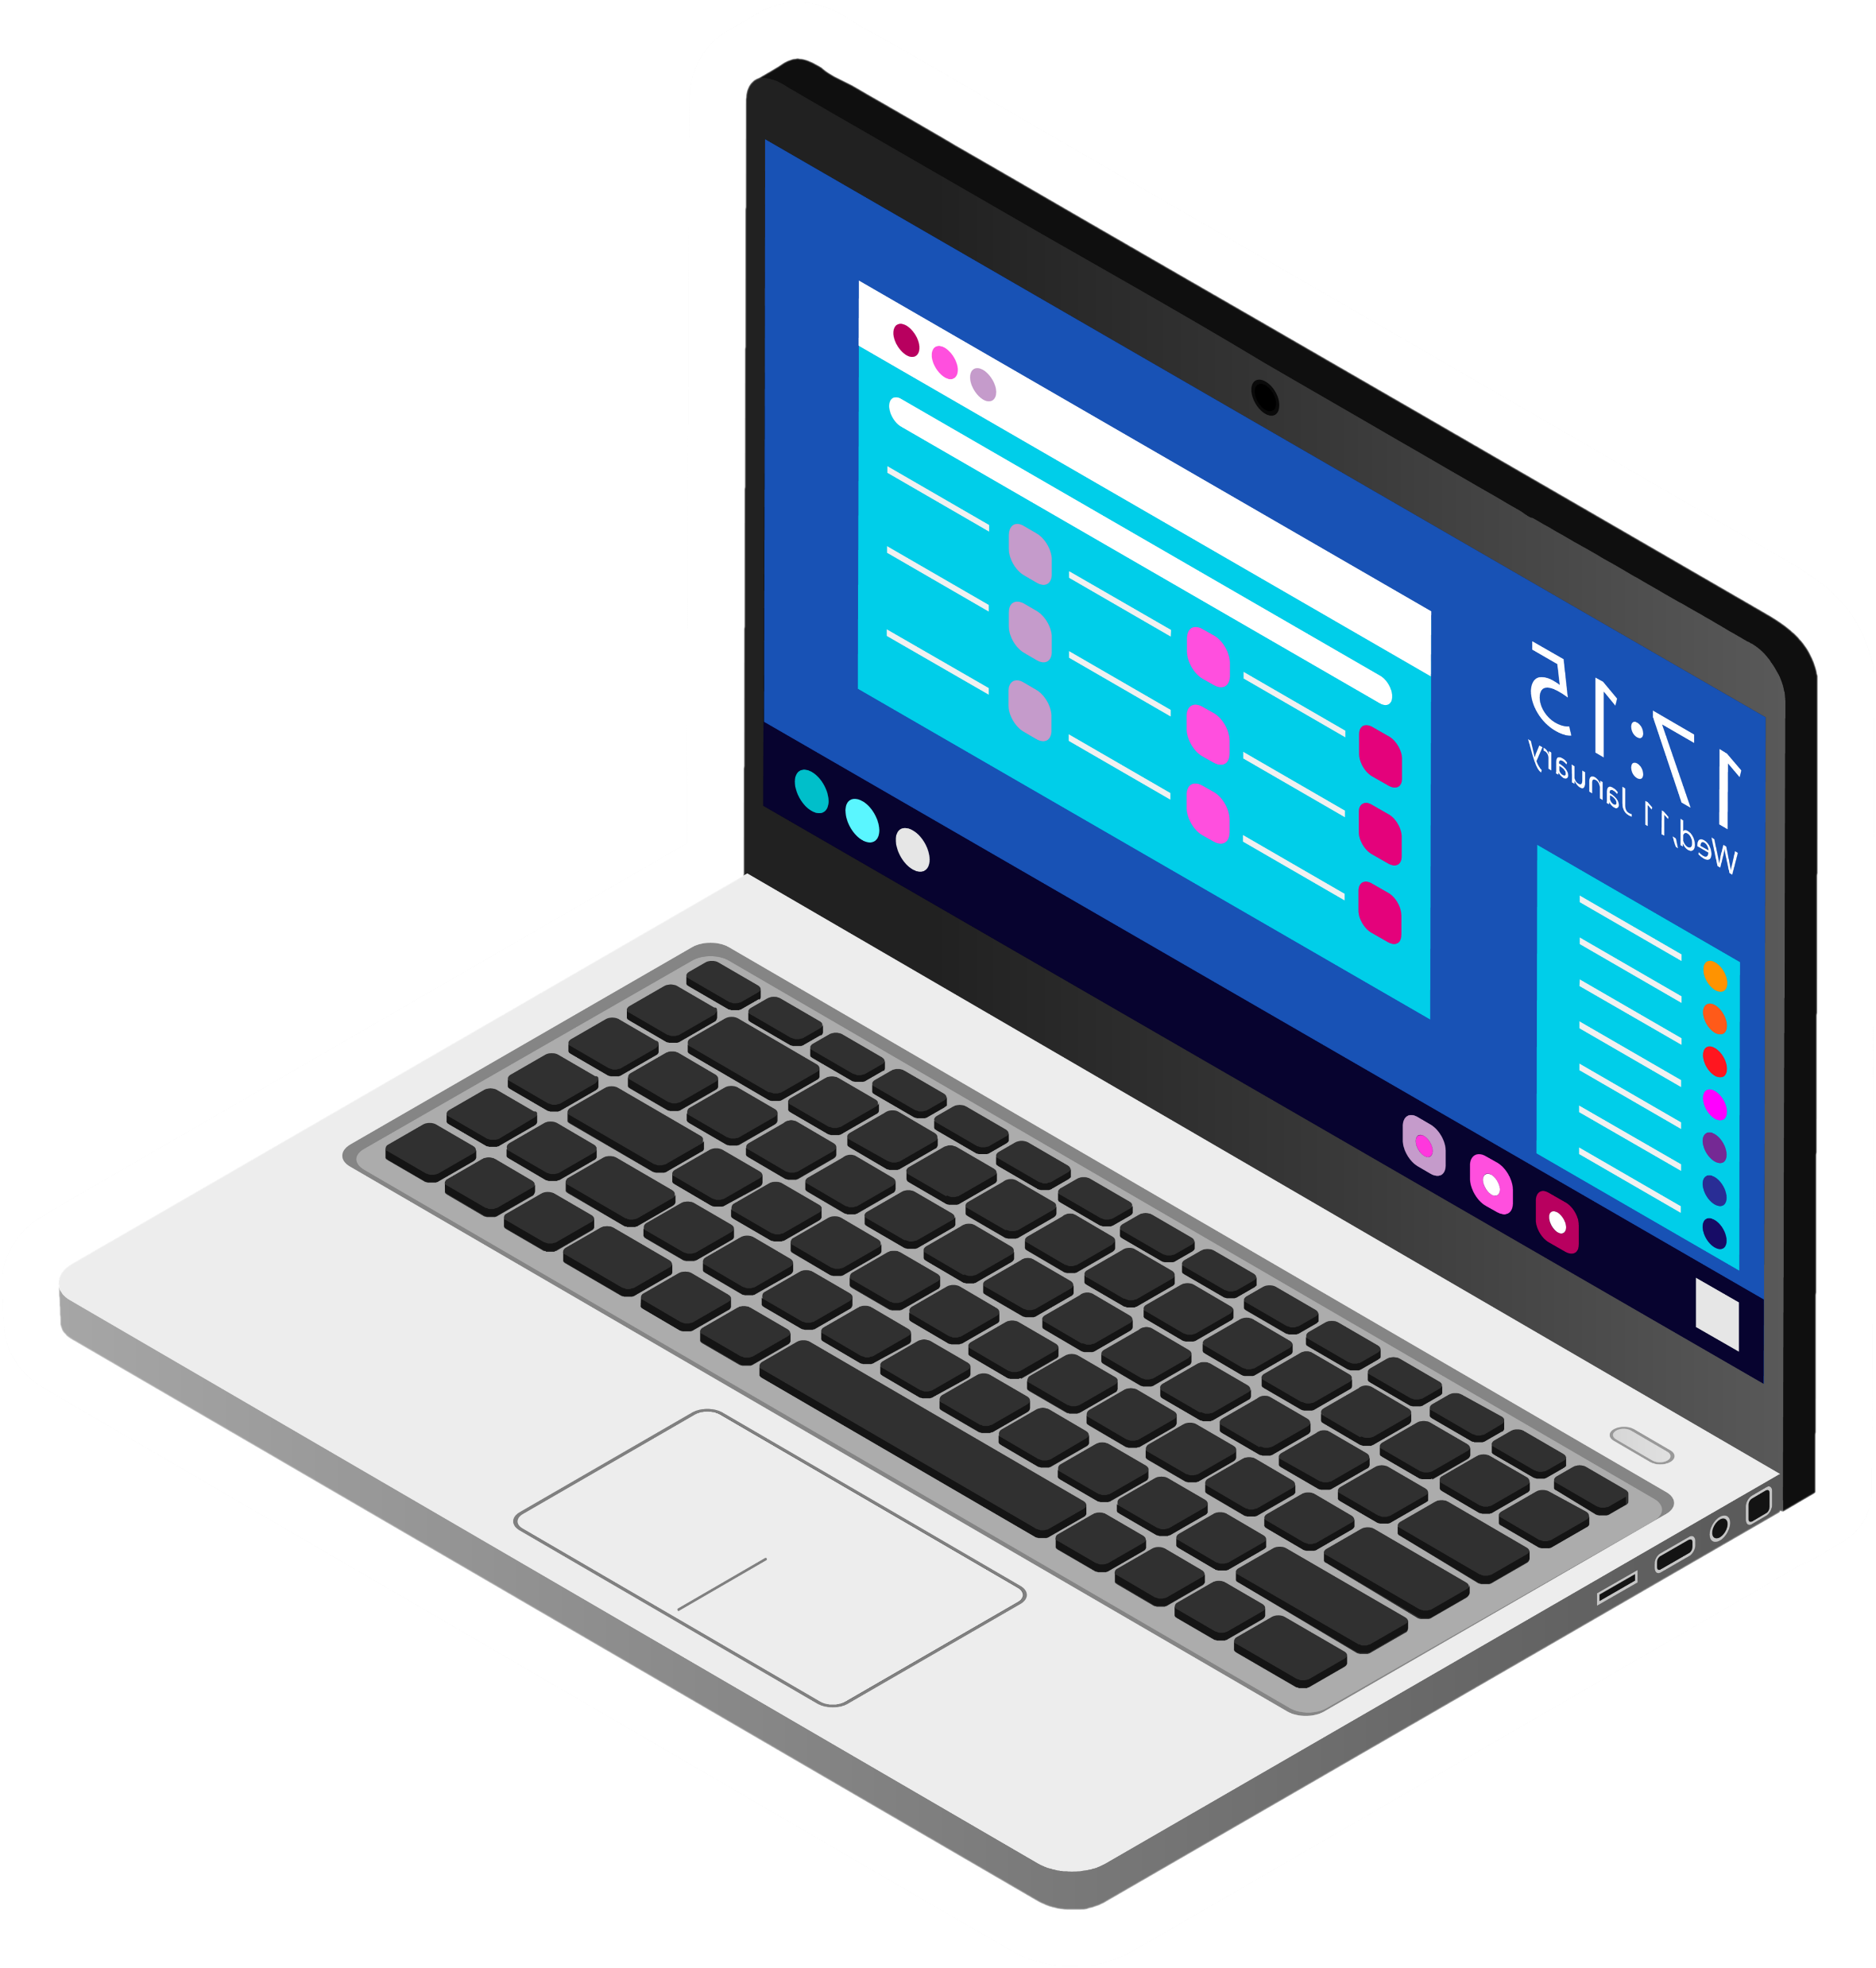
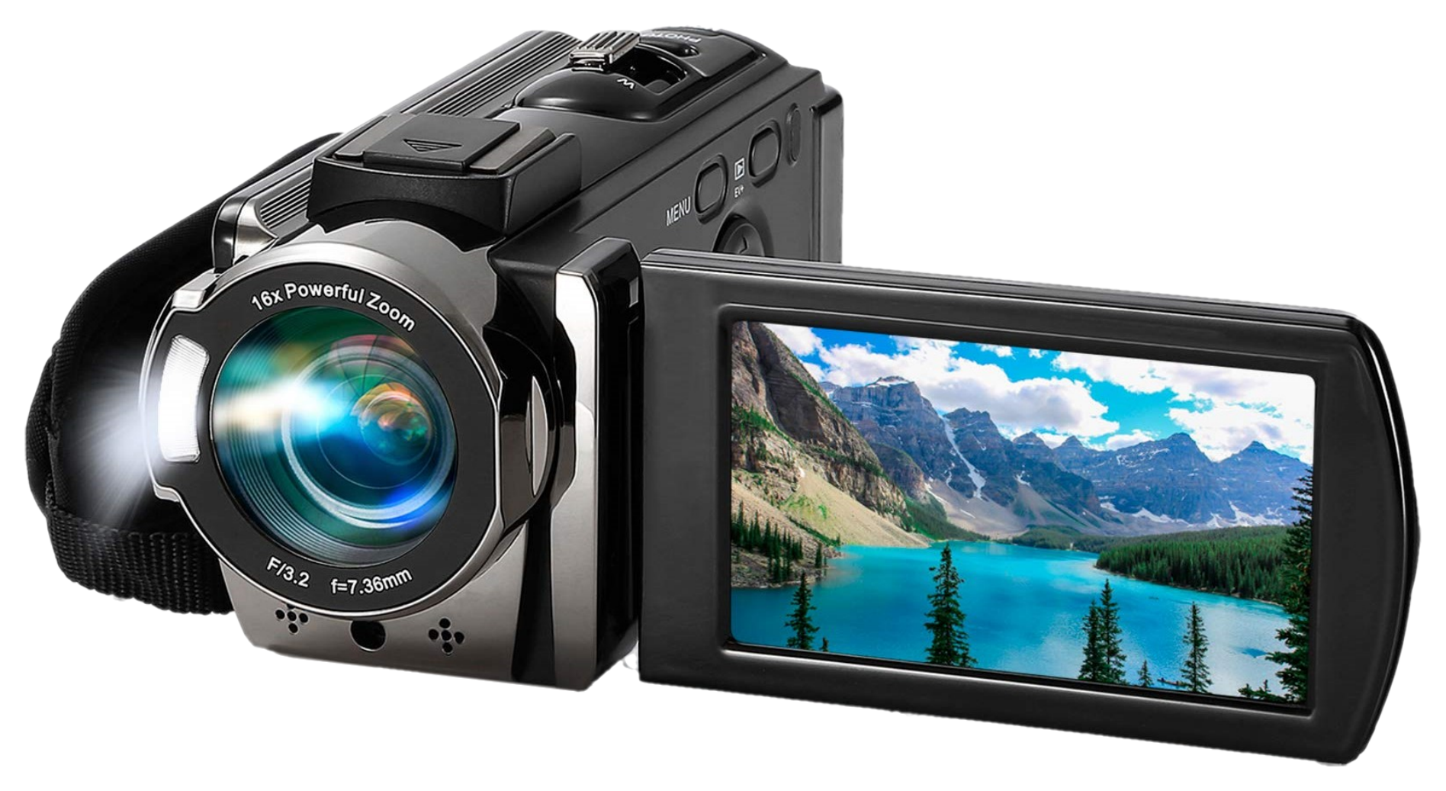
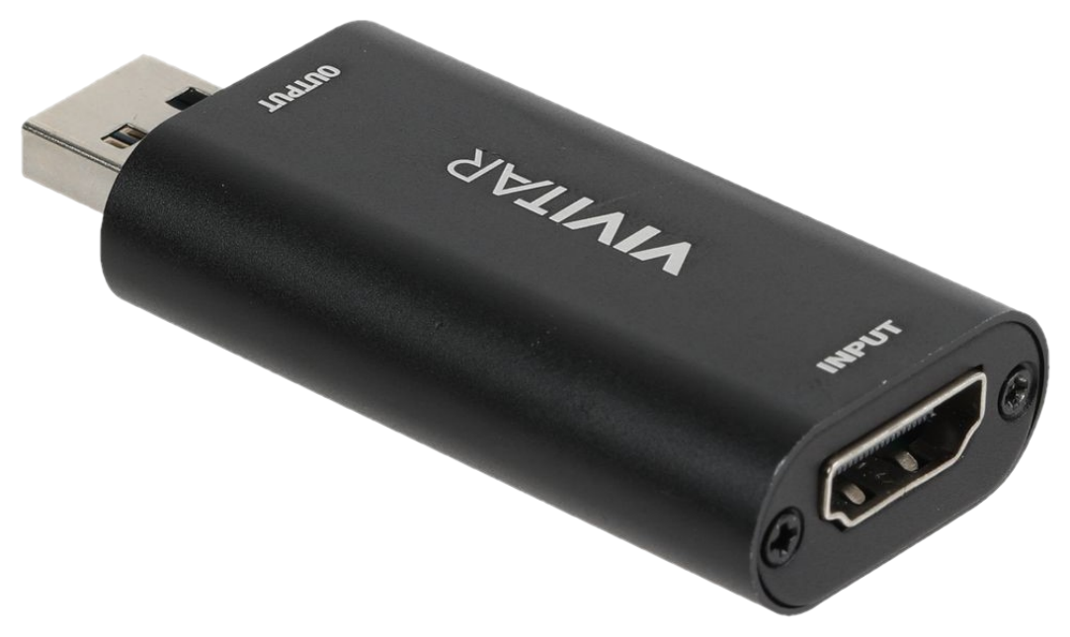
Media Layout
Youtube
Link Together
HDMI to HDMI Mini Cable
OBS Software

Slide 5
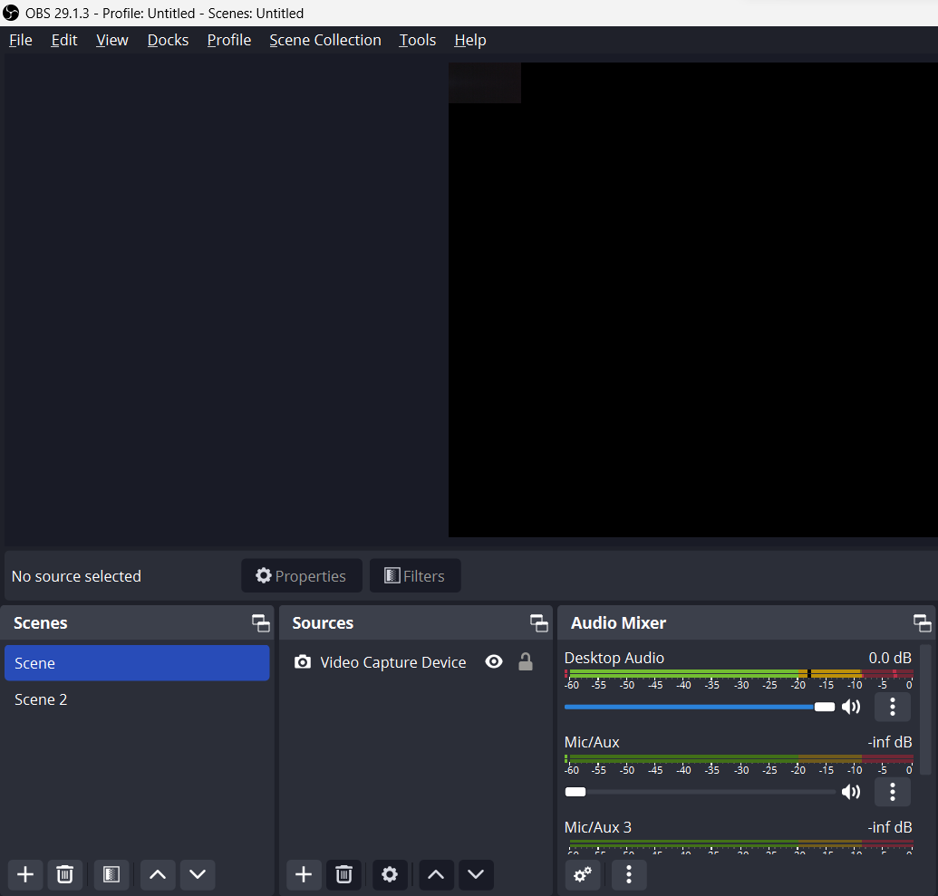
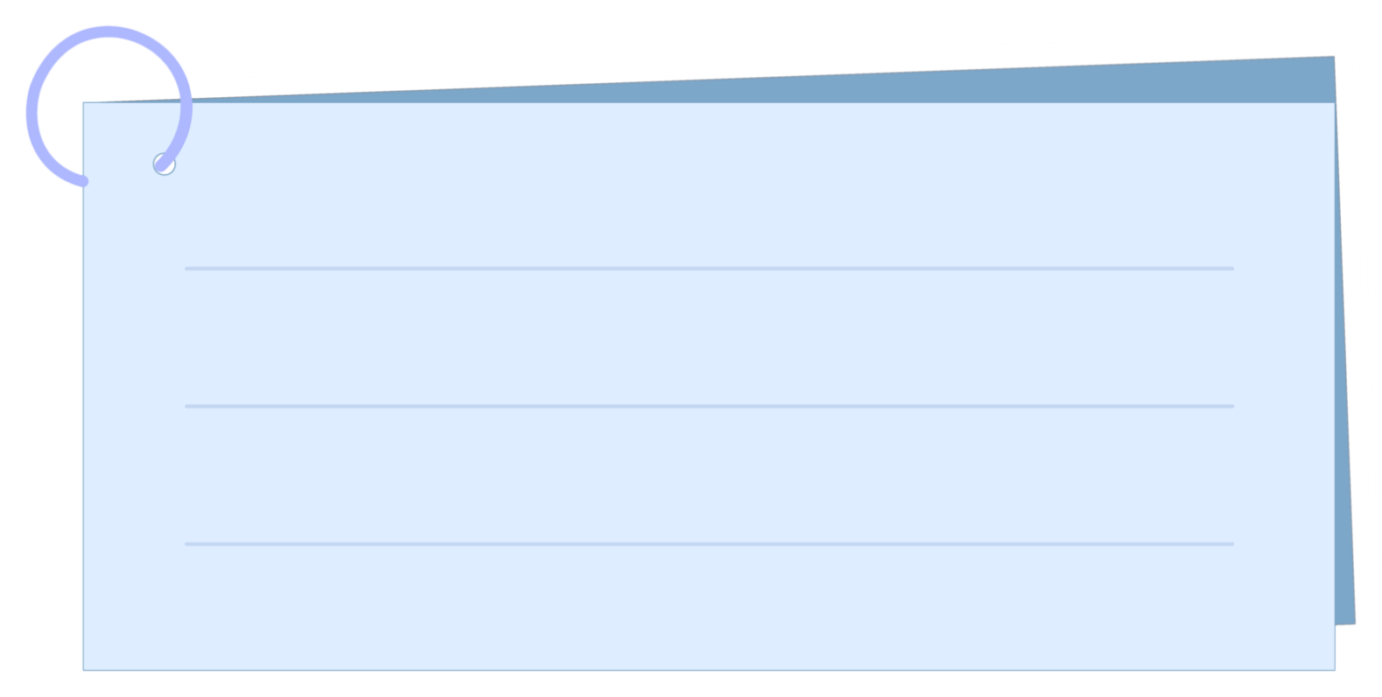
OBS – Scenes
Scenes Sources
► Each scene will involve various inputs, allowing you to insert and rearrange different sources.
Scenes
► This is where you can add, and reorder scenes as needed

Slide 6
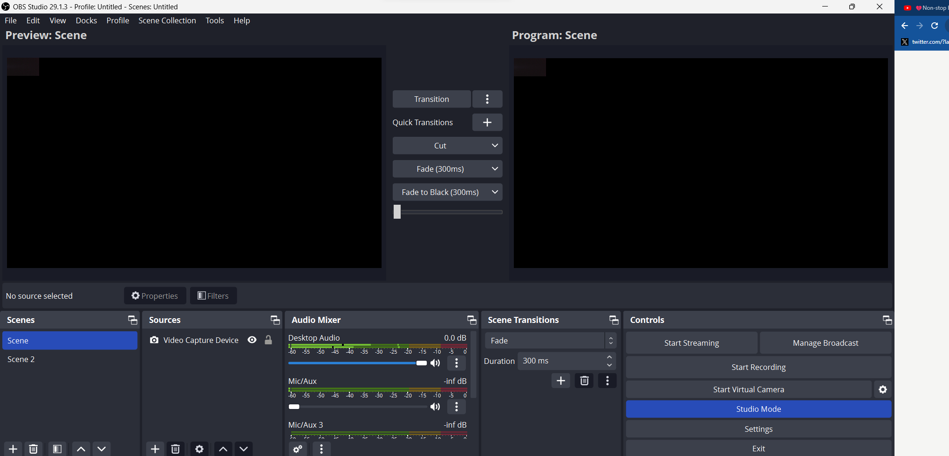

OBS – Creating Scene Resources for Livestream
Preview Mode
► See the scene you have on deck and edit your scenes here
Program View
► This is what your viewers see.
Studio Mode
►Click the Studio Mode to view both Preview Mode and Program View (Recommended)

Slide 7
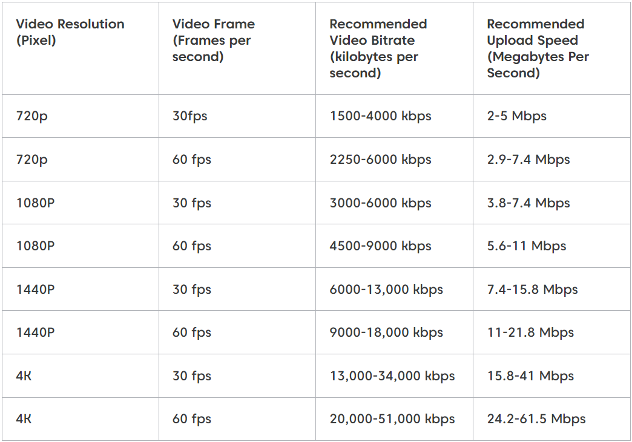
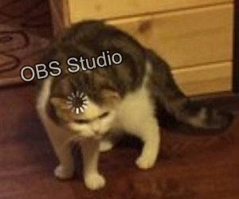
Recommended Setting
Streaming Settings
Recommended Setting
OBS Stream will experience frequent delays if your Wi-Fi connection is not good

Slide 8
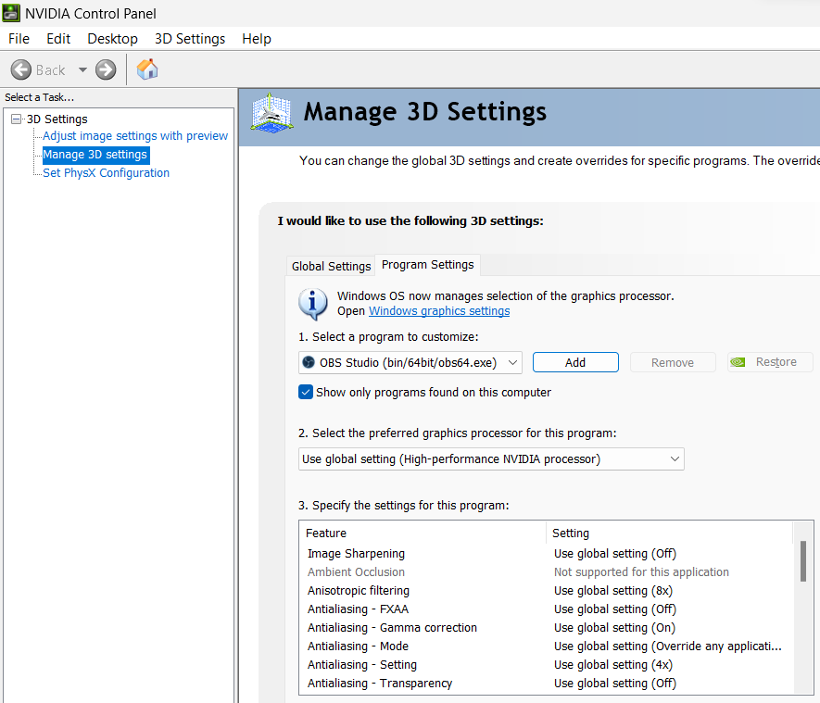
Recommended Setting
NVDIA Graphics Settings
Add “OBS Application”

Slide 9
Tips and Ticks
Always update OBS. Always ensure you have a good Wi-Fi signal. A few days before the livestream setup, do a dry run to rectify any problems that may occur, to prevent them on the actual day.

Slide 10
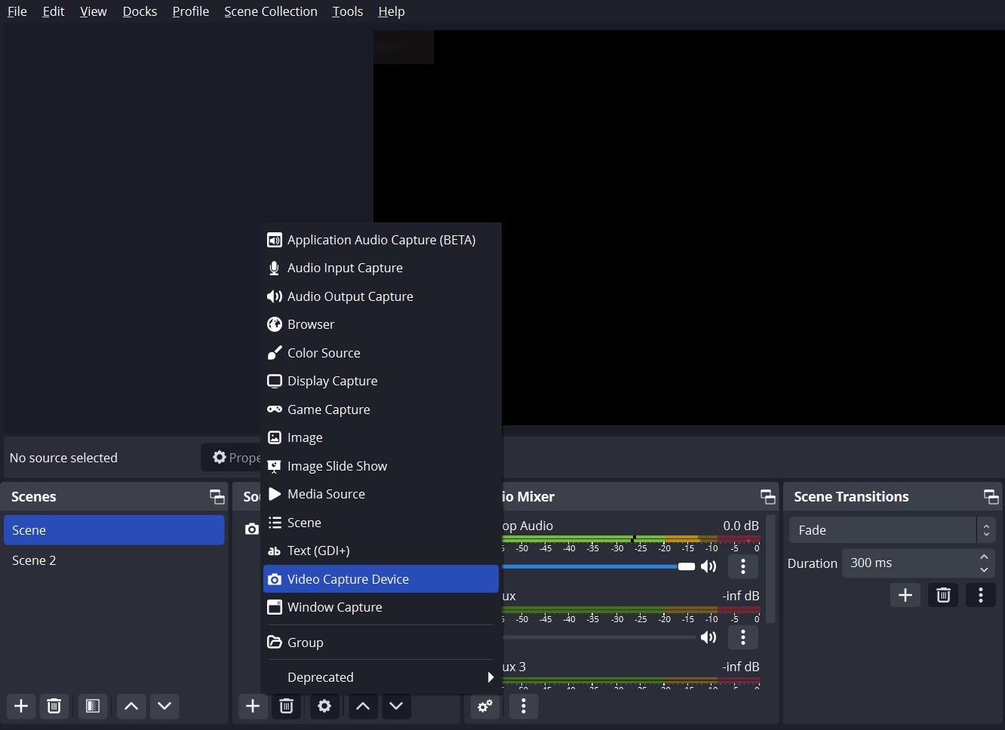
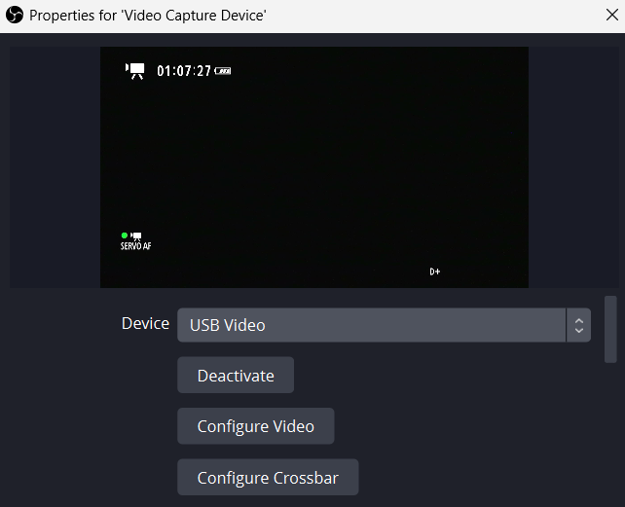
OBS – Creating Scene Resources for Livestream
Step 1: Create Scenes and Sources
Scenes Sources
1 ► Select “Video Capture Device”
2 ► USB Video

Slide 11
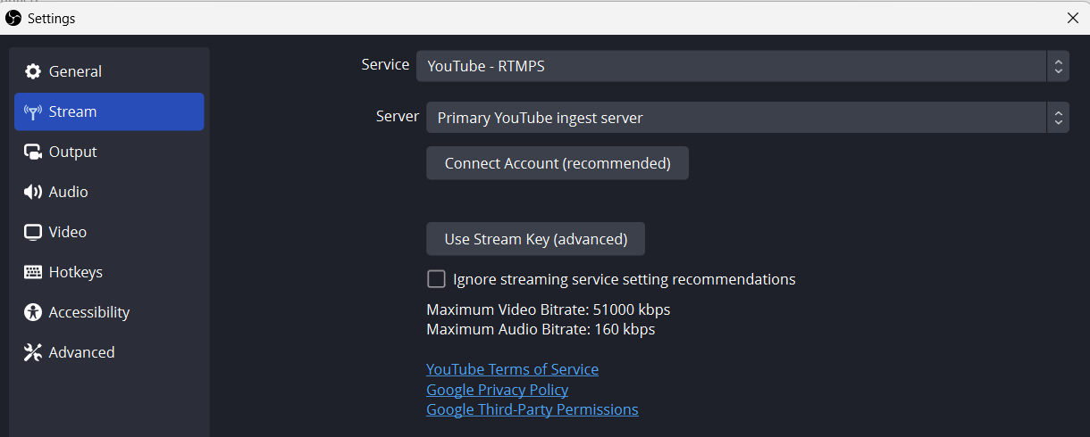
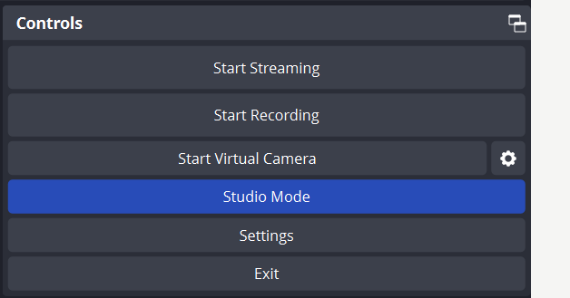
Link OBS Studio
w/ Youtube Acc
Step 2: Link OBS with Youtube
Link OBS with Youtube
1 ► Setting
2 ► Connect Account (Recommended)
https://studio.youtube.com/

Slide 12
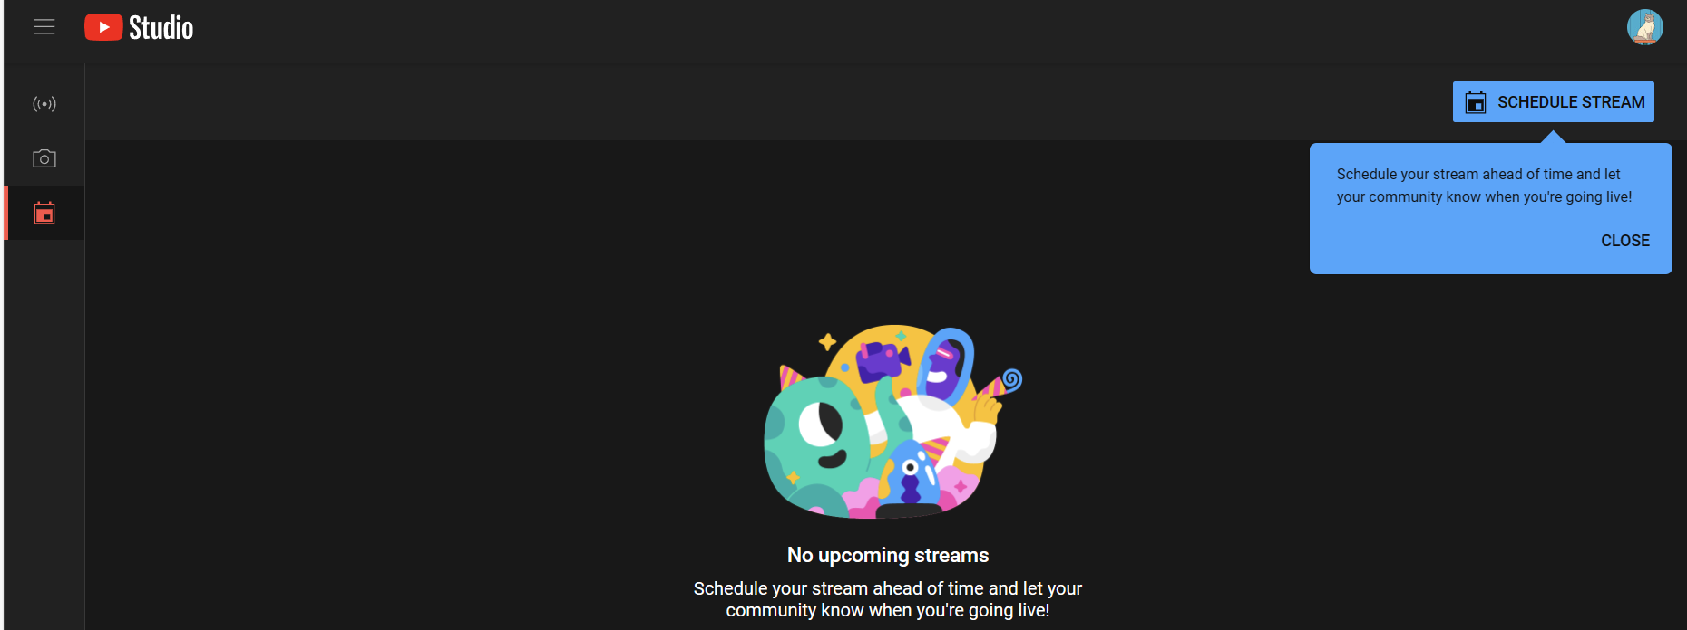
Step 3: Start Stream / Schedule
Youtube Studio
Start Stream
Schedule Stream

