Slide 1



Team details
Team name
Kredibel
Every number has a source.
Team leader
Muhammad Fadly Tanjung
Problem statement
Theme 1, BFSI: Intelligent Risk, Fraud and Financial Experiences. Small businesses close their books by hand, so duplicates, edited documents and diverted payments go unnoticed.
An AI finance workspace that checks a small business's own books, built on Gemini, ADK, Cloud Run, Firestore and Firebase.
Notes:
Kredibel, for Theme 1 BFSI: Intelligent Risk, Fraud & Financial Experiences. Team leader Muhammad Fadly Tanjung, with Ibnu Habibie, Jabbar Ali Panggabean and Muhammad Arisandy Pratama.

Slide 2
Brief about the idea
02
Kredibel reads every number twice, and only counts it when both readings agree
Kredibel is an AI finance workspace for small businesses and their accountants. Upload bank statements, invoices, receipts and the general-ledger export in any order.
It catches duplicates and edited documents before they are counted, reconciles every month, sends the few things AI cannot settle to a short review queue, and shows each month's fraud risk with the evidence and the next steps.
statement-2026-08.pdf, page 2
Date
Description
Credit
1
14 Aug
CASH DEPOSIT
7,250,000.00
Reading 1
7,250,000.00
Gemini reads the page image
Reading 2
7,250,000.00
Any order
Page and box
95%
The PDF's own text layer, or Document AI OCR for scans
same data, same result
behind every value
of bank lines matched automatically
Both agree, so the value counts
7,250,000.00
Disagreement is uncertainty, never an accusation.
Agreed
Notes:
One sentence: Kredibel checks a small business's own books. The idea that runs through everything: every figure is read twice, by Gemini from the page image and by an independent witness (the PDF text layer, or Document AI OCR for scans), and code only counts a value when both agree.

Slide 3
The problem
03
Small businesses close their books by hand, and three kinds of mistakes slip through
Duplicates
Edited documents
Diverted payments
×2
85.6%
USD 2.77 B
one expense, counted twice
of fraud and risk leaders name bank statements the document most open to manipulation
lost to business email compromise in the US in 2024
The same statement uploaded twice, a supplier invoice scanned again, a receipt photographed by two people. Expenses are counted twice and suppliers paid twice.
Editing a PDF takes minutes. A changed amount or a balance that no longer adds up looks perfectly normal on screen.
An invoice paid to a bank account the supplier never used before is how payment diversion works.
Fraud costs organizations about 5% of revenue a year (ACFE). Mistakes surface weeks later, if at all; owners need the evidence, not another black-box score.
Sources: Inscribe 2026 Document Fraud Report (vendor survey); FBI IC3 2024 report; ACFE Occupational Fraud 2024.
Notes:
Three failure modes. Figures: Inscribe 2026 (vendor survey of fraud and risk leaders) and FBI IC3 2024 (BEC losses USD 2.77 billion). Kredibel targets all three in the same workspace.

Slide 4
Opportunities
04
Extraction tools read a document once. Kredibel checks it against itself, the bank and the ledger
Typical OCR and expense tools
Kredibel
How it solves the problem
Duplicates are stopped at upload, edits are caught by forensics on grounded values, and diverted payments surface when reconciliation meets a supplier account it has never seen.
Reading
Reads once and trusts the output
Reads twice; a value counts only when both readings agree
Duplicates
Counted again
Exact copies never read; near copies held for a person
Edited PDFs
Not checked
Running balances, revision history, fonts in amount columns
Our USP
Every number has a source.
Fraud signal
A score without reasons
A policy file sets the level; each finding opens its page
Every match, finding and figure opens the page and box it came from, and the AI explains while code decides.
Upload order
Can change the result
Same data, same result, in any order
Notes:
How it differs: reading twice with grounding, duplicates held before they count, forensics, explainable policy-based risk, and order-independent reconciliation. USP: every number has a source.

Slide 5
List of features offered by the solution
05
Seven checks between an upload and a closed month
1
Duplicates first
D01
D02–D06
5
Self-reconciling months
Any upload order
Exact copies are never read again; a re-scanned invoice or re-photographed receipt is held until a person decides.
Exact, split, net-of-tax and ledger matches with reasons; only unique, high-scoring matches are automatic.
2
Read twice, pay once
6
Short review queue
Every fix audited
Gemini reads each page image; the text layer or Document AI OCR is the witness. Every value keeps its page and box.
Proposed matches, missing documents, possible copies and uncertain values, each with the evidence and only the fixes that make sense.
3
Ledger files by code
7
Explainable risk
Once per layout
Critical
High
Medium
Low
Code maps columns from header words and value shapes; Gemini only for headers it cannot place; confirmed once per layout.
A policy file sets each month's level; Gemini explains it and orders the next steps; a grounding guard checks every number it writes.
4
Forensics
Around it
A01
M03
M04
X01
X08
Running balances, totals, PDF revision history, odd fonts in amount columns, statement continuity, a supplier's new account.
Dashboard against what the owner expected, money-flow Sankey and P&L; Transactions with each line's IFRS and US GAAP class; a Finance Assistant that cites its sources; labels people confirm; every run traced; a public demo account and a guided tour.
Notes:
Walk the seven checks in the order a document meets them. The codes are the real finding codes shown in the app: D for duplicates, A for arithmetic, M for file metadata, X for cross-document checks.

Slide 6
Process flow diagram
06
One upload, from any file to a month you can trust
Review queue
1
2
3
4
What AI left open
Upload anything
Read twice
Check
Reconcile
Fraud risk
Statements, invoices, receipts, ledger export, any order
Gemini on the page image; text layer or OCR as the witness
Copies held, balances, revisions, fonts
Bank lines to invoices, receipts and ledger; same result in any order
Evidence, next steps
Dashboard
Person
Gemini
Document AI
Code
Code
Where money went
Same file again? Recorded, never read, costs nothing
Each fix reconciles the month again
Who does the work
Gemini
reads and explains
Code
decides every number
Person
resolves exceptions
Notes:
Follow one upload. Exact copies stop at the door. Each page is read twice, then deterministic checks run, then the month is reconciled from all its data. Three outputs: the review queue, the month's fraud risk and the dashboard. A person's fix re-runs the month and is never undone.

Slide 7
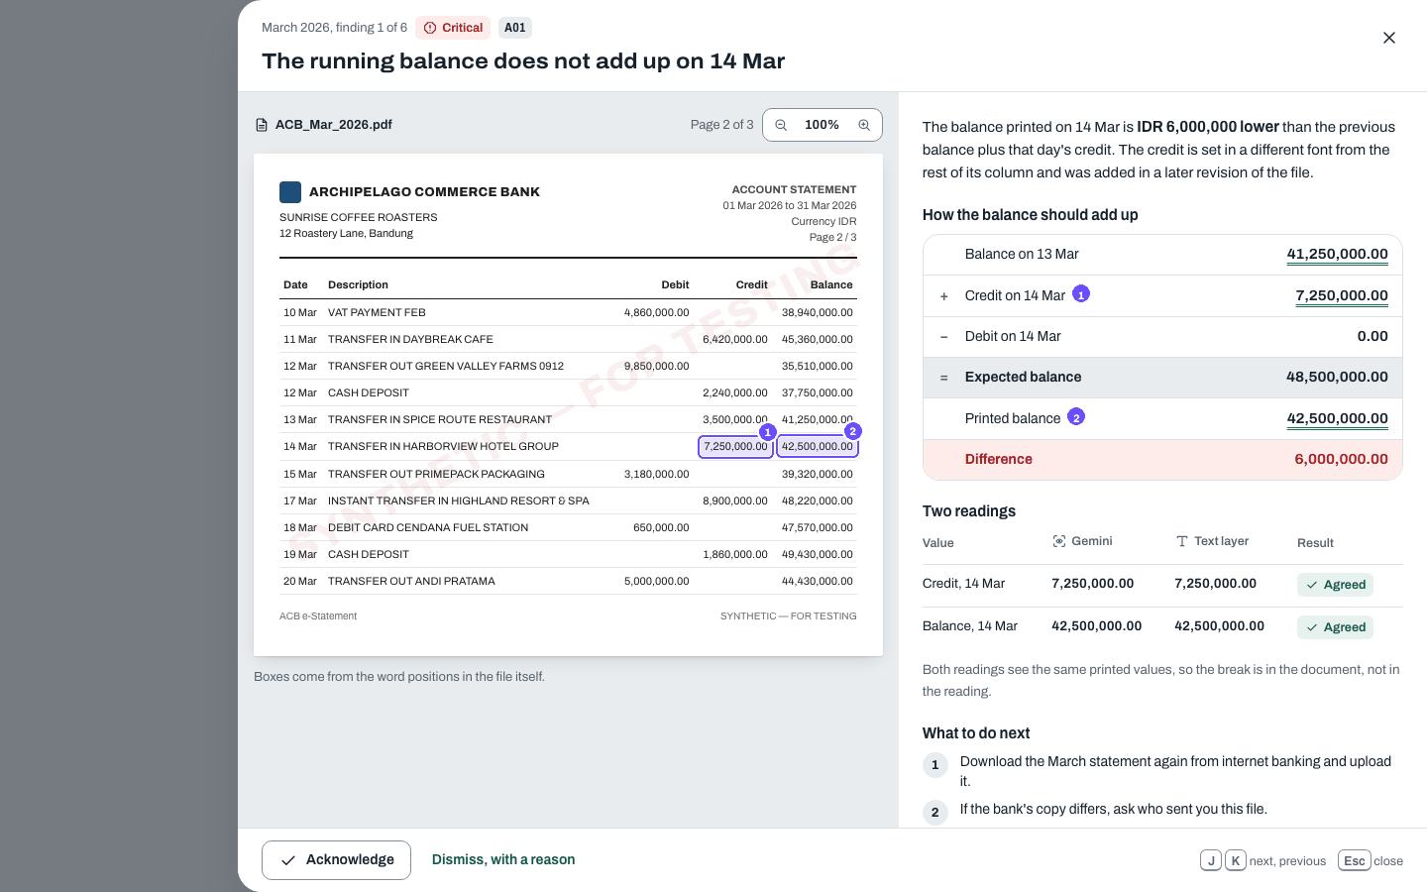
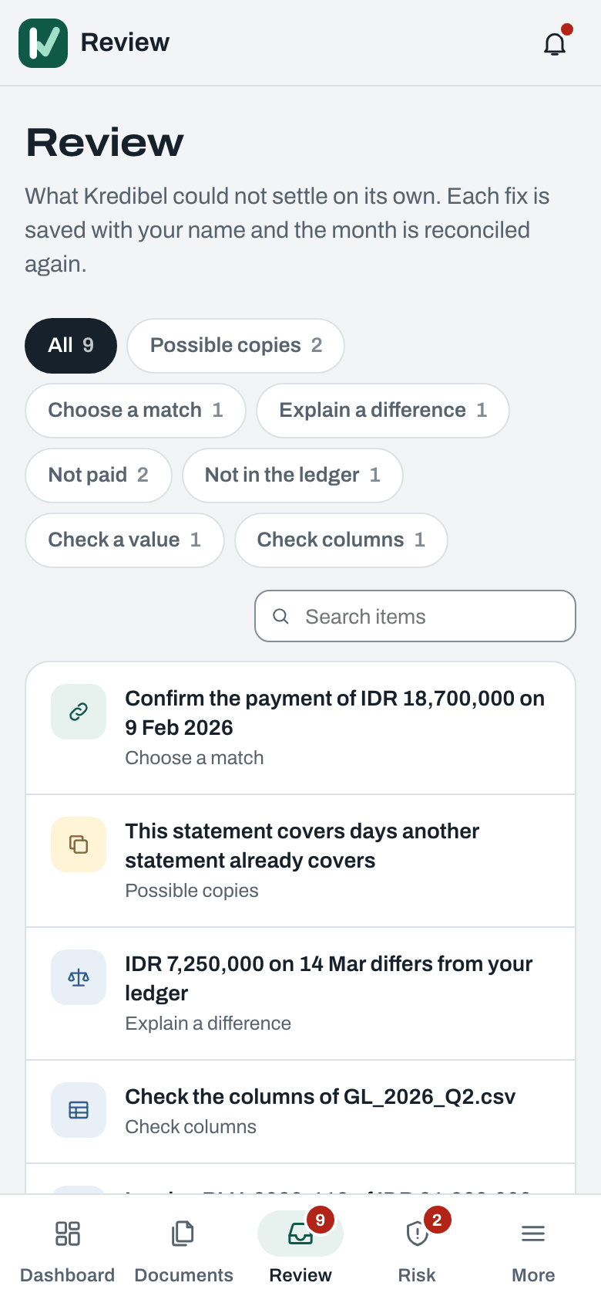
Wireframes and mock diagrams
07
43 screens designed first, at phone, tablet and desktop widths
Evidence first
Every figure is one tap from the page and box it came from.
Shape before colour
Double, dotted and wavy rules say agreed, one reading, conflict.
Works at 360 px
Photograph a receipt or settle a review item on a phone.
Evidence viewer: the lamp on the edited credit, both readings, the broken balance
Review queue, 390 px
Notes:
All screens were designed as HTML mocks generated from the same token file as the app, and the app is checked against them in the browser at 390, 834 and 1440 px.

Slide 8
Architecture diagram of the proposed solution
08
Two ADK workflows on Cloud Run, fed by Cloud Tasks, with Gemini as reader and explainer
Users
Google Cloud, asia-southeast1: runtime and state
Gemini Enterprise Agent Platform
React SPA
1
kredibel-web
kredibel-worker
4
Gemini Flash
Owner or accountant, browser or phone
Cloud Run, public. REST API, SHA-256 copies, page split, review actions, assistant
Cloud Run, IAM only. ADK document_workflow and month_workflow
reads page images, explains each month, assistant
Firebase Auth
2
3
Gemini Flash-Lite
ID token
Cloud Tasks
classify, map columns, categorize
one task per document and month
5
gemini-embedding-001
Firebase Hosting
SPA and /api in front of Cloud Run
Firestore
Cloud Storage
records, matches, vectors, live progress
originals, page images, reading cache
Document AI OCR (us)
1
Upload with ID token
2
Queue the document
3
Run the workflow
4
Read and explain
5
Write results; the app updates live
Delivery and operations: Cloud Build, Artifact Registry, Secret Manager, Cloud Trace (ADK spans), Cloud Logging, Cloud Monitoring with budget alerts
Notes:
Numbers follow one upload. The web service records exact copies and splits pages, Cloud Tasks pushes work with OIDC to an IAM-only worker, the ADK workflows call Gemini and Document AI, and results land in Firestore where the browser listens read-only.

Slide 9
Technologies to be used in the solution
09
Google Cloud for every managed service and model; open source only inside our containers
Agents
Agent Development Kit 2.x graph workflows, one per document and one per month; traces in Cloud Trace
Models
Gemini Flash and Flash-Lite, gemini-embedding-001, on Gemini Enterprise Agent Platform
Documents
Gemini on page images, Document AI Enterprise OCR for scans and photos
Runtime
Cloud Run (web and worker), Cloud Tasks, Firebase Hosting
Data
Firestore with vector search, Cloud Storage
Identity
Firebase Authentication (Google or email), IAM-only worker with OIDC, Secret Manager
Delivery
Cloud Build, Artifact Registry, Cloud Scheduler, Cloud Logging, Cloud Monitoring
Planned, P1
Model Armor screening, Agent Platform Sessions and Memory Bank for the assistant
Open source inside
FastAPI
Pydantic
pikepdf
React 19
Vite
Tailwind v4
TanStack Query
d3-sankey
Storybook
Playwright
Model IDs are configuration, never literals in code; prompts are versioned files; every limit lives in a plan contract enforced on the server.
Notes:
Everything managed is Google Cloud. Open-source libraries run inside our own containers only.

Slide 10
How we use Gemini
10
Gemini reads and explains. Code decides every number
Where Gemini works
Where code decides
Read each page image into values, citing the layout chunk of every value
Flash
Grounds every value in the page's own words; the model never marks itself right
Classify each document
Flash-Lite
Duplicates by SHA-256 and by content; held, never deleted
Propose ledger columns only when code cannot place a header
Flash-Lite
Forensics, matching and totals in Decimal; same data, same result
Categorize bank lines in cached batches of 100
Flash-Lite
Risk levels from a versioned policy file
Explain each month's risk and order the next steps
Flash
A grounding guard checks each number Gemini writes before you see it
Answer questions from the books, quoting the pages used
Flash + embeddings
Documents are adversarial. Page text is data, never instructions; structured outputs only; prompts live in versioned files.
Notes:
This is the core of our Gen AI design. Gemini does the perception and the language; deterministic code owns every number, match and risk level, and checks Gemini's output before it is shown.

Slide 11
Estimated implementation cost
11
About USD 0.45 to read and check a half-year of books
Reading the statements and invoices of a half-year (scenario S1), USD
Unit costs
3-page bank statement
USD 0.02
Invoice
USD 0.004
Receipt photo
USD 0.005
Ledger file, new layout
USD 0.001
Month run
USD ≤ 0.005
Assistant question
USD 0.015
Gemini reads each page image; the free PDF text layer, or Document AI OCR at USD 1.50 per 1,000 pages for scans, is the witness. Exact duplicates cost nothing.
Running it
Serverless; Cloud Run scales to zero. Firestore for a half-year import ≈ USD 0.01.
Free trial capped at USD 5 of estimated AI spend per workspace per month.
Expected competition spend ≈ USD 60 to 90.
USD 0.43
Measured: one full reading of an earlier 80-document demo company (89 pages).
Notes:
Adaptive reading is the cost story: one Gemini read per page plus a free or cheap witness, instead of specialised parsers at 10 to 25 times the cost. Unit costs are estimates from Gemini and Document AI list prices; the USD 0.43 is measured from run usage.

Slide 12
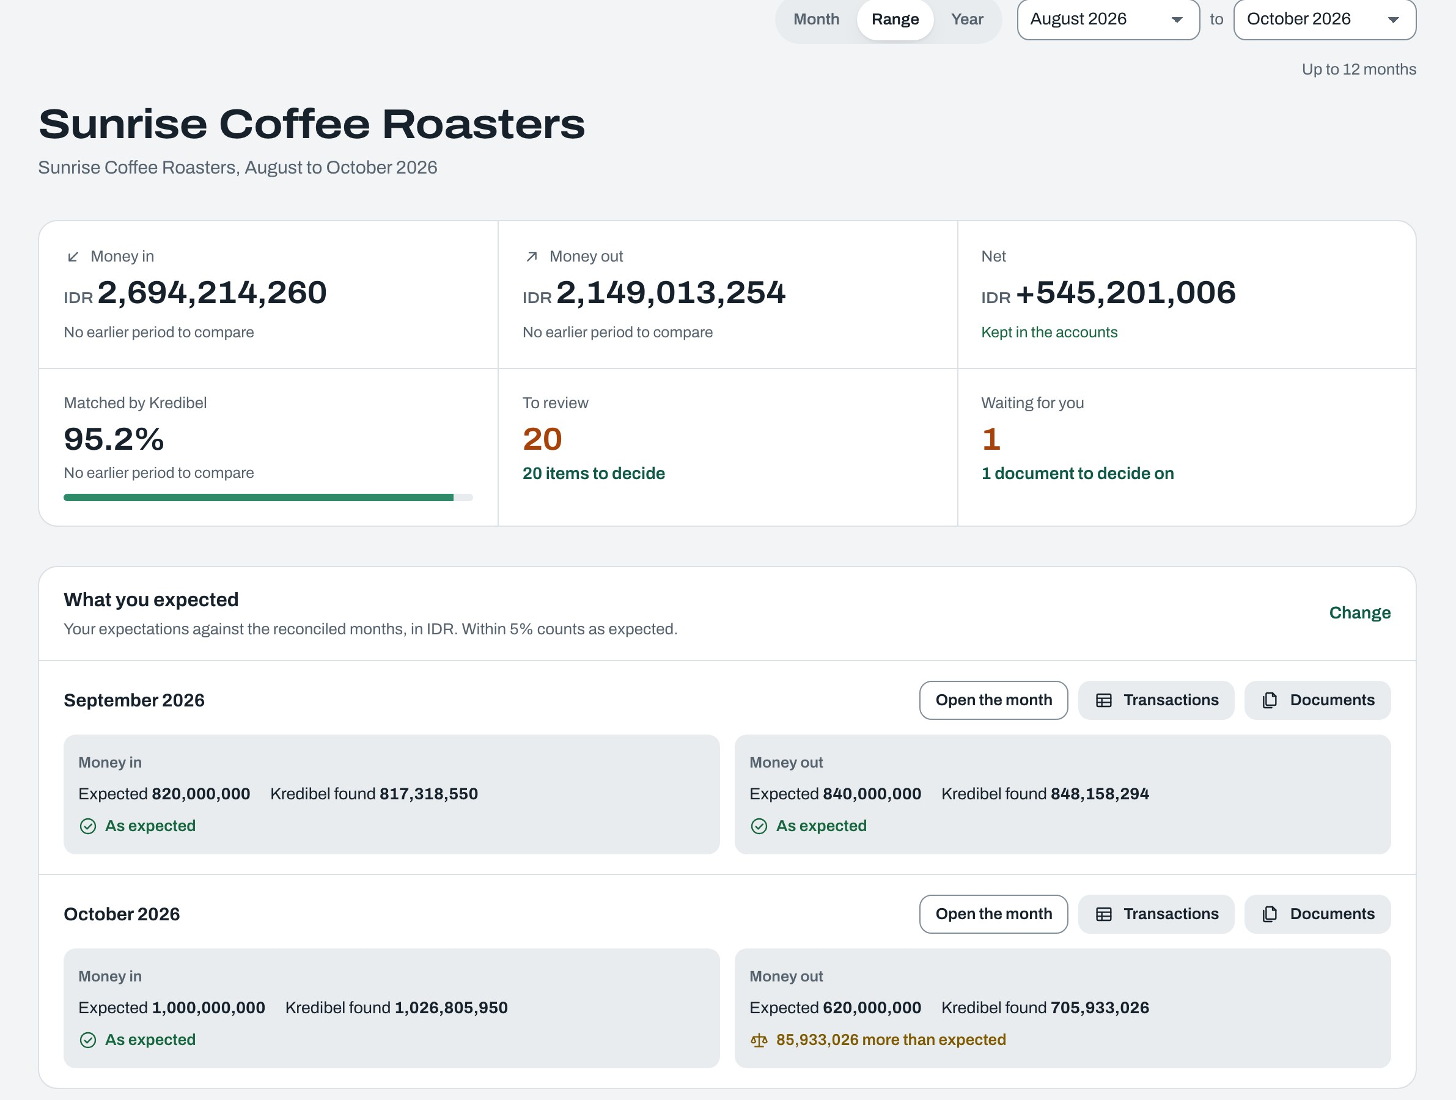
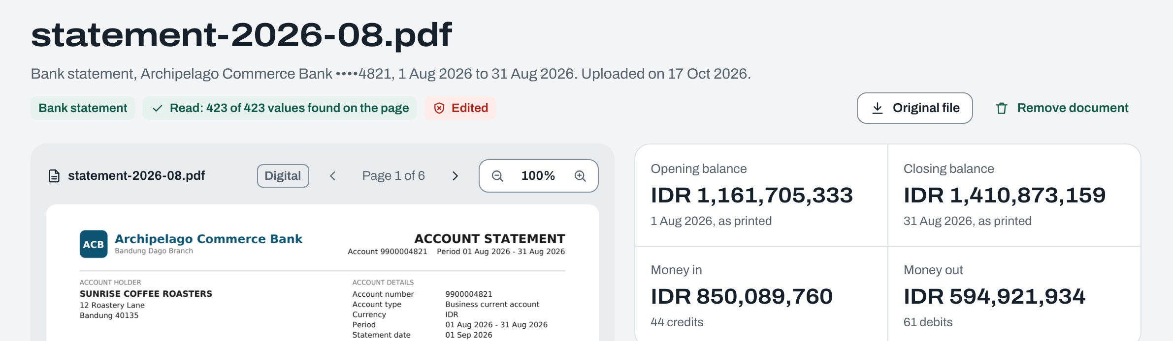
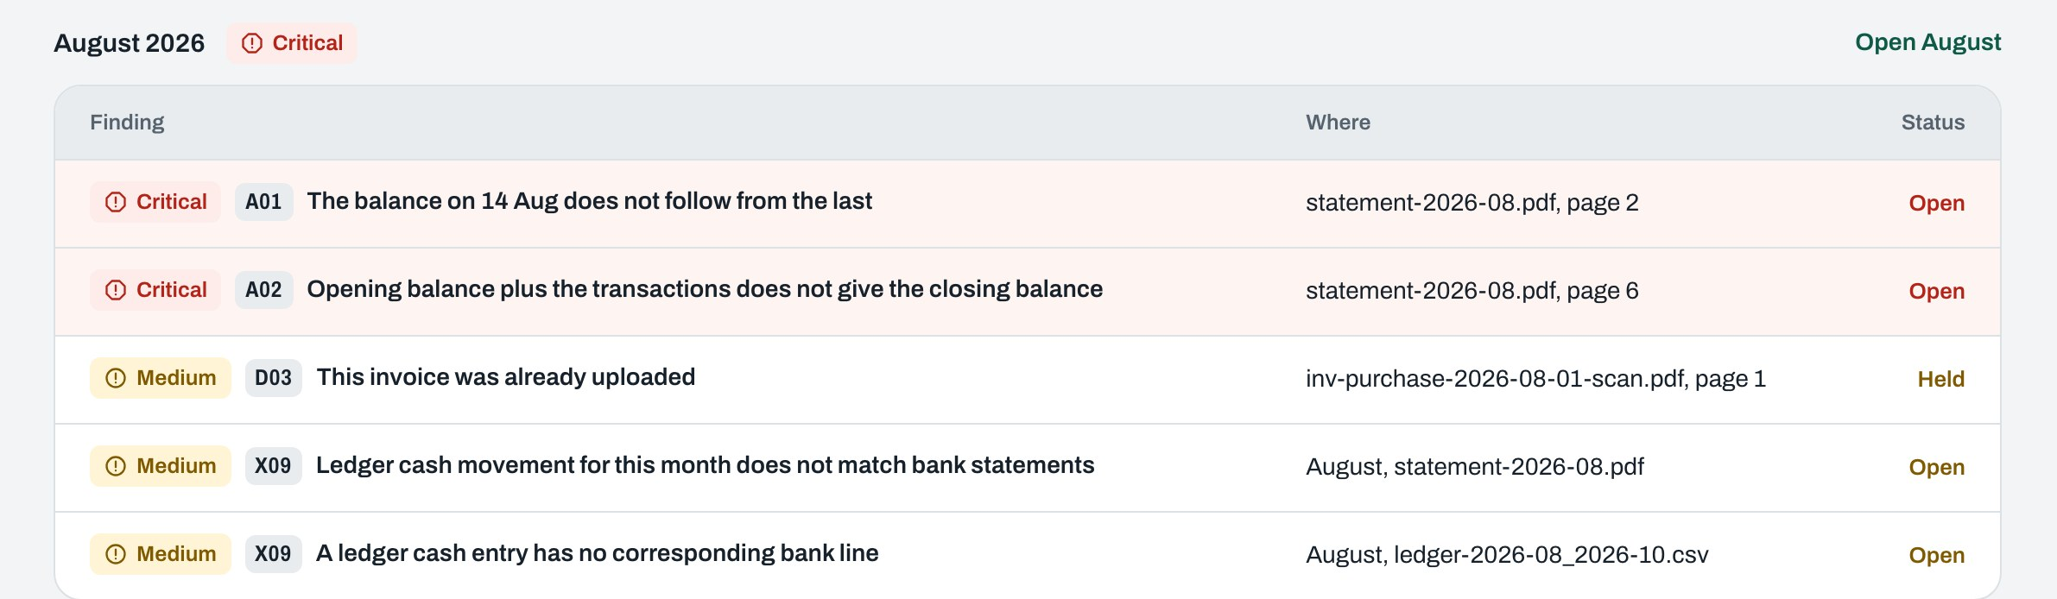
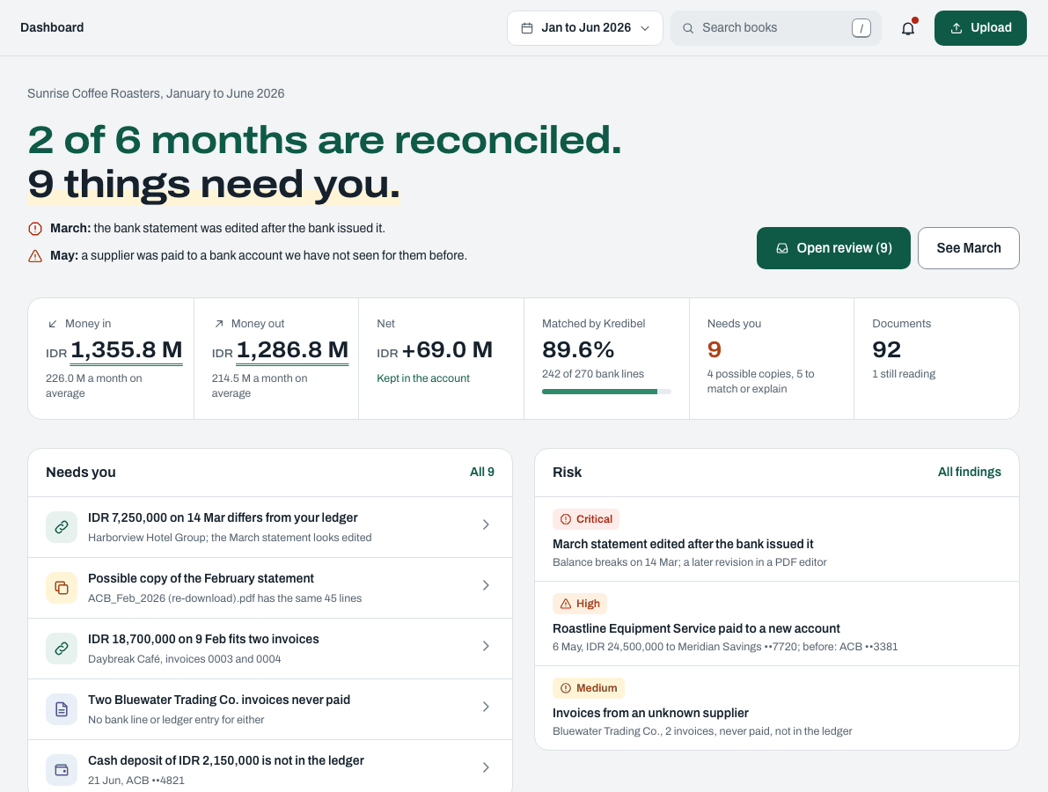
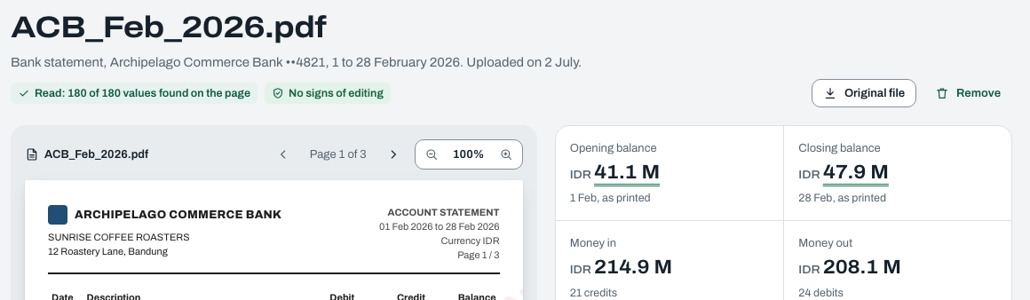
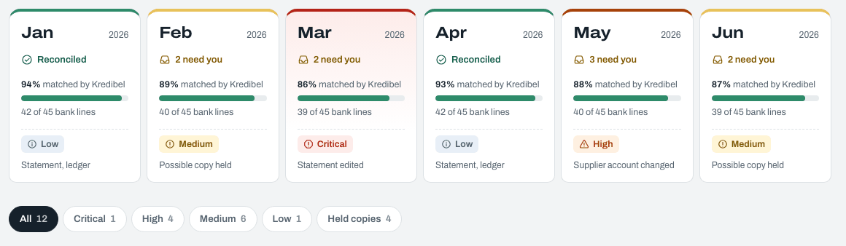
Snapshots of the prototype
12
The working prototype, live on Cloud Run
Document: 423 of 423 values found on the page, and the edit flagged
Dashboard: August to October against what the owner expected
Risk: every finding with its code and its page
Notes:
Live at kredibel.app (Firebase Hosting in front of Cloud Run), with the demo company of the video: 300 synthetic documents, August to October 2026.

Slide 13
Prototype performance report and benchmarking
13
Measured in production and on real documents, gated in CI
718 / 718
95%
14×
values grounded on a real 13-page bank statement with 178 lines
of bank lines matched automatically in the 300-document demo company (295 of 310)
lower reading cost than Form and Invoice Parser for the same documents (USD 0.35 vs 4.90)
Scenario gates, automated tests on synthetic books with known answers
S1
Clean half-year
85% or more of bank lines matched automatically, none wrong
Pass
S2
Edited March statement
Tampered, with all six expected findings
Pass
S3
Duplicates
Exact copy not read again; four content copies held
Pass
S4
Payment diversion
Supplier's new account (X08) and unknown supplier (R02)
Pass
S5
Reverse upload order
Same matches and figures as S1
Pass
Also: 848 backend tests, 217 synthetic-data tests, 265 frontend tests and 216 browser checks against the mocks at three widths. The eval runner with a Gemini judge is next (spec 012).
Notes:
We only quote what we measured. Real-document grounding figures come from production-style runs; the scenario gates are automated tests on synthetic books with known ground truth. The full eval report with match rates is the next deliverable.

Slide 14
Additional details and future development
14
Next: from checked books to a loan readiness report
Built and deployed
Next
Later
October 2026
P1
Production
Reading twice with grounding
Model Armor screening of every file
Bank feeds and e-invoice validation
Duplicates and forensics
Assistant agent with Memory Bank
Accounting-tool connectors
Reconciliation in any order
Team roles, invites, month sign-off
Loan readiness report from verified months
Risk with explanations
Eval suite and BigQuery reporting
In-region processing, VPC Service Controls
Review queue, dashboard, P&L, transactions
Demo company, demo account, guided tour
Responsible AI
People resolve exceptions
Copies held, never deleted
No personal attributes
Synthetic data in tests
Notes:
The roadmap builds on verified months: once a business's books are checked, the same evidence supports a loan readiness report. Data residency is a configuration path: in-region OCR and model endpoints.

Slide 15




Provide links to your
15
Open the demo company and see it for yourself
Final product
https://kredibel.app
Demo sign-in demo@kredibel.app / Kredibel-Demo-2026, or any Google account: explore the demo company, or upload the sample books linked in the README.
GitHub repository
https://github.com/fadlytanjung/kredibel
Specs, architecture decisions, contracts, design tokens and the code.
Demo video, 3 minutes
https://youtu.be/5UI2NZFmzrk
The working prototype on production, recorded with the demo account.
All documents in the demo are synthetic and marked SYNTHETIC, FOR TESTING.
Notes:
Before sending: add the demo video link.

Slide 16


