Slide 1




LAMP_BOT
Change Character
PLAY
Sound ON

Slide 2

LAMP_BOT
Change Character
PLAY
Sound OFF

Slide 3

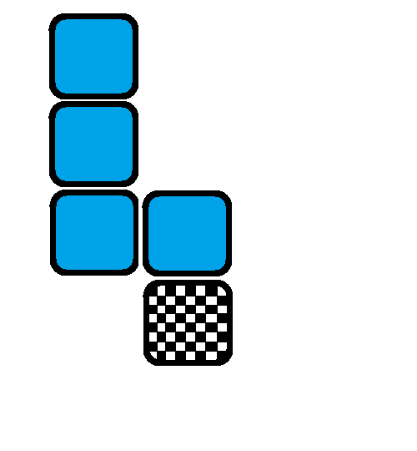
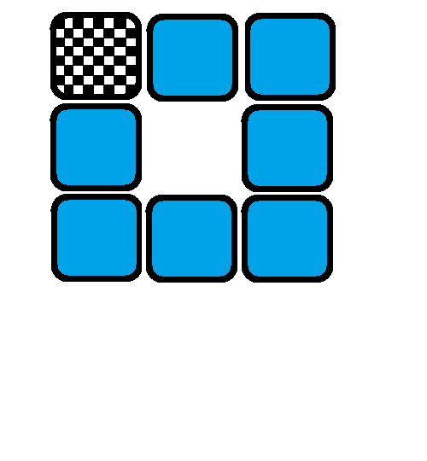
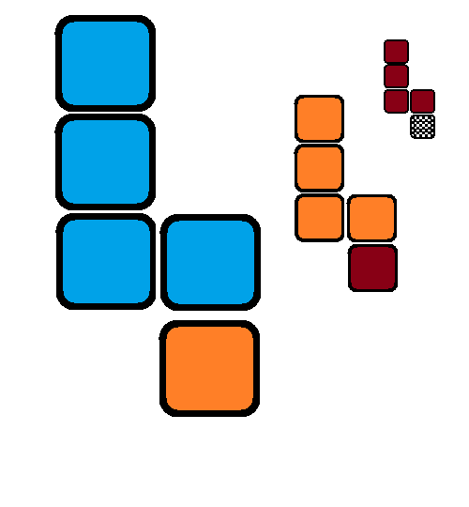
SELECT_CHAPTER
1_BASIC
2_LOOP
3_PROCEDURE
Sound ON

Slide 4
SELECT_CHAPTER
1_BASIC
2_LOOP
3_PROCEDURE
Sound OFF

Slide 5



CHAPTER_BASIC
SELECT_STAGE
Sound ON

Slide 6
CHAPTER_BASIC
SELECT_STAGE
Sound OFF

Slide 7
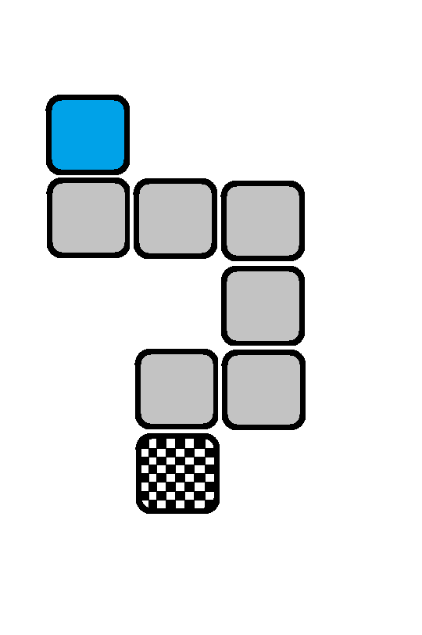

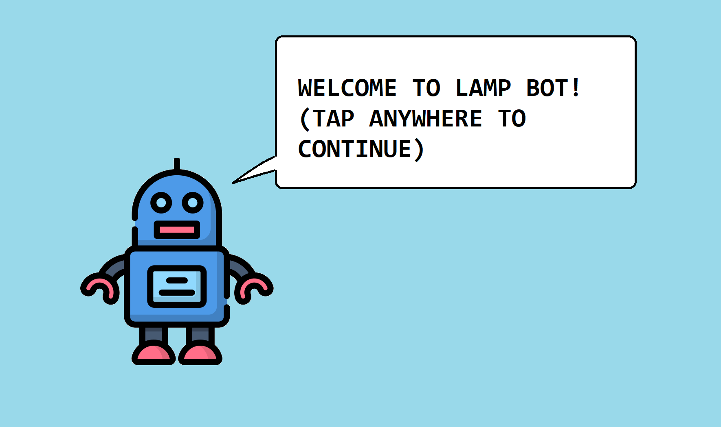














CHAPTER_BASIC
STAGE_1
X: 667 Y:31
X:670 Y:16
3
Sound ON

Slide 8
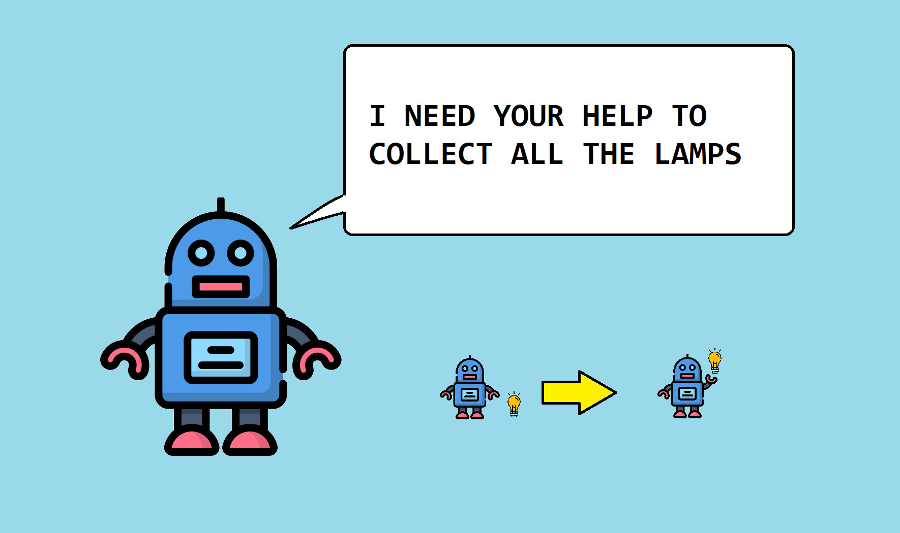
CHAPTER_BASIC
STAGE_1
X: 667 Y:31
X:670 Y:16
3
Sound ON

Slide 9
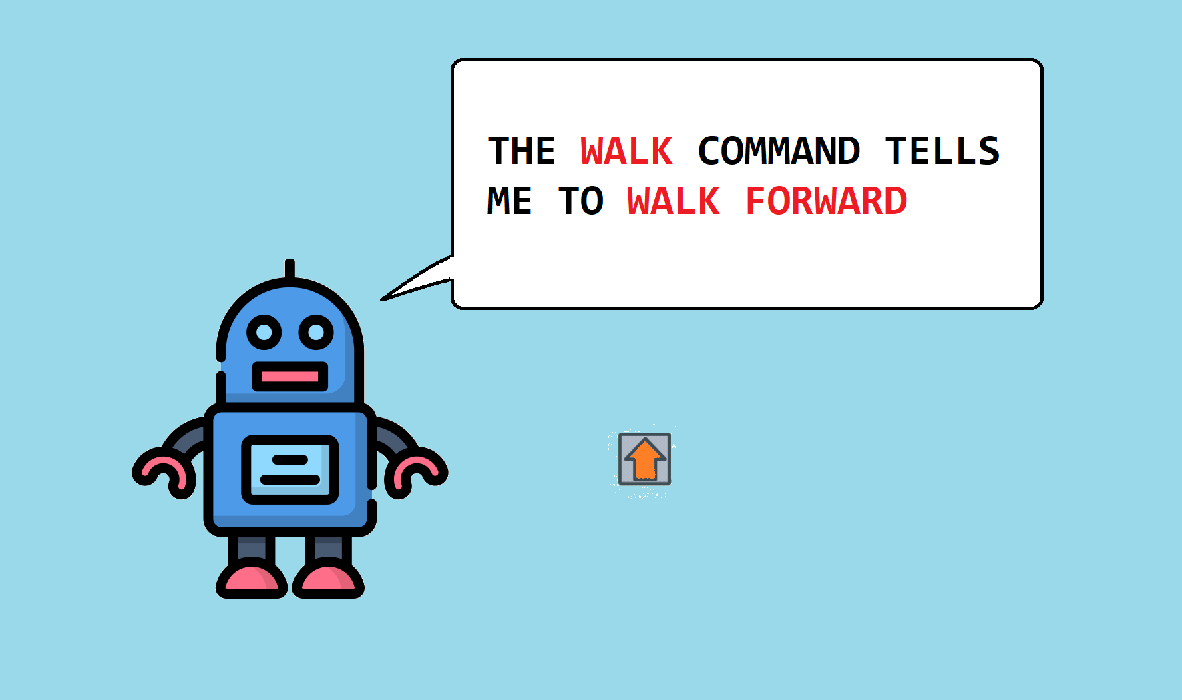
CHAPTER_BASIC
STAGE_1
X: 667 Y:31
X:670 Y:16
3
Sound ON

Slide 10
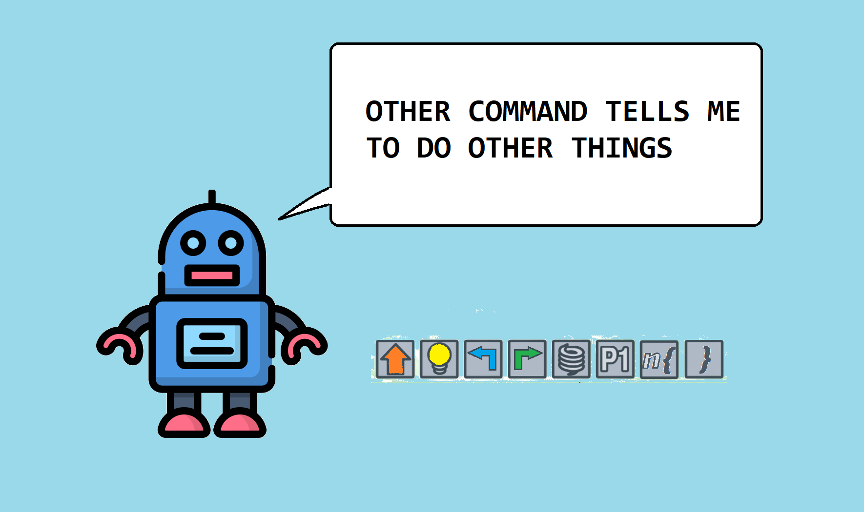
CHAPTER_BASIC
STAGE_1
X: 667 Y:31
X:670 Y:16
3
Sound ON

Slide 11
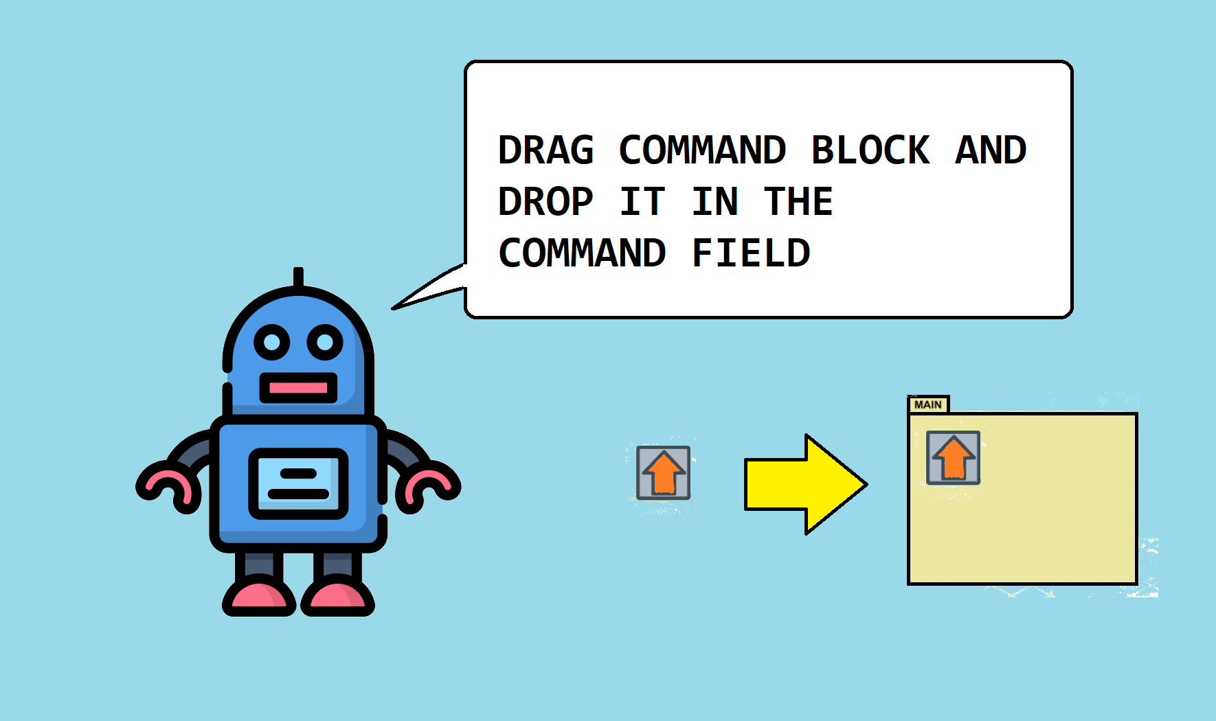
CHAPTER_BASIC
STAGE_1
X: 667 Y:31
X:670 Y:16
3
Sound ON

Slide 12
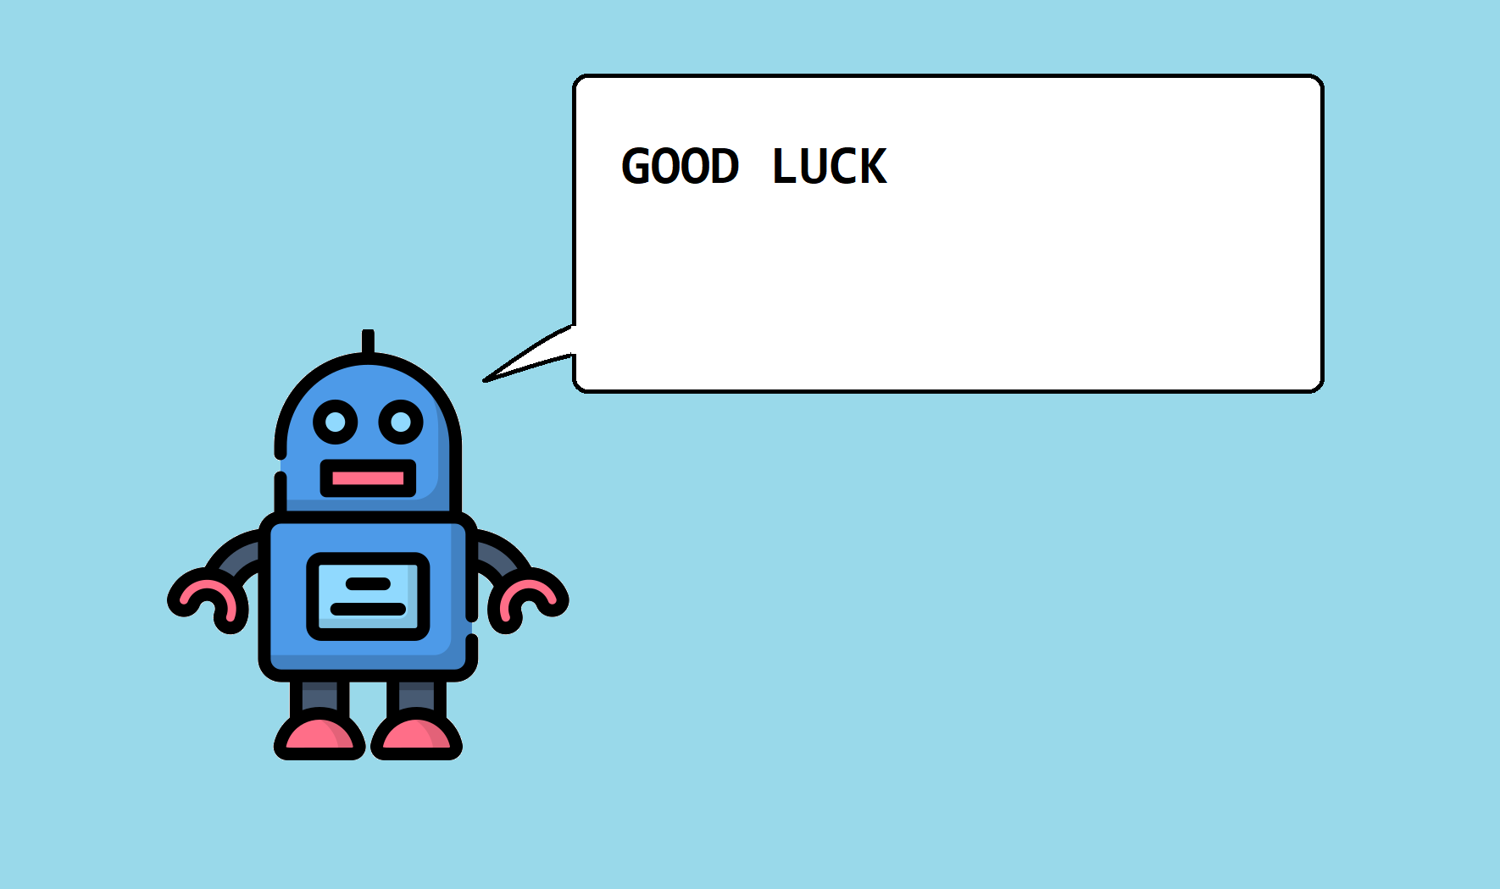
CHAPTER_BASIC
STAGE_1
X: 667 Y:31
X:670 Y:16
3
Sound ON

Slide 13
CHAPTER_BASIC
STAGE_1
X: 667 Y:31
X:670 Y:16
3
Sound ON

Slide 14
CHAPTER_BASIC
STAGE_1
X: 667 Y:31
X:670 Y:16
3
Sound ON

Slide 15
CHAPTER_BASIC
STAGE_1
X: 667 Y:159
X:670 Y:16
3
Sound ON

Slide 16

CHAPTER_BASIC
STAGE_1
X: 667 Y:159
X:670 Y:16
3
Sound ON

Slide 17
CHAPTER_BASIC
STAGE_1
X: 667 Y:159
X:670 Y:16
3
Sound ON

Slide 18

CHAPTER_BASIC
STAGE_1
X: 667 Y:159
X:670 Y:16
3
Sound ON

Slide 19
CHAPTER_BASIC
STAGE_1
X: 667 Y:159
X:670 Y:16
3
Sound ON

Slide 20

CHAPTER_BASIC
STAGE_1
X: 667 Y:159
X:670 Y:16
3
Sound ON

Slide 21

CHAPTER_BASIC
STAGE_1
X: 667 Y:159
X:670 Y:16
3
Sound ON

Slide 22

CHAPTER_BASIC
STAGE_1
X: 667 Y:159
X:670 Y:16
3
Sound ON

Slide 23

CHAPTER_BASIC
STAGE_1
X: 667 Y:159
X:670 Y:16
3
Sound ON

Slide 24
CHAPTER_BASIC
STAGE_1
X: 667 Y:159
X:670 Y:16
3
Sound ON

Slide 25
CHAPTER_BASIC
STAGE_1
X: 667 Y:159
X:670 Y:16
3
Sound ON

Slide 26
CHAPTER_BASIC
STAGE_1
X: 667 Y:159
X:670 Y:16
3
Sound ON

Slide 27
CHAPTER_BASIC
STAGE_1
X: 667 Y:159
X:670 Y:16
3
Sound ON

Slide 28
CHAPTER_BASIC
STAGE_1
X: 667 Y:159
X:670 Y:16
3
Sound ON

Slide 29

CHAPTER_BASIC
STAGE_1
X: 667 Y:159
X:670 Y:16
3
Sound ON

Slide 30

CHAPTER_BASIC
STAGE_1
X: 667 Y:159
X:670 Y:16
3
Sound ON

Slide 31
CHAPTER_BASIC
STAGE_1
X: 667 Y:159
X:670 Y:16
3
Sound ON

Slide 32

CHAPTER_BASIC
STAGE_1
X: 667 Y:159
X:670 Y:16
3
Sound ON

Slide 33

CHAPTER_BASIC
STAGE_1
X: 667 Y:159
X:670 Y:16
3
Sound ON

Slide 34

CHAPTER_BASIC
STAGE_1
X: 667 Y:159
X:670 Y:16
3
Sound ON

Slide 35
CHAPTER_BASIC
STAGE_1
X: 667 Y:159
X:670 Y:16
3
Sound ON

Slide 36

CHAPTER_BASIC
STAGE_1
X: 667 Y:159
X:670 Y:16
3
Sound ON

Slide 37

CHAPTER_BASIC
STAGE_1
X: 667 Y:159
X:670 Y:16
3
Sound ON

Slide 38
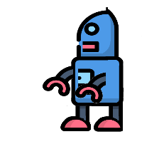
CHAPTER_BASIC
STAGE_1
X: 667 Y:159
X:670 Y:16
3
Sound ON

Slide 39

CHAPTER_BASIC
STAGE_1
X: 667 Y:159
X:670 Y:16
3
Sound ON

Slide 40

CHAPTER_BASIC
STAGE_1
X: 667 Y:159
X:670 Y:16
3
Sound ON

Slide 41

CHAPTER_BASIC
STAGE_1
X: 667 Y:159
X:670 Y:16
3
Sound ON

Slide 42
CHAPTER_BASIC
STAGE_1
X: 667 Y:159
X:670 Y:16
3
Sound ON

Slide 43

CHAPTER_BASIC
STAGE_1
X: 667 Y:159
X:670 Y:16
3
Sound ON

Slide 44

CHAPTER_BASIC
STAGE_1
X: 667 Y:159
X:670 Y:16
3
Sound ON

Slide 45
CHAPTER_BASIC
STAGE_1
X: 667 Y:159
X:670 Y:16
3
Sound ON

Slide 46

CHAPTER_BASIC
STAGE_1
X: 667 Y:159
X:670 Y:16
3
Sound ON

Slide 47

CHAPTER_BASIC
STAGE_1
X: 667 Y:159
X:670 Y:16
3
Sound ON

Slide 48

CHAPTER_BASIC
STAGE_1
X: 667 Y:159
X:670 Y:16
3
Sound ON

Slide 49
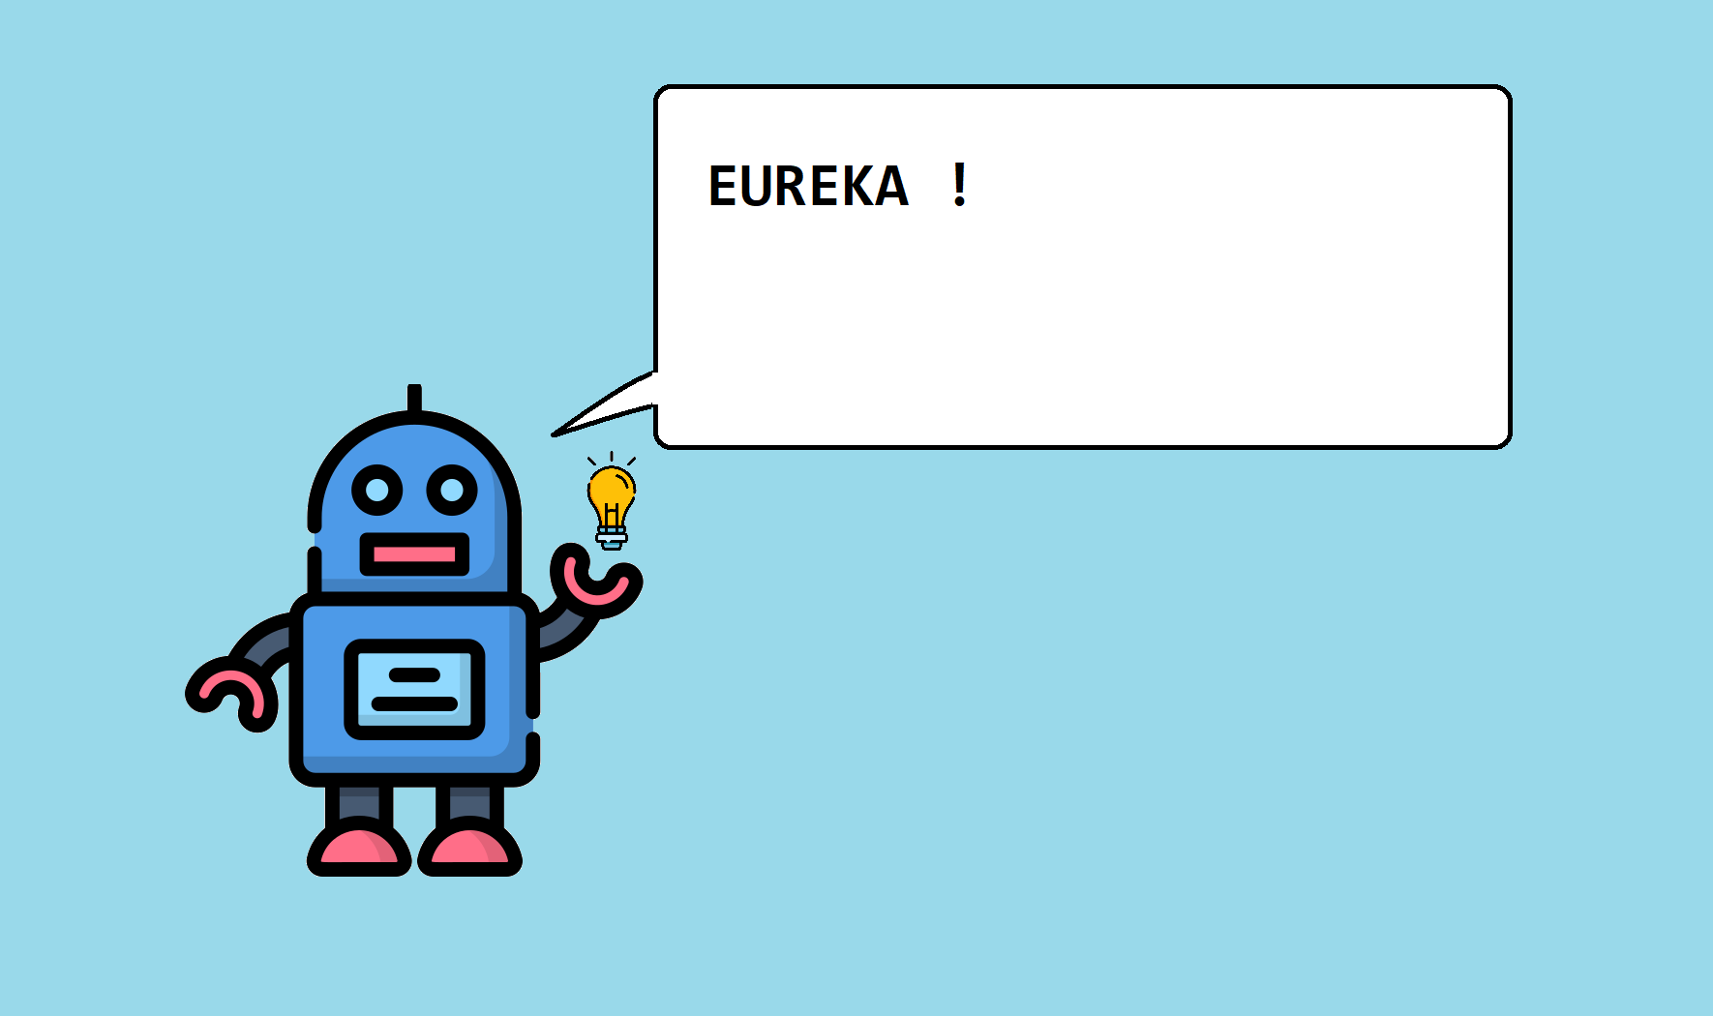
CHAPTER_BASIC
STAGE_1
X: 667 Y:159
X:670 Y:16
3
Sound ON

Slide 50

CHAPTER_BASIC
SELECT_STAGE
Sound OFF

