Slide 1


Session 4 - Python Programming
Copyright 2018 © Huawei Technologies Co., Ltd

Slide 2


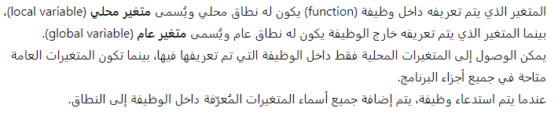
Anonymous Functions
Syntax of lambda function:
Example:
Output:
Global Variables and Local Variables

Slide 3

Contents
Conditional and Looping Statements
Functions
Object-Oriented Programming

Slide 4
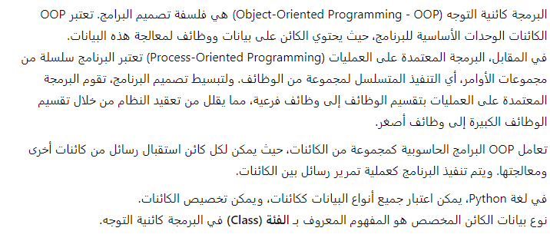
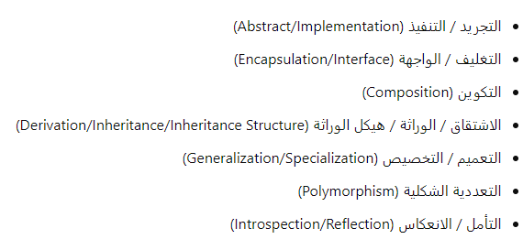
Object-Oriented Programming
Common Python OOP Terms

Slide 5
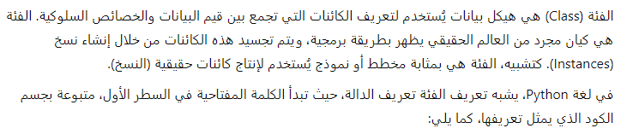
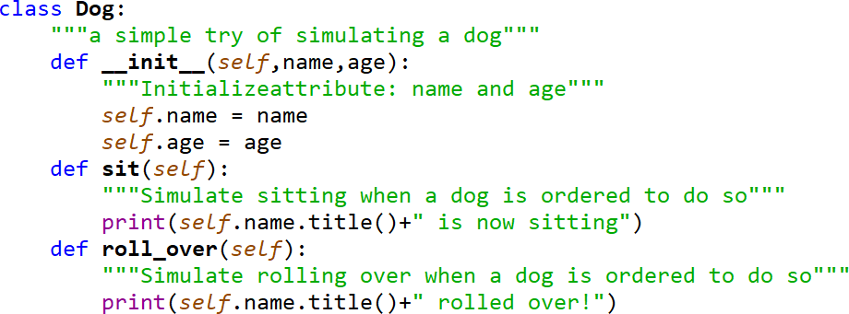


Classes(Objects or (كائنات
def functionName(args): ‘function documentation string' function_suite
class ClassName(object):
‘Click class documentation string’
class_suite

Slide 6
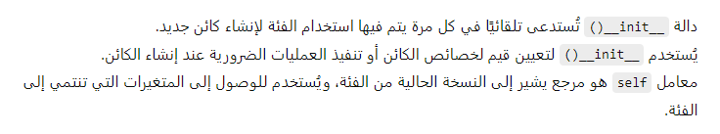
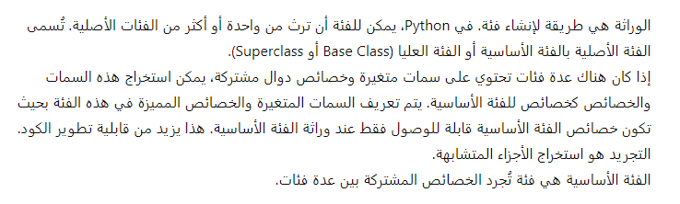
Classes con…
Inheritance

Slide 7

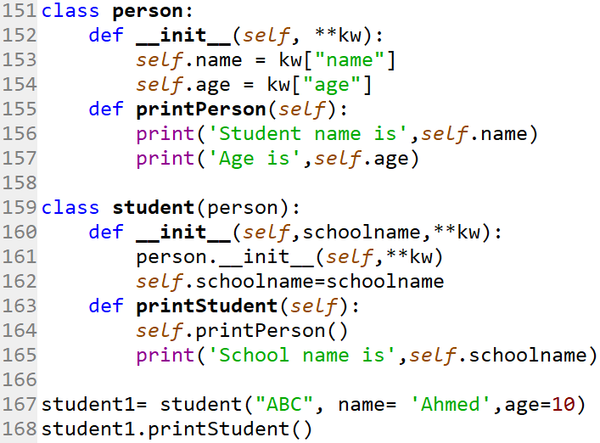
Inheritance con…
Example:

Slide 8
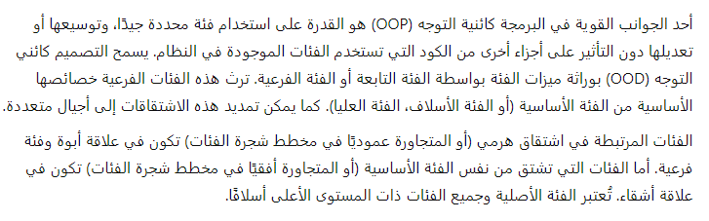
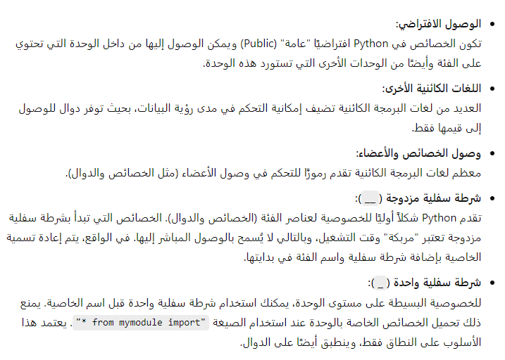
Subclasses
Privatization

Slide 9
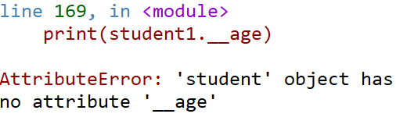
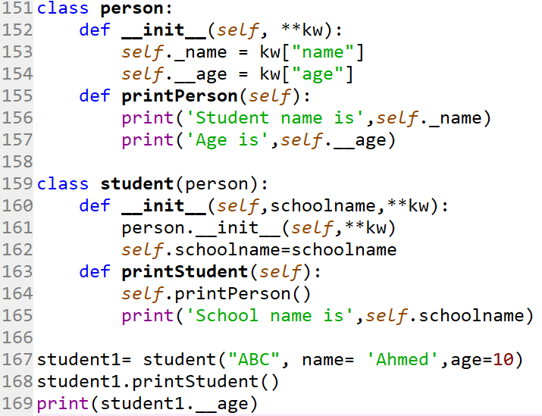
Privatization
ERROR
_name is protected attribute
age is a private attribute

Slide 10
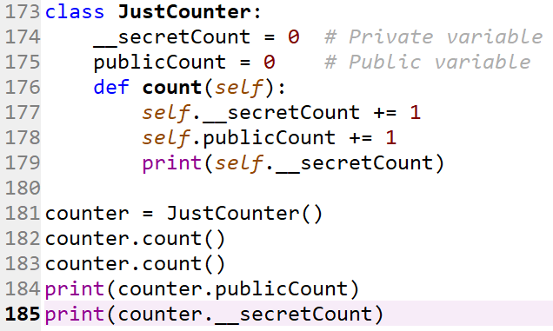
Privatization con…

Slide 11
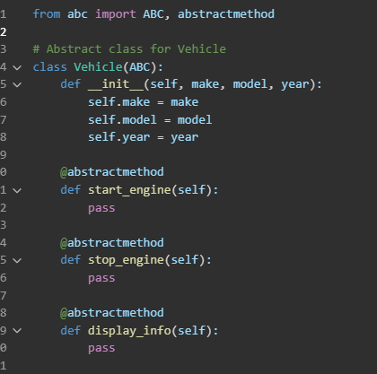
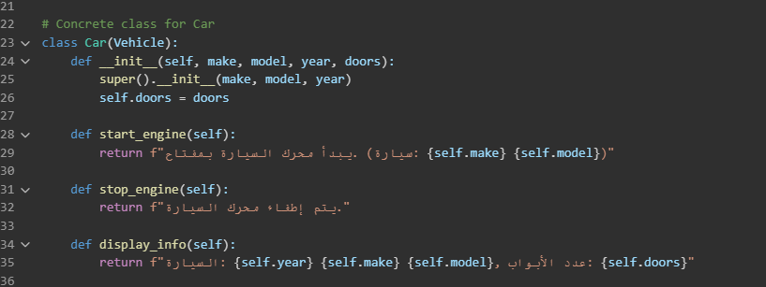
Abstract

Slide 12
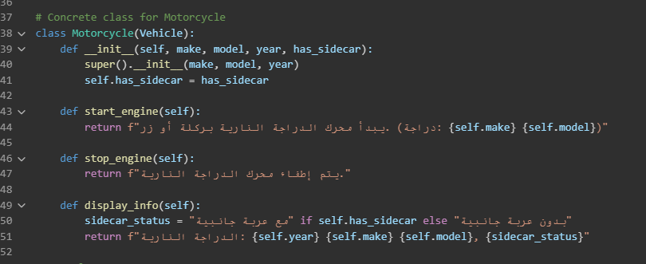
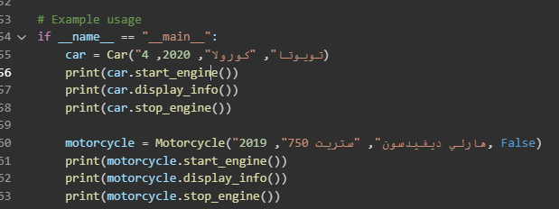

Slide 13
Hands-on
Create Rectangle class which contain:
Width and length as a private attributes
Initialize the variables using name keyword arguments
Create an area method which return the area of the rectangle
Create a rectangle
Display its area

Slide 14

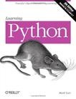

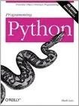
More Information
Official site:
www.python.org
References
Learning Python
Python Standard Library
Programming Python
Python Standard Library

Slide 16

Thanks

Slide 17
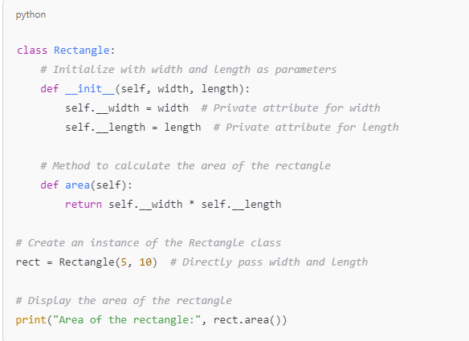
Solution OF Hands-on
Area of the rectangle: 50

