Slide 1




Sagemaker

Slide 2
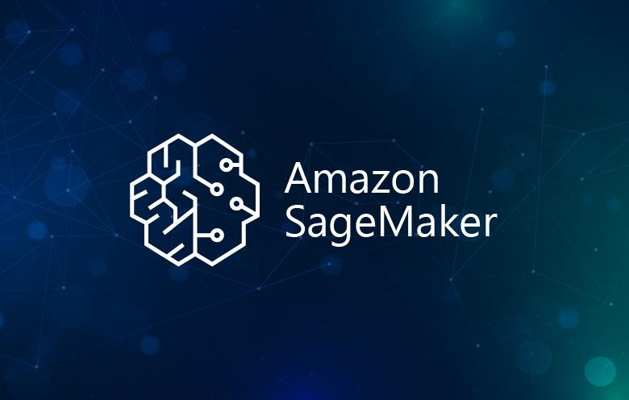
Sagemaker
Amazon SageMaker is a fully-managed machine learning platform provided by Amazon Web Services (AWS). It offers a comprehensive set of tools and services that enable data scientists, developers, and machine learning practitioners to quickly and easily build, train, and deploy machine learning models at scale.

Slide 3
Key features of SageMaker
Integrated Development Environment (IDE): SageMaker Studio provides a unified web-based IDE for developing, training, and deploying machine learning models. It includes Jupyter notebooks, code editors, and built-in collaboration features.
Built-in Algorithms and Frameworks: SageMaker offers a wide range of pre-built algorithms and popular machine learning frameworks such as TensorFlow, PyTorch, and scikit-learn, allowing users to get started quickly without having to build models from scratch.
Automated Model Training and Tuning: SageMaker makes it easy to train models with a few clicks. It supports automatic model tuning, which helps find the best hyperparameters for a model, and distributed training for handling large-scale datasets.

Slide 4
Key features of SageMaker
Flexible Deployment Options: SageMaker provides various deployment options, including real-time inference endpoints, batch transform jobs for offline predictions, and support for serverless inference using AWS Lambda.
Model Monitoring and Management: SageMaker offers tools for monitoring model performance, detecting data drift, and sending alerts when issues arise. It also provides model versioning and lineage tracking for better model governance.
MLOps Automation: SageMaker Pipelines enables the automation of machine learning workflows, from data preparation to model deployment. It integrates with other AWS services like AWS CodePipeline and AWS Step Functions for end-to-end MLOps.

Slide 5
Key features of SageMaker
Experimentation and Debugging: SageMaker Experiments allows users to track and compare multiple model iterations, while SageMaker Debugger helps identify and fix issues during model training.
Security: SageMaker provides built-in security features, such as VPC support, encryption, and IAM roles, to ensure data protection and access control. It also complies with various industry standards and certifications.

Slide 6
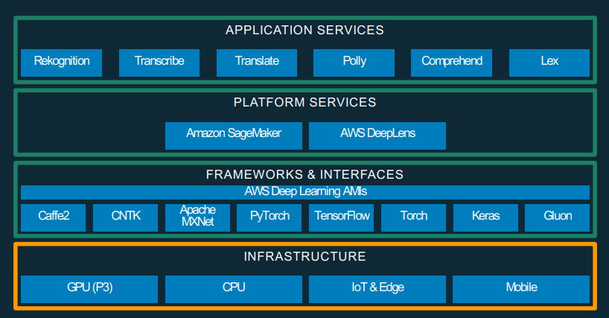
SageMaker

Slide 7
SageMaker Studio
Integrated development environment (IDE) for machine learning
Jupyter notebooks, code editors, and terminals
Collaboration features for team productivity

Slide 8
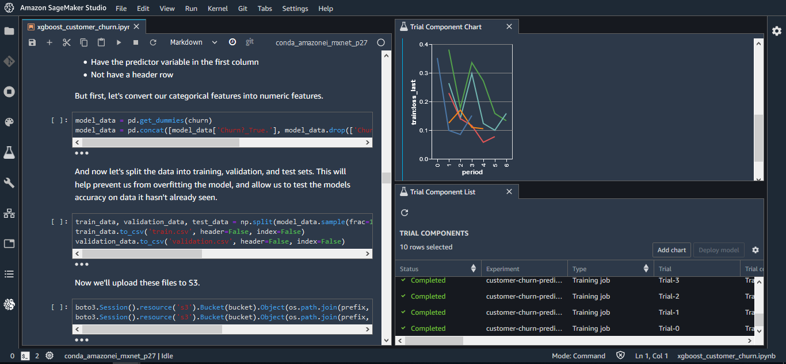
SageMaker Studio

Slide 9
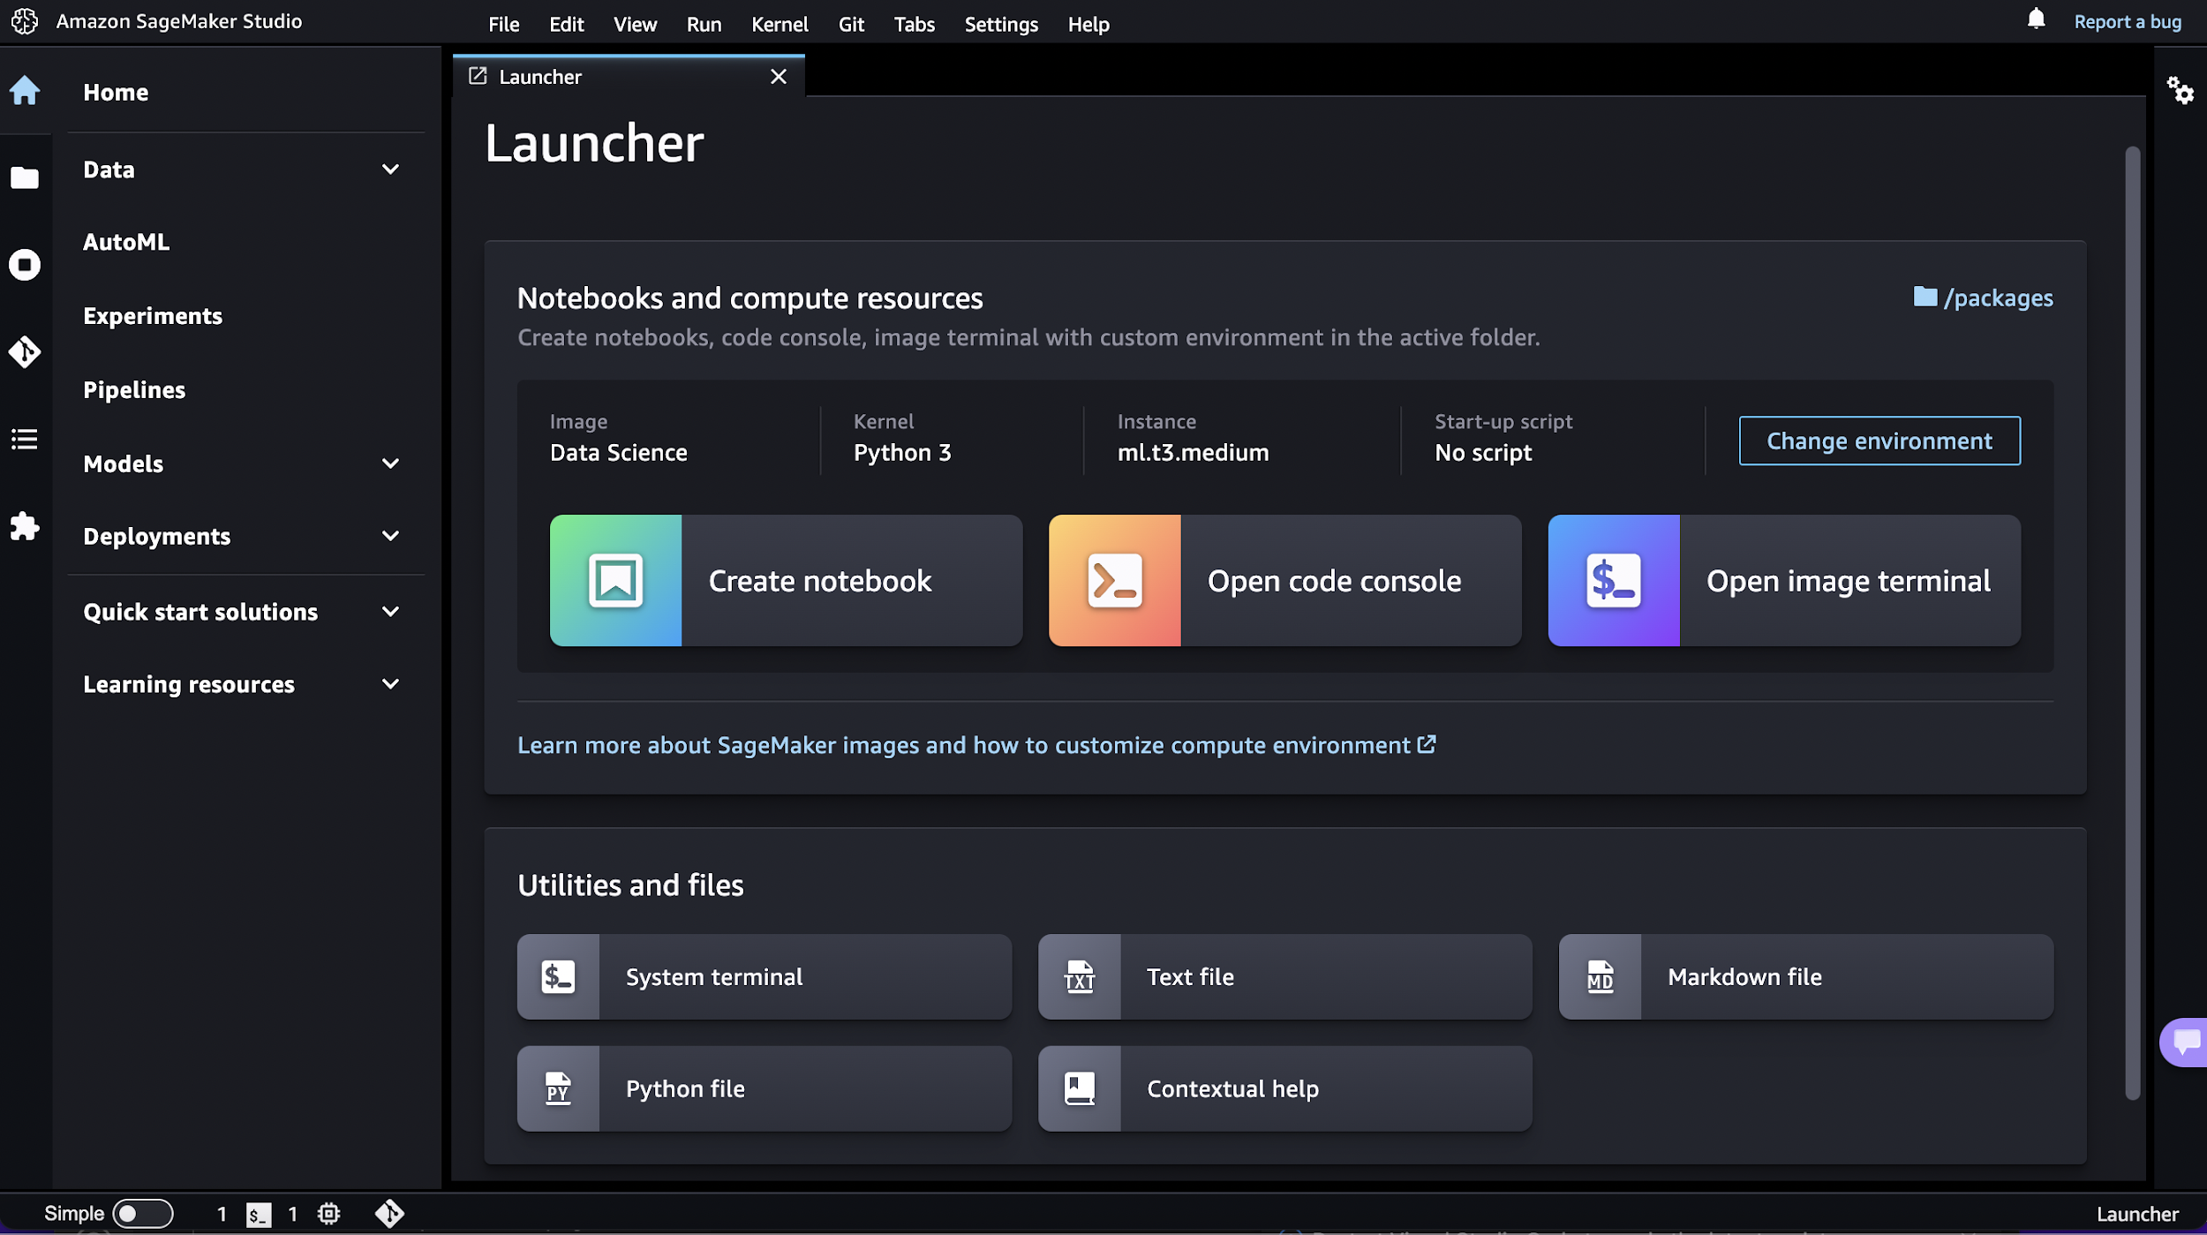
SageMaker Studio

Slide 10
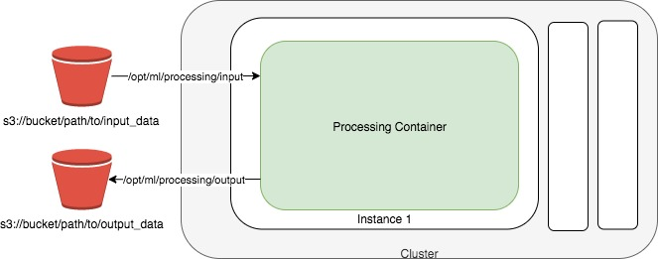
Data Preparation and Processing
architecture diagram for data preprocessing using Amazon SageMaker
The raw input data from the "s3://bucket/path/to/input_data" bucket is fed into a "Processing Container" which runs on an EC2 instance within the SageMaker environment. This processing container performs the necessary data preprocessing tasks.
The preprocessed output data is then stored back into S3 in the "s3://bucket/path/to/output_data" bucket.
The entire preprocessing workflow is orchestrated and managed within a SageMaker "Cluster", which handles the provisioning and scaling of the underlying compute resources required for running the processing container.

Slide 11
Model Training and Hyperparameter Tuning
The training data is stored in an S3 bucket.
The training code, which includes the model definition and training logic, is developed using SageMaker's built-in algorithms or custom code written in popular frameworks like TensorFlow or PyTorch. This code is also stored in an S3 bucket.
SageMaker's managed ML compute instances are used to run the training job. These instances are provisioned and managed by SageMaker, abstracting away the underlying infrastructure complexity.
During the training process, the training code is executed on the ML compute instances. The training data is read from the S3 bucket, and the model is trained using the specified algorithm and hyperparameters.
As the model trains, snapshots of the model are saved to an S3 bucket. These model artifacts can be used later for deployment or further training.
Once the training is complete, the trained model is stored in the S3 bucket.

Slide 12
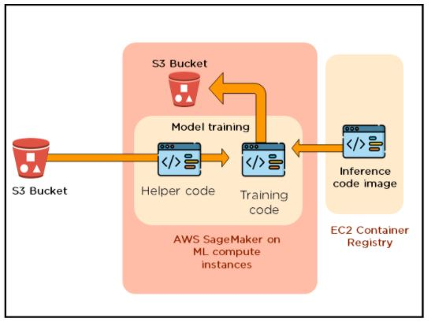
Model Training and Hyperparameter Tuning

Slide 13
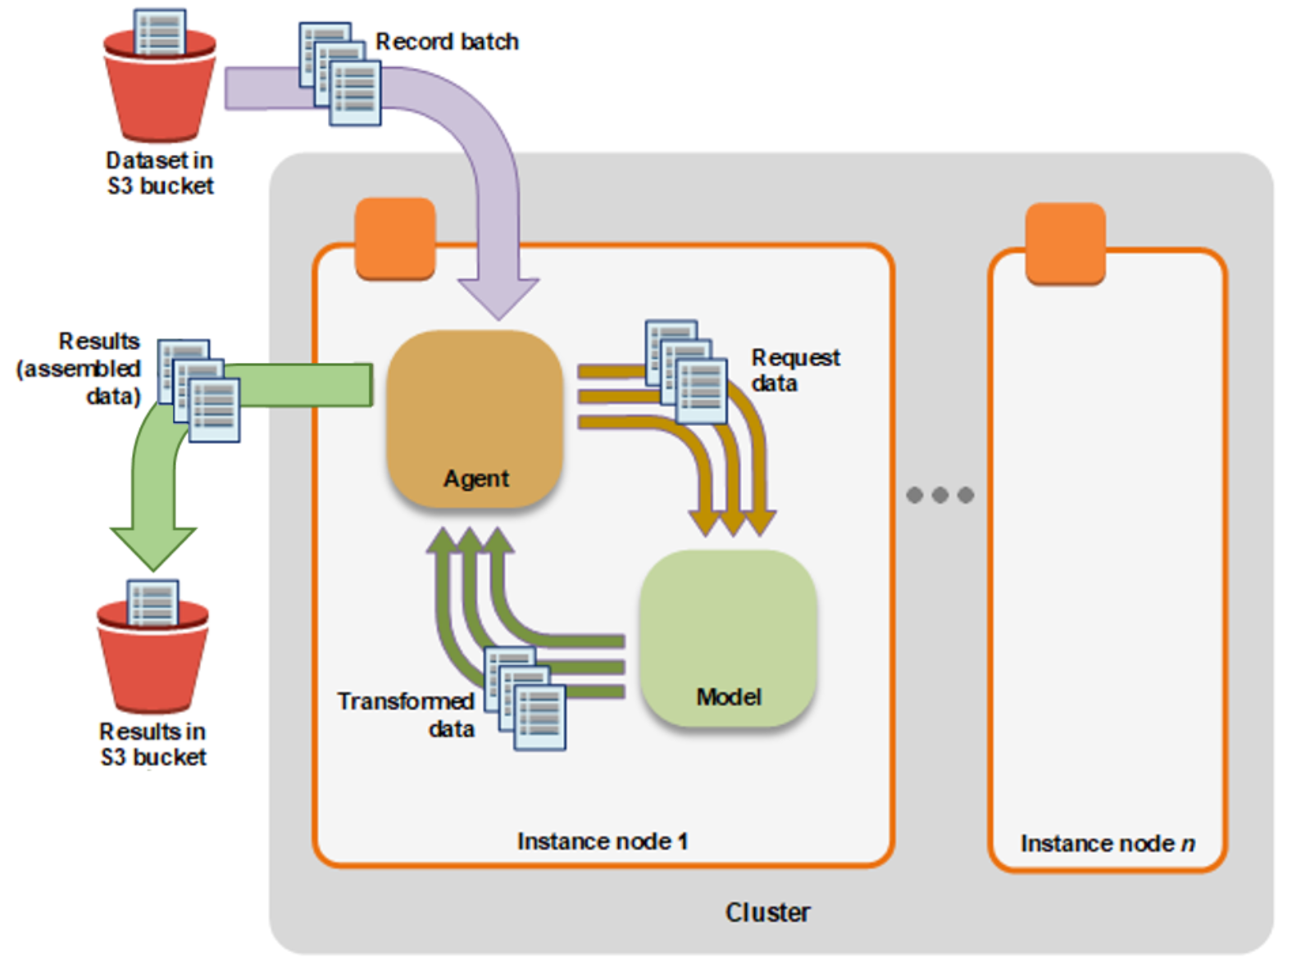
Model Deployment and Inference
Batch transform

Slide 14
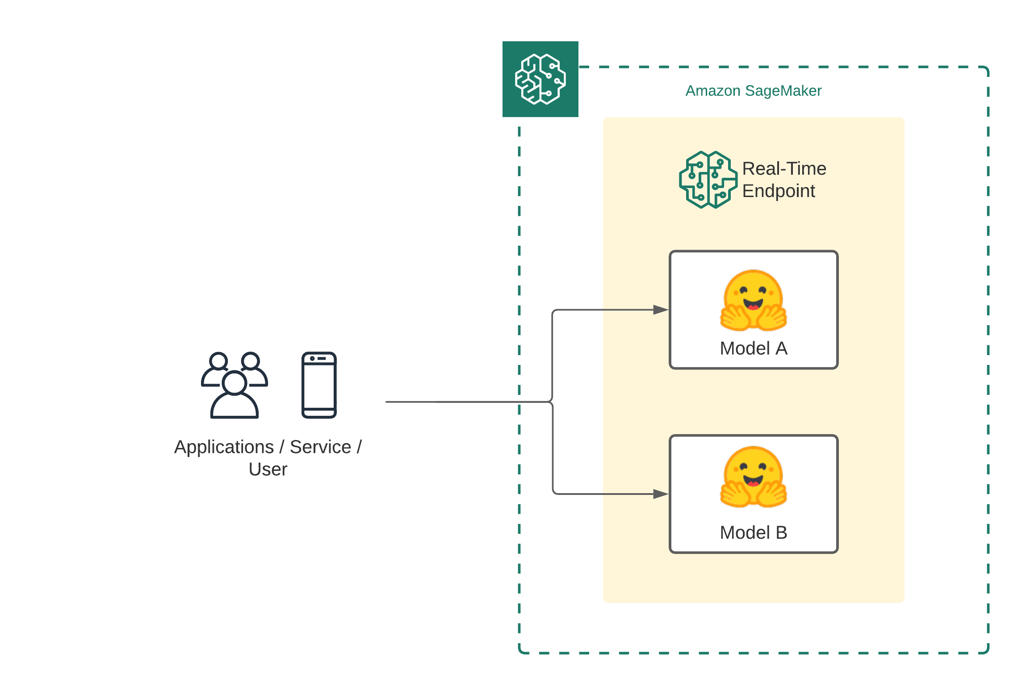
Model Deployment and Inference
API - Endpoint

Slide 15
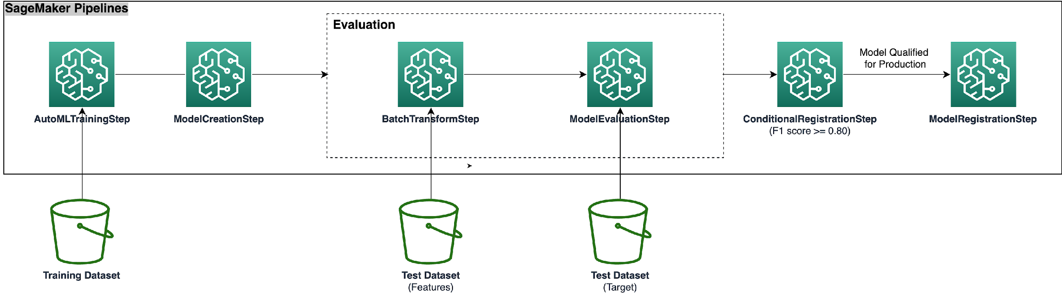
Pipeline
Amazon SageMaker Pipelines is a fully managed continuous integration and continuous delivery (CI/CD) service for machine learning (ML) workflows. It enables data scientists and ML engineers to create, automate, and manage end-to-end ML pipelines, from data preparation to model deployment.

Slide 16
Amazon SageMaker Resources
Getting started with Amazon SageMaker: https://aws.amazon.com/sagemaker/
Use the Amazon SageMaker SDK:
Python: https://github.com/aws/sagemaker-python-sdk
SageMaker Examples: https://github.com/awslabs/amazon-sagemaker-examples

Slide 17



THANK YOU

