Slide 1


E-commerce
App Migration
Advisor
Project Team
Eng. Khaled Mohsen
Eng. Fady Nabil
Eng. Mohamed Nabil
Eng. Mohamed Waheed
Eng. Osama Mamdouh
Eng. Sayed Reda
App Migration

Slide 2
Table of Contents
I
Business Case
3
II
Benefits of Cloud Migration
4
III
Methodology
9
IV
Final Architecture
13
App Migration
2

Slide 3
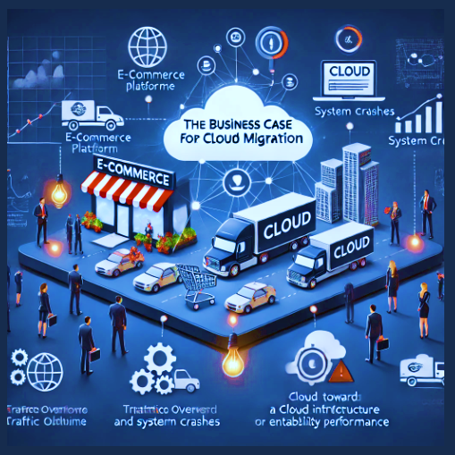
I
Business Case
As an e-commerce platform experiencing frequent downtime and performance issues during high traffic, we faced the challenge of migrating to the cloud to ensure stability, scalability, and reliability.
Our goal is to seamlessly transition the platform to a cloud environment, ensuring minimal disruption to services while improving performance during peak demand.
We need a solution that offers dynamic scalability, robust network infrastructure, secure connectivity, and reliable monitoring to prevent future outages and ensure a smooth shopping experience for our customers."
3
Notes:
Sayed

Slide 4

II
Benefits of Cloud Migration
Migrating the e-commerce application to the cloud is essential for improving scalability, performance, and cost efficiency. Cloud infrastructure dynamically allocates resources, reducing downtime and ensuring reliability. It also supports rapid feature deployment and future growth, while minimizing on-premises maintenance. Below are the key benefits of cloud migration:
Scalability
The cloud offers dynamic resource allocation, allowing businesses to scale infrastructure up or down based on demand. This flexibility ensures that the platform can handle traffic spikes without compromising performance, which is essential for e-commerce applications with fluctuating user activity.
6
2
Notes:
Sayed

Slide 5
II
Benefits of Cloud Migration
Cost Efficiency
Improved Performance
Cloud services follow a pay-as-you-go model, enabling businesses to pay only for the resources they actually use. This eliminates the need for large upfront investments in physical hardware and reduces ongoing maintenance costs, leading to significant savings over time.
With global data centers and advanced load-balancing, cloud platforms provide faster data delivery and reduce latency. This results in improved application performance, which is critical for customer satisfaction and business continuity.
7
2
Notes:
Sayed

Slide 6
II
Benefits of Cloud Migration
Security
Reliability and Availability
Cloud providers implement stringent security measures, including data encryption, secure access controls, and compliance with industry standards. This helps safeguard sensitive business and customer data, reducing the risk of breaches or cyberattacks.
Cloud infrastructure ensures high availability and redundancy, with built-in backup and disaster recovery options. This minimizes downtime and ensures business continuity, providing an uninterrupted experience for users, even in the event of hardware failure or natural disasters.
8
2
Notes:
Sayed

Slide 7

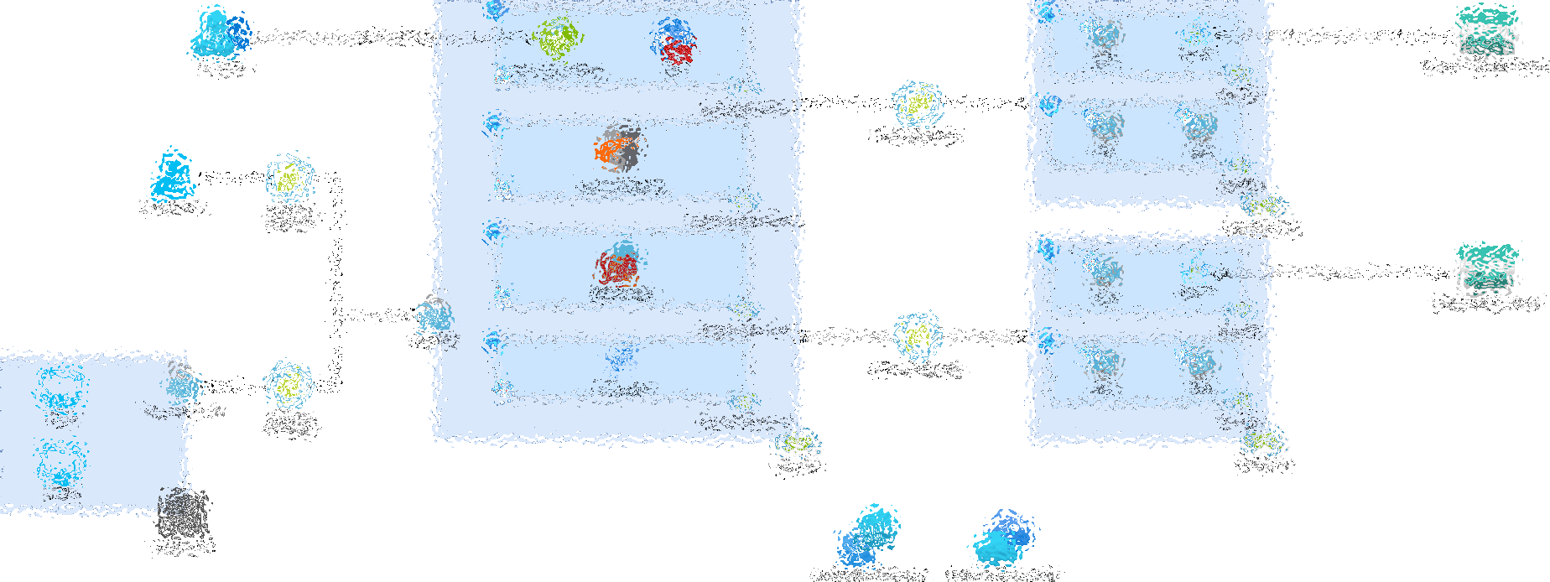
What’s the Architecture ?

Slide 8

Let’s take it step by step

Slide 9
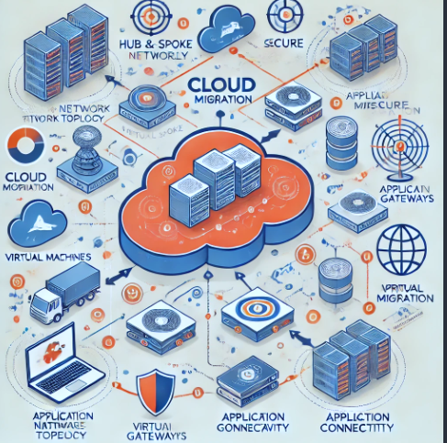
III
METHODOLOGY
Step 1: Network Segmentation
We requires a cloud design with centralized management and two workload environments: Production and Testing.
Our Solution:
Created a hub-and-spoke network topology in Azure.
Configured one hub VNet for centralized services and two spoke VNets for hosting both Forntend and Database environments.
Step 2: Workload Hosting Service
We needs a suitable workload hosting service for his web application with greater control and customization.
Our Solution:
Chose Virtual Machines for greater control and customization.
Deployed one VMs in each spoke VNet to host the web application components, ensuring redundancy and high availability.
9
2
Notes:
Fady
Step 1: Network Segmentation
Step 2: Workload Hosting Service
Step 3: Application Delivery

Slide 10
III
METHODOLOGY
Step 3: Application Delivery
We requires a scalable load balancing option with applicable security rules to ensure secure and reliable delivery of my web application to end users.
Our Solution:
Configured the Application Gateway, scalable load balancing.
Implemented WAF rules to protect the application from common web vulnerabilities.
And we also enabled the DDos Option to protect our network from the Distributed denial-of-service attacks
Step 4: Secure Connectivity
The customer needs secure and efficient connectivity between the VNets ensuring low latency and high bandwidth communication between the web application components in the spokes and the centralized services in the hub.
Our Solution:
Established VNet peering between the hub and spoke VNets.
Configured network security groups (NSGs) to control inbound and outbound traffic, and also we have re-route the traffic through the Firewall to make sure that the traffic are inspected and monitored.
9
2
Notes:
Wahed
Step 4: Secure Connectivity
Step 5: Centralized Firewall
Step 6: Secure Remote Access

Slide 11
III
METHODOLOGY
Step 5: Centralized Firewall
We wants a centralized cloud native security service to control and log all network traffic flowing between the VNets, providing an additional layer of security for our web application environment..
Our Solution:
Deployed an Azure Firewall in the hub VNet.
Configured the firewall to log and control traffic between the hub and spoke VNets.
Implemented security rules to allow only necessary traffic.
Enable IPDS.
Step 6: Secure Remote Access
To facilitate management and maintenance, the customer needs a secure solution for RDP/SSH connectivity to the virtual machines hosting his web application components without exposing them to the public internet.
Our Solution:
Set up an Azure Bastion host in the hub VNet.
Configured Bastion for secure RDP/SSH connectivity to VMs in the spoke VNets.
Eliminated the need to expose VMs to the public internet, ensuring secure access.
9
2

Slide 12
III
METHODOLOGY
Step 7: Monitoring
We needs comprehensive monitoring capabilities to collect and analyze logs and metrics from all components of our web application environment for effective monitoring and troubleshooting...
Our Solution:
Integrated Azure Monitor.
Configured monitoring for the critical components such as “App GW, Firewall” of the infrastructure.
We also enforced Tagging Policy for all azure resources to be able to track the cost.
Step 8: Backup and Disaster Recovery
We want regular backups and quick recovery of the virtual machines hosting his web application components to protect against data loss and ensure business continuity
Our Solution:
Implemented Azure Backup and Recovery Services Vault.
Configured regular backups for all VMs hosting the web application components.
9
2
Notes:
Osama
Step 7: Monitoring
Step 8: Backup and Disaster Recovery

Slide 13
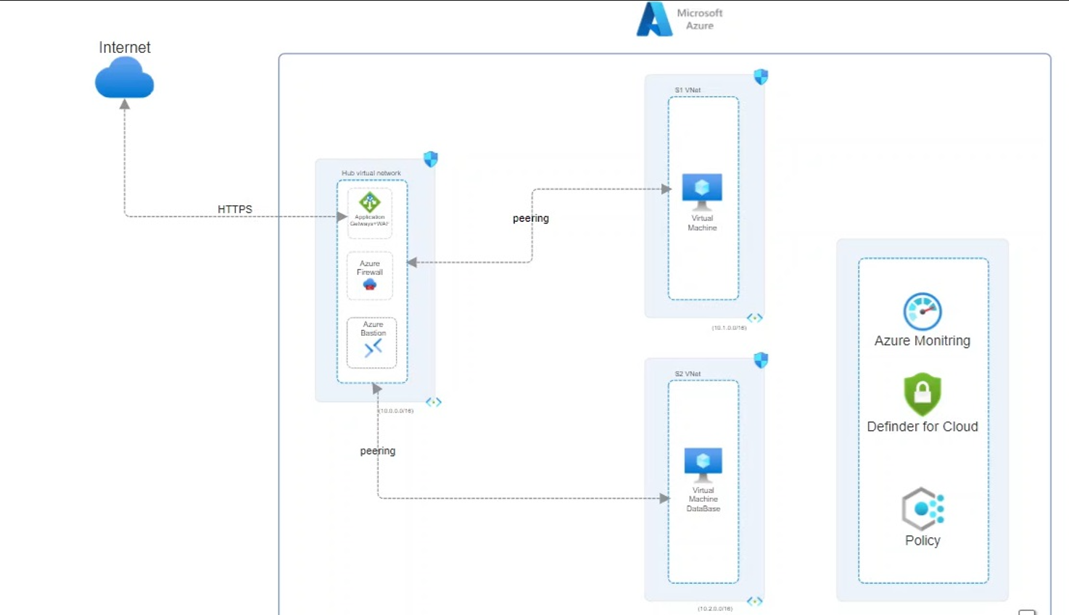
The Final Architecture
Notes:
Nabil

Slide 14
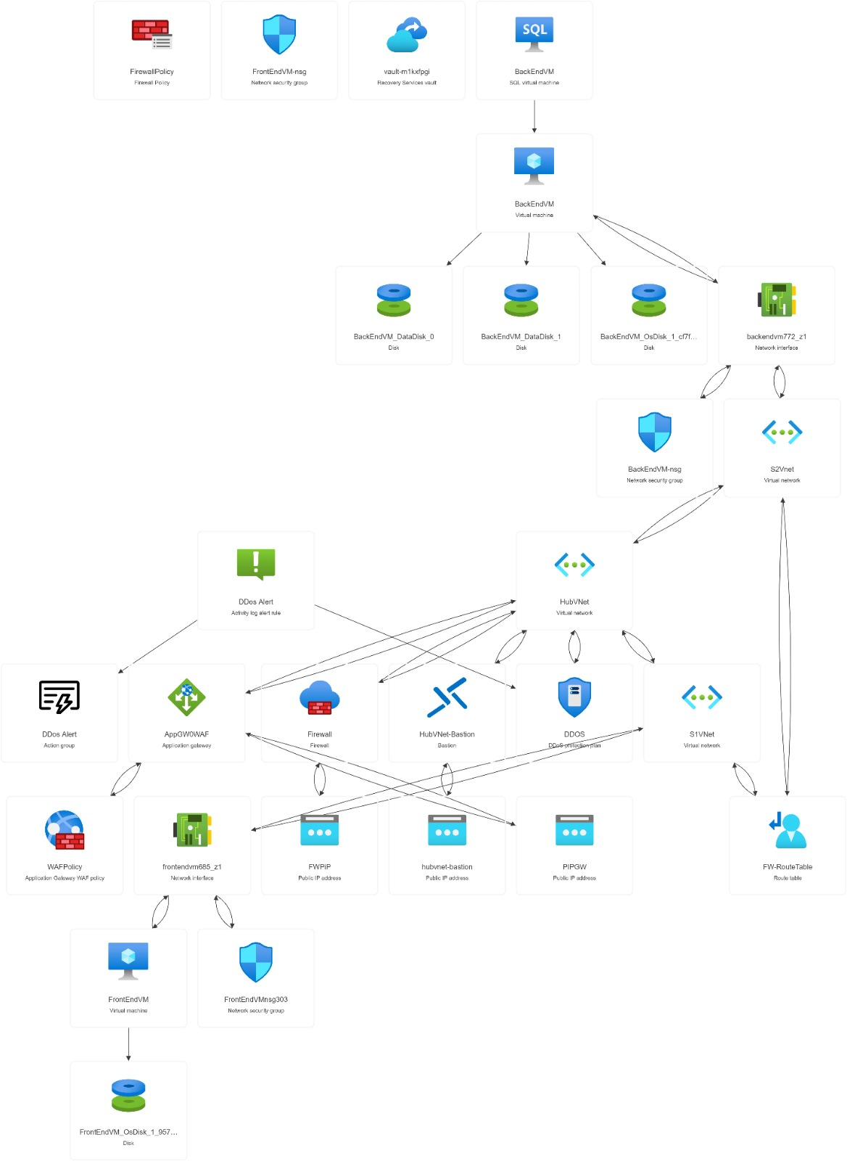
Implementation on Azure

Slide 15
Demo
App Migration

Slide 16
Any Questions ?
App Migration

Slide 17
Thank you
for listening!
App Migration

