Slide 1
Big Data
Dr taysir hassan

Slide 2
An overview of our database
The movies database has 12 column which are names,date_x,score,genre,overview,crew,orig_title,status,orig_lang,budget_x,revenue,country.
In our application we won’t display the overview and the crew column.
The database has over 10000 rows.
We will also be using MongoDb.
MongoDb: is a non-relational document database that provides support for JSON-like storage. The MongoDB database has a flexible data model that enables you to store unstructured data, and it provides full indexing support, and It is much faster than the relational databases.

Slide 3
An overview of our GUI application
We used python for the implementation of our desktop application.
We also used pymongo, Pyqt5 and sys which are libraries in python.
Pymongo: is a Python distribution containing tools for working with MongoDB and is the recommended way to work with MongoDB from Python.
PyQt5: is a Python binding for Qt, which is a set of C++ libraries and development tools providing platform-independent abstractions for graphical user interfaces (GUIs).

Slide 4

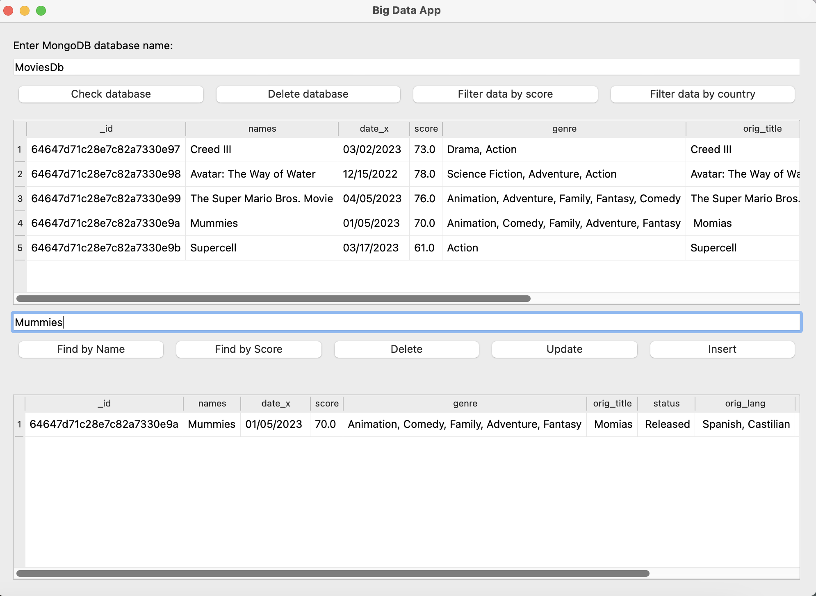
Big data desktop application

Slide 5
Check database: In this button we check if the entered database name exists then show it in the table beneath it.
Delete database: If the user finds the database, He will be able to delete it with this button.

Slide 6
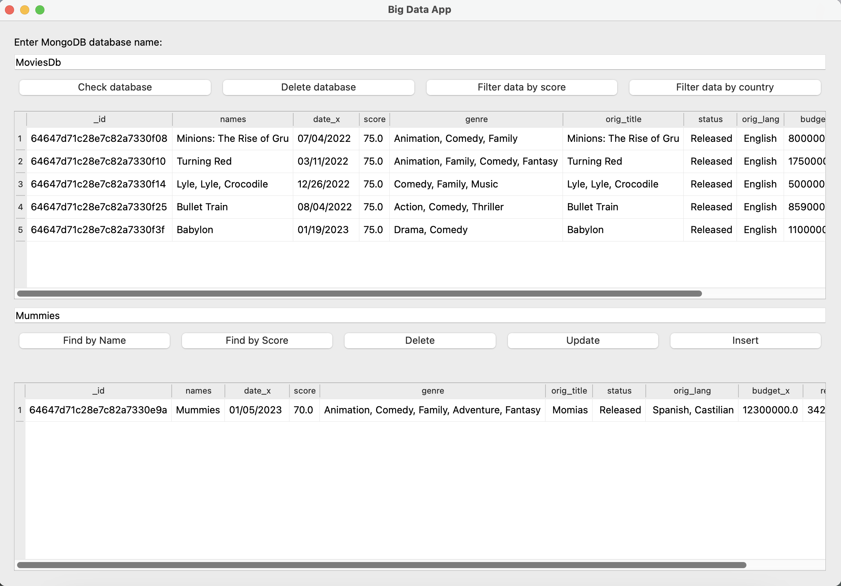
Filter data by score: In this button we filter our data by their score which is initialy set to 75.
Filter data by country: This button filter data by their country.

Slide 7
Find by score: User can enter the score of movie and then button return first movie with this score.
Find by name: This button finds movies by the name.

Slide 8
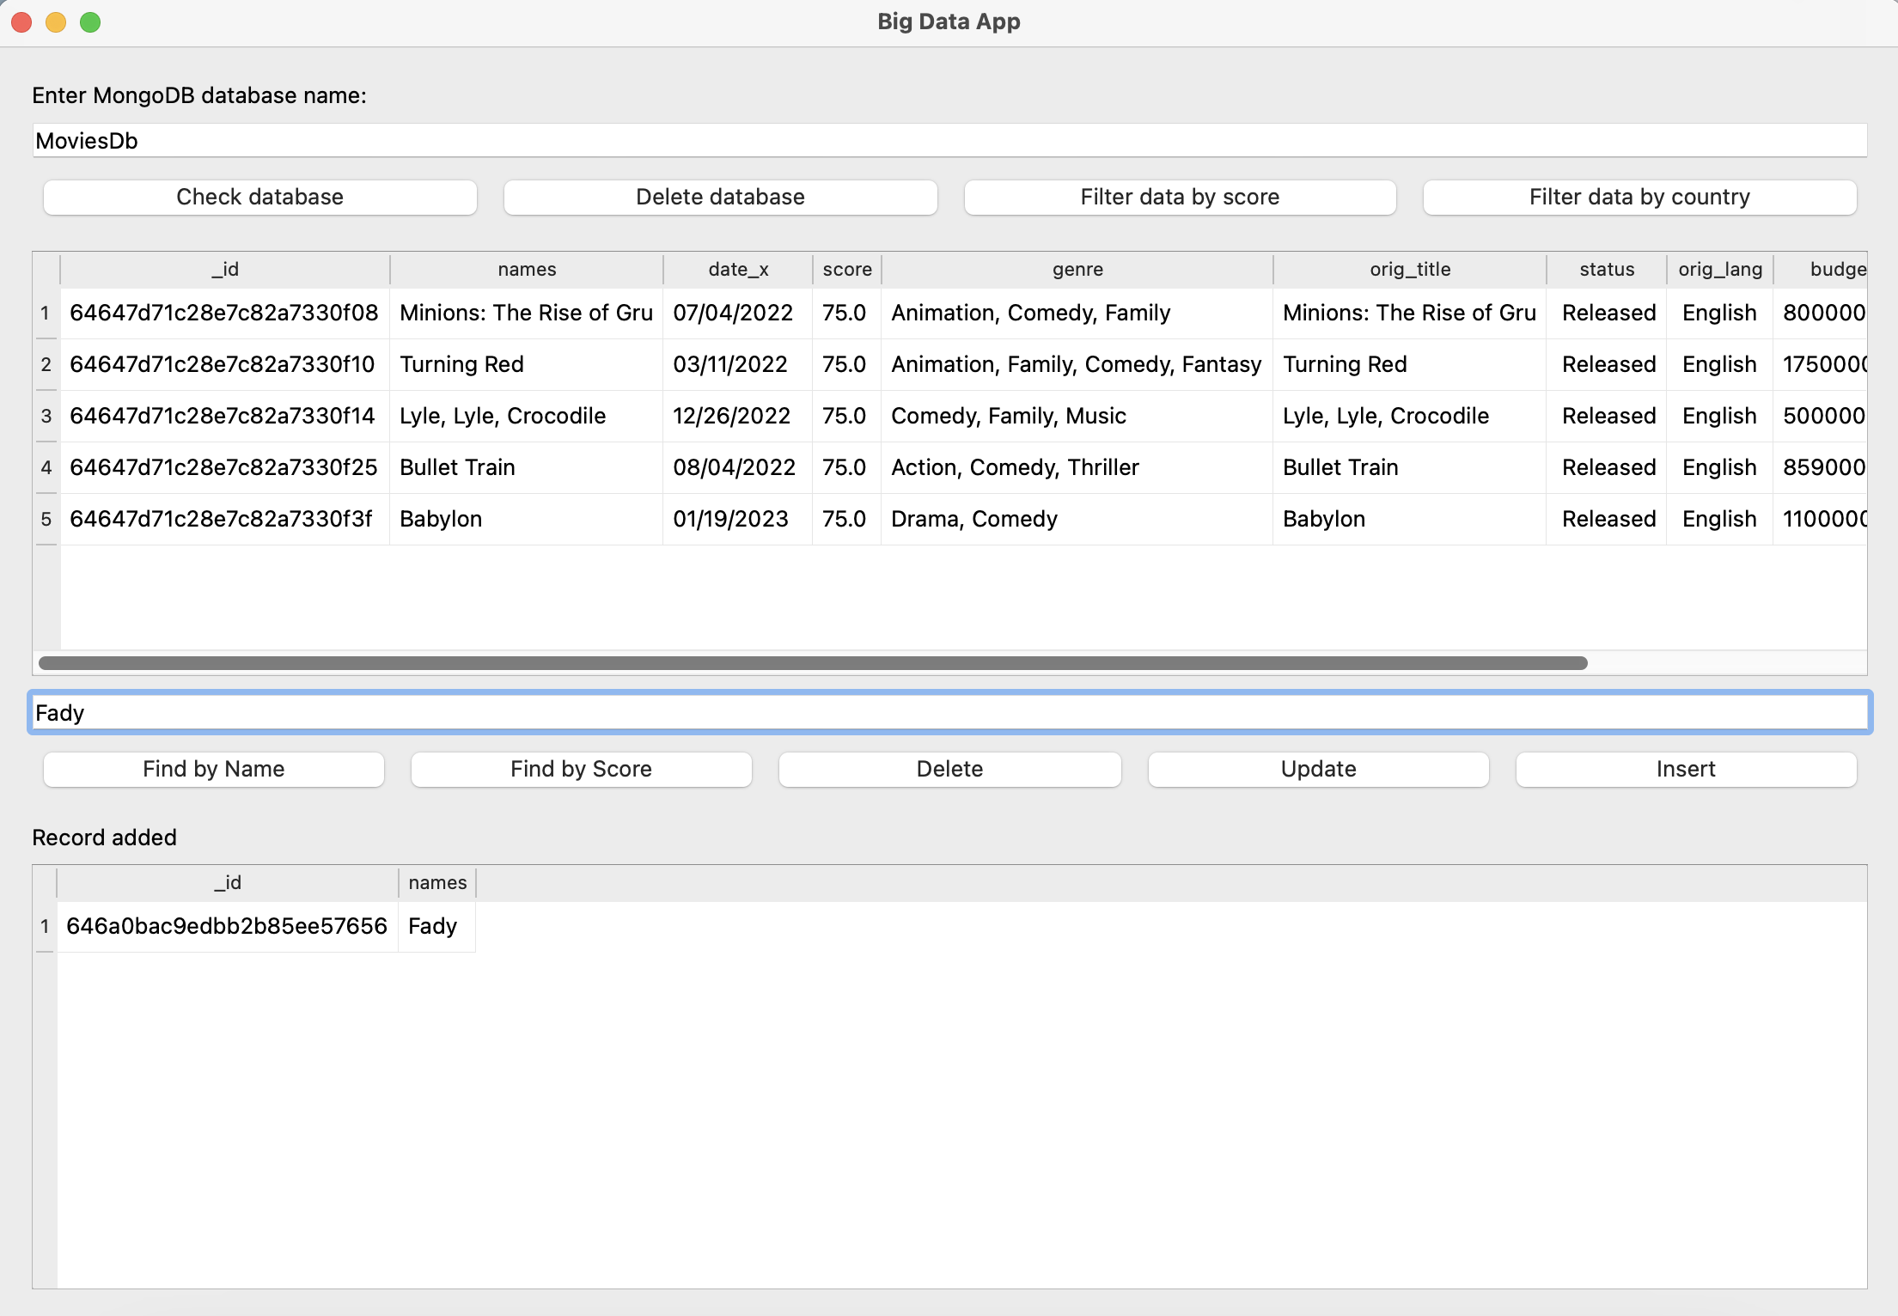
Insert: User can enter data to the database using this button.
Delete: user can search for a movies then delete it using this button.
Update: This button finds a movie then change its name.

Slide 9
Fady Emad Fady Sherif Ashraf Medhat Beshoy Nashaat Soha Sarah Taher
Dr taysir hassan

