Slide 1
Artificial Intelligence Project: Hierarchy Deep Q-Learning
Yiheng Lin, Zhihao Jiang

Slide 2
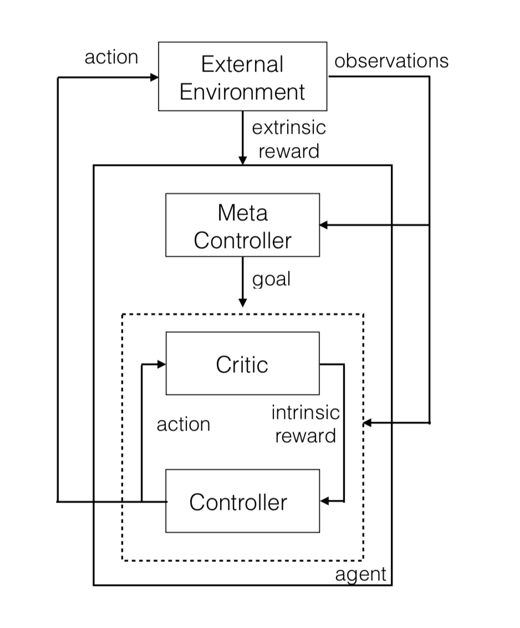
Introduction
Meta Controller:
(Higher Hierarchy)
Interact with External Environment (extrinsic reward), set goals for Controller;
Controller:
(Lower Hierarchy)
Try to achieve goals, receive intrinsic reward from Meta Controller.

Slide 3
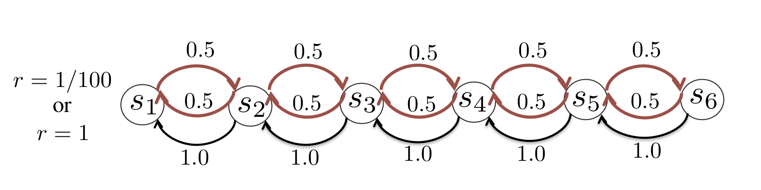
Problem Setting
Reward: if s6 is visited, reward = 1; else, reward = 0.01
Actions: 1: move to left with probability 1;
2: move to right with probability 0.5; otherwise, move to left;

Slide 4
Difficulties
Hidden State: What if we have an additional state to indicate whether s6 is visited?
Search Efficiency: Can epsilon greedy agent keep taking action 2 for enough times?

Slide 5
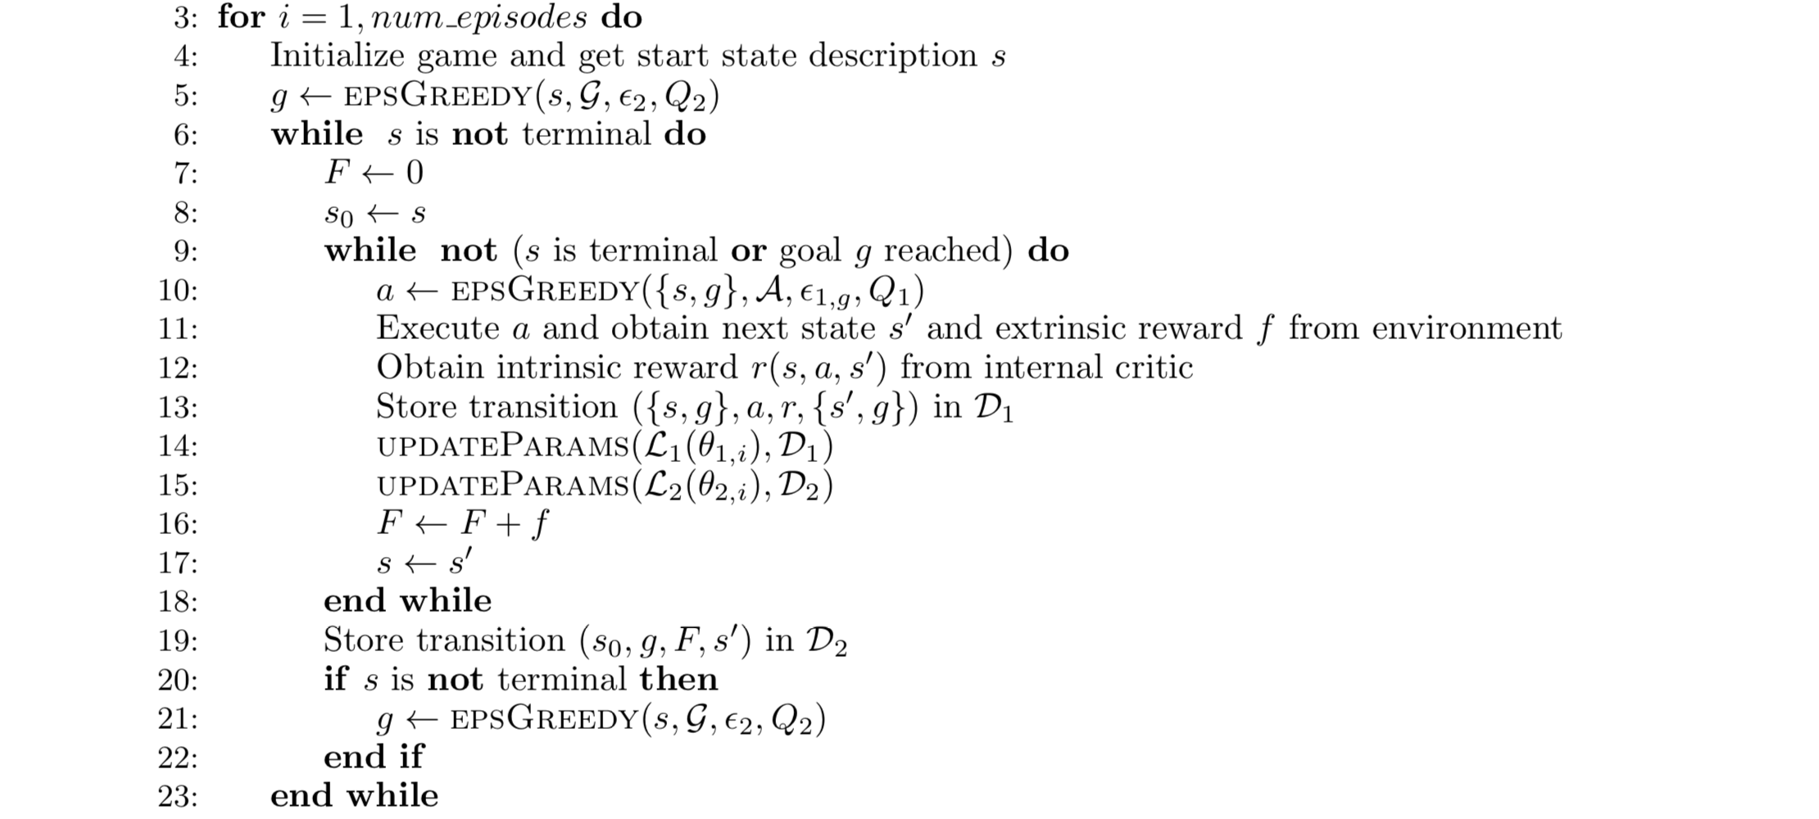
Reimplementation
Meta Controller chooses a goal
Controller chooses an action
Controller’s reward

Slide 6
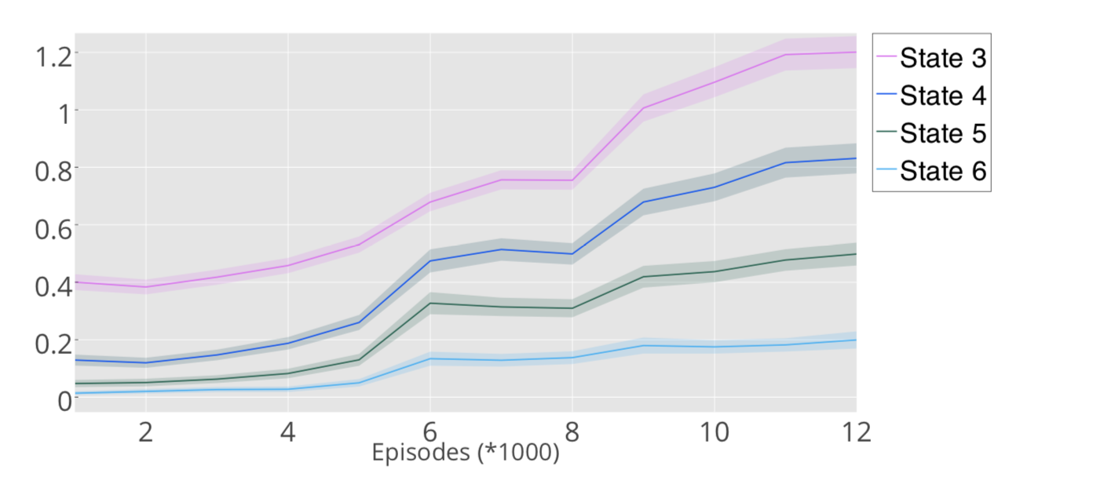

Reimplementation
Authors’ Result:
Ref: Hierarchical Deep Reinforcement Learning: Integrating Temporal Abstraction and Intrinsic Motivation

Slide 7

Reimplementation
Our result:
epoch | s1 | s2 | s3 | s4 | s5 | s6
1 | 1 | 1.596 | 0.903 | 0.421 | 0.172 | 0.058
2 | 1 | 1.571 | 0.859 | 0.435 | 0.21 | 0.063
3 | 1 | 1.654 | 0.928 | 0.415 | 0.211 | 0.07
4 | 1 | 1.661 | 0.978 | 0.484 | 0.237 | 0.07
5 | 1 | 1.592 | 0.9 | 0.499 | 0.298 | 0.107
6 | 1 | 1.635 | 1.003 | 0.601 | 0.36 | 0.127
7 | 1 | 1.576 | 0.942 | 0.574 | 0.306 | 0.098
Ref: https://github.com/EthanMacdonald/h-DQN

Slide 8
Reimplementation
Interesting Phenomena:
When goal is sited to s2, the controller often takes action 2…
Then it can visit s6…
Meta-Controller receives a big reward…
Meta-Controller tends to set s2 as the goal…
But, is this stable?
Maybe the experience of Controller is too volatile to train Meta Controller?
Quality input guarantees quality output…

Slide 9
Our Attempt
Key idea: Explore efficiently
The effect of subgoal in the previous example
Other thinking
Random subgoal
“most unknown” subgoal

Slide 10
Implementation Details
Set the subgoal
Transmit the reward information

Slide 11
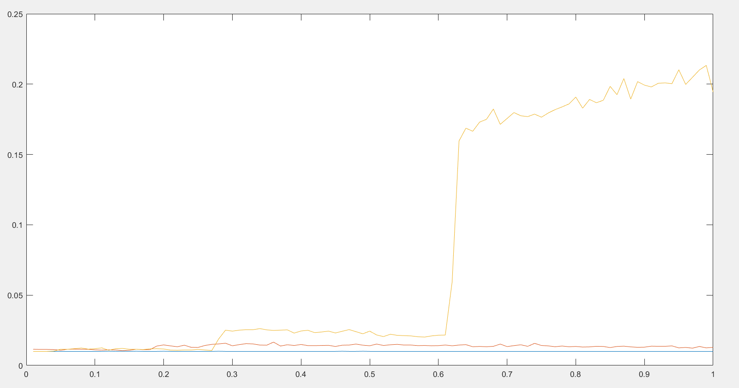
Performance
Discovery: the line raises abruptly some time

Slide 12
Some Ideas
Initial parameters in DQN using this method
Combine this method with deep learning

Slide 13
Plan of Further Work
Why the performance line raises abruptly
How to implement our idea in more general model
Is the ideas useful for DQN

Slide 14
Thanks

