Slide 1
Artificial Intelligence Project: Hierarchy Deep Q-Learning
Zhihao Jiang, Yiheng Lin

Slide 2
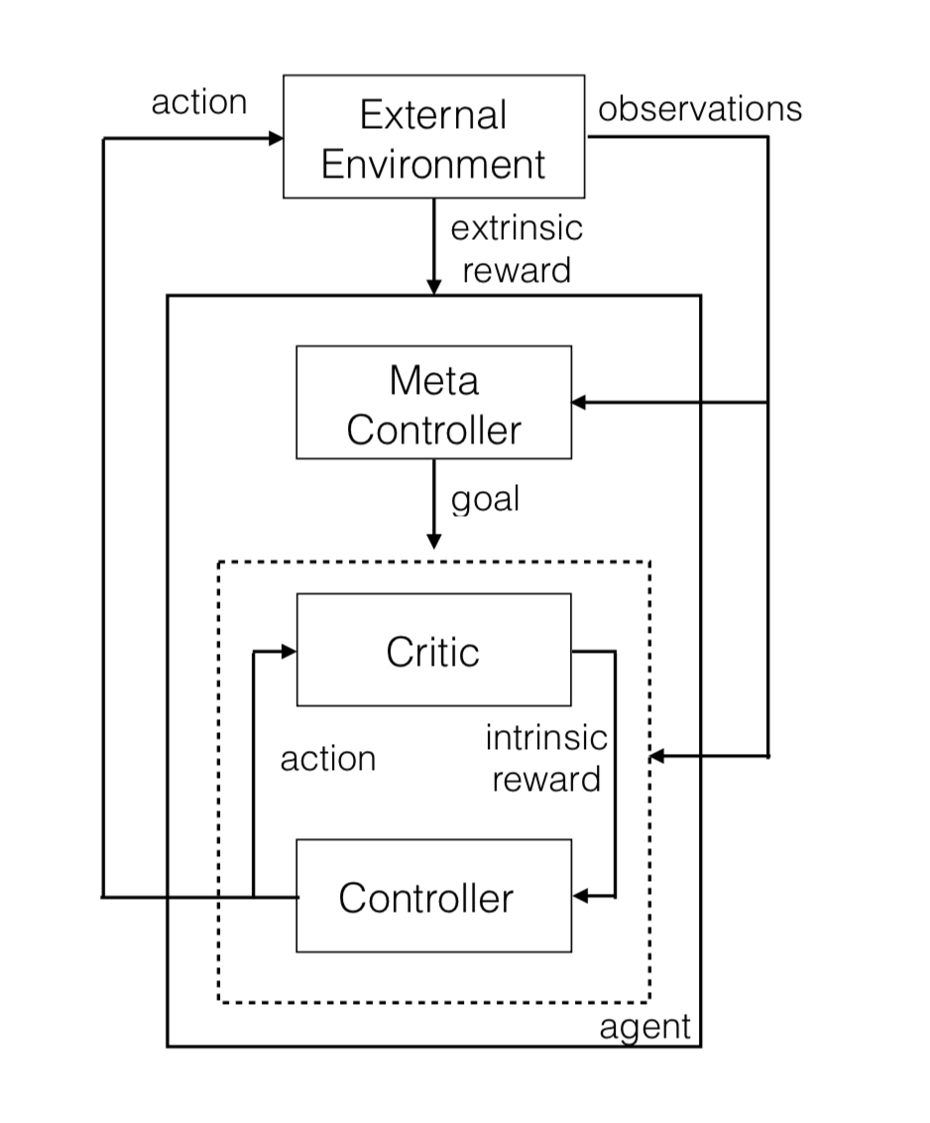
Introduction
Meta Controller:
(Higher Hierarchy)
Interact with External Environment (extrinsic reward), set goals for Controller;
Controller:
(Lower Hierarchy)
Try to achieve goals, receive intrinsic reward from Meta Controller.

Slide 3
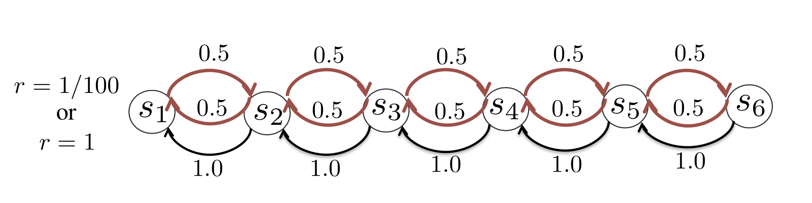
Problem Setting
Reward: if s6 is visited, reward = 1; else, reward = 0.01
Actions: 1: move to left with probability 1;
2: move to right with probability 0.5; otherwise, move to left;

Slide 4
Difficulties
Hidden State: What if we have an additional state to indicate whether s6 is visited?
Search Efficiency: Can epsilon greedy agent keep taking action 2 for enough times?

Slide 5
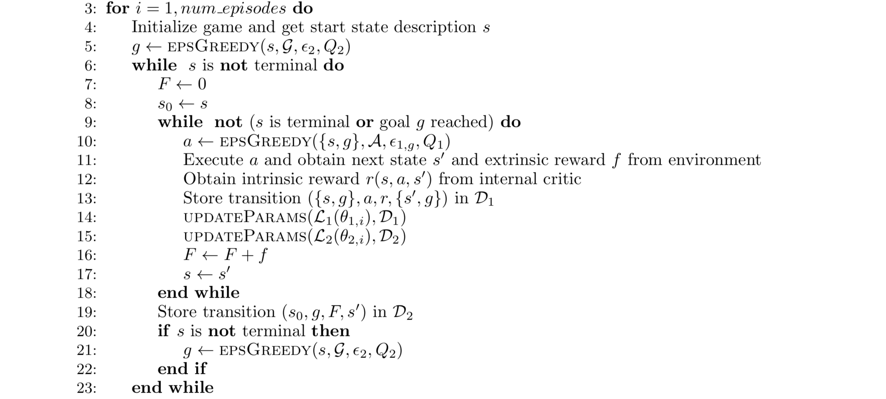
Reimplementation
Meta Controller chooses a goal
Controller chooses an action
Controller’s reward

Slide 6
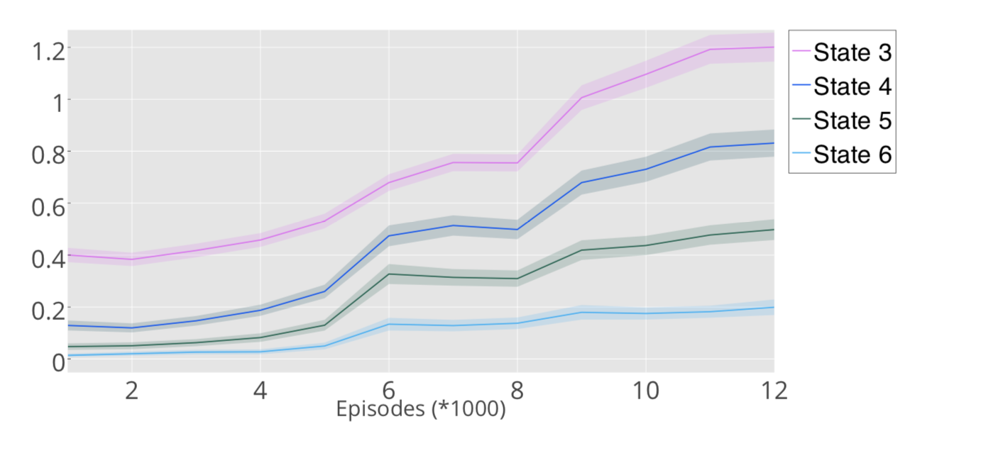

Reimplementation
Authors’ Result:
Ref: Hierarchical Deep Reinforcement Learning: Integrating Temporal Abstraction and Intrinsic Motivation

Slide 7

Reimplementation
Our result:
epoch | s1 | s2 | s3 | s4 | s5 | s6
1 | 1 | 1.596 | 0.903 | 0.421 | 0.172 | 0.058
2 | 1 | 1.571 | 0.859 | 0.435 | 0.21 | 0.063
3 | 1 | 1.654 | 0.928 | 0.415 | 0.211 | 0.07
4 | 1 | 1.661 | 0.978 | 0.484 | 0.237 | 0.07
5 | 1 | 1.592 | 0.9 | 0.499 | 0.298 | 0.107
6 | 1 | 1.635 | 1.003 | 0.601 | 0.36 | 0.127
7 | 1 | 1.576 | 0.942 | 0.574 | 0.306 | 0.098
Ref: https://github.com/EthanMacdonald/h-DQN

Slide 8
Reimplementation
Interesting Phenomena:
When goal is sited to s2, the controller often takes action 2…
Then it can visit s6…
Meta-Controller receives a big reward…
Meta-Controller tends to set s2 as the goal…
But, is this stable?
Maybe the experience of Controller is too volatile to train Meta Controller?
Quality input guarantees quality output…

