Slide 1
18.404/6.840 Lecture 7
Last time: - Equivalence of variants of the Turing machine model
a. Multi-tape TMs
b. Nondeterministic TMs
c. Enumerators
- Church-Turing Thesis
- Notation for encodings and TMs
Today: (Sipser §4.1) - Decision procedures for automata and grammars
1

Slide 2

TMs and Encodings – review
A TM has 3 possible outcomes for each input $w$:
Accept $w$ (enter $q\text{acc}$)
Reject $w$by halting (enter $q\text{rej}$ )
Reject $w$by looping (running forever)
$A$ is T-recognizable if $A=L(M)$ for some TM $M$.
$A$ is T-decidable if $A=L(M)$ for some TM decider $M$.
halts on all inputs
$〈O_{1}, O_{2}, …, O_{k}〉$ encodes objects $O_{1}, O_{2}, …, O_{k}$ as a single string.
Notation for writing a TM $M$ is
$M=$ “On input $w$
[English description of the algorithm]”
2

Slide 3






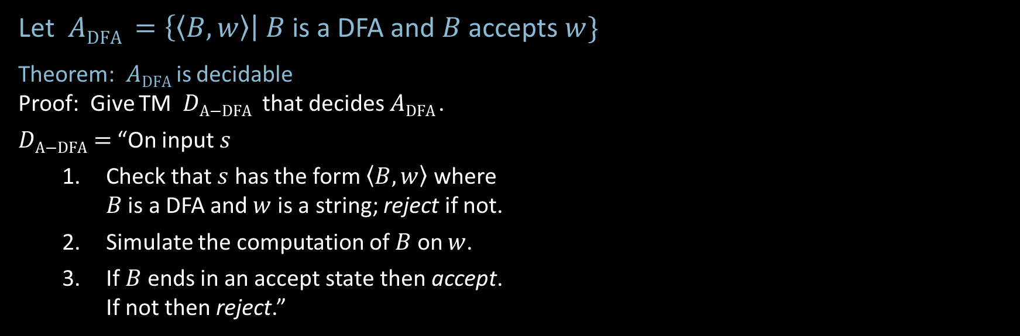

Acceptance Problem for DFAs
Let $A\text{DFA} =\left\{〈B,w〉\right| B$ is a DFA and $B$ accepts $w\}$
Theorem: $A\text{DFA}$is decidable
Proof: Give TM $D\text{A}\text{−}\text{DFA}$ that decides $A\text{DFA}$.
$D\text{A}\text{−}\text{DFA}=$ “On input $s$
Check that $s$ has the form $〈B,w〉$ where $B$ is a DFA and $w$ is a string; reject if not.
Simulate the computation of $B$ on $w$.
If $B$ends in an accept state then accept. If not then reject.”
Shorthand: On input $〈B,w〉$
input tape contains $〈B,w〉$
$$\left(Q=\left\{q_{0}, …,q_{k}\right\}, Σ=\left\{0,1\right\}, δ=⋯, q_{0}, F=⋯\right), w=01101$$
$$D\text{A}\text{−}\text{DFA}$$
$$B$$
$$w$$
$$q_{i }, k$$
work tape with current state and input head location
3

Slide 4

Acceptance Problem for NFAs
Let $A\text{NFA} =\left\{〈B,w〉\right| B$ is a NFA and $B$ accepts $w\}$
Theorem: $A\text{N}\text{FA}$is decidable
Proof: Give TM $D\text{A}\text{−}\text{NFA}$ that decides $A\text{N}\text{FA}$.
$D\text{A}\text{−}\text{NFA}=$ “On input $〈B,w〉$
Convert NFA $B$ to equivalent DFA $B′$.
Run TM $D\text{A}\text{−}\text{DFA}$ on input $〈B′,w〉$. [ Recall that $D\text{A}\text{−}\text{DFA}$ decides $A\text{D}\text{FA}$ ]
Accept if $D\text{A}\text{−}\text{DFA}$ accepts. Reject if not.”
New element: Use conversion construction and previously constructed TM as a subroutine.
4

Slide 5

Emptiness Problem for DFAs
Let $E\text{DFA}=\left\{〈B〉\right| B$ is a DFA and $L\left(B\right)=∅\}$
Theorem: $E\text{D}\text{FA}$is decidable
Proof: Give TM $D\text{E}\text{−}\text{DFA}$ that decides $E\text{DFA}$ .
$D\text{E}\text{−}\text{DFA}=$ “On input $〈B〉$ [IDEA: Check for a path from start to accept.]
Mark start state.
Repeat until no new state is marked:
Mark every state that has an incoming arrow from a previously marked state.
Accept if no accept state is marked. Reject if some accept state is marked.”
5

Slide 6

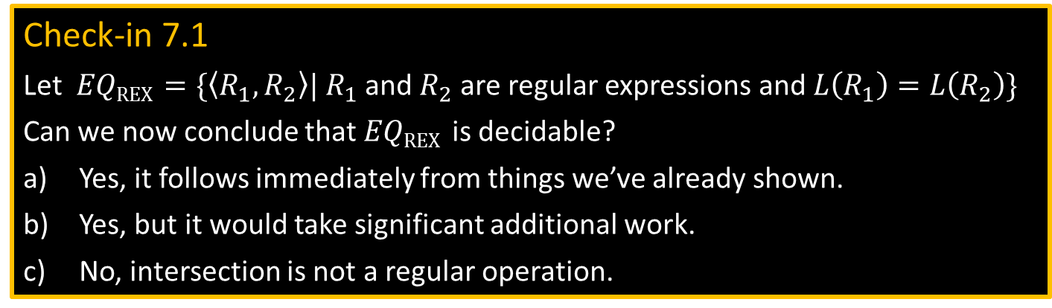


Equivalence problem for DFAs
Let $EQ\text{DFA}$ $=\{〈A,B〉|$ $A$ and $B$ are DFAs and $L\left(A\right)=L\left(B\right)\}$
Theorem: $EQ\text{D}\text{FA}$is decidable
Proof: Give TM $D\text{E}\text{Q}\text{−}\text{DFA}$ that decides $EQ\text{DFA}$ .
$D\text{E}\text{Q}\text{−}\text{DFA}=$ “On input $〈A,B〉$ [IDEA: Make DFA $C$ that accepts $w$ where $A$ and $B$ disagree.]
Construct DFA $C$ where $L\left(C\right)=\left(L\left(A\right)∩\overline{L\left(B\right)}\right)∪\left(\overline{L\left(A\right)}∩L\left(B\right)\right)$.
Run $D\text{E}\text{−}\text{DFA}$ on $〈C〉$ .
Accept if $D\text{E}\text{−}\text{DFA}$accepts. Reject if $D\text{E}\text{−}\text{DFA}$ rejects.”
Check-in 7.1
Let $EQ\text{REX}$ $=\{〈R_{1},R_{2}〉|$ $R_{1}$ and $R_{2}$ are regular expressions and $L\left(R_{1}\right)=L\left(R_{2}\right)\}$
Can we now conclude that $EQ\text{REX}$ is decidable?
Yes, it follows immediately from things we’ve already shown.
Yes, but it would take significant additional work.
No, intersection is not a regular operation.
$$L\left(A\right)$$
$$L\left(B\right)$$
Symmetric difference
Check-in 7.1
6

Slide 7

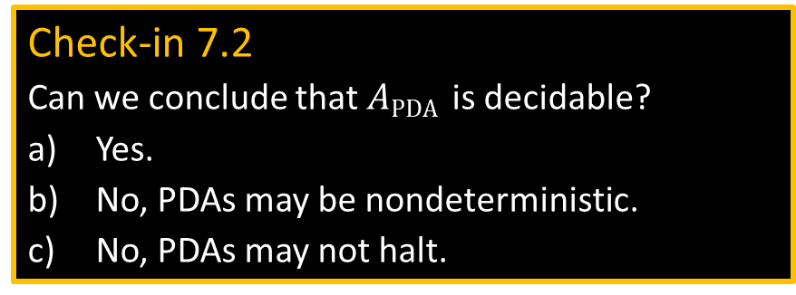

Acceptance Problem for CFGs
Let $A\text{CFG} =\{〈G,w〉| G \text{is} \text{a} \text{CFG} \text{and} w∈L\left(G\right)\}$
Theorem: $\text{A}\text{CFG}$is decidable
Proof: Give TM $D\text{A}\text{−}\text{CFG}$ that decides $A\text{CFG}$ .
$D\text{A}\text{−}\text{CFG}=$ “On input $〈G,w〉$
Convert $G$ into CNF.
Try all derivations of length $2|w|−1$.
Accept if any generate $w$. Reject if not.
Corollary: Every CFL is decidable.
Proof: Let $A$ be a CFL, generated by CFG $G$.
Construct TM $M_{G}=$“on input $w$
1. Run $D\text{A}\text{−}\text{CFG}$ on $〈G,w〉$.
2. Accept if $D\text{A}\text{−}\text{CFG}$ accepts Reject if it rejects.”
Recall Chomsky Normal Form (CNF) only allows rules: A $→$ BC
B $→$ b
Lemma 1: Can convert every CFG into CNF.
Proof and construction in book.
Lemma 2: If $H$ is in CNF and $w∈L(H)$ then every derivation of $w$ has $2|w|−1$ steps.
Proof: exercise.
Check-in 7.2
Can we conclude that $A\text{PDA}$ is decidable?
Yes.
No, PDAs may be nondeterministic.
No, PDAs may not halt.
Check-in 7.2
7

Slide 8


Emptiness Problem for CFGs
Let $E\text{CFG}$ $=\{〈G〉| G$ is a CFG and $L\left(G\right)=∅ \}$
Theorem: $E\text{CFG}$is decidable
Proof: $D\text{E}\text{−}\text{CFG}=$ “On input $〈G〉$ [IDEA: work backwards from terminals]
Mark all occurrences of terminals in $G$.
Repeat until no new variables are marked
Mark all occurrences of variable A if A $→B_{1}B_{2}⋯B_{k}$ is a rule and all $B_{i}$ were already marked.
Reject if the start variable is marked. Accept if not.”
S $→$ RTa
R $→$ Tb
T $→$ a
S
R
T
a
R
T
b
T
a
8

Slide 9
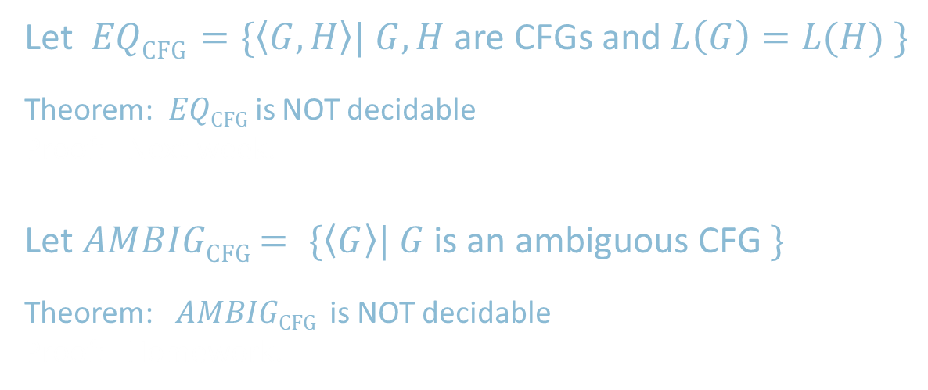
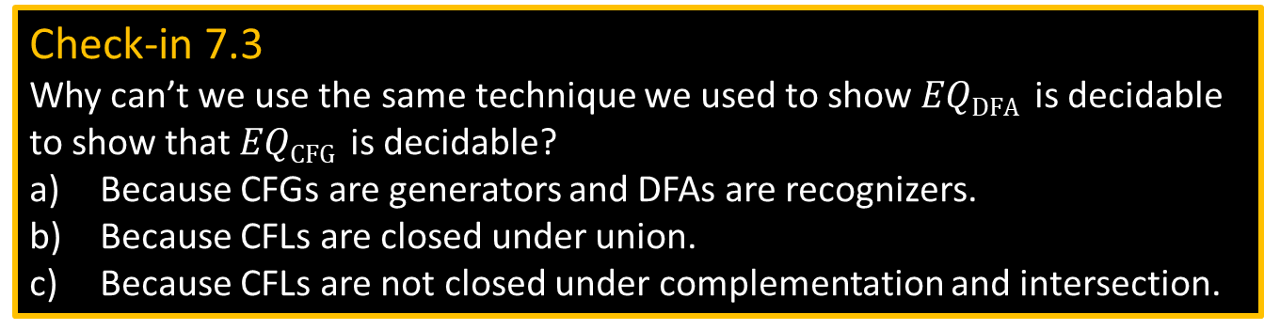
Equivalence Problem for CFGs
Let $EQ\text{CFG}$ $=\{〈G,H〉| G,H$ are CFGs and $L\left(G\right)=L(H) \}$
Theorem: $EQ\text{CFG}$is NOT decidable
Proof: Next week.
Let $AMBIG\text{CFG}$ $= \{〈G〉| G$ is an ambiguous CFG $\}$
Theorem: $AMBIG\text{CFG}$ is NOT decidable
Proof: Homework.
Check-in 7.3
Why can’t we use the same technique we used to show $EQ\text{DFA}$ is decidable to show that $EQ\text{CFG}$ is decidable?
Because CFGs are generators and DFAs are recognizers.
Because CFLs are closed under union.
Because CFLs are not closed under complementation and intersection.
Check-in 7.3
9

Slide 10



Acceptance Problem for TMs
Let $A\text{TM}$ $=\{〈M,w〉| M$ is a TM and $M$ accepts $w\}$
Theorem: $A\text{TM}$is not decidable
Proof: Thursday.
Theorem: $A\text{TM}$is T-recognizable
Proof: The following TM $U$ recognizes $A\text{TM}$
$U=$ “On input $〈M,w〉$
Simulate $M$ on input $w$.
Accept if $M$ halts and accepts.
Reject if $M$ halts and rejects.
Reject if $M$ never halts.”
Von Neumann said $U$inspired the concept of a stored program computer.
Turing’s original “Universal Computing Machine”
Description of $M$, input $w$
$$U$$
Not a legal TM action.
10

Slide 11

Quick review of today
We showed the decidability of various problems about automata and grammars: $A\text{DFA}$ , $A\text{N}\text{FA}$ , $E\text{DFA}$ , $EQ\text{DFA}$ , $A\text{CFG}$ , $E\text{DFA}$
We showed that $A\text{TM}$ is T-recognizable.
11

Slide 12
MIT OpenCourseWare
https://ocw.mit.edu
18.404J Theory of Computation
Fall 2020
For information about citing these materials or our Terms of Use, visit: https://ocw.mit.edu/terms.

