Slide 1

Predicting Race From Fatal Shooting Data
By Daniel Liang

Slide 2
Data Cleaning
Replaced race letters with names of races, such as replacing “W” with “White”
Dropped rows with only NaNs in columns other than id, name, and date
Dropped rows with NaNs in the race column (the actual race is required for model training)
Filled NaNs in the armed column with the mode: gun
Filled NaNs in the age column with the median
Filled NaNs in the gender column with the mode: M
Filled NaNs in the flee column with the mode: Not fleeing

Slide 3
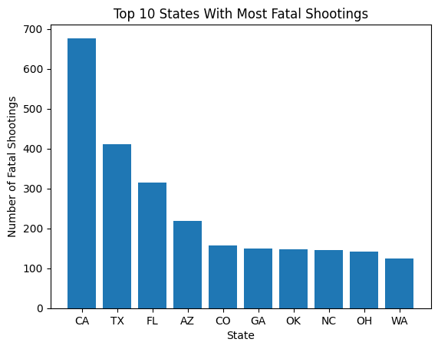
Fatal Shootings By State
The top 10 states with most fatal shootings are shown in the bar chart, with the top 5 being California, Texas, Florida, Arizona, and Colorado.

Slide 4
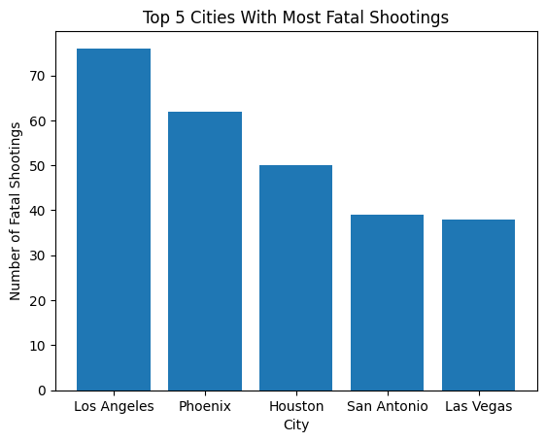
Fatal Shootings By City
The top 5 cities with most fatal shootings are shown in the bar chart, which are Los Angeles, Phoenix, Houston, San Antonio, and Las Vegas.

Slide 5
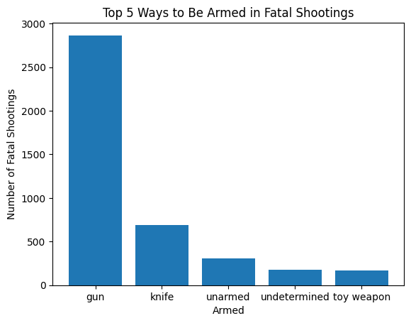
Being Armed in Fatal Shootings
The top 3 ways to be armed in fatal shootings are shown in the bar chart below, which are guns, knives, and toy weapons. Guns were used significantly more often than any other way to be armed. However, being unarmed and having an undetermined armed status occurred more often than being armed with toy weapons.

Slide 6
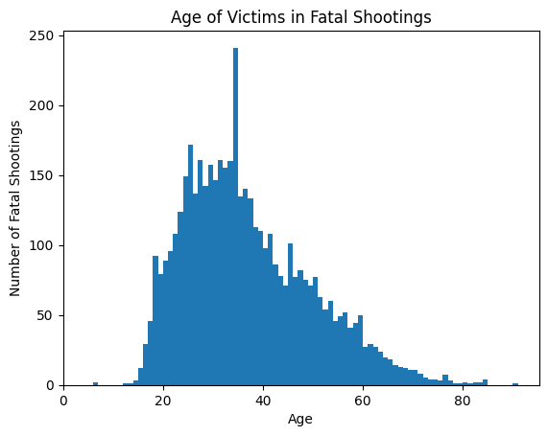
Age Distribution of Victims
The age distribution of victims in fatal shootings is shown in the histogram below. It is skewed to the right and shows that younger people (25 to 35 years old) were involved more often in fatal shootings. The very tall bar is due to median imputation of missing ages.

Slide 7
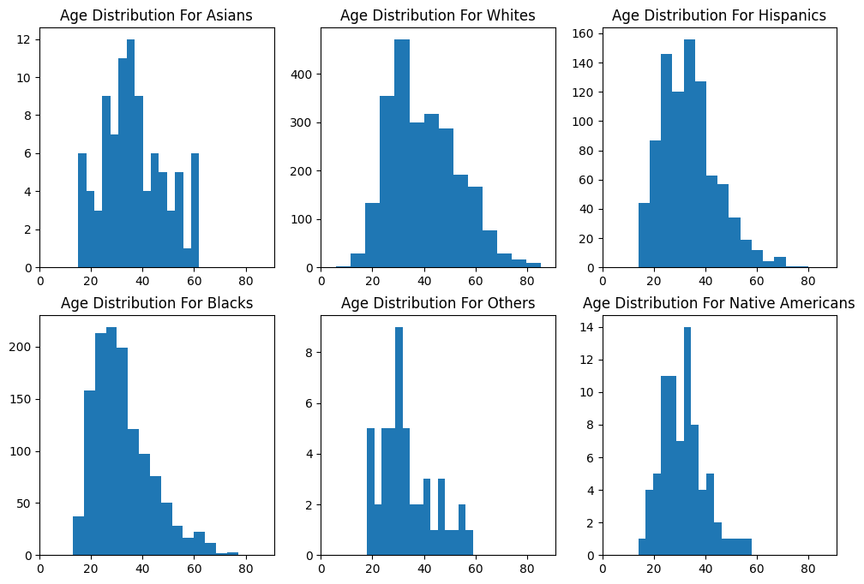
Age Distribution By Race
The age distribution for each race is shown in each of the histograms below. All of the distributions are skewed to the right and show that younger people were involved more often in fatal shootings.

Slide 8
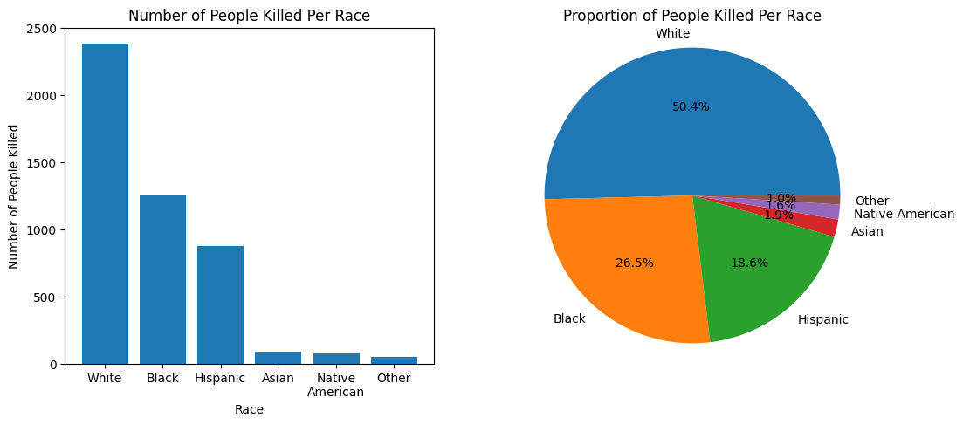
People Killed Per Race
The number and proportion of people killed per race are shown in the bar chart and pie chart below. White people were killed the most in fatal shootings, accounting for about 50% of the total deaths from fatal shootings. The second most killed in fatal shootings were black people, but they were killed almost two times less than white people. Asian and Native American people accounted for a very small proportion of the total deaths from fatal shootings.

Slide 9
Data Preprocessing
Further categorized the categories in armed column manually
Performed one-hot encoding on manner_of_death, armed, gender, threat_level, and flee categories and dropped first dummy column
Split each column corresponding to two categories into the two columns corresponding to each category
Dropped columns that will not be trained on: id, name, date, city, and state
Randomly split data into training and test data (80/20 split) using stratified splits for race
Performed a limited amount of random oversampling of the minority classes (Asian, Native American, Other) and added the random samples to the training data
Split the training data and test data into feature matrices (X) and target vectors (y)

Slide 10
Data Models
Logistic Regression:
Used regularization
Balanced the classes through weights
K-Nearest Neighbors:
Used hyperparameter grid search for k with stratified 5-fold cross-validation using weighted F-score
Weighed nearest neighbors by inverse of Euclidean distance
Decision Tree:
Balanced the classes through weights

Slide 11
Model Performance
Logistic Regression:
accuracy 0.344245
precision 0.505756
recall 0.344245
F-score 0.401303
K-Nearest Neighbors:
accuracy 0.458289
precision 0.433461
recall 0.458289
F-score 0.435859
Decision Tree:
accuracy 0.337909
precision 0.423361
recall 0.337909
F-score 0.371810
The highest value for each performance metric is bolded. Precision, recall, and F-score are all weighted by the number of positive instances. It should be noted that weighted recall is equivalent to accuracy and is shown to be so above.
The relatively high performance of k-nearest neighbors may be due to the class imbalance in the dataset. The logistic regression and decision tree classifiers weighed smaller classes more, but the k-nearest neighbor classifier did not do that.

Slide 12
Conclusion
It seems that the classifiers above are able to predict the race of a person based on the features provided to a certain extent. A classifier guessing at random would have a test accuracy of about 1/6 = 16.67%. The performance metrics of the classifiers being higher signify a relationship between the features used and the race of a person.
However, the performance metrics are overall still not very satisfactory. This may be due to the features chosen to be trained on. It is possible that including date, city, and state and excluding certain features will increase classifier performance. The poor performance may also be due to the lack of variety in the data for the minority classes: Asian, Native American, and Other. This is all under the assumption that race can be predicted from the available data.

